Slide 1
5th forms
Quiz “MY HOME”

Slide 2
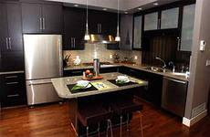
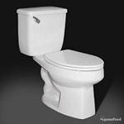
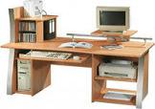

1)WHAT IS THERE IN THE KITCHEN?
Desk
Toilet
Cooker

Slide 3
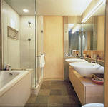

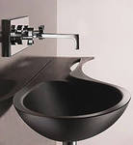

2)WHAT IS THERE IN THE BATHROOM?
2) what is there in the bathroom?
a) сooker b) washbasin c) painting

Slide 4
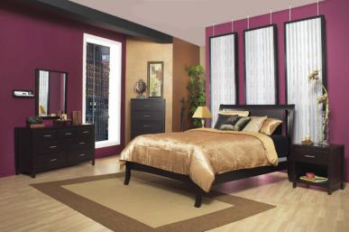
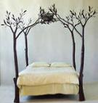
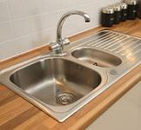
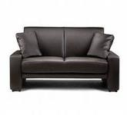
3) what is there in the bedroom ?
a)bed b)sink c) sofa

Slide 5

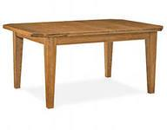
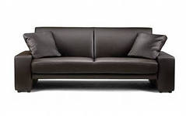

4)WHAT IS THERE IN THE KITCEN?
A)TABLE B)SOFA C)MIRROR

Slide 6
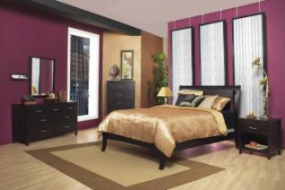
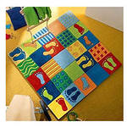
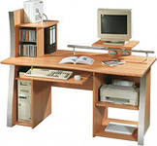

5)What is there in the bedroom?
a)carpet
b)desk
c)books

Slide 7

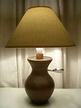
6) What is there in the kitchen ?
A) cooker
B) books
C) lamp

Slide 8
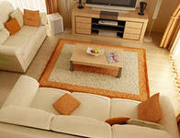
7)What is there in the living room?
a) Bed b)Sofa c)Cooker

Slide 9
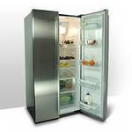
8)What is there in the bathroom?
a) bed b) mirror c) fridge

