Slide 1
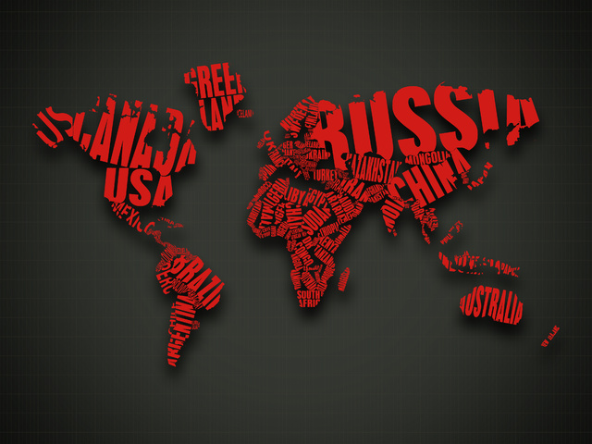
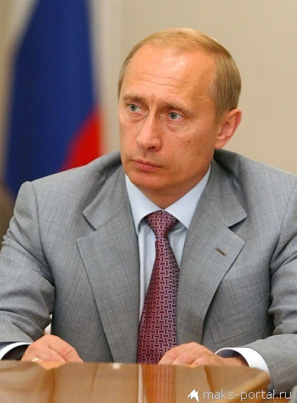
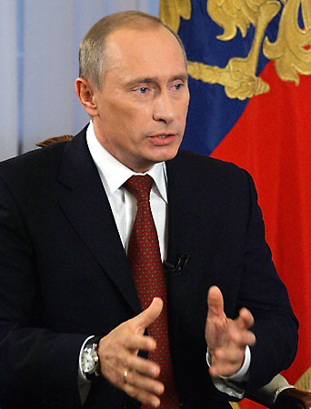
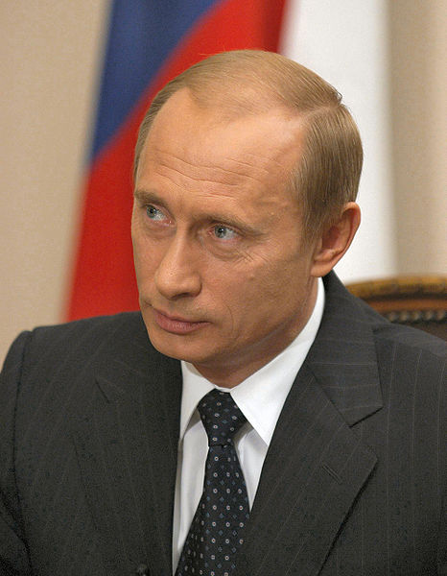
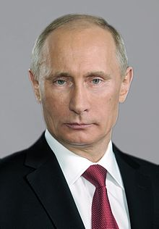
V. PUTIN- THE LEADER AND THE MAN
ADDITIONAL MATERIAL
TO
ENGLISH IX O.V. AFANASYEVA
I.V. MIKHEEVA
UNIT TWO
PEOPLE AND SOCIETY
EX.59 P.105
TEACHER:
NEKRASOVA TATYANA NEKRASOVA

Slide 2
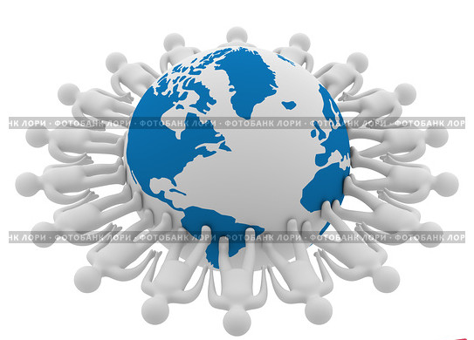
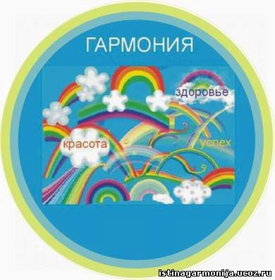

Brainstorm:
If there is harmony in the heart, there will be harmony in the family. If there is harmony in the family, there will be harmony in the nation. If there is harmony in the nation, there will be harmony in the world.
(Confucius )
Сomment on the quotation line by line…
Line 1. If there is harmony in the heart, there will be harmony in the family.
Line 2. If there is harmony in the family, there will be harmony in the nation.
Line 3. If there is harmony in the nation, there will be harmony in the world.

Slide 3
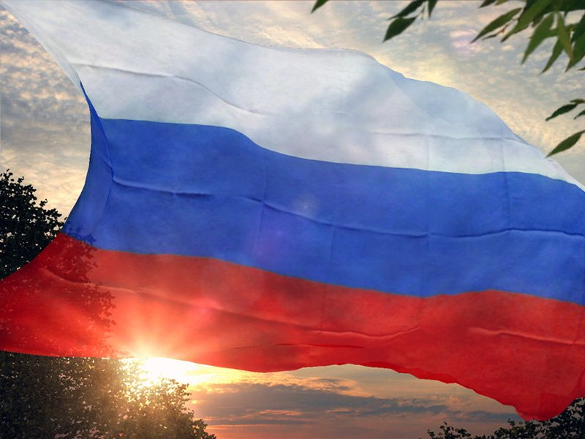
Definitions:
The term democracy – (Greek )
-"rule by the (simple) people“.
Democracy is «Government of the people, by the people, for the people» Abraham Lincoln (1809-1865)
Wikipedia: “A politician is an individual who is a formally recognized and active member of a government, or a person who influences the way a society is governed through an understanding of political power and group dynamics.”

Slide 4
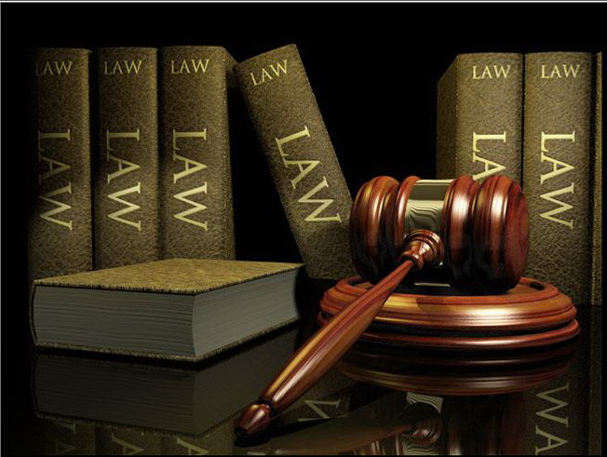

The Russian Federation
Russia is a democratic federative state based on rule of law and a republican form of government. According to the Constitution Russia is a Presidential Republic
State power in Russia is exercised by the President, the Federal Assembly, the Government and the Courts.
The main law of our country is the Constitution. It was adopted in 1993.
December, 12
is the Day of Constitution

Slide 5
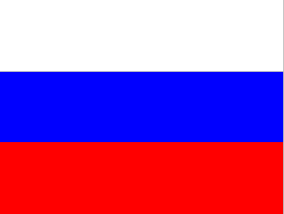
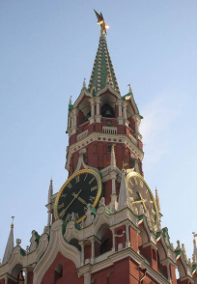
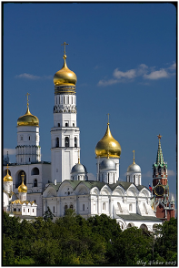
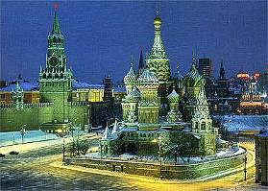
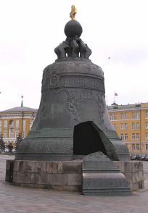
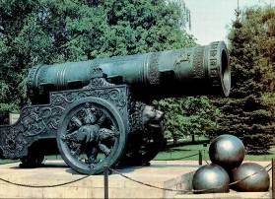
The national symbol of Russian is a white-blue-red flag, the hymn, a two-headed eagle-the coat of arms, the Kremlin, a lot of ancient Cathedrals and many others…

Slide 6
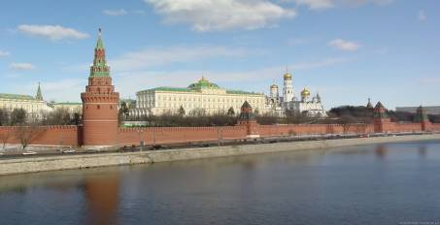
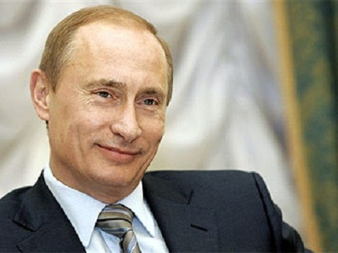
Study the information and fill the table:
The head of state is the president and is elected directly by the people every four years and cannot serve more than two terms.
The President is commander in chief of the armed forces; he makes treaties, enforces laws, and appoints ministers.
The Federal government consists of three branches: legislative, executive and judicial.
The legislative power is vested in the Federal Assembly. It consists of 2 chambers: the Council of Federation and the State Duma.
The executive power in Russia belongs to the Government. The president appoints its head - the Prime minister.
The judicial power belongs to the system of courts. It consists of the Constitutional court, the Supreme Court and regional courts.
There are many political parties in our country: The Democratic, the Communist, the Liberal and many others.

Slide 7
The President
The Federal Assembly
The Federal Government
The Duma
The Federation
Government
The Chairman of the
Government,
Ministers
The Supreme Court of Russian
Federation
The Constitutional Court of the Russian
Federation
All men and women over 18

Slide 8
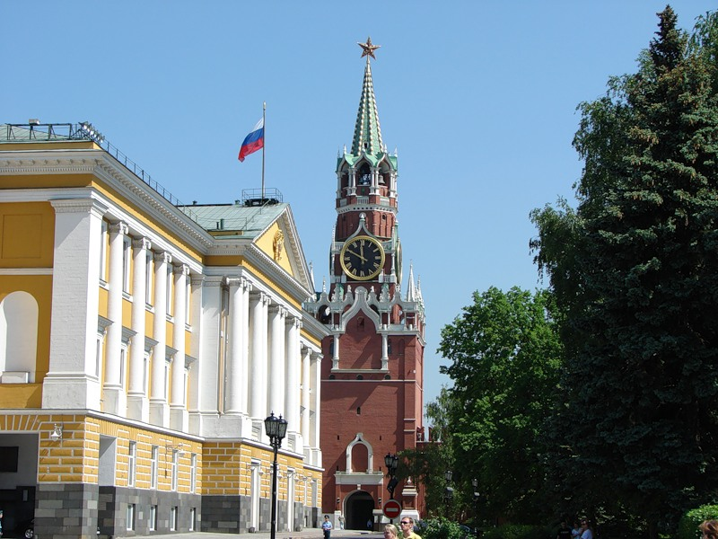
Finish the sentences:
The head of state is ……
The President is elected by…..
The President can serve…..
The President is Commander…..
He makes …….., enforces………, and appoints….. .
The Federal government consists of…..
The legislative power is vested in …….
The judicial power belongs to…..
The main law is….
There are many political parties: …..
Fill the Table
The political system
The head of state
Legislative Branch of power
Executive Branch of power
Judicial Branch of power
Main political parties
 | The Russian Federation
The political system | democratic federative state
The head of state | president
Legislative Branch of power | Federal Assembly
Executive Branch of power | Government, President, Prime Ministers
Judicial Branch of power | Constitutional court, the Supreme Court and regional courts.
Main political parties | The Democratic, the Communist, the Liberal

Slide 9
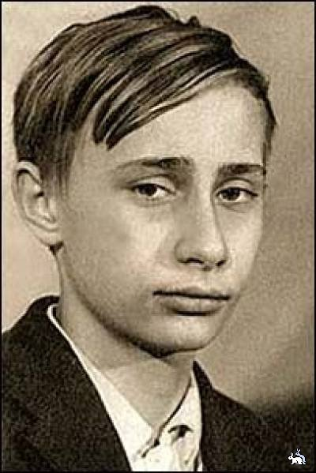
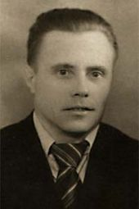
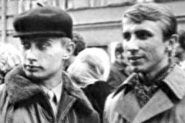
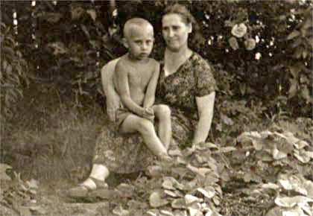
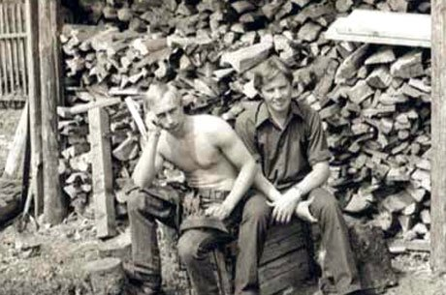
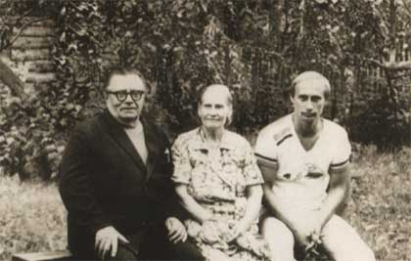
Study the brief information
and answer the questions:
-born in Leningrad
( October, 7, 1952)
-graduated with a degree in law from
Leningrad State University
(1975)
earned a Ph.D. degree in economics
was assigned to work in the Committee
for State Security (KGB)
served in East Germany
became the assistant to the rector
of Leningrad State University
(1990)
-was appointed Prime Minister
( August 1999)
-became acting President
(December31, 1999)
-was elected president of Russia
(on March 26 2000)
-was inaugurated as president
(May 7, 2000)
-was elected President of Russia for the second term
( March 14, 2000)
Putin's father,
Vladimir Spiridonovich
Putin with his mother, Maria Ivanovna, in July 1958
QUESTIONS
What education has V.Putin got?
Where did he work and what positions did he hold?
When was he elected President of Russia for the first term? For the second term?

Slide 10
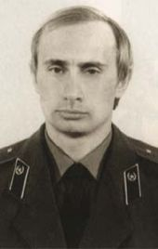
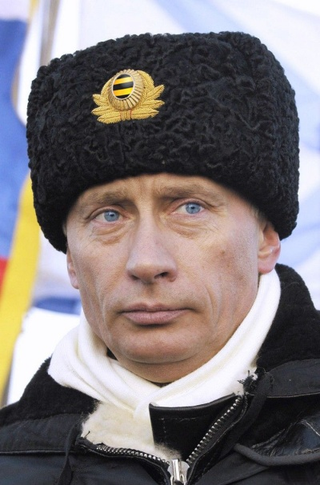
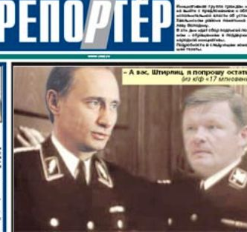
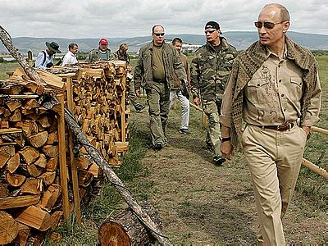
KGB career
Putin served 15 years as a foreign intelligence officer for the Committee for State Security (KGB), including six years in Dresden(1985 to 1990), East Germany.

Slide 11
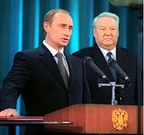
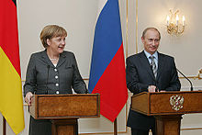
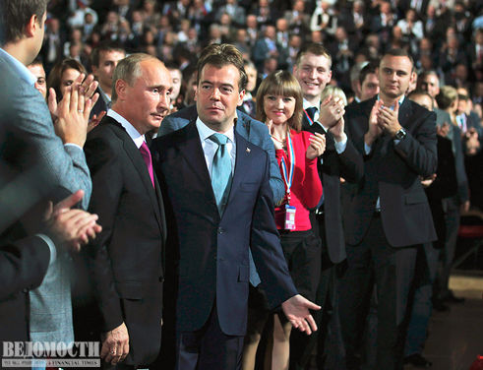
Political career
Russian intelligence officer and politician who served as president (1999–2008, 2012– ) of Russia and also was the country’s prime minister (1999, 2008–12). On May 7th 2012, V. Putin was elected president of Russia for the 3rd term.
In 1990 he retired from active KGB service with the rank of lieutenant colonel and returned to Russia to become prorector of Leningrad State University.
Soon afterward Putin became an adviser to Sobchak, the first democratically elected mayor of St. Petersburg. He quickly became known for his ability to get things done; by 1994 he had risen to the post of first deputy mayor.
In 1996 Putin moved to Moscow, where he joined the presidential staff as deputy to Pavel Borodin, the Kremlin’s chief administrator. Putin moved up in administrative positions. ...

Slide 12
Find the English equivalents for the following:
слабое, неэффективное государство
слепо выполнять
возродить Россию
коррупция среди чиновников
смягчение экономических реформ
снижение налогов
приватизация сельскохозяйственных земель
долги перед зарубежными странами
предпринять шаги к партнерству
повысить сотрудничество
удерживать огромную власть
давать взятки
resurrect Russia
foreign debts
reduce taxes
the privatization of agricultural land
took steps to partnering with …
warming strict economic reforms
to increase cooperation
weak and ineffective state
to wield tremendous power
to pay bribes
blindly follow
white collar corruption

Slide 13
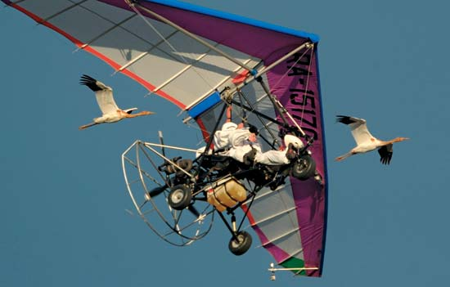
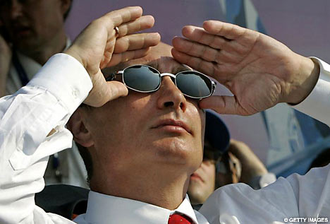
Just in his off-time
Putin is
a judo champion,
an avid hunter,
a fisherman,
a scuba diver …
an all-around man’s man…

Slide 14
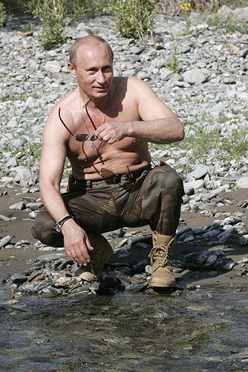
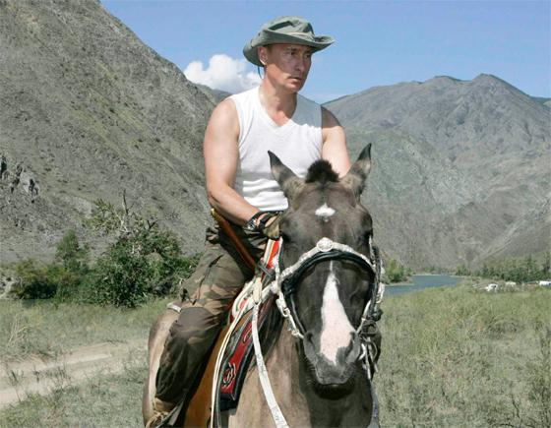
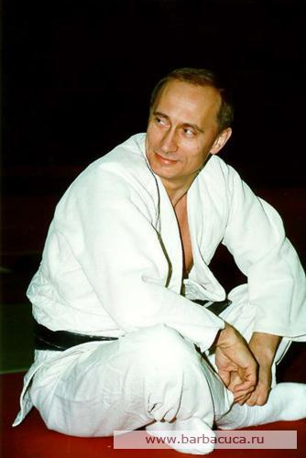
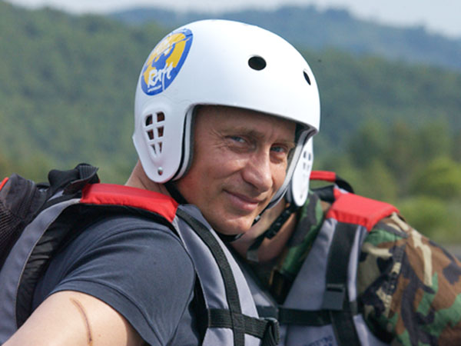
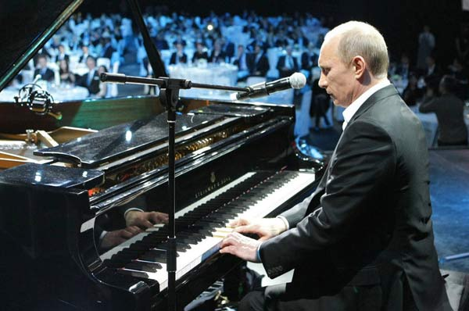
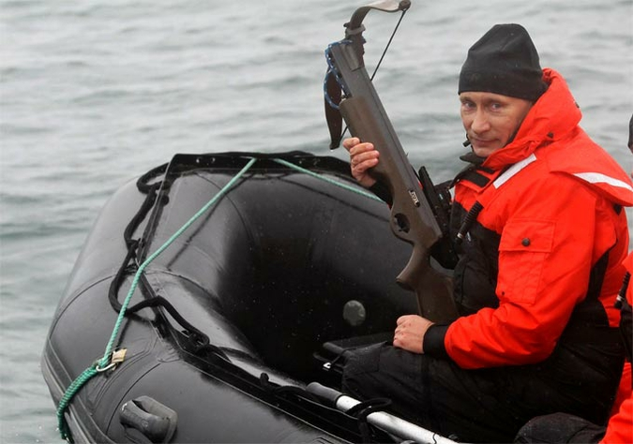
.

Slide 15
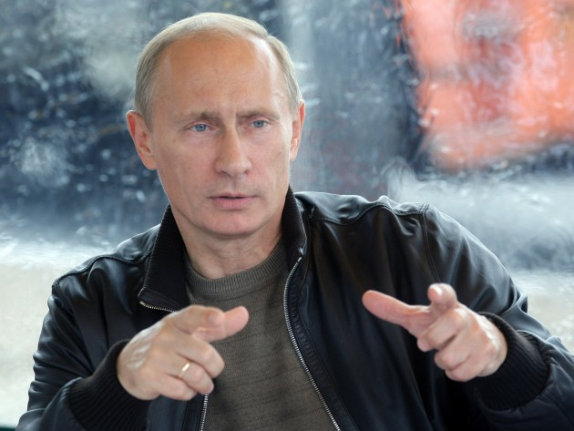
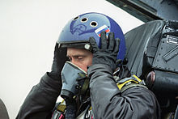
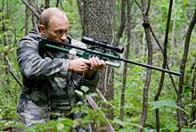
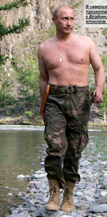
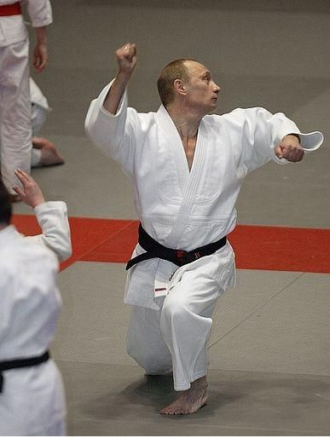
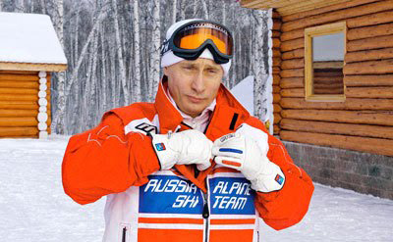
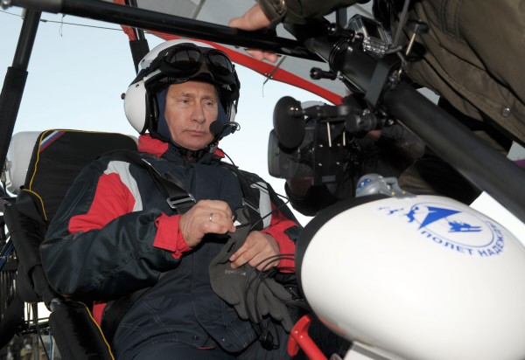

Slide 16
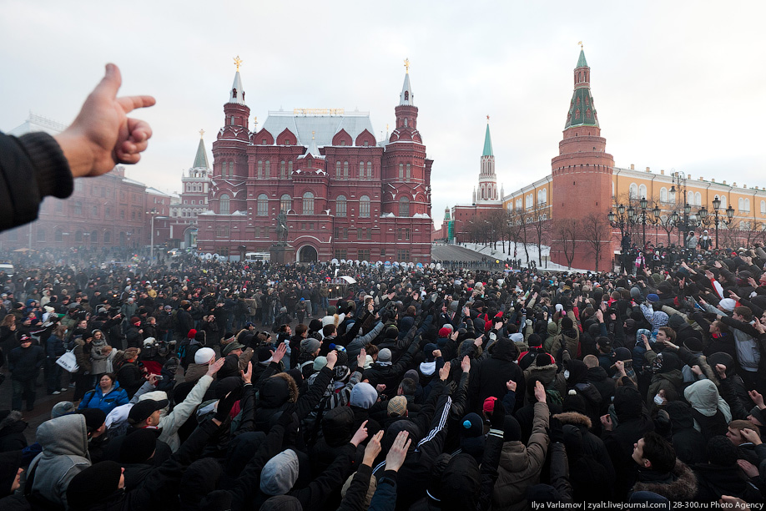
Who will be the next president?

Slide 17
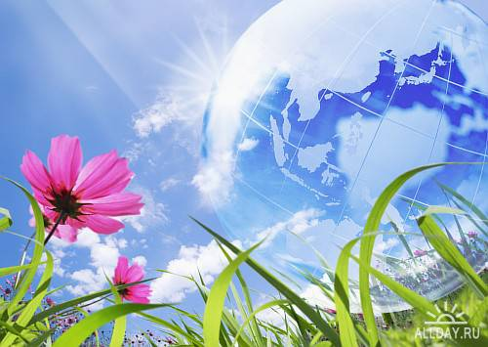
http://putin.kremlin.ru/bio
http://www.biography.com/people/vladimir-putin
http://en.wikipedia.org/wiki/Vladimir_Putin
http://global.britannica.com/EBchecked/topic/484357/Vladimir-Putin
Teacher:
Tatyana Nekrasova
Gymnasium 1
Komsomolsk-na- Amure

