Slide 1
Should you go to a doctor?
The 17th of March
МОБУ «Поярковская СОШ №2»
Ефремова Лариса Николаевна

Slide 2
[З:] Early to bed,
[З:] [ r] early to rise
[ h] [ θ] Makes a man healthy,
[ θ] wealthy and wise.
Phonetic exercise

Slide 3
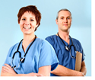
Find the Odd-Man-Out
Pediatrician, vet, surgeon, a cold
To treat, a stomachache, a headache, a toothache
Terrible, doctor, good, bad
Medicine, consult, take, stay
Disease, health, unhealthy
a cold
To treat
doctor
Medicine
unhealthy

Slide 4
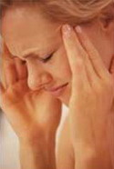
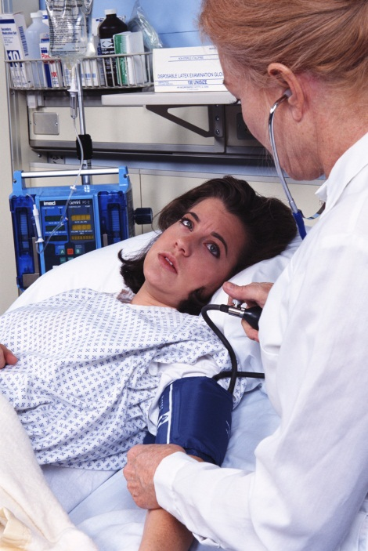
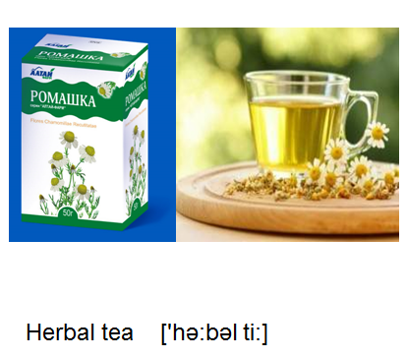
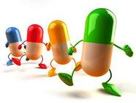
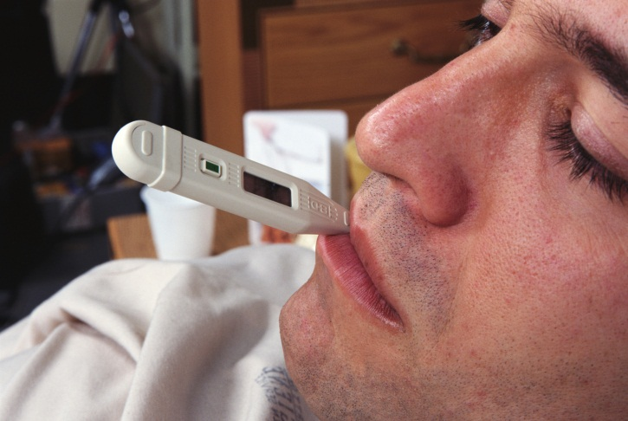
What problems do they have? Give them some advices.
She must (should)… He must (should)…
A headache

Slide 5
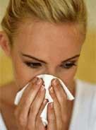

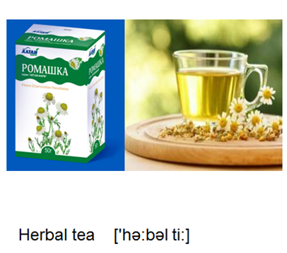
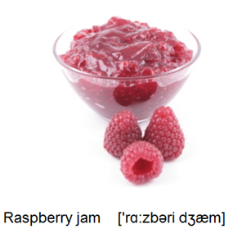
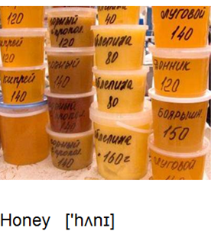
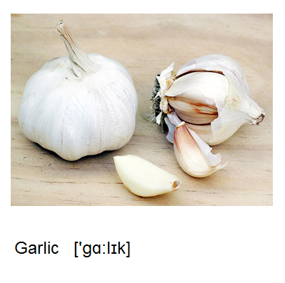

What problems do they have? Give them some advices.
She must (should)… He must (should)…
A cold

Slide 6


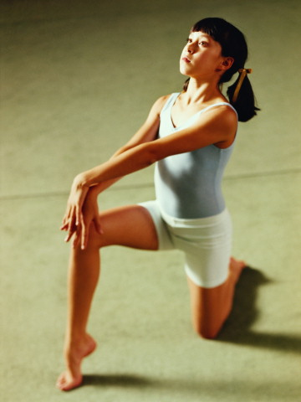
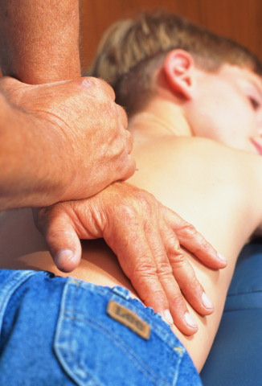
What problems do they have? Give them some advices.
She must (should)… He must (should)…
A backache

Slide 7
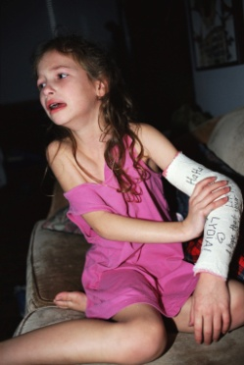

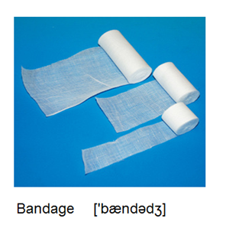
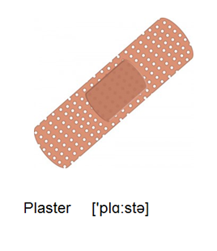
What problems do they have? Give them some advices.
She must (should)… He must (should)…
She’s hurt
her arm

Slide 8
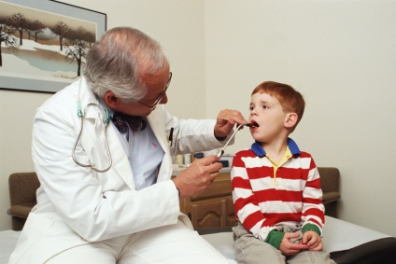
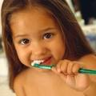
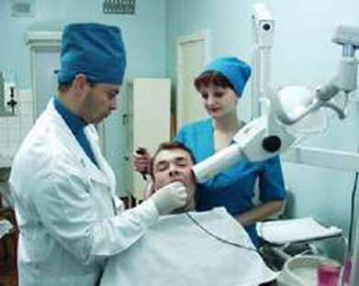
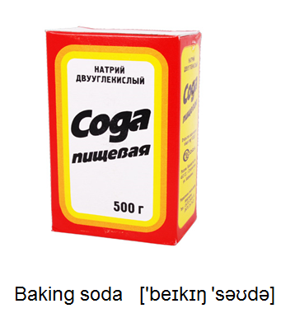
What problems do they have? Give them some advices.
She must (should)… He must (should)…
A toothache

Slide 9
Translate from English into Russian
health
disease
to be healthy
to be ill
to feel well
to feel bad
to feel OK
to feel terrible
to rest
to have a rest
to take medicine
to stay in bed
to stay at home
to consult a doctor
I think, you should consult a doctor when you have a problem.
When I don’t feel well, my parents always call the pediatrician.
Eat healthy food and you will feel OK without doctors.
When you have a headache you should drink herbal tea.
She has a medical check every year.
The doctor advises him to stay in bed and take the medicine.
Every day we drink milk for breakfast, eat a lot of vegetables and take care of ourselves.
hospital
after
to hurt
to put
to call
to advise
to worry
hot
to drink
to want
to use
to wash
to move

Slide 10
Translate into English
= если
= когда?
= что? Какой…?
= Где? Куда?
= после
= повредить
= положить
to rest
to have a rest
to take medicine
to stay in bed
to stay at home
to consult a doctor
if
when
what
where
after
to hurt
to put
1. Я часто простужаюсь.
1. I often have a cold.
2. Today I don’t feel OK. I think, I need to
go home.
2. Сегодня я не чувствую себя хорошо. Я думаю, мне надо пойти домой.
3. У меня ужасно болит голова. – Тебе надо принять лекарство.
3. I have a terrible headache. – You need
to take a medicine.
4. Моя нога болит после игры. Я хочу
отдохнуть.
4. My leg hurts after the game. I want
to rest.
5. Что ты делаешь, когда у тебя болит
горло? – Я пью горячий чай.
5. What do you do when you have a sore
throat? – I drink hot tea.
6. I will bring my cat to the vet tomorrow.
6. Завтра я отнесу мою кошку к ветеринару.

Slide 11
физкультминутка

Slide 12
What doctors do the children consult? Listen to the texts.
Pediatrician
A dentist
A veterinarian
A surgeon

Slide 13
Синквейн
1строка – существительное по теме
2 строка – 2 прилагательных
3 строка – 3 глагола
4 строка – 4 любых слова по теме
5. Составить предложение из этих слов

Slide 14

THANK YOU
The lesson is over.
You may be free.

Slide 15
Используемые ресурсы
Rusderm.ru Медицинские шаблоны Power Point
Разработка урока Шатровой Ирины Вениаминовны, ГОУ 489, Санкт-Петербург, 2011 «Keep fit and healthy»
WWW.SuperSimpleSongs.com

