Slide 1


Slide 2
Good morning, Good morning,
Good morning to you!
Good morning, Good morning,
I am glad to see you!

Slide 3
Фонетическая зарядка.
(a:) park, are, car, dark, farmer ;
(з:) her, girl, dirty, shirt, bird;
(о:) horse, corn, short, morning;
(w) what, why, when, where, white;
(i:) teacher, jeans, green, see, teeth.

Slide 4
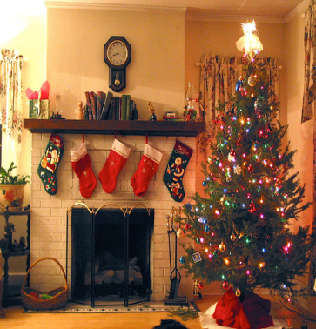
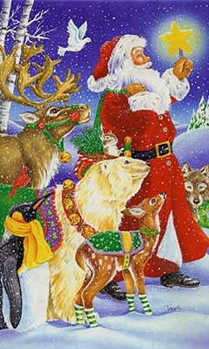
Merry Christmas! Happy New Year!

Slide 5
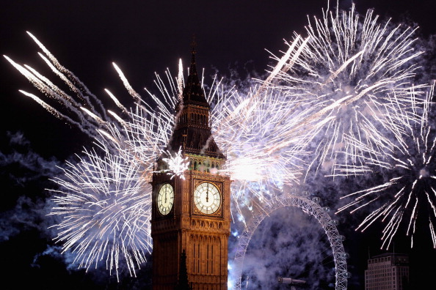

Slide 6
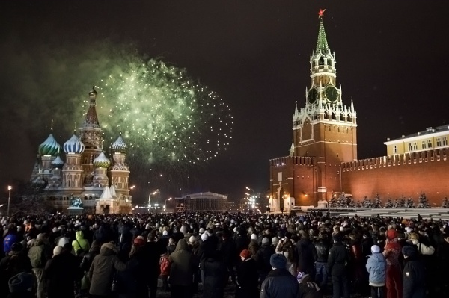

Slide 7
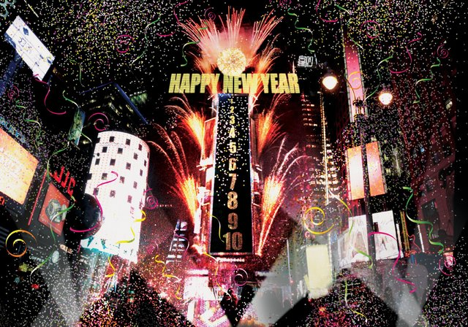

Slide 8
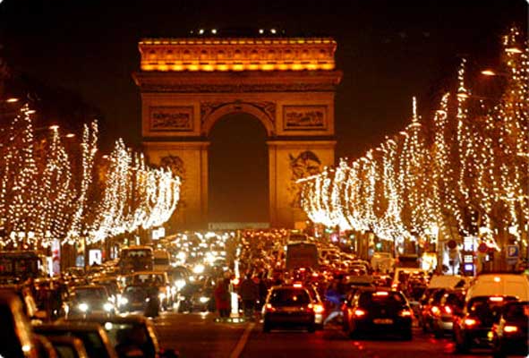

Slide 9




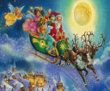

New words!
Happy желать
New Year подарок
Christmas счастливый
Wish Новый Год
Present Рождество
Santa Claus ☺ Счастливого
Рождества
Merry Christmas Санта

Slide 10

Stand up! Clap! Clap!
Arms up! Clap! Clap!
Step! Step! Arms Down!
Clap! Clap! Sit down!

Slide 11
Help Larry, Lulu and Rascal!
Исправь предложения:
Larry and Lulu are ten. Larry is … Lulu is …
They do not go to school.
Larry and Lulu help Santa Claus.
Rascal is a nice black cat.
Lulu would like a big red ball.
They have got a nice Sunday tree.

Slide 12

Скажи, что бы ты хотел получить в подарок от Деда Мороза.
Начни своё высказывание со слов:
I would like….

Slide 13
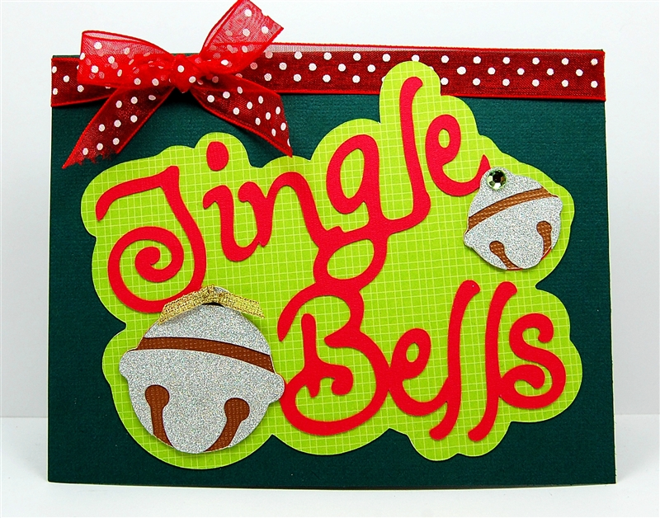

Slide 14
Homework
1. Learn new words.
2. A letter to Santa Claus

Slide 15
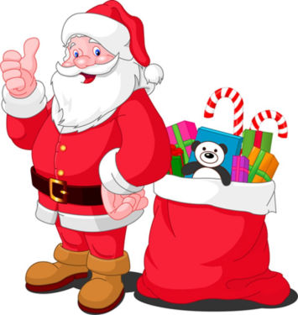
Конец урока.
Наш урок подходит к концу, мы с вами очень хорошо поработали.
The lesson is over.
Good bye!

