Slide 1
Time for school

Slide 2
Make up a cinquain
Example:
Your cinquain:
Sightseeing
interesting, tiring
to watch, to listen to, to take photos
I love going sightseeing
Sightseeing develops cultural knowledge
School
_________________
__________________________________
__________________________________
___________________________________________________

Slide 3



New Vocabulary:
to pick up = to take quickly
to go mad = to get nervous, angry
to rush = to run as fast as one can
to go downstairs =
to go upstairs =
to lock smth. =
to unlock smth. =
a seatbelt = a belt in a car or a plane

Slide 4



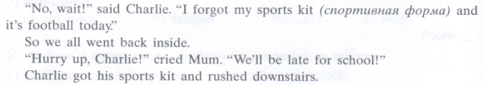

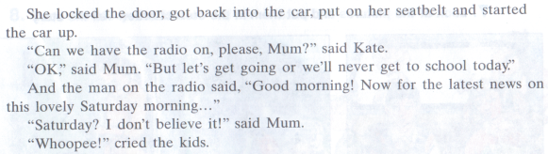
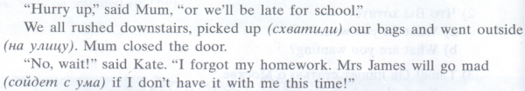
1
2
3
4
5
6
7

Slide 5
-
-
-
-
-
-
-
-
-
-

Slide 6
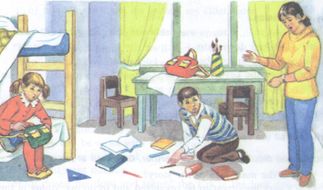
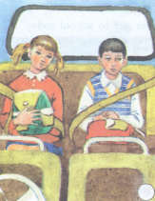
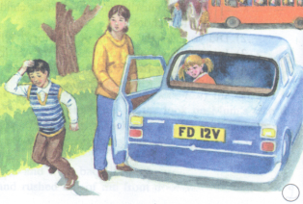
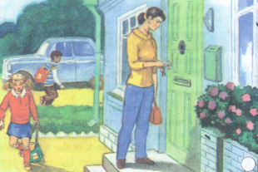
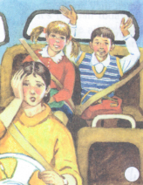
1 One day in the morning…
2 | 3
4 | 5

Slide 7





One day in the morning… __________________________________________________________________________________________________________________________________________________________________________________________________________________________________________________________________________________________________________________________________________________________________________________________________________________________________________________________________________________________________________________________________________________________________________________________________________________________________________________________________________________________________________________________________________________________________________________________________________________________________________________________________________________________________________________________________________________________________________________________________________________________________________________________________________________________________________________________________________________________________________________________________________________________________________________________________________________________________________________________________________________________________________________________________________________________________________________________________________________________________________

Slide 8
Презентация учителя английского языка
ГБОУ г.Москва гимназия №1748 «Вертикаль» Пряженниковой Ольги Валентиновны
В презентации использованы материалы учебника для 5 класса общеобразовательных учреждений
«Английский с удовольствием / Enjoy English»
М.З. Биболетова, Н.В. Добрынина, Н.Н. Трубанева

