Slide 1
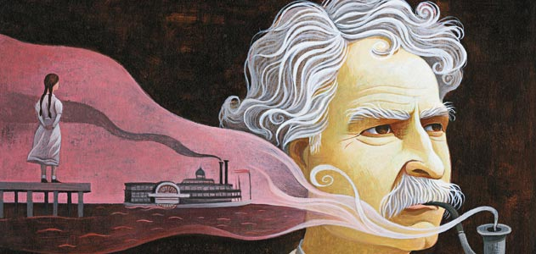
Mark Twain
“All modern American literature comes from one book by M.Twain called Huckleberry Finn.”
Учитель англ. языка
МБОУ СОШ №3
г. Бугульма
Валиахметова И.М.

Slide 2
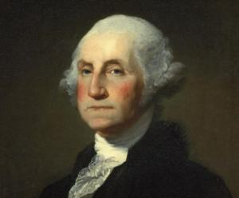
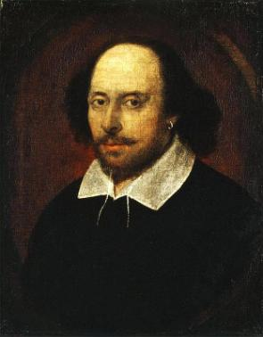
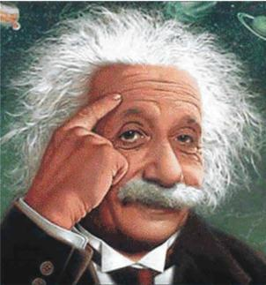
Who are these people?

Slide 3
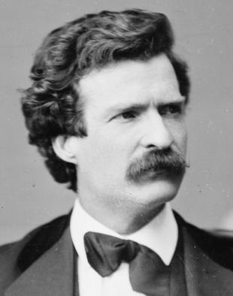
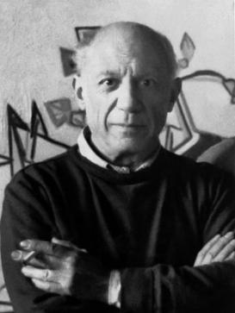
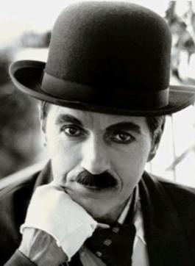
What are they famous for?

Slide 4
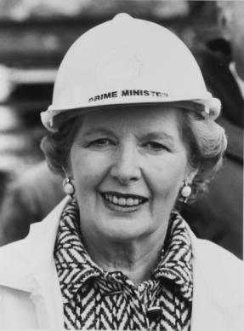
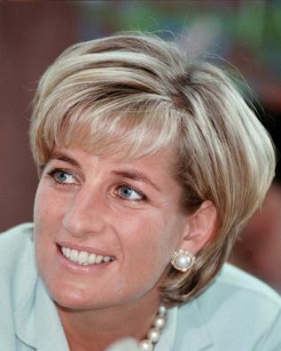
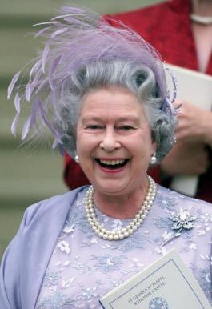
Do you know these women?

Slide 5
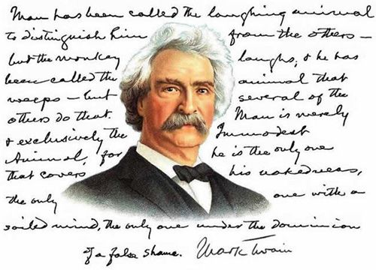
US humorist, novelist, short story author, & wit

Slide 6

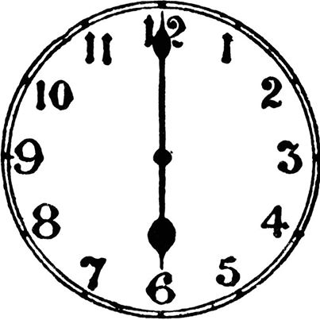
Homework

Slide 7
A plan for retelling
M. Twain was a … .
He was well known ... .
One day the literary club … .
Before his lecture a club member … .
M. Twain noticed an old man … .
He began to tell … .
Everybody laughed but … .
After the lecture, the club member … .
He told the famous writer that … .

Slide 8
Listening
What was M.Twain’s real name?
Who were the prototypes of the heroes of his stories?
How many children did he have?

Slide 9
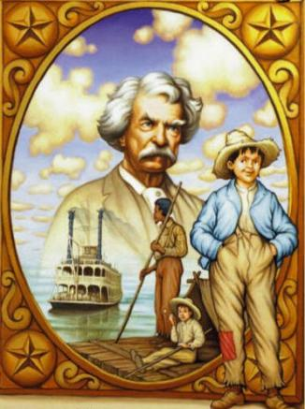
Reading
Role-play “Interview Mark Twain”
Ps→P1
When and where were you
born?
What is your real name?
What is your favorite book?
Did you like to study
when you were a child?
etc.

Slide 10
Reading for detail
Choose the correct verb to complete the sentences: was invited, was sent, had, took, decided, began, was, was, published, spent.
In summer, when school ... over, the boys ... many happy hours on the Missouri River.
Mark Twain ... to work as a journalist for a newspaper.
In 1876 M.Twain ... his best novel “The adventures of Tom Sawyer.”
When Samuel ... to write he chose for himself the name Mark Twain.
When the boy ... five years old, he ... to school.
The pilot ... to know the river very well when he ... a ship along it.
In 1853 Samuel ... to leave home.

Slide 11
Reading for detail
Answers
was, spent
was invited
published
decided
was, was sent
had, took
decided

Slide 12
A project work
M.Twain
Childhood
Studies
Work
Family

Slide 13
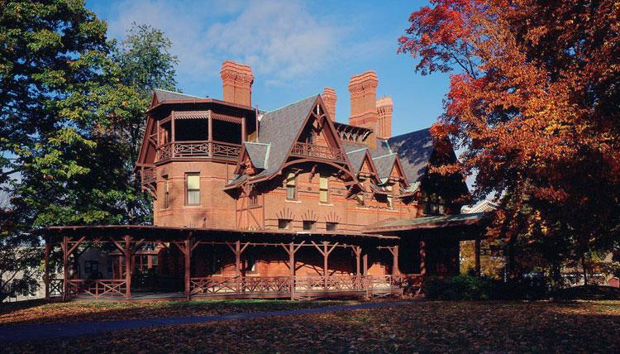
The Mark Twain House and Museum, the USA

Slide 14
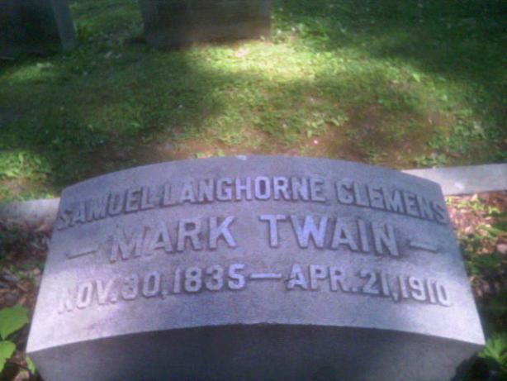
Mark Twain’s grave

Slide 15
