Slide 1
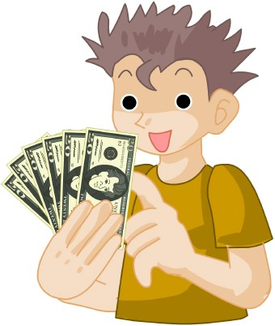

Who wants to win millions?
Hundred Dollar Questions

Slide 2
Who will be the first? Guess the lot.
S
T
E
answer

Slide 3
STone

Slide 4
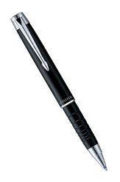
Who will be the second? Guess the lot.
P
H
answer

Slide 5
HEN

Slide 6
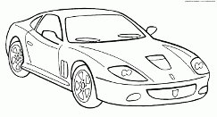
Who will be the third? Guess the lot.
S
F
answer

Slide 7
scarf

Slide 8
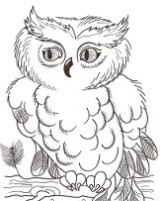
Who will be the fourth? Guess the lot.
D
,
w
answer

Slide 9
window

Slide 10
Geography 1
People 1
Geography 2
People 2
Russia
$100
$100
$100
$100
$100
$200
$200
$200
$200
$200
$300
$300
$300
$300
$300
$400
$400
$400
$400
$400

Slide 11
$100
What is the longest river in Russia?

Slide 12
$200
In what country are there severe droughts?

Slide 13
$300
How many islands are in the UK?

Slide 14
$400
What is the highest mountain in the world?

Slide 15
$100
Americans like to volunteer, don’t they?

Slide 16
$200
What nation has more patience?

Slide 17
$300
What nation is the most self-confident of all the others?

Slide 18
$400
What characteristics are typical for Americans?

Slide 19
$100
What is the fourth largest country in the world?

Slide 20
$200
Which country lasts 4500 km from one ocean on the east to another one on the west?

Slide 21
$300
What climate is in the UK?

Slide 22
$400
What kind of desert area covered with Australia?

Slide 23
$100
The British are hospitable, aren’t they?

Slide 24
$200
Are the British risk-takers?

Slide 25
$300
What means
“self-confident”?

Slide 26
$400
What means “toughness”?

Slide 27
$100
Which lake is the deepest one in Russia?

Slide 28
$200
Is there the Lake District in Russia?

Slide 29
$300
Where is situated
The Black Sea?

Slide 30
$400
Why do Russians not cut shrubs?

