Slide 1
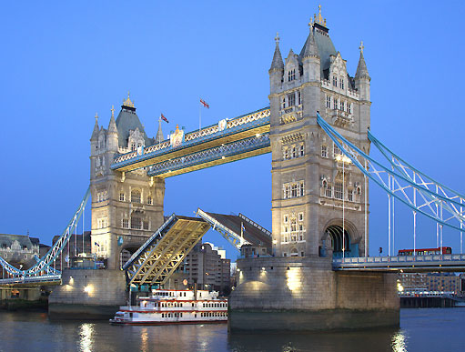
THE PASSIVE VOICE

Slide 2
[ tr ]
Don’t trouble trouble
till trouble troubles you.

Slide 3
[ i: ]
He speaks Chinese
and Japanese
with equal ease.

Slide 4
[ ŋ ]
As I was getting along, along, along,
And singing a comical song, song, song,
The lane that I went was long, long, long,
And the song that I sang was long, long, long,
And so I went singing a song.

Slide 5
[ tr ]
The train and its trucks
are trapped by a tree-trunk
across the track.

Slide 6
A Man Is Made
A man is made
Of flesh and blood
Of eyes and bones and water.
The very same things make his son
As those that make
His daughter.
A tree is made
Of leaf and sap,
Of bark and fruit and berries
It keeps a bird's nest
In its boughs
And blackbirds eat the cherries.
A table's made
Of naked wood
Planned smooth as milk. I wonder
If tables ever dream of sun,
Of wind. And rain, and thunder?
And when man takes
His axe and strikes
And sets the sawdust flying -
Is it a table being born?
Or just a tree that's dying?

Slide 7
A Man Is Made
A man is made
Of flesh and blood
Of eyes and bones and water.
The very same things make his son
As those that make
His daughter.
A tree is made
Of leaf and sap,
Of bark and fruit and berries
It keeps a bird's nest
In its boughs
And blackbirds eat the cherries.
A table's made
Of naked wood
Planned smooth as milk. I wonder
If tables ever dream of sun,
Of wind. And rain, and thunder?
And when man takes
His axe and strikes
And sets the sawdust flying -
Is it a table being born?
Or just a tree that's dying?

Slide 8
A Man Is Made
A man is made
Of flesh and blood
Of eyes and bones and water.
The very same things make his son
As those that make
His daughter.
A tree is made
Of leaf and sap,
Of bark and fruit and berries
It keeps a bird's nest
In its boughs
And blackbirds eat the cherries.
A table's made
Of naked wood
Planned smooth as milk. I wonder
If tables ever dream of sun,
Of wind. And rain, and thunder?
And when man takes
His axe and strikes
And sets the sawdust flying -
Is it a table being born?
Or just a tree that's dying?

Slide 9
Exercise 1
More than 15 official languages are spoken in India.
A lot of texts of popular songs are written in English.
Sometimes Australia is called “the Lucky Country”.
Russian scientists are known all over the world.
A lot of Russian students are given stipends for studying in Western Universities every year.
Books of Russian writers are read in many countries.

Slide 10
Exercise 2
When mum came home, everything was in perfect order:
The carpet was vacuum-cleaned.
The dishes were washed.
The flowers were watered.
The rubbish was taken away.
The cat was fed.
The supper was cooked.
No wonder that Jane was awarded a ticket to her favourite group’s show.

Slide 11
THE PASSIVE VOICE
to be
Participle II
Изменяемая часть
Неизменяемая часть
The book is read.
The book was read.
The book will be read.
The books are read.
Are the books read?
The books are not read.

Slide 12
Give the 3 forms of the verbs:
начинать | begin
ломать |  | broke
забывать |  |  | forgotten
знать |  | knew
учить |  |  | learnt
выбирать | choose
давать | give
слышать |  | heard
видеть |  |  | seen
думать | think
продавать |  | sold
создавать |  |  | made
простираться | spread
писать |  | wrote
петь |  | sang

Slide 13
THE ACTIVE VOICE
Подлежащее
He
Сказуемое
wrote
Дополнение
a book.
THE PASSIVE VOICE
Подлежащее
The book
Сказуемое
was written
Дополнение
him.
by

Slide 14
THE PASSIVE VOICE

Slide 15
Variant 1
Active |  | Passive
They make good cars in Germany. |  | Good cars are made in Germany.
They grow rice in China. |  | Rice is grown in China.
2. Bell invented the telephone. |  | 2. The telephone was invented by Bell
3. Boys broke a window yesterday. |  | 3. The window was broken by boys.
They built 5 new factories last year. |  | 4.Five new factories were built last year.
They will translate this text into English |  | 5. This text will be translated into English
Bell didn’t invent the television |  | 6. The television wasn’t invented by Bell.
Variant 2
Active |  | Passive
They make good cars in Germany. |  | Good cars are made in Germany.
1.They cook porridge for breakfast. |  | 1.Porridge is cooked for breakfast.
2.Mary told me everything. |  | 2. I was told everything.
3.Boys stole a bike last Monday. |  | 3. The bike was stolen by the boys.
4.We decorated the New Year Tree on Sunday. |  | 4.The New Year Tree was decorated on Sunday.
5.They sell fresh Fruit here. |  | 5. Fresh fruit are sold here.
6.He will send you a telegram in a week. |  | 6. The telegram will be sent to you in a week.

Slide 16
The English language …
is spoken
is used
is widely spread
is called the language of…
Most … (famous songs, business letters, films, summits)
are sung
are written
are made
are held

Slide 17
[ ai ]
There was a young lady from Niger
Who smiled as she rode on a tiger.
They returned from the ride
With the lady inside
And the smile on the face of the tiger.

Slide 18
Your home task for tomorrow:
Exercises 28, 29 (sb) p.59

