Slide 1
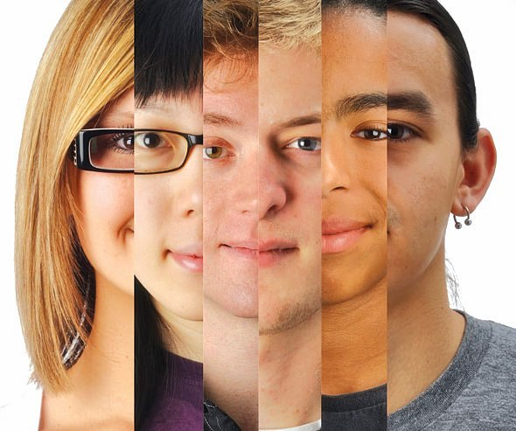
On the Road to TOLERANCE
On the Road to TOLERANCE
“Though all society is founded on
intolerance,
all improvement is founded on tolerance”.

Slide 2
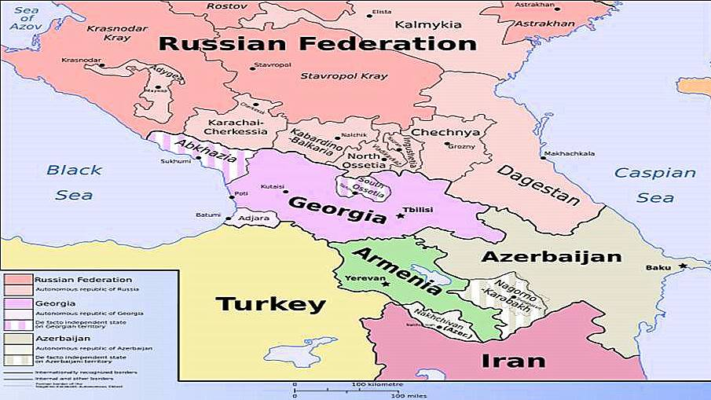
Geopolitical map of the Caucasus region

Slide 3
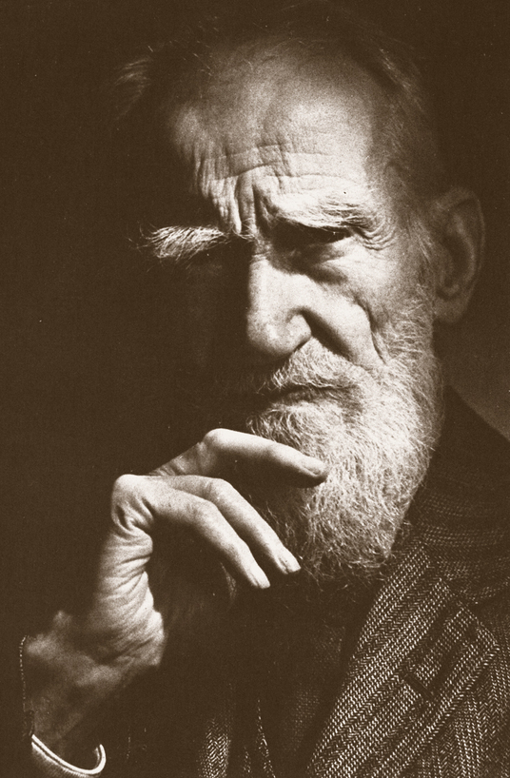
“Now when we have already learned to fly through the air like birds, to swim under water like fish, we lack only one thing - to learn to live on Earth like people!“
B. Shaw
George Bernard Shaw
1856-1950
(Irish Dramatist)

Slide 4
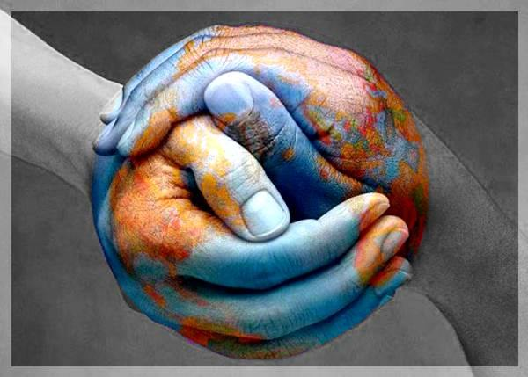

International Day for Tolerance 16 November
In 1996, the UN General Assembly invited UN Member States to observe the International Day for Tolerance on 16 November, with activities directed towards both educational establishments and the wider public. This action followed on the United Nations Year for Tolerance, 1995, proclaimed by the UN General Assembly in 1993 at the initiative of UNESCO.

Slide 5

French :
the ability to recognize other ideas or opinions
which are different from your own ones
English:
Readiness to be indulgent
TOLERANCE
Chinese:
To allow, to accept, to be magnanimous to
somebody
Arabian:
Forgiveness, condescension, softness,
compasson

Slide 6

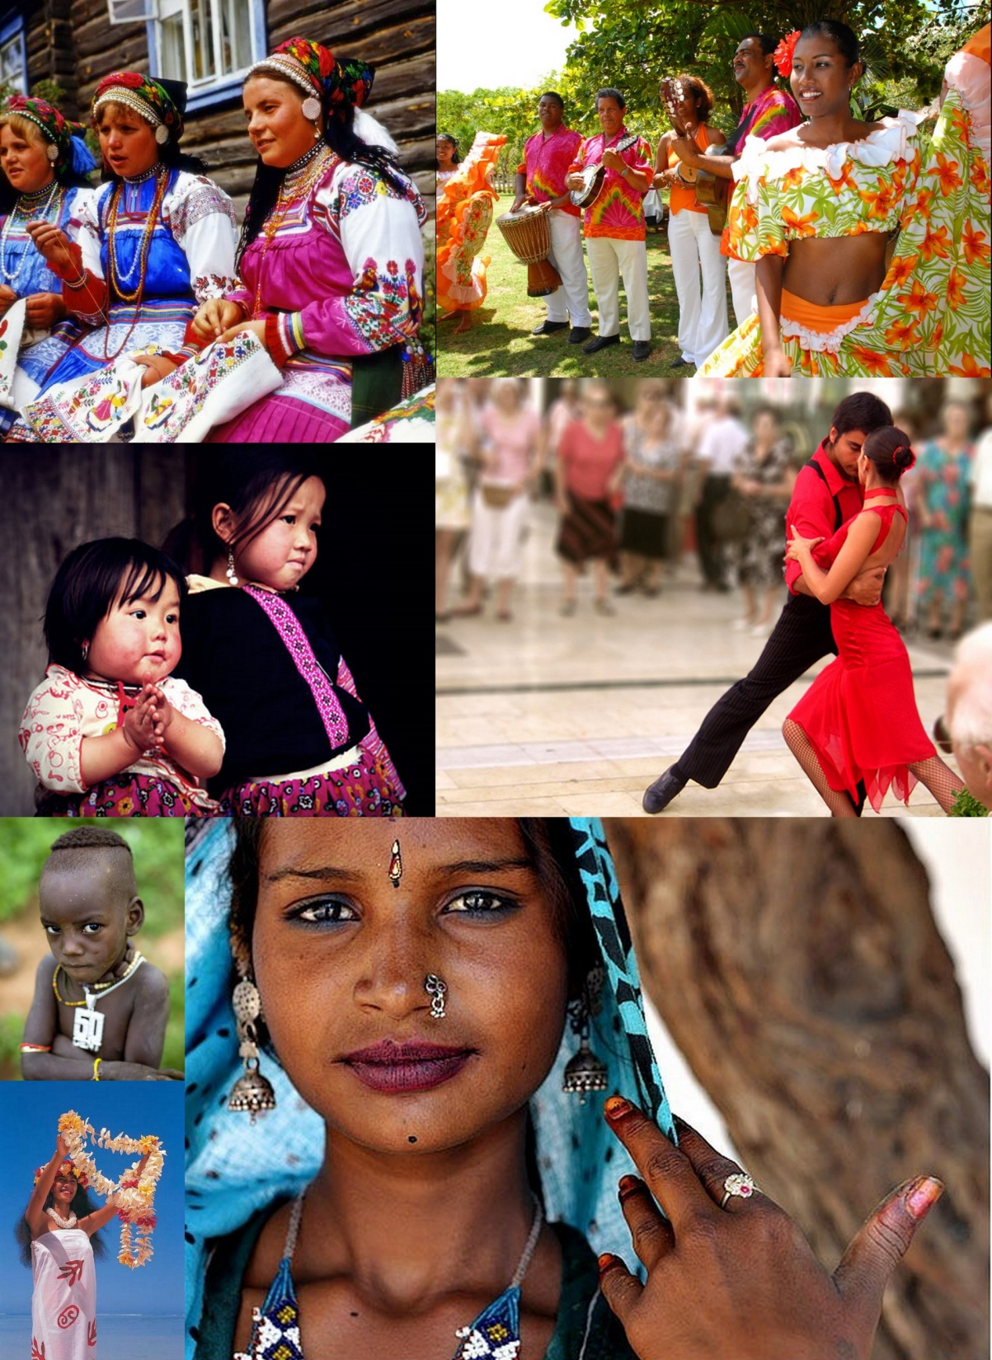
Outstanding people about tolerance
“We may have different religions, different languages, different colored skin, but we all belong to one human race.”
Kofi Annan
“In the practice of tolerance, one's enemy is the best teacher.”
Dalai Lama
“The highest result of education is tolerance”.
Helen Keller, 'Optimism,' 1903

Slide 7
TOLERANCE
respect of
human dignity
TOLERANCE
cooperation,
partnership
readiness
to agree with
other opinions
to accept
others as they are
Ability to put oneself in the place of the other
TOLERANCE
TOLERANCE
Recognition of diversity and equality of others

Slide 8


Slide 9
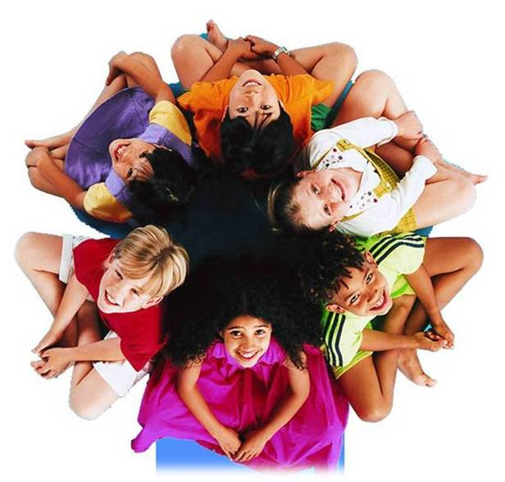
“There were neither two equal opinions nor two identical hairs or seeds in the world. The most universal quality is diversity.” M.Mountain
Recognition of diversity and equality of others.
Notes:
in

Slide 10
ARE YOU A TOLERANT PERSON?
A B
TOLERANCE ____ ____
Unselfishness (альтруизм) ____ ____
Sense of humor ____ ____
Tolerance to differences ____ ____
(терпимость к иному)
Trust (доверие) ____ ____
Ability to control oneself ____ ____
(способность управлять своими чувствами)
7) Friendliness (дружелюбие)____ ____
8) Ability not to condemn anybody
(способность не осуждать) ____ _____
9) Ability to listen ___ _____
Aptitude for sympathy ___ _____
(склонность к сочувствию)

Slide 11


Slide 12
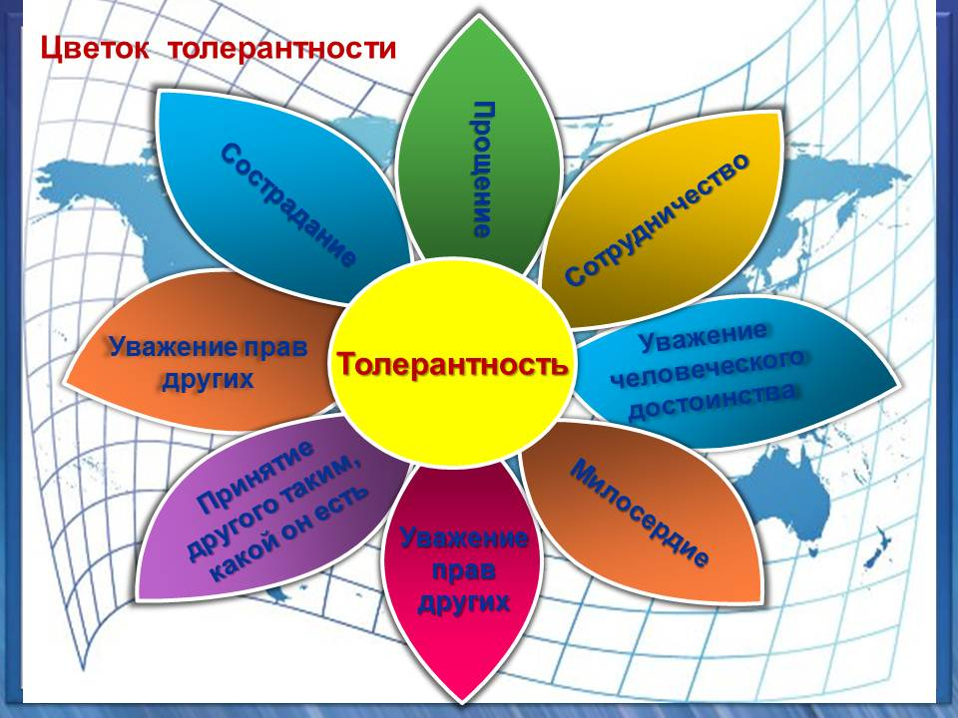
TOLERANCE FLOWER
SYMPATHY
FOGIVENESS
COOPERATION
TO RESPECT the
RIGHTS of OTHERS
TOLERANCE
RESPECT HUMAN DIGNITY
RESPECT the
RIGHTS of
OTHERS
CHARITY
To accept a person as he is

Slide 13
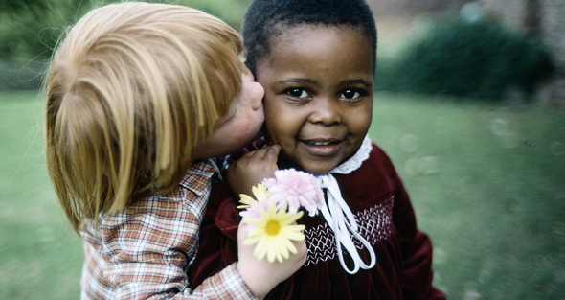
T- tactful
O- observant
L- loving
E- expressive
R- rewarding
A- affectionate
N- nice
C- caring
E- enthusiastic
Try to treat people in the way you want to be treated

Slide 14







Symbols of UNESCO

Slide 15
