Slide 1

Внеклассное мероприятие подготовлено учителем английского языка
МБОУ СОШ №20 г. Королева
Гурковой Инной Николаевной
Now I Know

Slide 2


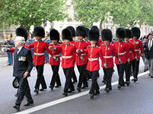
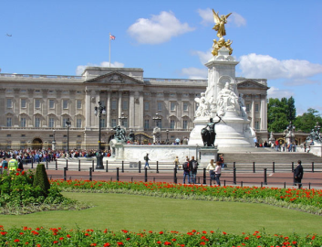

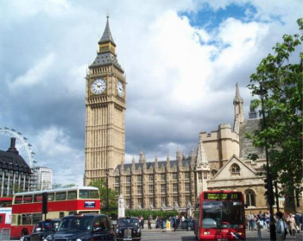
Now I know…
Гуркова И.Н.

Slide 3
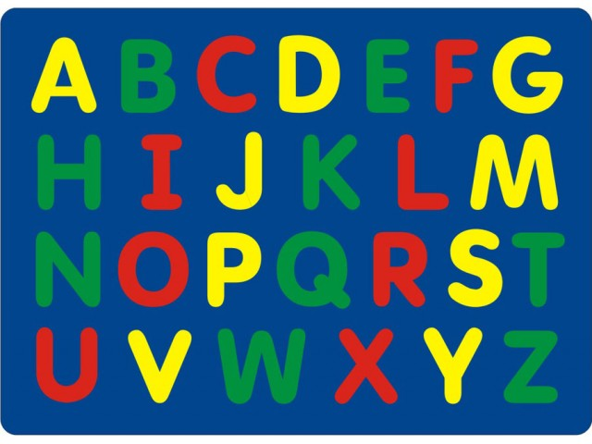

Now I know the ABC
1

Slide 4
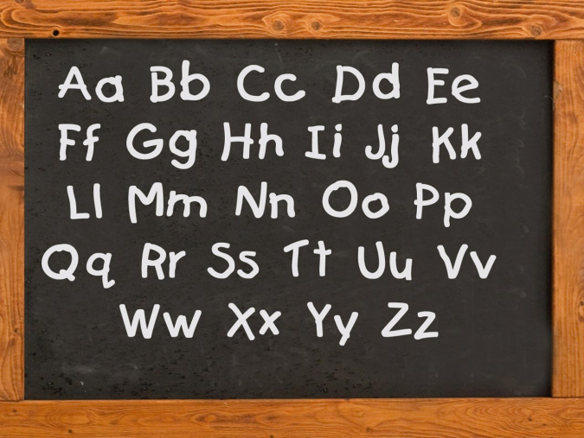
Now I know the ABC.
26 letters.
20 consonants, 6 vowels
2
Гуркова И.Н

Slide 5
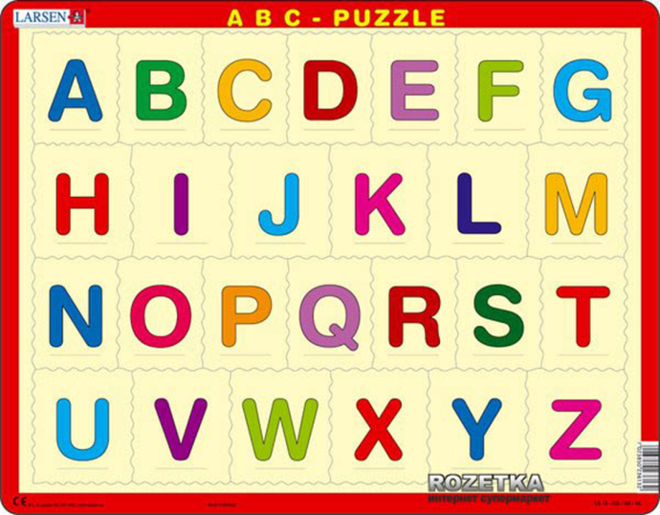
Now I know the ABC.
Name the neighbours.
3

Slide 6
The Competition.
Cross out the wrong sound.
B [ b ], [ d ], [ p ] A [ e ], [ei ], [ æ ]
L [ v ], [ f ], [ l ] C [ z ], [ k ], [ s ]
F [ t ], [ f ], [ k ] X [ ks ], [ k ], [ s ]
I [ i ], [ e ], [ ai ] H [ n ], [ h ], [ m]
W [ w], [ v ], [ r ] E [ e ], [ i:], [ a ]
Гуркова И.Н
4

Slide 7
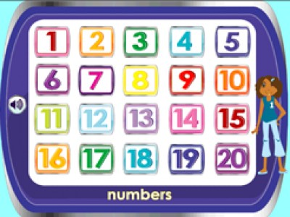
Now I know how to count.
Гуркова И.Н
5

Slide 8
Now I know how to count.
How much is 15 and 5?
10 + 7 = 7 + 5 =
13 + 7 = 9 + 10 =
7 + 6 = 5 + 11 =
8 + 8 = 7 + 8 =
4 + 14 = 3 + 13 =
6

Slide 9

B I N G O
7

Slide 10
Now I know numbers.
t | i | f | n | s | e | v | e | n | f
w | e | i | b | t | l | p | o | k | o
o | m | v | o | n | e | o | v | g | u
q | c | e | v | b | o | m | c | x | r
e | i | g | h | t | n | s | a | z | z
r | a | l | h | j | i | u | t | e | n
e | a | x | q | w | n | i | p | t | r
t | h | r | e | e | e | o | s | i | x
8

Slide 11
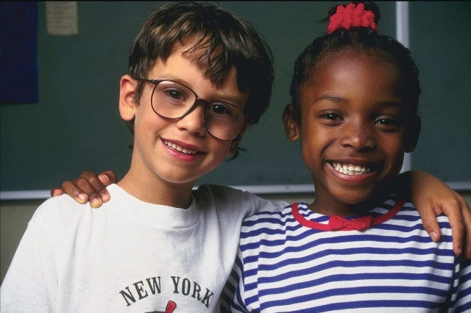
Now I know how to make friends.
9

Slide 12
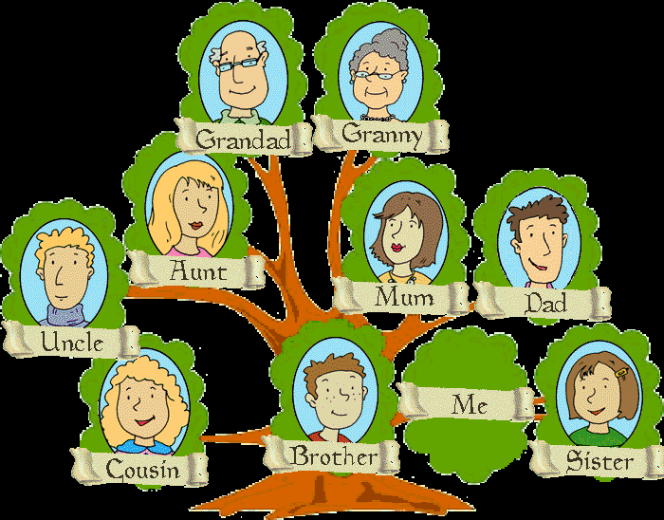
Now I know how to tell about my family.
A mother
A father
A sister
A brother
A grandmother
A grandfather
10

Slide 13

Now I know how to tell about my family
11

Slide 14
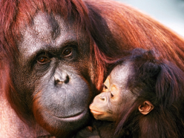
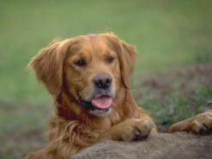
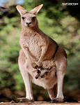
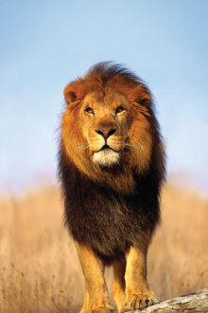
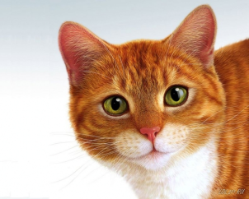
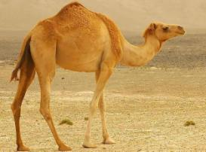
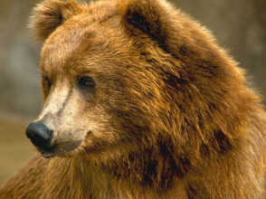
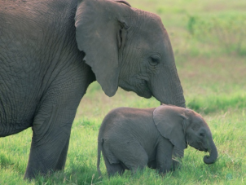
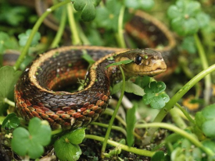
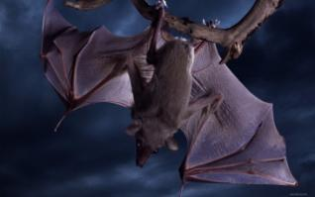
Now I know the names of animals.
12

Slide 15

Now I know colours.
13

Slide 16

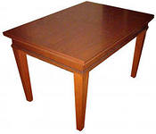

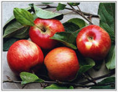
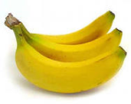

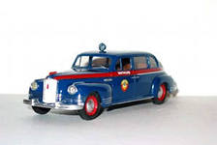
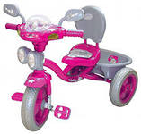
Now I can draw.
14

Slide 17


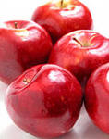

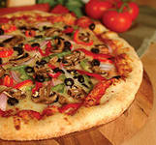
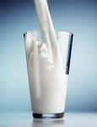
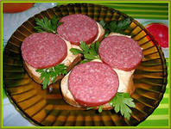

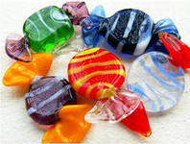

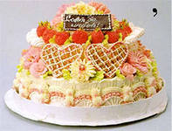
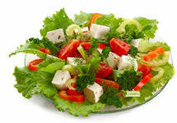
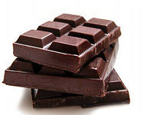
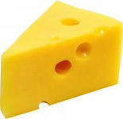
Now I can say what I like.
15

Slide 18
The competition.
Scrambled words.
eppal wstee
keca likm
nadelemo zzipa
16

Slide 19
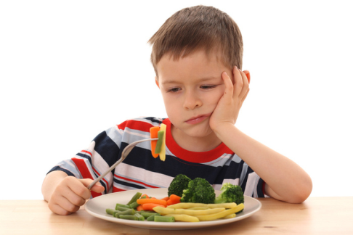
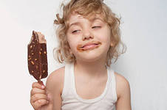
I like ice cream! Yum!
17

Slide 20

Now I can sing in English.
18

