Slide 1
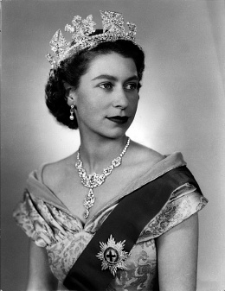
The British Royal Family
Rita Prodayvoda

Slide 2
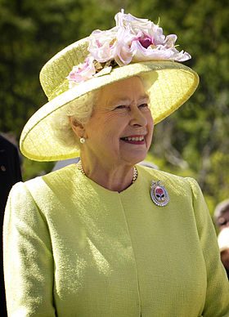
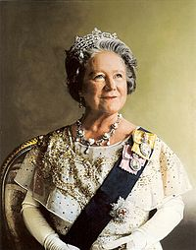
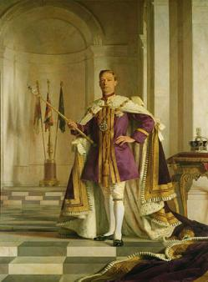
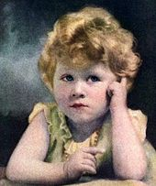
Queen Elisabeth II
Elizabeth II, born April 21, 1926
In power since February 6, 1952

Slide 3
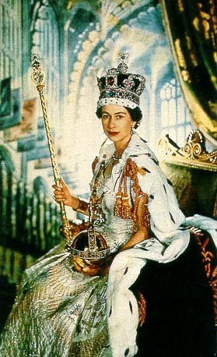
Royal Career
Coronated on 2 June 1953
Head of State / Head of Nation
Head of Commonwealth
Supreme Governor of the Church of England
Defender of the Faith
Head of the Armed Forces

Slide 4
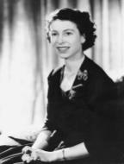
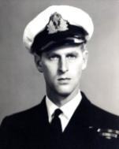
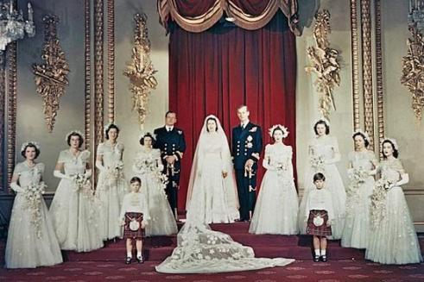
Love Story
met in 1934 (third cousins through Queen Victoria)
began to exchange letters in July 1939
engagement was officially announced on 9 July 1947
married on 20 November 1947 at Westminster Abbey

Slide 5
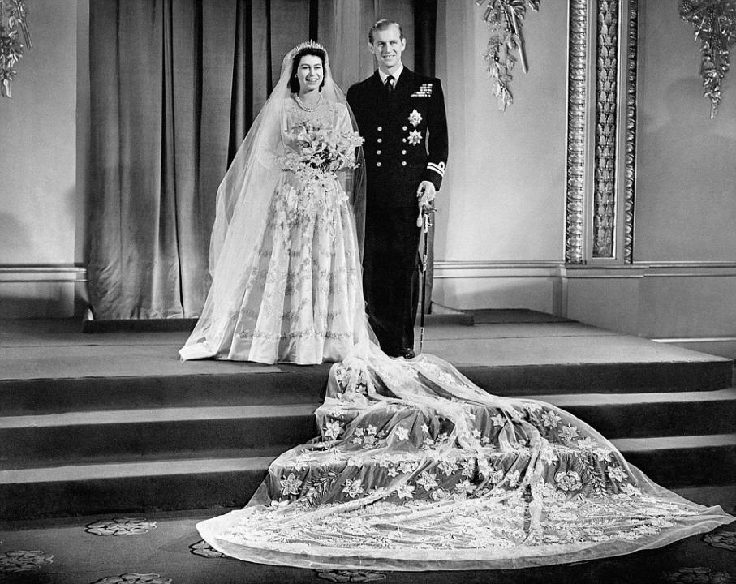

Slide 6
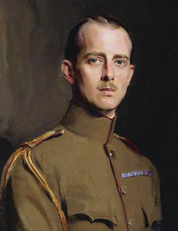
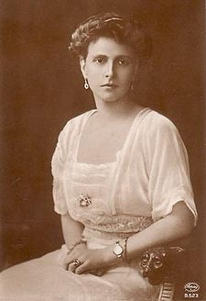
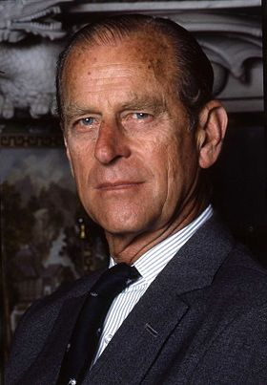
Royal Husband
Philip Mountbatten = Prince Philip, Duke of Edinburgh
born 10 June 921 as Prince Philip of Greece and Denmark
first met Elisabeth in 1934
married her on 20 November 1947

Slide 7
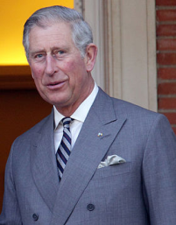
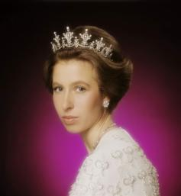
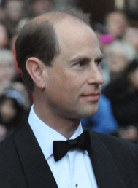
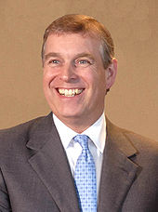
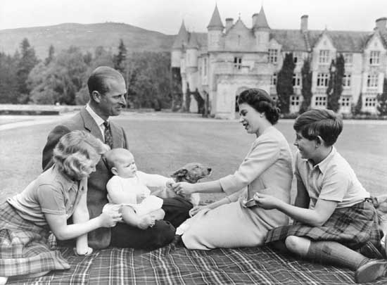
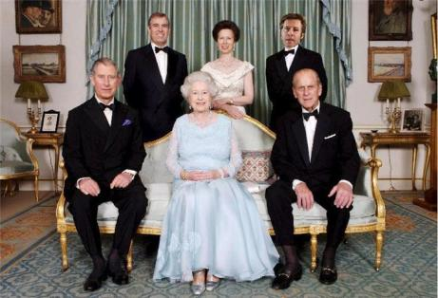
Royal Children

Slide 8
Today…
Eight grandchildren:
Peter Phillips (b. 1977)
Zara Phillips (b. 1981)
Prince William (b. 1982)
Prince Harry (b. 1984)
Princess Beatrice (b. 1988)
Princess Eugenie (b. 1990)
Lady Louise Windsor (b. 2003)
James, Viscount Severns (b. 2007)
Two great-grandchildren
Savannah (b. 2011)
George Alexander Louis (b. 2013)

Slide 9
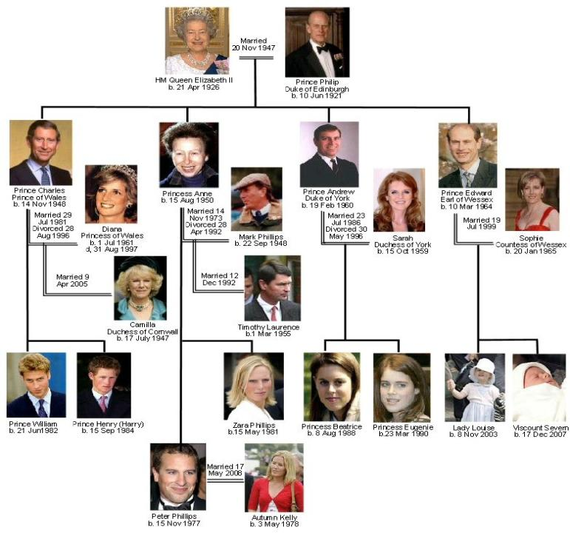

Slide 10
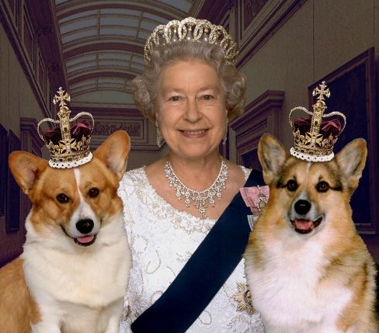
Corgis:
Linnet
Monty
Willow
Holly
Pets
Dorgis:
Cyder
Berry
Candy
Vulcan

Slide 11
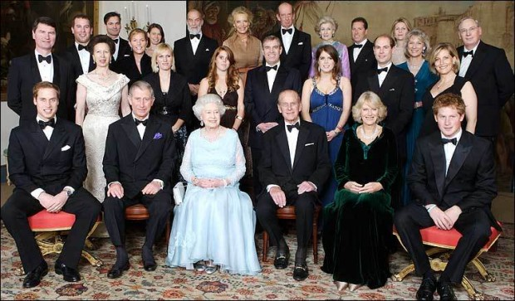
Tomorrow…
Queen’s approval rating ~80%
73% of Britons believe Britain would be worse without monarchy

Slide 12
