Slide 1
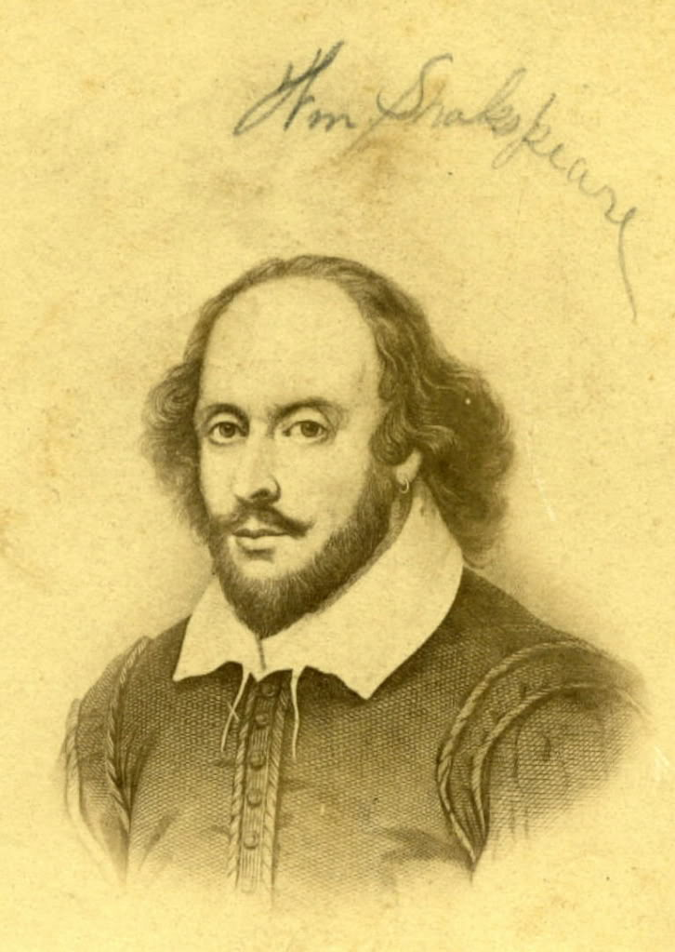
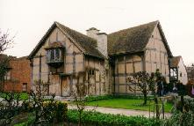
William Shakespeare
1564-1616
I.V. Postyka , an English teacher
Students of 9b class
School 101, Krasnodar

Slide 2
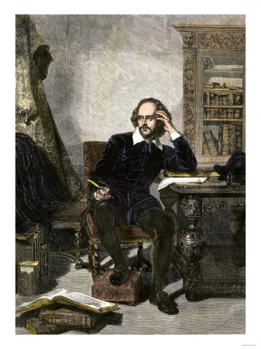
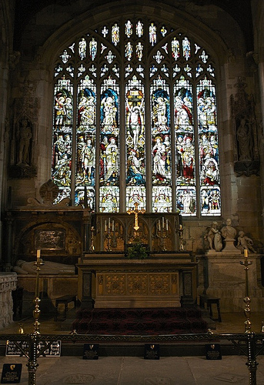
“He was the man who of all modern, and perhaps ancient poets, had the largest and most comprehensive soul.”
(John Dryden)

Slide 3
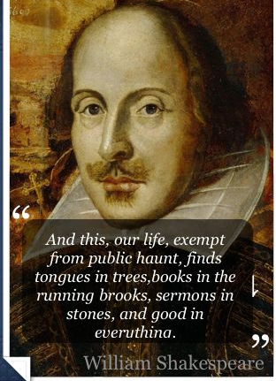
The English people called Shakespeare “Our National bard”, “The Poet of Nature” and “The Great Unknown”.

Slide 4

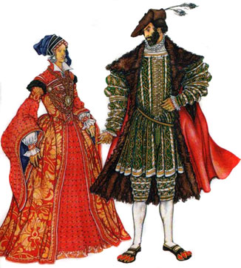

William Shakespeare was born at Stratford-on Avon on the 23rd of April 1564. His father, John Shakespeare, was a farmer’s son, who came to Stratford in 1551 and became a prosperous tradesman.
His mother, Mary Arden was a farmer’s daughter. John and Mary had eight children, four girls and four boys.
The third child was William. William was a boy of free and open nature, much like his mother who was a woman of a lively disposition.

Slide 5
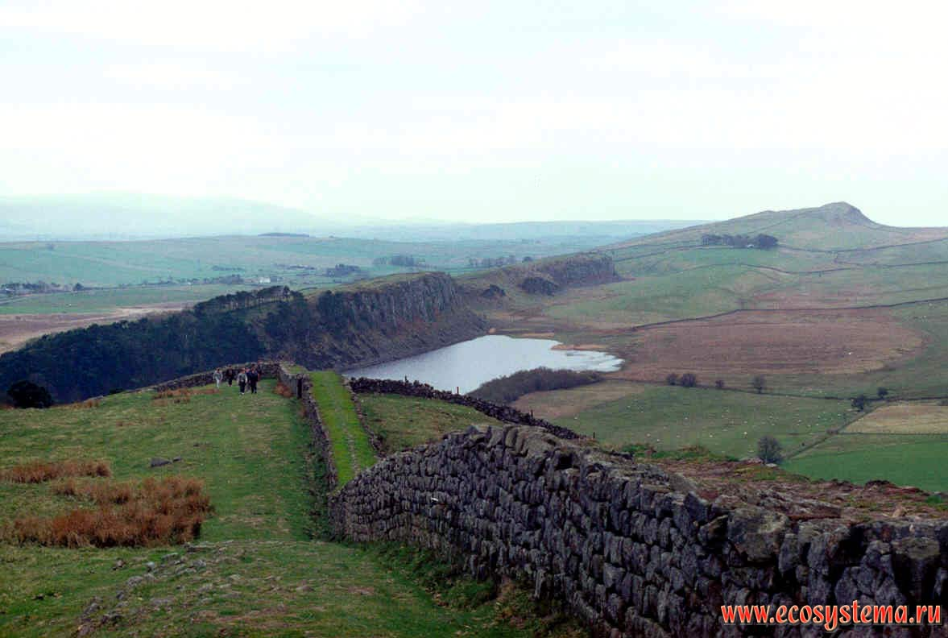
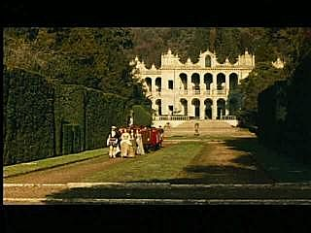
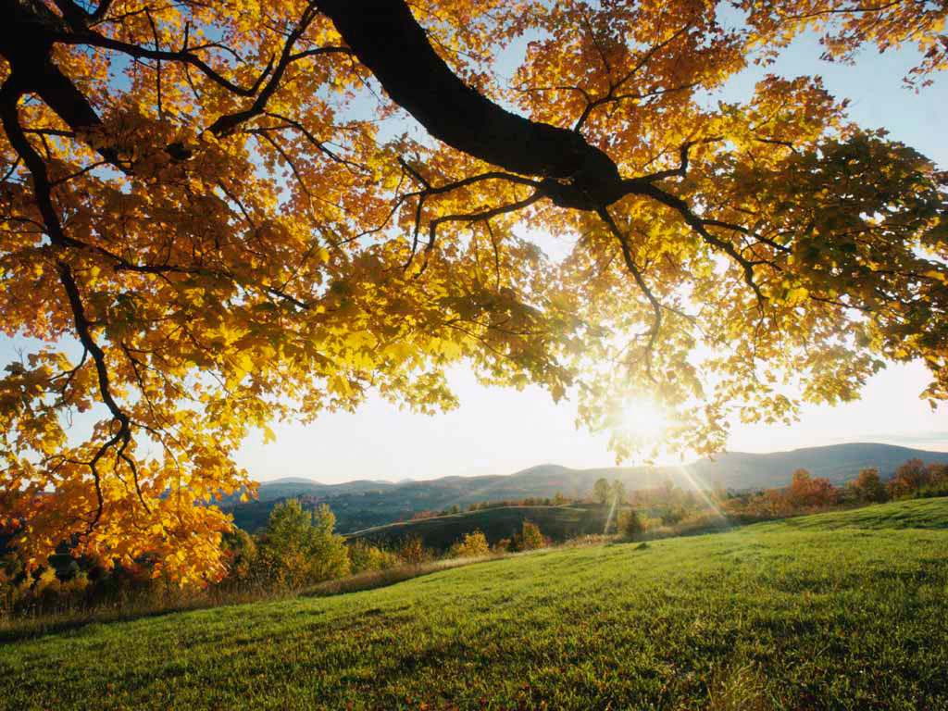
Stratford was a charming little town in the centre of England. The beauty of this place must have influenced powerfully to the poet’s imagination.

Slide 6
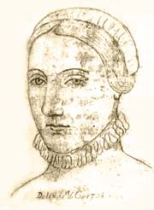
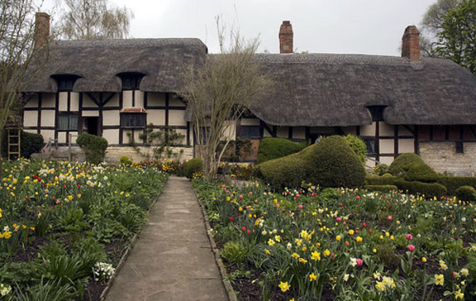
At the age of 18, Shakespeare married the 26-year-old Anne Hathaway . They had three children: Susanna and twins, son Hamnet and daughter Judith

Slide 7
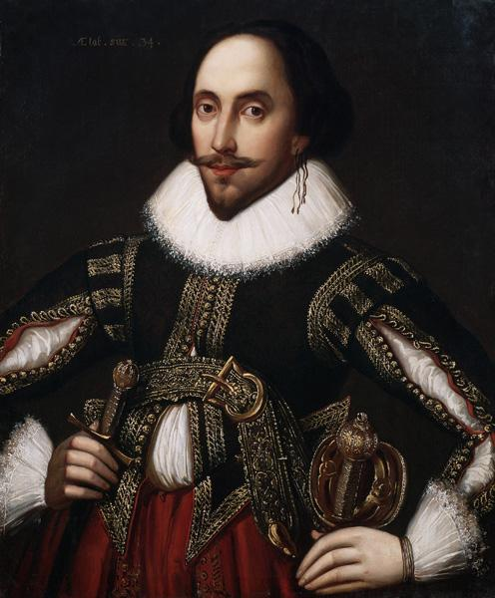
  A few years later after his marriage, about the year 1587, Shakespeare left his native town for London.
  Soon he had gained a reputation for both acting and writing

Slide 8
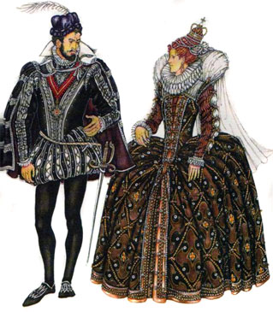
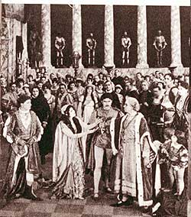
He wrote plays on his own, first comedies, and then historical plays. New plays by William Shakespeare appeared almost every year between 1590 and 1613. He was known as an actor and A writer of plays.

Slide 9
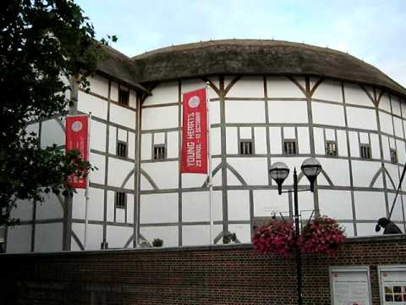
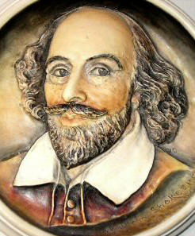
In 1594 Shakespeare became a member of the Lord Chamberlain’s company of actors.
When the company built the “Globe” theatre most of his greatest plays were performed there. His career as a dramatist lasted for nearly 21 years.

Slide 10
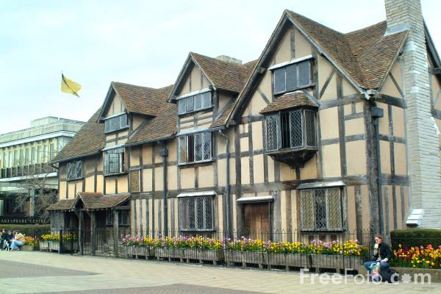
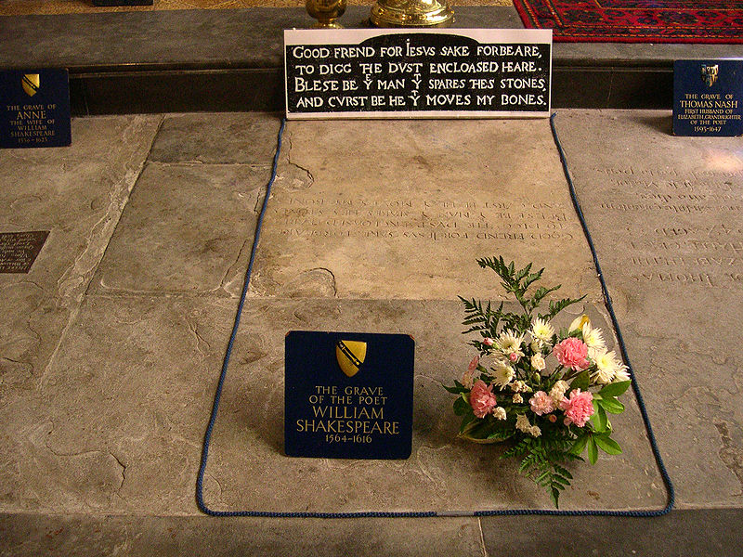
In spite of prosperity he must have left lonely among the people surrounding him. In 1612 he returned to Stratford-on Avon for good.
The last years of his life Shakespeare spent in Stratford. He died on the 23rd April 1616.

Slide 11
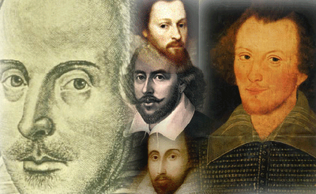

Facts About Shakespeare!
When he speaks in his plays, we feel that he speaks for us and to us.
His plays are staged by all the world’s theatres and in Russia as well.
Many world famous composers wrote music on the theme of his plays, such as Verdi ,Rossini, Berlioz, Tchaikovsky, Shostakovich.
Almost all Shakespeare’s comedies and tragedies have appeared in the cinema.

Slide 12
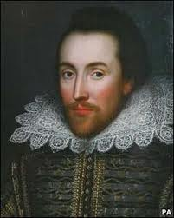
Quiz about Shakespeare ‘s life:
What titles have the English people given to William Shakespeare?
When and where was Shakespeare born?
How many children did John and Mary Have?
What kind of boy was William?
What must have influenced poet’s imagination?
When did his poems begin to appear?
When did he marry Anne Hathaway?
How many children did they have?
Where were most of Shakespeare’s plays performed?
When and where did he die?

Slide 13
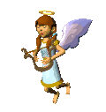
That’s Right!

Slide 14
Internet Resources:
http://en.wikipedia.org/wiki/
http://shakespeare.palomar.edu/
http://www.booktrust.org.uk/books/teenagers/writing-tips/tips-for-writing-book-reviews/
https://www.google.ru/search?q=works+of+Shakespeare&newwindow/
http://shakespeare.mit.edu/

