Slide 1



Shakespeare’s masterpieces
I.V.Postyka , an English teacher
Students of 9b class
School 101, Krasnodar

Slide 2

The Sonnet
No longer mourn for me when I am dead Than you shall hear the surly sullen bell Give warning to the world that I am fled From this vile world with vilest worms to dwell: Nay, if you read this line, remember not The hand that writ it, for I love you so, That I in your sweet thoughts would be forgot, If thinking on me then should make you woe. O! if, I say, you look upon this verse, When I perhaps compounded am with clay, Do not so much as my poor name rehearse; But let your love even with my life decay; Lest the wise world should look into your moan, And mock you with me after I am gone.

Slide 3



William Shakespeare wrote 37 plays, 154 sonnets and two narrative poems.
Shakespeare’s plays belong to different dramatic genres. They are histories, tragedies, comedies and tragic- comedies.
Shakespeare’s Literary Work is usually divided into three periods:
The first period- from 1590 to 1601- when he wrote histories, comedies and sonnets.
The second period- from 1601 to 1608- was the period of tragedies.
The third period- from 1608 to 1612- when he wrote mostly tragic-comedies.

Slide 4
The sonnet is a poetical form that appeared in Italy in the 14th century. It was introduced into English literature during the first period of The Renaissance. Shakespeare’s sonnet has 14 lines.
Drama is the branch of theatre in which speech is paramount. Classical forms of drama, including Greek and Roman drama, classic English drama including William Shakespeare is still performed today.
Comedy is any humorous discourse generally intended to amuse, especially in television, film, and stand-up comedy. It must be carefully distinguished from the academic definition, namely the comic theatre, whose Western origins are found in Ancient Greece.

Slide 5
The idea of freedom for people.
Humanism.
The love for mankind .
The idea of patriotism.
Social relations between people.
The themes of love and friendship.
The masses as а political force
The central themes of Shakespeare :

Slide 6
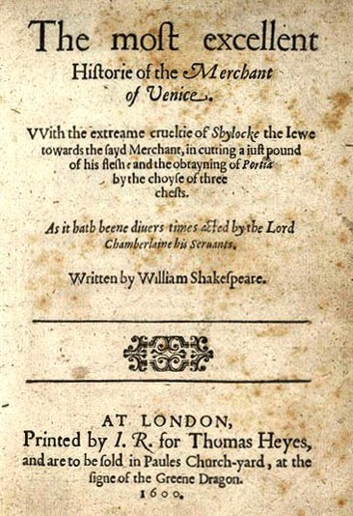
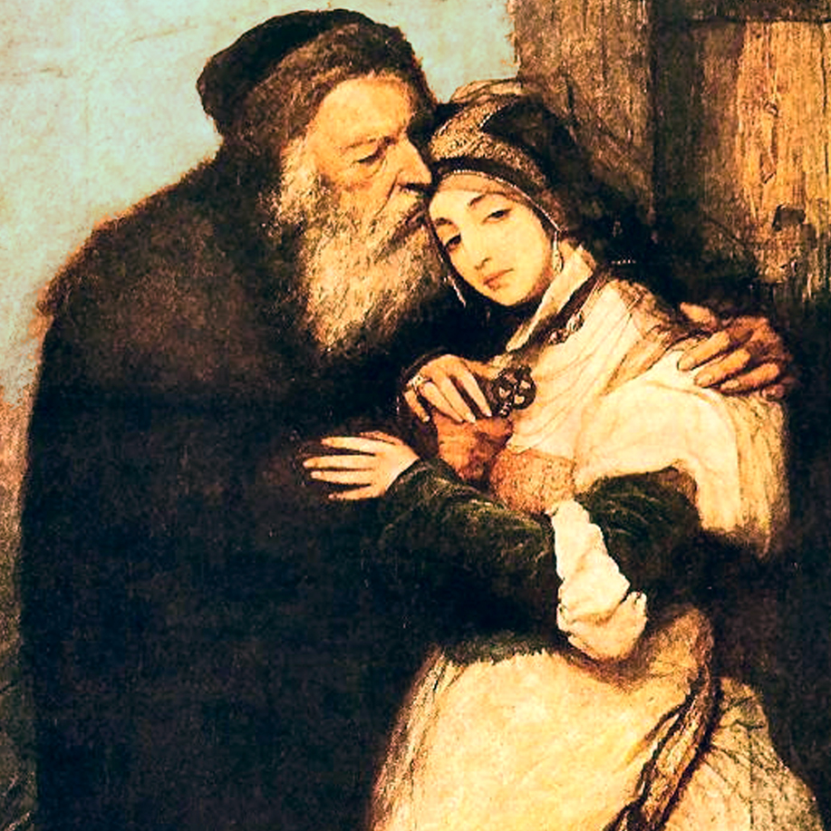
The Merchant of Venice is a play by William Shakespeare, though classified as a comedy in the First Folio and sharing certain aspects with Shakespeare's other romantic comedies, the play is perhaps most remembered for its dramatic scenes, and is best known for Shylock and the famous "Hath not a Jew eyes?" speech.

Slide 7
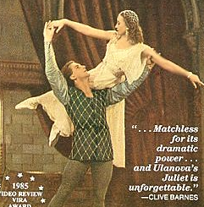

Romeo and Juliet” was Shakespeare’s first tragedy. Romeo and Juliet are the victims of a long senseless feud between their families. The world of Montagues and Capulets is antagonistic to their love.
The young people are to fight against feudal traditions and patriarchal morality. The death of the young people makes the older generation realize the absurdity of their feud and leads to the reconciliation of the two families.
The tragedy ends in an optimistic mood.

Slide 8
There are some phrases that have become sayings:
All’s well that ends well.
All that glisters is not a gold.
A sea of troubles.
Brevity is the soul of wit.
To be or not to be, that is the question.
There is no darkness but ignorance.
Love’ s labour is lost.

Slide 9
Quiz
When and where did the sonnet appear?
How many lines does the sonnet have?
What forms of drama do you know?
What are the central themes of Shakespeare?
Who is the main character of “Merchant of Venice”?
What are Romeo and Juliet fight against?
What phrases became sayings?

Slide 10
Internet Resources:
http://en.wikipedia.org/wiki/
http://shakespeare.palomar.edu/
http://www.booktrust.org.uk/books/teenagers/writing-tips/tips-for-writing-book-reviews/
https://www.google.ru/search?q=works+of+Shakespeare&newwindow/
http://shakespeare.mit.edu/

