Slide 1
Books. Famous writers
Урок английского языка, 6 класс
Автор: Михеева Татьяна Петровна
МОБУ СОШ № 30 им В.И.Кузьмина
г.Якутск

Slide 2
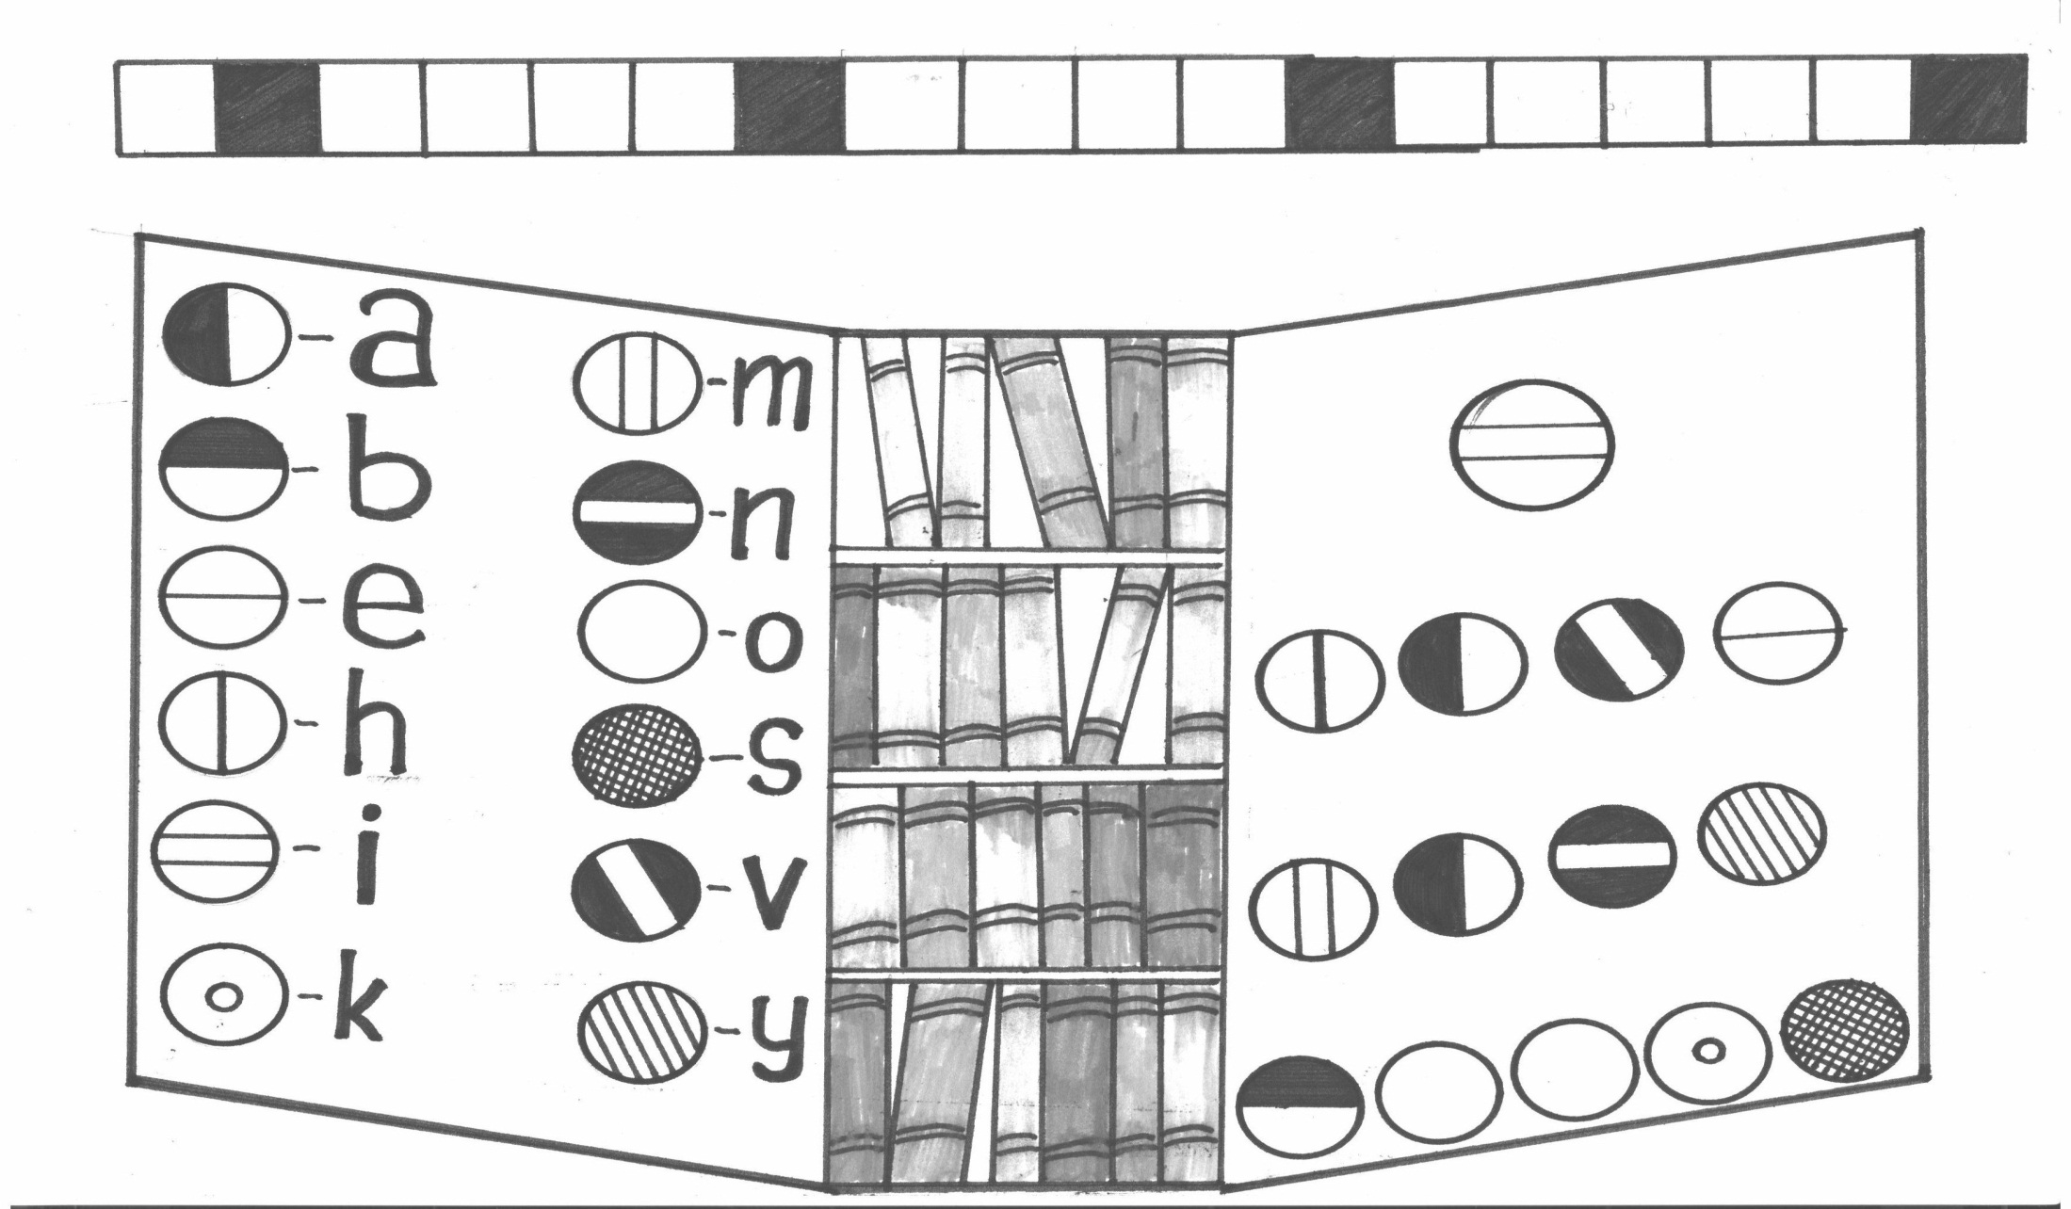
Task I puzzle1
I h a v e m a n y b o o k s

Slide 3
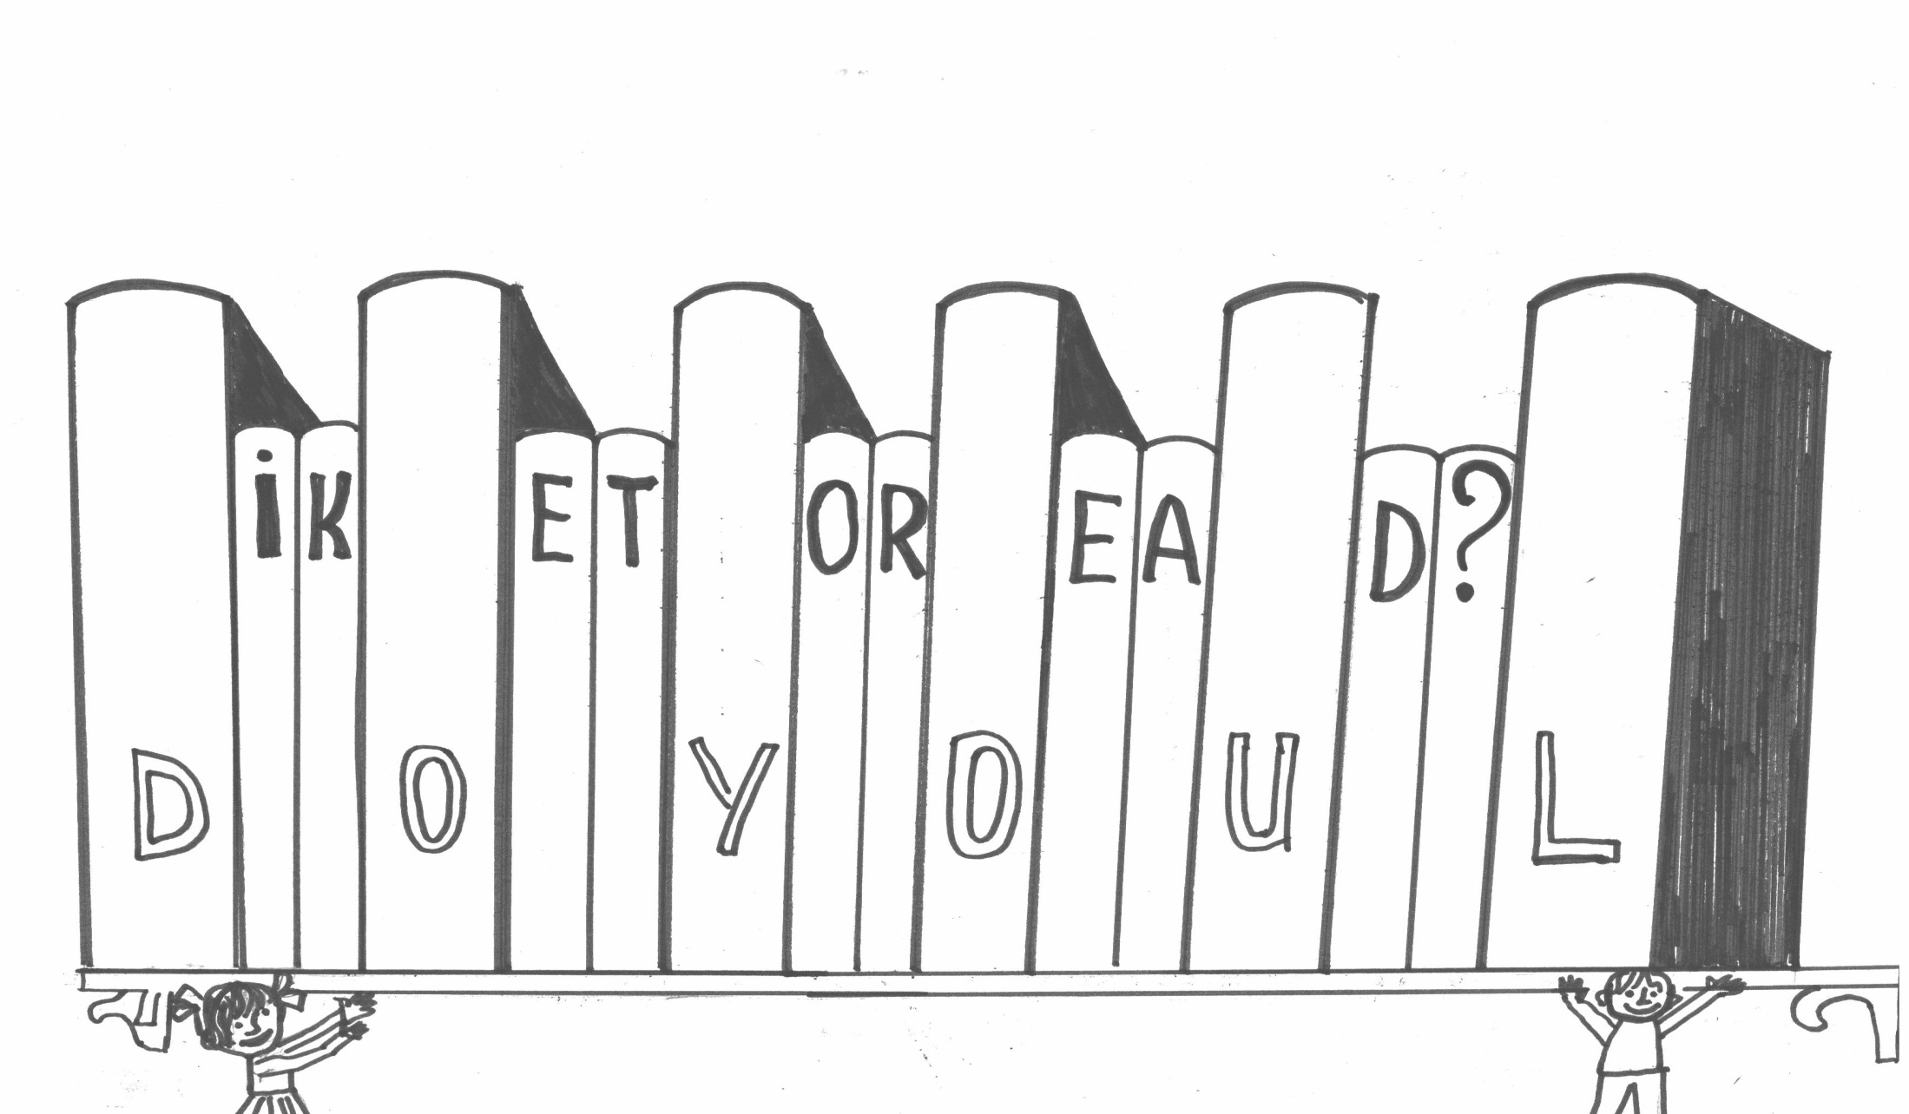
puzzle2
Do you like to read?

Slide 4
Task2
Riddles
I know everything,
I teach everybody.
But to make friends with me
You must first learn.
The field is white,
Black is the seed,
The man who sows it
Is clever indeed.
I’m neither a rhyme nor a song,
I can be short or very long,
I can be funny or quite sad,
But to read me you’ll be glad
  A page of a book
  A book
A story

Slide 5
Task 3
A Literary game
Match the following works and their authors.
1.Treasure Island a. Mark Twain
2.Gulliver’s Travels b. R.R. Tolkien
3. Winnie-the Pooh c. Rudyard Kipling
4. The Adventure of Sherlock Holmes d. R.S. Stevenson
5. Alice in Wonderland e. Jonathan Swift
6.Harry Potter and the Philosopher’s f. Daniel Defoe
stone
7.Robinson Crusoe g. Lewis Carol
8. The Adventures of Tom Sawyer h. Arthur Conan Doyle
9. Mowgli i. J.K Rowling
10. The Lord of Rings j. Alan Alexander Milne

Slide 6
Task 4
Test-Foreign literature
1. This writer began to write detective stories in 1920.
a. Jack London b. Mark Twain c. Agatha Christie
2. “Treasure island” is an adventure story about…looking for
buried treasure.
a. pirates b. children c. policemen
3. In this town the tourists can see the house where
Shakespeare lived with his family.
a. London b. Edinburg c. Stratford- on –Avon
4.What was the aunt’s name of Tom Sawyer?
a. Molly b. Polly c. Maggie
5. “The Prince and the Pauper” was written by this writer
a. Mark Twain b. Jack London c. Conan Doyle

Slide 7
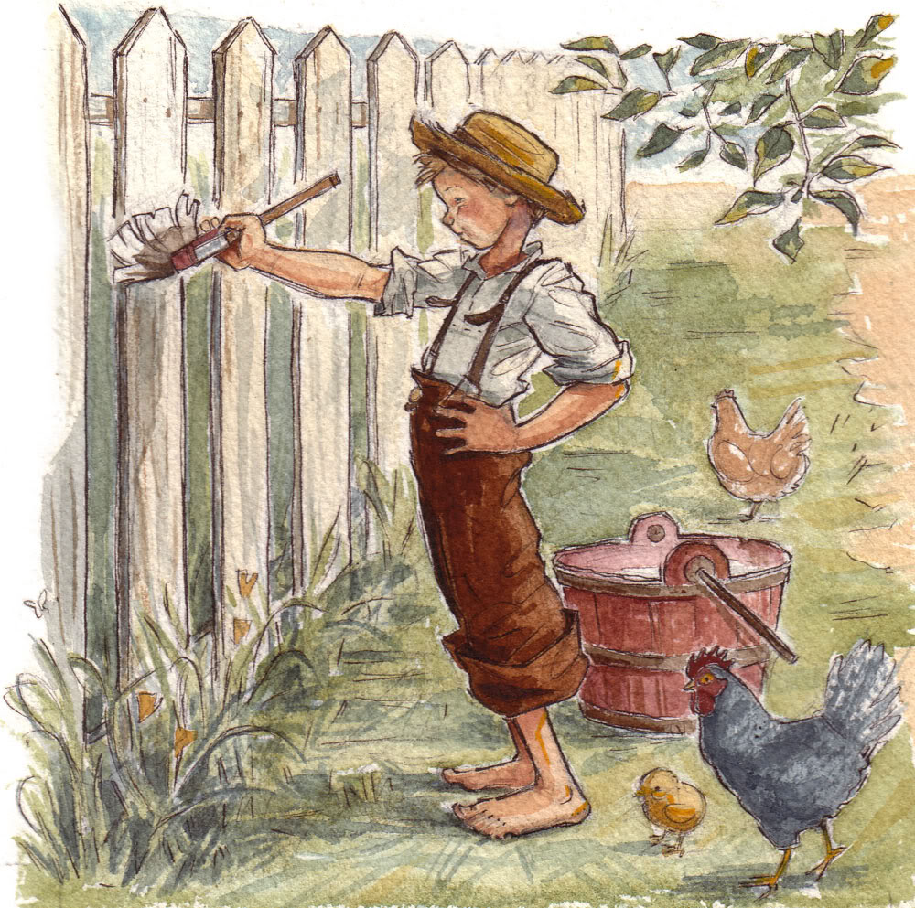
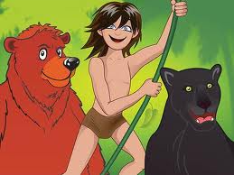
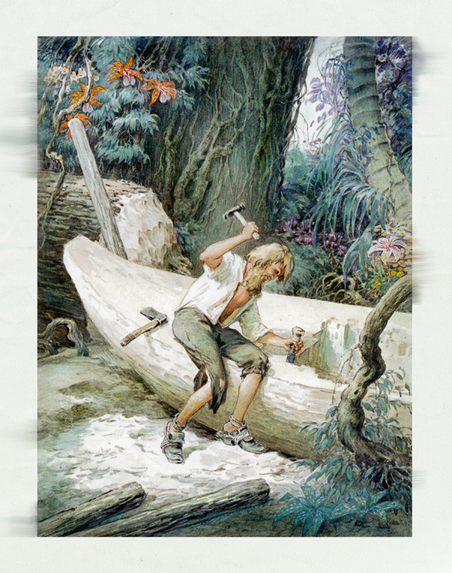
Task5 My favourite character
Name the character and the author of a book, say what you know about the book
This is ….. He is a character in the book ……. by the well-known ……. He is famous English ( American) writer. This book is about ….

Slide 8
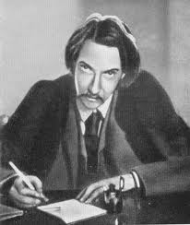
Task 6
Famous British writers
FAMOUS BRITISH WRITERS
ROBERT LOUIS STEVENSON | to be born in 1850 a well-known Scottish writer the author of adventure stories to be read with great interest (the author’s adventure stories) the best-known adventure novels in English “Treasure Island”, “Kidnapped” to die in 1894

Slide 9
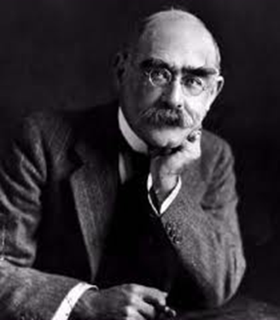
Task 6
Famous British writers
FAMOUS BRITISH WRITERS
to be born in Bombay in 1865 a famous British writer, poet novelist to write a lot of poems, stories for children to be recognized all over the world ( his books) “The Jungle Book” “The Second Jungle Book” “The Seven Sea” “ Captains Courageous” to get Nobel Prize for literature in 1907 to die 1936 | JOSEPH RUDYARD KIPLING

Slide 10
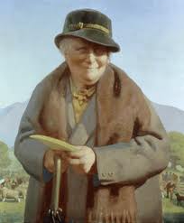
Task 6
Famous British writers
FAMOUS BRITISH WRITERS
BEATRIX POTTER | to be born in 1866 a famous English writer and illustrator to write animal stories for young children to draw pictures for her books to be very popular with British children and their parents (her books) “The Tale of Peter Rabbit” The Tale of Squirrel Nutkin The Tailor of Gloucester The Tale of Benjamin Bunny The Tale of Two Bad Mice to die in 1943

Slide 11
Task 7 Синквейн
Первая строка - одним словом обозначается тема (имя существительное).
Вторая строка - описание темы двумя словами (имена прилагательные).
Третья строка - описание действия в рамках этой темы тремя словами (глаголы, причастия).
Четвертая строка - фраза из четырех слов, выражающая отношение к теме (разные части речи).
Пятая строка - это синоним из одного слова, который повторяет суть темы.
Books Book
Interesting, exciting. Great, funny
Read, travel, learn. Read, enjoy, think
We like reading books. We are fond of reading
Adventure. Fun.

