Slide 1


Places of interest

Slide 2

Once an Englander wanted to visit our republic.

Slide 3

A travel agent found information about some places of interest.

Slide 4

First he advised to visit the capital of Komi Republic- Syktyvkar.

Slide 5
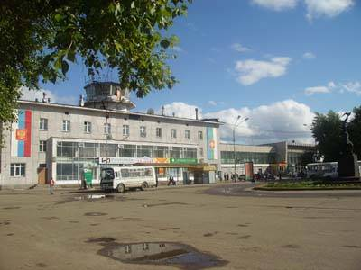
The Englander began his excursion in a airport.

Slide 6
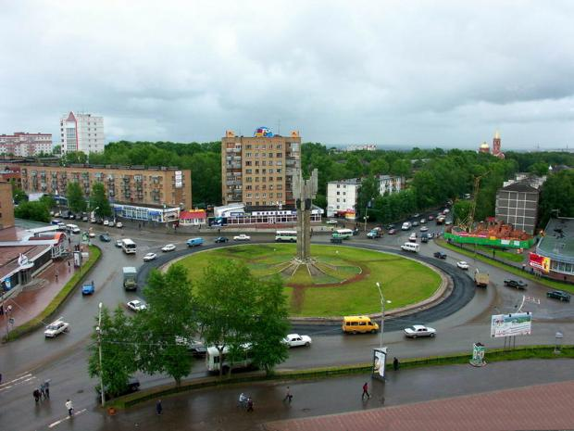
He saw a monument of three orders on the crossing of streets.

Slide 7
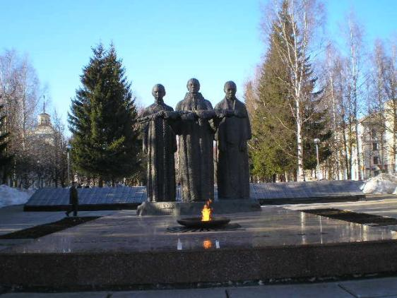
He visited a memorial to fallen soldiers.

Slide 8
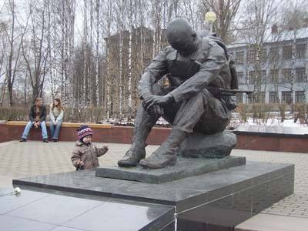
He saw a monument to soldiers who were fallen in a war with Afghanistan.

Slide 9
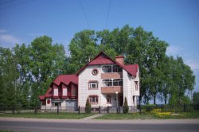
He visited a museum of famous skier R.P. Smetanina.

Slide 10
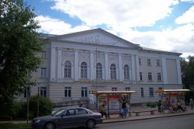
He saw the building of the House of creation of children.

Slide 11
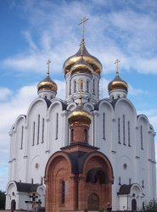
He saw the Stephan the Permskii cathedral.

Slide 12
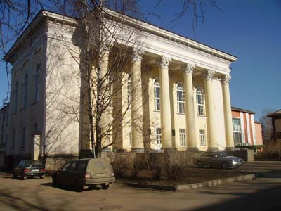
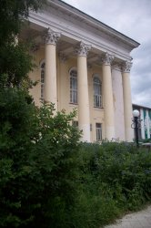
He saw the National library.

Slide 13
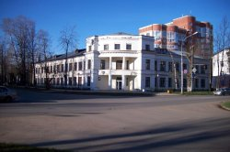
He saw the building of gymnasium for girls.

Slide 14
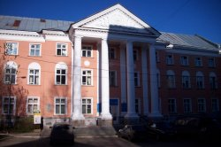
He saw the building of the Trade- union.

Slide 15
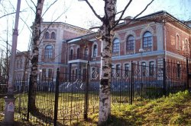
He saw beautiful pictures in the National gallery.

Slide 16
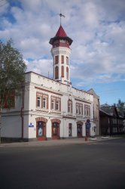
He saw the famous fireman`s watch-tower.

Slide 17
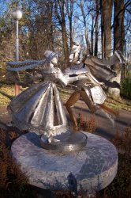
He wandered the sculpture-garden.

Slide 18
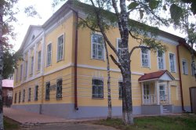
He saw the oldest building-the house of merchant Suhanov.

Slide 19
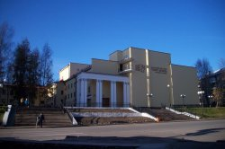
He wandered the V.Savin drama theatre.

Slide 20
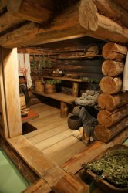
He saw many interesting things in the museum of ethnography.

Slide 21
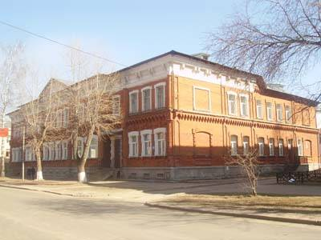
He saw the building of medical academy.

Slide 22
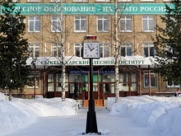
At the building of the timber institute he saw a watch.

Slide 23
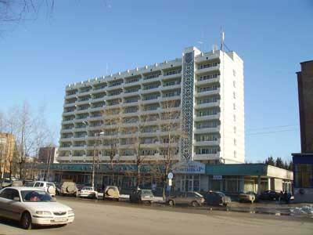
He was impressed by the hotel “ Syktyvkar”.

Slide 24
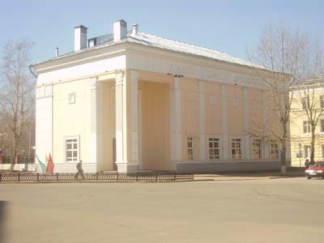
The cinema “Rodina” was a very interesting building.

Slide 25
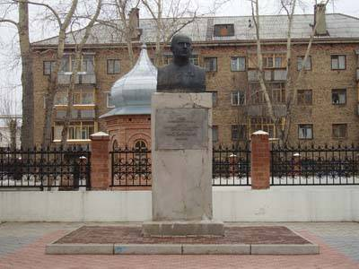
He saw a Babushkin-monument.

Slide 26
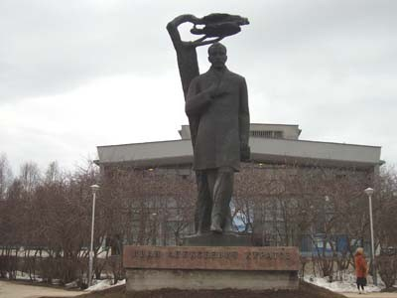
He saw a theatre of music and opera and a Kuratov –monument.

Slide 27
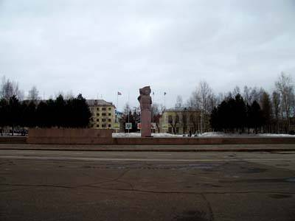
On the Stefanovskaja square he saw a Lenin- monument.

Slide 28
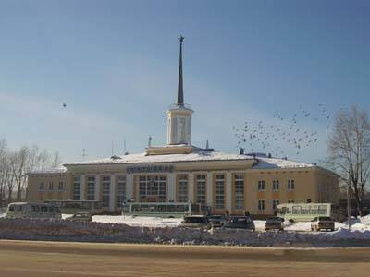
He visited the railway station.

Slide 29
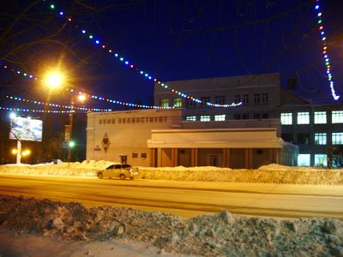
He saw a building of teacher- training college.

Slide 30
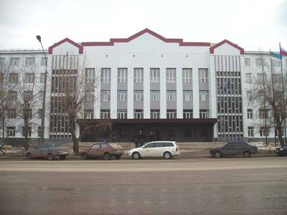
He saw the University.

Slide 31
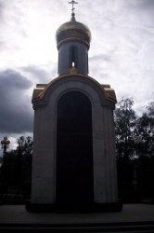
He saw the memorial to the victims of repressions.

Slide 32
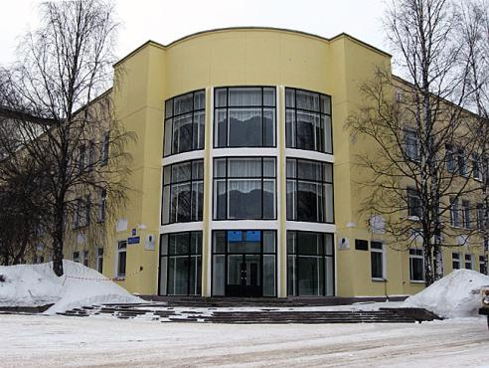
He visited the academy of the science.

Slide 33
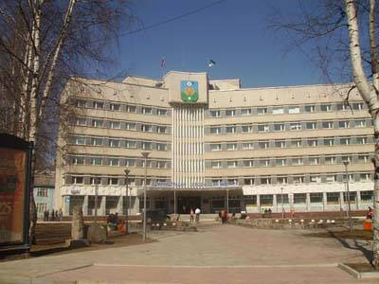
He saw the office building of Syktyvkar.

Slide 34
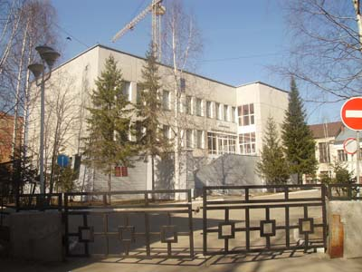
He saw the building of registry office.

Slide 35
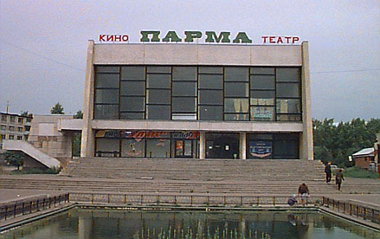
He went to the cinema “Parma”.

Slide 36
Once he meet two friends who were speaking about their home village.

Slide 37

What were they speaking about?

Slide 38
The Englander wanted to visit this village.

Slide 39
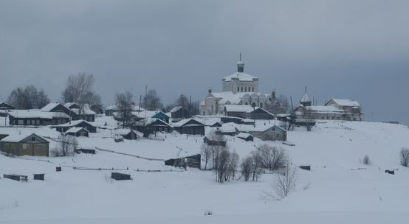
Let`s introduce Ust-Nem.

Slide 40
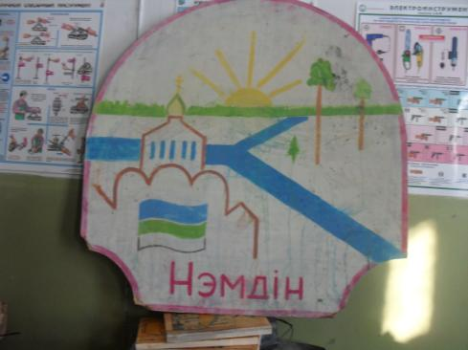
Let`s introduce the coat of arms of Ust-Nem.

Slide 41
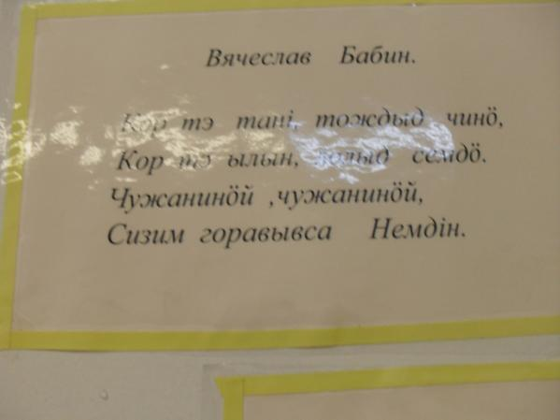
Let`s introduce the anthem of Ust-Nem.

Slide 42
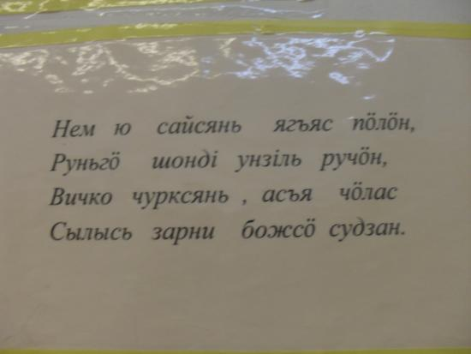

Slide 43
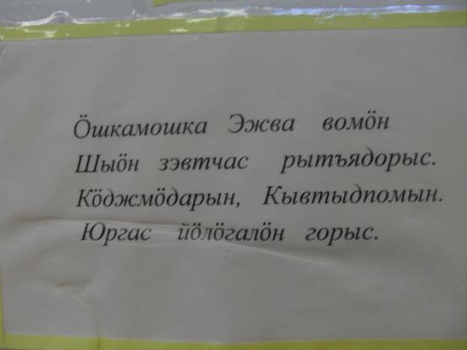

Slide 44
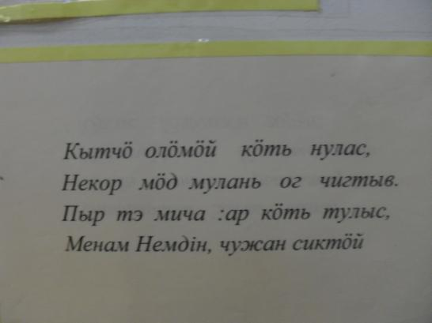

Slide 45
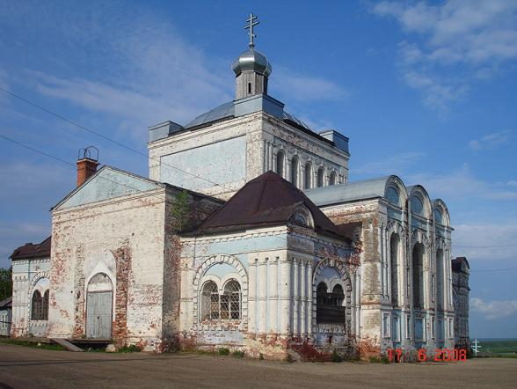
Let`s have a look to the church!

Slide 46
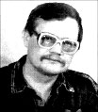
Let`s ask the poet Babin to visit his house.

Slide 47
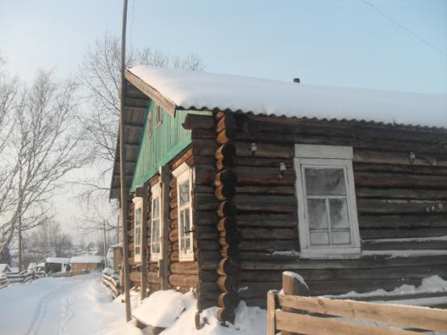
Let`s visit the house where he lives.

Slide 48
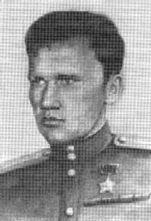
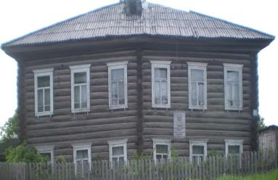
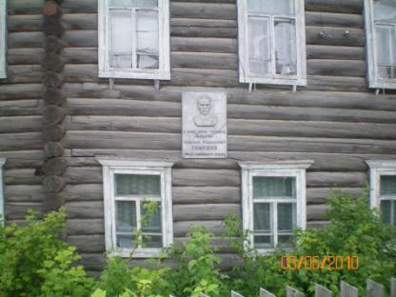
Let`s visit the house where the hero of SU Timushev was born.

Slide 49
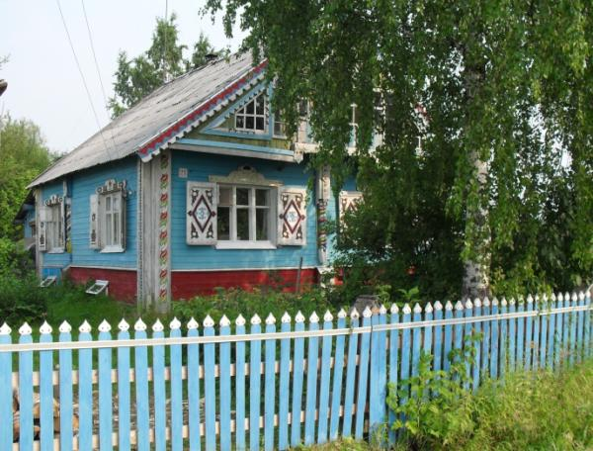
Let`s visit the house of the famous painter Malzev.

Slide 50
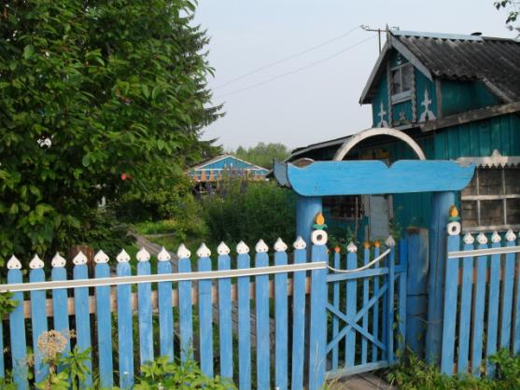
Look at the wicket and a little house.

Slide 51
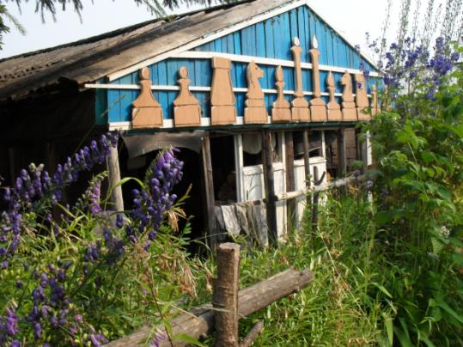
Look at the chess figures of the shed.

Slide 52
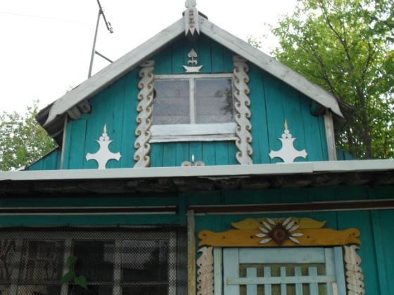
Sorry we can`t see the figure of a horse on the roof.

Slide 53
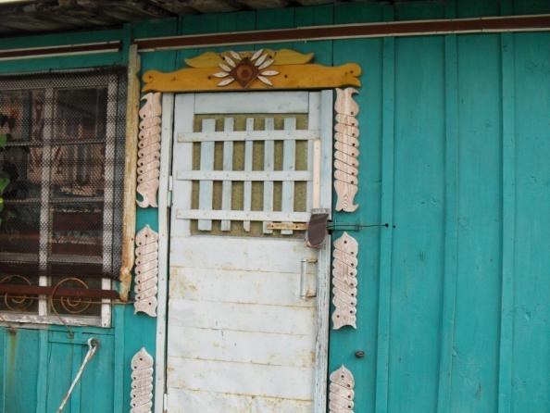
Look at the door of the little house.

Slide 54
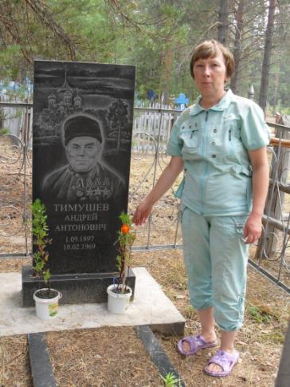
We can visit the tombstone of A. A.Timushev. He was a holder of three orders of glory.

Slide 55

We can visit the monument to the fallen soldiers.

Slide 56

We can visit the tombstone of the spouses Shchekin . They were the first teachers.

Slide 57

We can see the R.G.Karmanov –school. He was a famous geologist.

Slide 58


We can see the monument to the soldiers who were fallen during the civil war.

Slide 59





We can see the traces of the bombs that were made during the civil war.

Slide 60

We can see a monument to the victims of repression.

Slide 61

We can visit one of the first buildings of the school.

Slide 62


We can visit the settlement Yndin .There were many deportee who were German.

Slide 63


We can learn about their difficult life .

Slide 64


We can see the remains of some buildings .

Slide 65


We can repent and think about them .We can hold the memory of the victims.

Slide 66

The tourist phoned home. He told about his visit. But he can`t remember all the facts.

Slide 67


Slide 68



a monument of three orders
an airport
a memorial to fallen soldiers

Slide 69

the building of the House of creation of children
monument to soldiers who were fallen in a war with Afghanistan

Slide 70
the Stephan the Permskii cathedral
fireman`s watch-tower
the National library

Slide 71
the gymnasium for girls
the National gallery.
the building of the Trade- union

Slide 72
the sculpture-garden
the memorial to the victims of repressions
the museum of ethnography

Slide 73

the house of merchant Suhanov
V.Savin drama theatre
the medical academy

Slide 74


the timber institute
the hotel “ Syktyvkar”
the cinema “Rodina”

Slide 75


Babushkin-monument
the theatre of music and opera and a Kuratov –monument

Slide 76


the railway station
the teacher- training college

Slide 77

the cinema “Parma”
museum of famous skier R.P. Smetanina

Slide 78



the office building of Syktyvkar
the building of registry office
the academy of the science

Slide 79


the University
the Stefanovskaja square with a Lenin- monument

Slide 80


Ust-Nem
the church

Slide 81

the poet Babin`s house

Slide 82


the house where the hero of SU Timushev was born

Slide 83


the house of the famous painter Malzev
at the wicket and a little house

Slide 84


the chess figures of the shed
the figure of a horse on the roof

Slide 85

the door of the little house

Slide 86


the monument to the fallen soldiers
the tombstone of A. A.Timushev

Slide 87


the tombstone to the spouses Tshekin
the R.G.Karmanov –school

Slide 88

the monument to the soldiers who were fallen during the civil war
the traces of the bombs

Slide 89


the monument to the victims of repression
one of the first buildings of the school

Slide 90


the settlement Yndin

Slide 91


the remains of the buildings

Slide 92

memory of the victims

Slide 93


the difficult life

Slide 94


Slide 95

Author:
Ignatova Nadezhda Jurjevna,
Republic Komi, Ust-Kulomskij rajon,s. Ust- Nem
R.G.Karmanov-school

