Slide 1
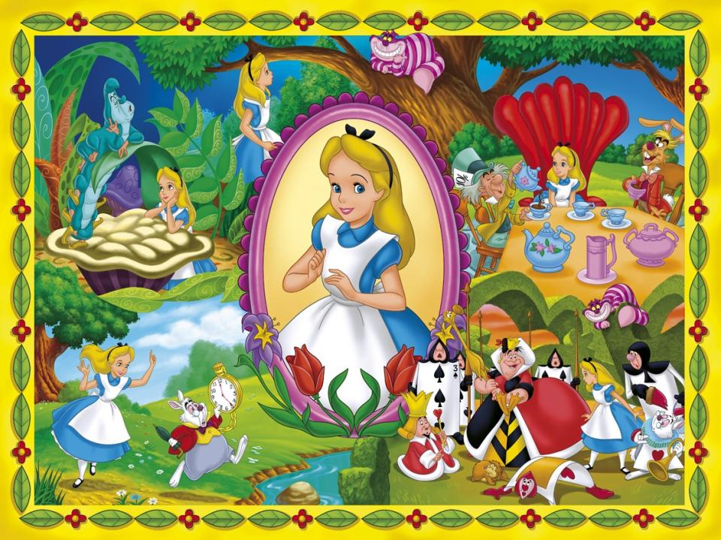

Slide 2
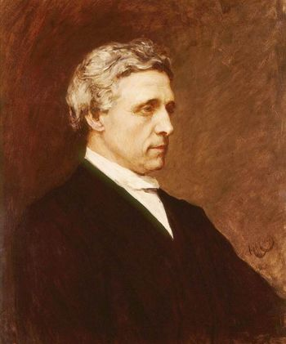
Lewis Carroll (the pen-name of Charles L. Dodgson) was born in the village of Daresbury, England, on January 27, 1832.

Slide 3
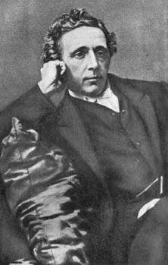
The eldest boy in a family of 11 children, Carroll was very good at mathematics and won many academic prizes. He was a photographer and wrote essays,
political pamphlets and poetry.

Slide 4
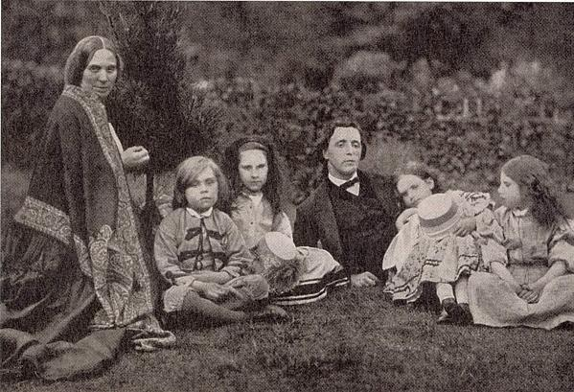
Charles Dodgson had no family, but he loved children very much. He often visited his friend’s family where there were three little girls.

Slide 5
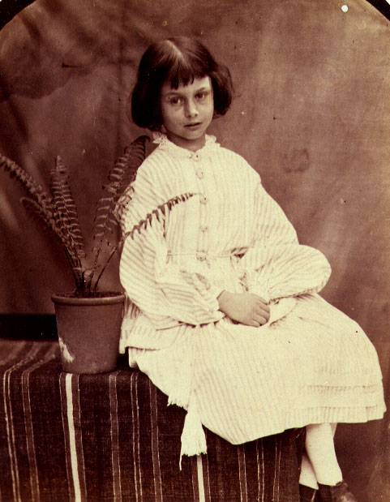
One of them Alice was four years old. Dodgson told her about the adventures of a little girl. Alice liked the stories very much.

Slide 6
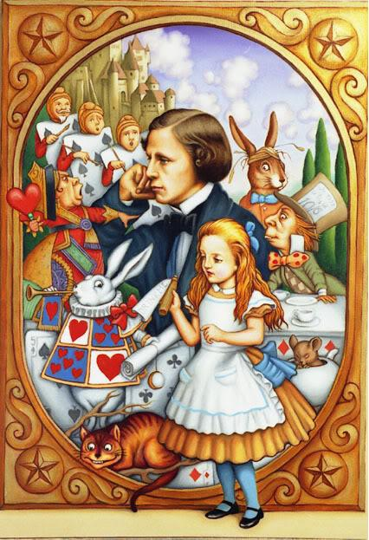
When Alice was about ten years old, she asked Charles to write down the stories.

Slide 7
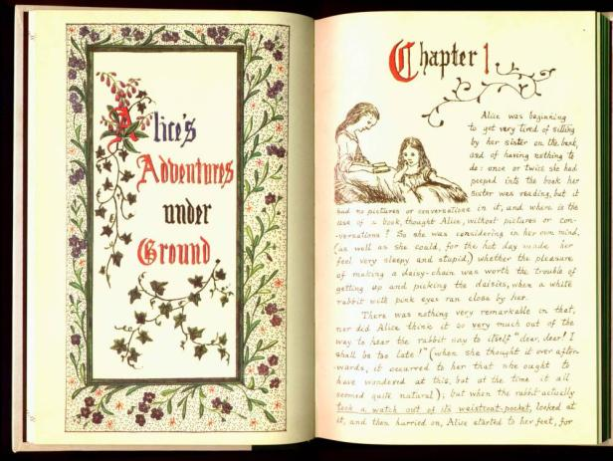
Нe made a handwritten book
for her and even draw pictures in it.

Slide 8
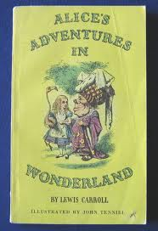
Charles decided to publish the book . The book came out in 1865 and all the people who read it liked it very much.

Slide 9
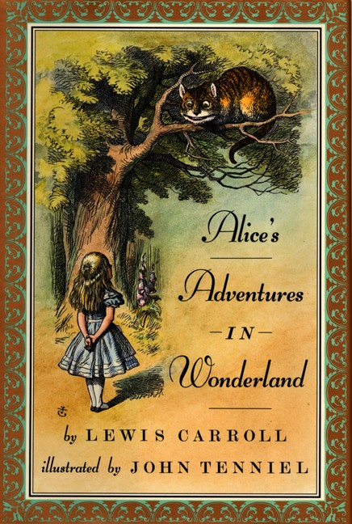
By the time of his death, Alice had become the most popular children's book in England, and now it is one of the most popular in the world.

Slide 11
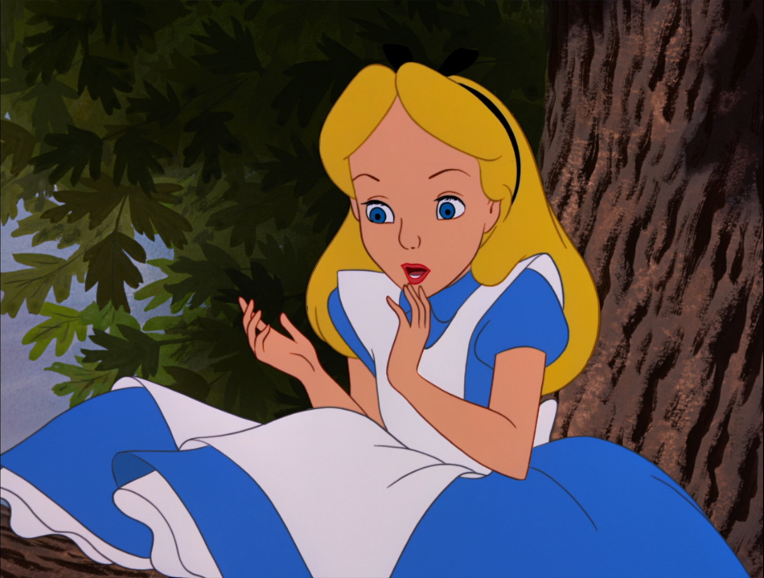
ALICE
EILAC

Slide 12
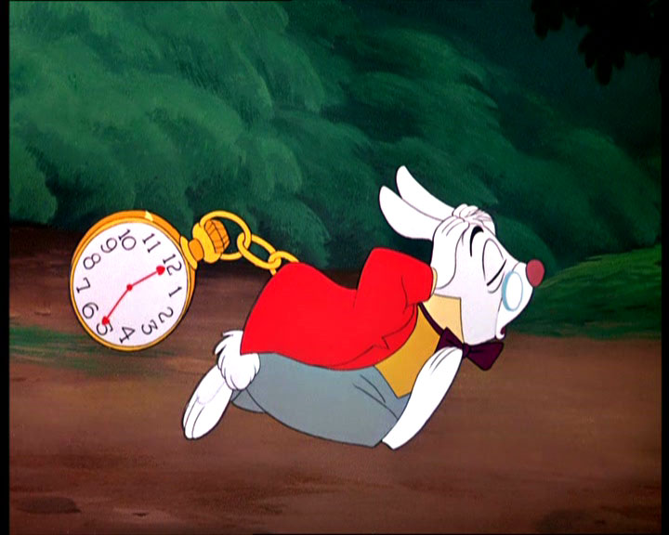
THE RABBIT
THE BATIBR

Slide 13
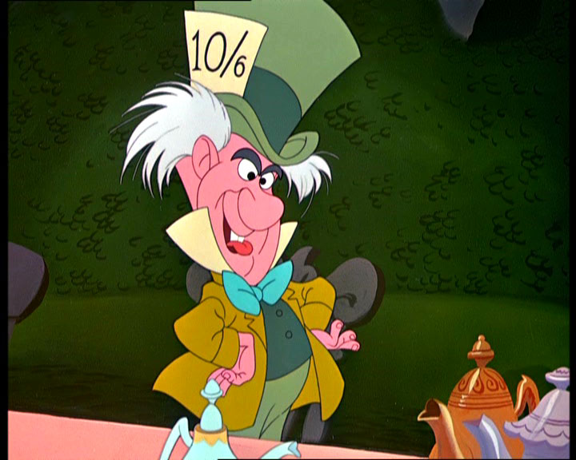
The THRATE
THE HATTER

Slide 14
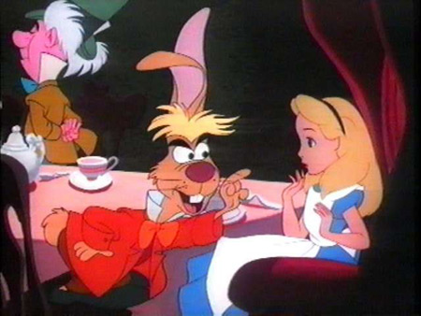
THE
MARCH HARE
THE
ARMHC
REHA

Slide 15
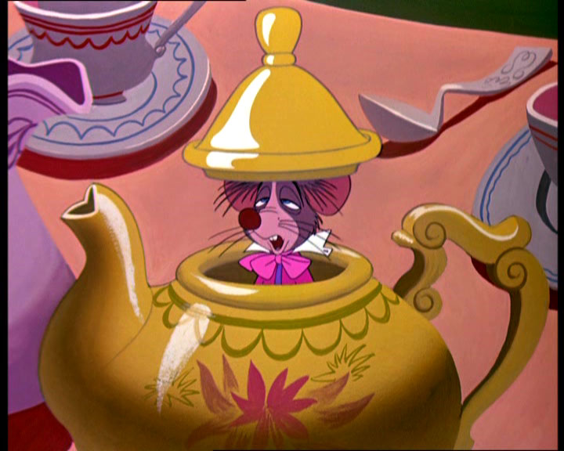
THE
OUSDEROM
THE DORMOUSE

Slide 16
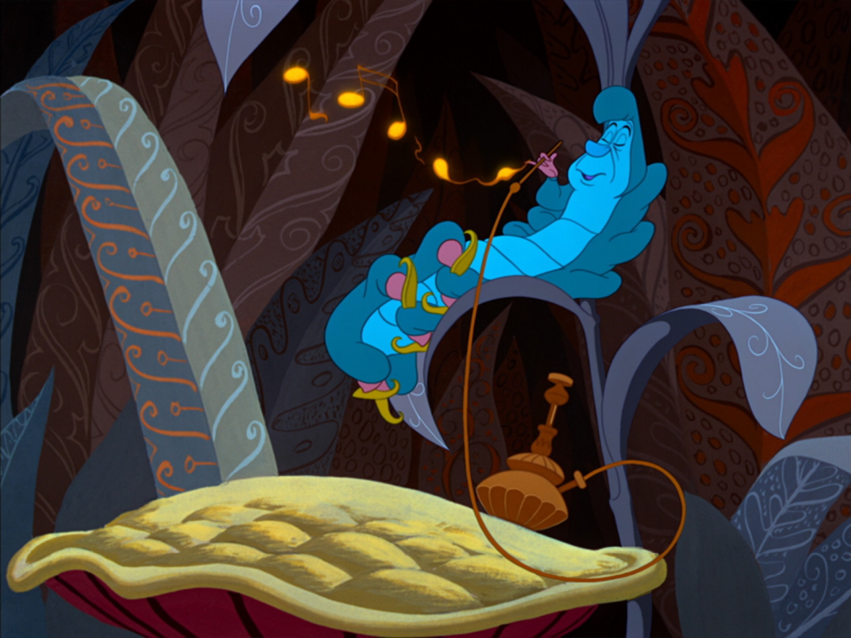
THE
RLPCEAITRLA
THE CATERPILLAR

Slide 17
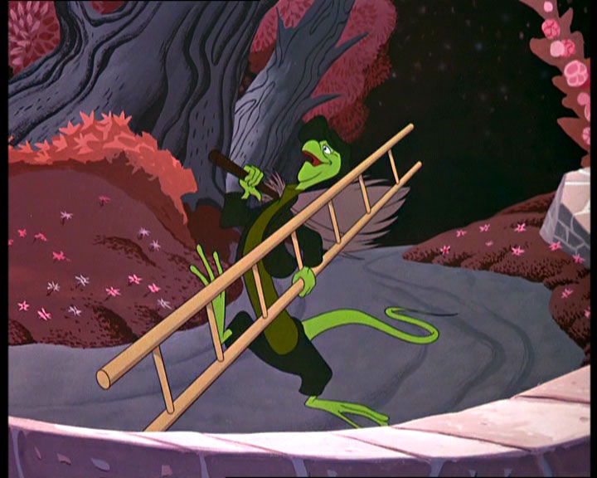
THE
RALZID
THE LIZARD

Slide 19
1. Alice saw the rabbit and ran after him.
2. Alice found a little bottle
on the table and drank it all.
3. She was in a very large room With many doors in it.
4. Alice was sitting on the grass by her sister who was reading a book.
5. She fell down the hole.
6. She was growing smaller and smaller.

Slide 20
4. Alice was sitting on the grass by her sister who was reading a book.
1. Alice saw the rabbit and ran after him.
5. She fell down the hole.
3. She was in a very large room With many doors in it.
2. Alice found a little bottle
on the table and drank it all.
6. She was growing smaller and smaller.

Slide 22
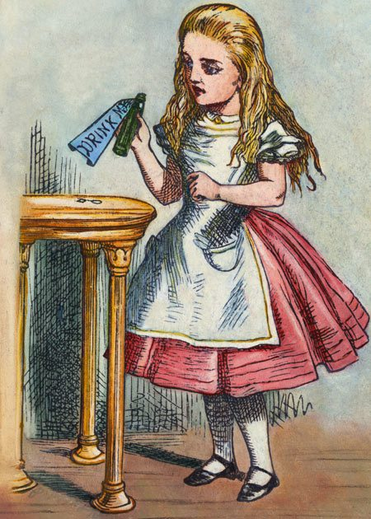
1. Alice noticed a table which had …..
3 legs
b) 4 legs
c) 5 legs
3 legs

Slide 23
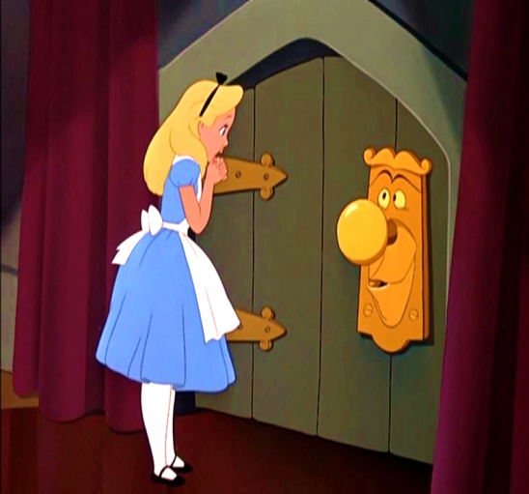
2.When she opened one of the doors, she saw ……
a lake
b) a garden
c) a castle
b) a garden

Slide 24
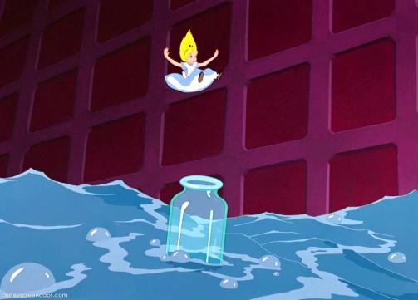
3. Alice saw something swimming in front of her. It was…
a) a crocodile
b) a mouse c) a cat
b) a mouse

Slide 25
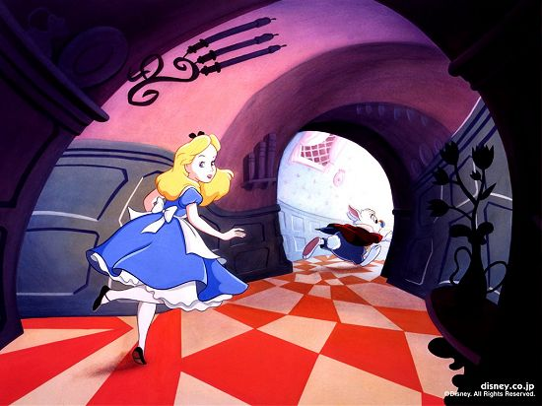
4.When Alice came to the White Rabbit’s house, she saw…..
a little bottle
b) a little cake
c) Marry Ann
a little bottle

Slide 26
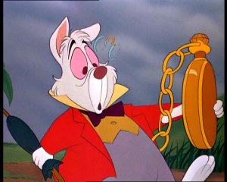
A watch, out of, The Rabbit, its, took, pocket, and, at, looked, it
The Rabbit took a watch out of its pocket and looked at it.

Slide 27
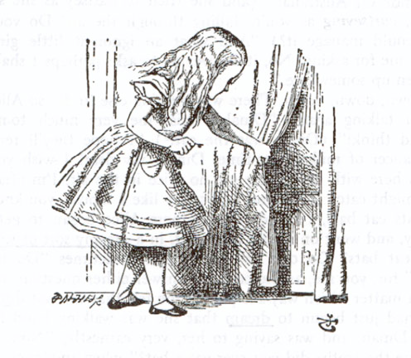
A table, and, a little, noticed, key, gold, she.
She noticed a table and
a little gold key.

Slide 28
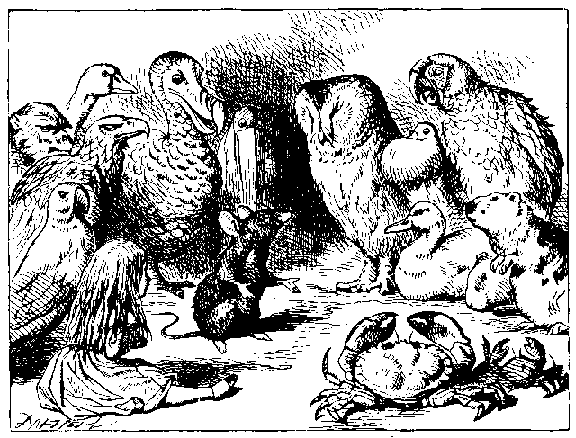
Didn’t, cats, the Mouse, dogs, like, and.
The Mouse didn’t like cats and
dogs.

Slide 29
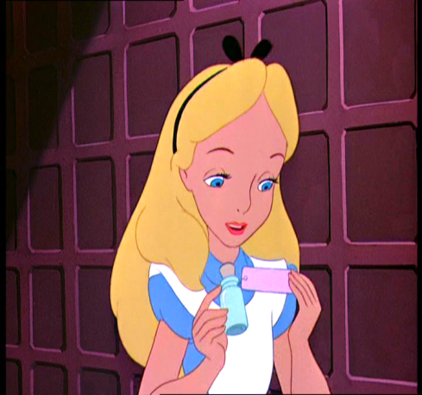
Alice, suddenly, that, near, saw, the mirror, a bottle, stood.
Alice stood near the mirror and suddenly saw a bottle.

Slide 30
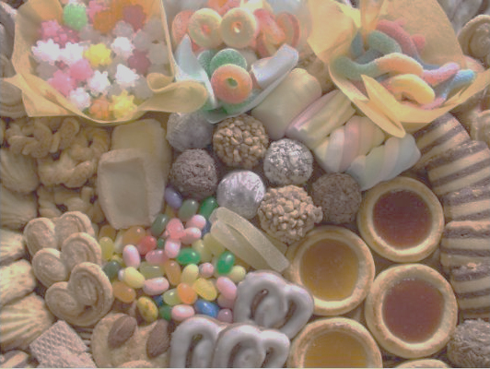
N
U
D
D
P
I
G

Slide 31
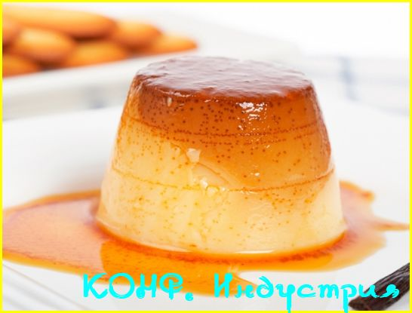
PUDDING

