Slide 1

Урок английского языка в 7 классе
подготовила и провела учитель Сатенова Ж.А. г. Байконур 2013г.

Slide 2
Today on the lesson we shall:
watch your presentations;
learn new words and expressions;
consolidate the building of exclamatory sentences;
read the text and do the tasks;
complete the dialogues.

Slide 3
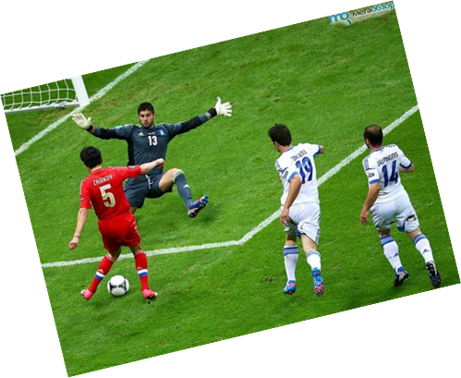
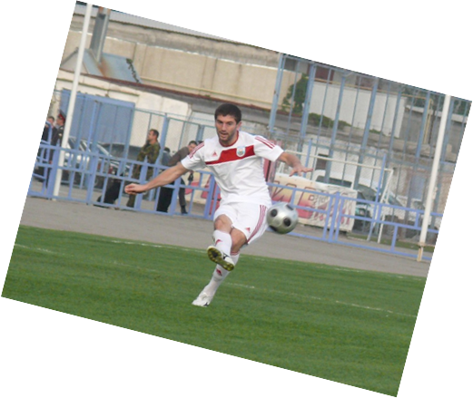
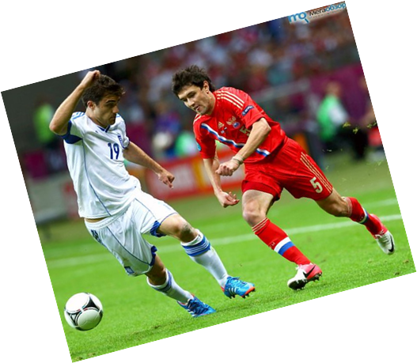
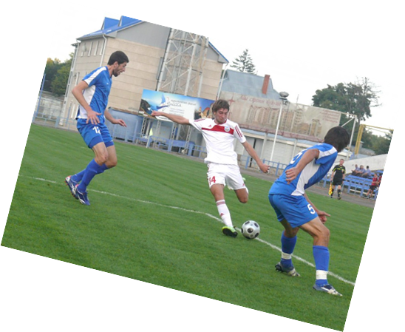
Do you need a challenge?
We have one for you!
Our team is called the
best one in this
season.
We need a new player
for our football team.
You must be really fit
and fast and you will
learn quickly.
Come every day
from 6 p.m.
to 8 p.m.

Slide 4
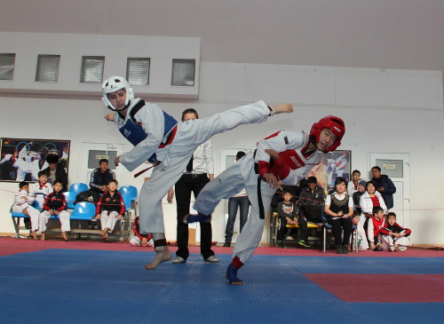
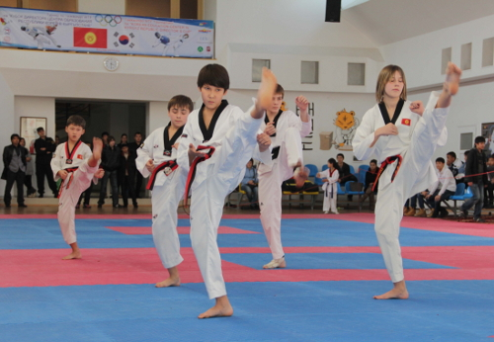
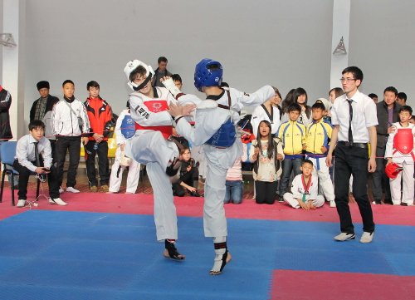
Do YOU WANT TO LIVE DANGEROUSLY?
If you are super
brave,
super strong
and super enduring
come and train with us!
Every Monday,
Wednesday
and Friday
6 p.m. to 8 p.m
Taekwondo
is a beautiful
and exciting sport,
but it is also
hard work!

Slide 5
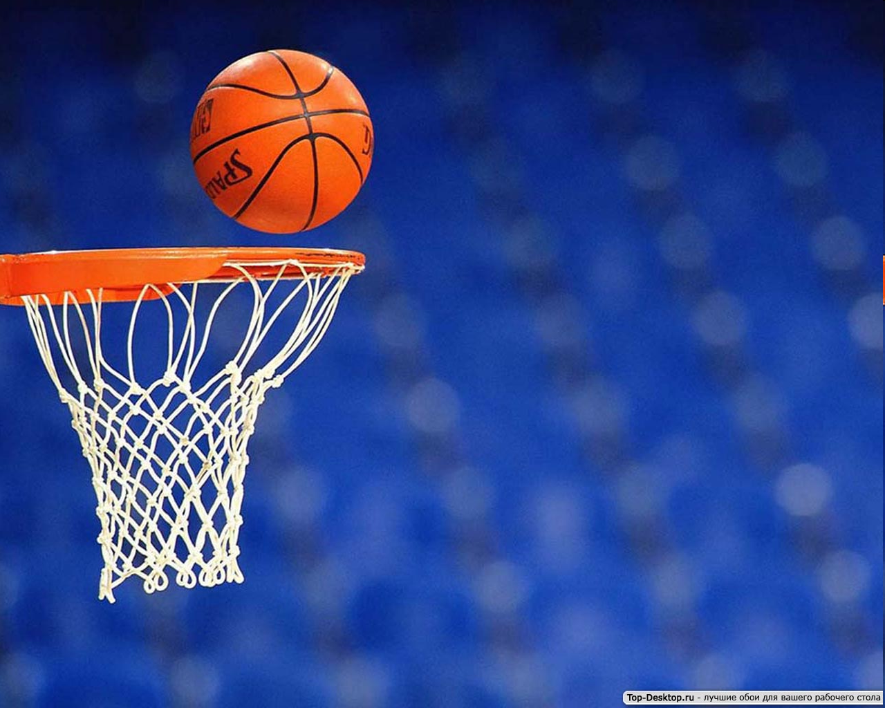
For boys and girls of any age.
Everybody is welcome.
If you join us, you will find
the best friends you
have ever had.
You’ll become stronger,
faster and taller.
If you have a great
desire and shooting talent
our school basketball club
is a good place to start
Every day 4 p.m. to 7 p.m.

Slide 6
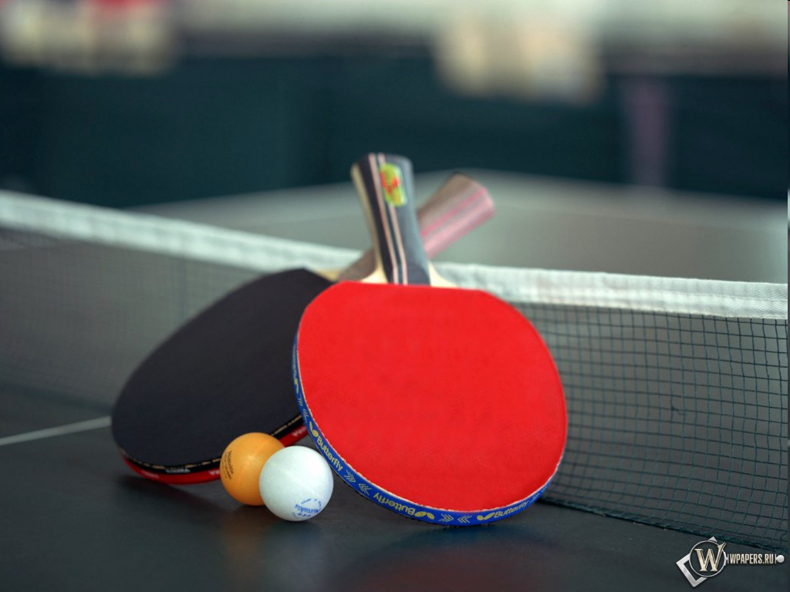
Table Tennis
is for you if you want
to make your life smarter,
better, faster and wiser!
Do you know that table tennis became a medal Olympic sport in the 1988 Summer Olympics
in Seoul?
Do you know how many balls two players can hit back and forth in 60 seconds?
Do you know that China, Sweden and South Korea are currently the world powers in table tennis.
We wait for you in our school Tennis Club
from Tuesday to Friday at 5 p.m.

Slide 7


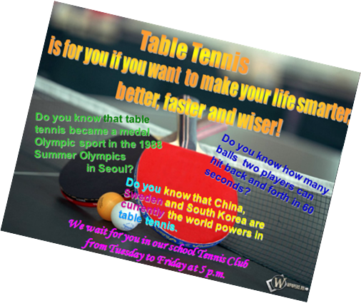

I like the idea of Ving
He/she gave a good description of …
He/she offered a clear explanation (объяснение) of …
Now I want to join … club.

Slide 8
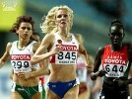

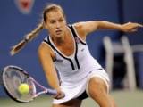
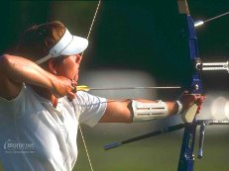
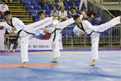


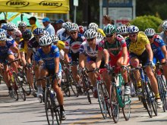
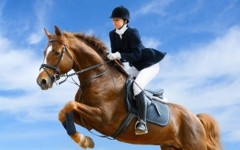
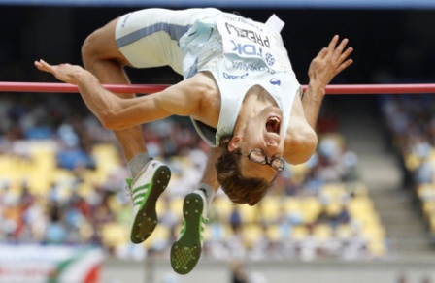
ATHLETICS
MOUNTAIN BIKING
TENNIS
ARCHERY
TAEK WON DO
TOBOGGAN
HOCKEY
CYCLING
EQUESTRIAN
HIGH JUMP

Slide 9
The theme of our
lesson is
“At the match”

Slide 10

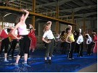
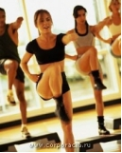
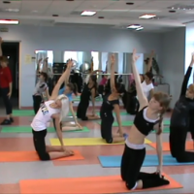
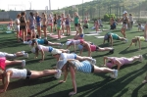
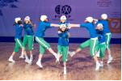
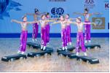
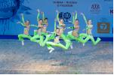
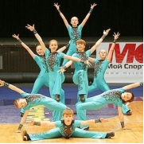
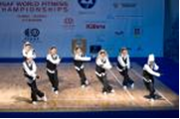
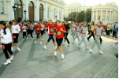


Let’s sing and do the exercises

Slide 11
Paragraph 1
Complete the sentences using the endings given below.
1. The Bears are playing brilliantly because
2. The Tigers are really nervous because
3. Mr. Smart doesn’t believe that the score is still nil-nil because
4. The goalkeeper of the Tigers is very good because
5. The Tigers have no chance today because
there is only
a little time till the end of the match.
he has saved his goal ten times.
their team is much weaker
than their opponents.
their excellent leader has left the team.
The odd ending is
he is a great defender.
they are the best football players at school.

Slide 12
Paragraph
Choose the right translation
1. O’Neill in possession.
2. He has a clear field.
A. О. Нейл занимает позицию.
A. Перед ним открытое пространство.
۷
B. О. Нейл владеет мячом.
۷
B. Он очищает себе путь.
C. О. Нейл на позиции.
С. У него чистое поле.
3. Stabber dives after it.
4. O’ Neil misses.
А. О. Неил промахивается
А. Стаббер ныряет за мячом.
۷
В. Стаббер занимается подводным плаванием.
B. О. Неил пропускает мяч.
С. Стаббер бросается к мячу.
۷
C. О. Неил теряет мяч.

Slide 13
Paragraph 3
The attack ______ __________ (not finish) yet.
The attack has not finished yet.
2. Harrison _____ already ________ (hit) the ball.
Harrison has already hit the ball.
3. Stabber _____ just _________ (save) his goal.
Stabber has just saved his goal.

Slide 14
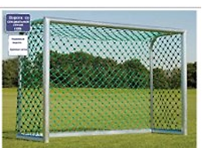
Paragraph 4
hits
pass
possession
blocks
towards
dodges

Slide 15






Check your ideas
But the bears don’t give up easily. Another attack.
Inin it. Now there will be a . What’s happening?
Inin wants to attack. What a stupid idea! Let’s
watch him. Inin is still in Inin is
running the Bears’ goal.
The defenders are ready. Fantastic! Inin
Morrison. I don’t believe it. He dodges Flint and
Carrington! What an excellent move! The boy is a
Natural. Inin the ball AND HE SCORES!!!
What a game! The Tigers have won for the first
time in twenty years.

Slide 16


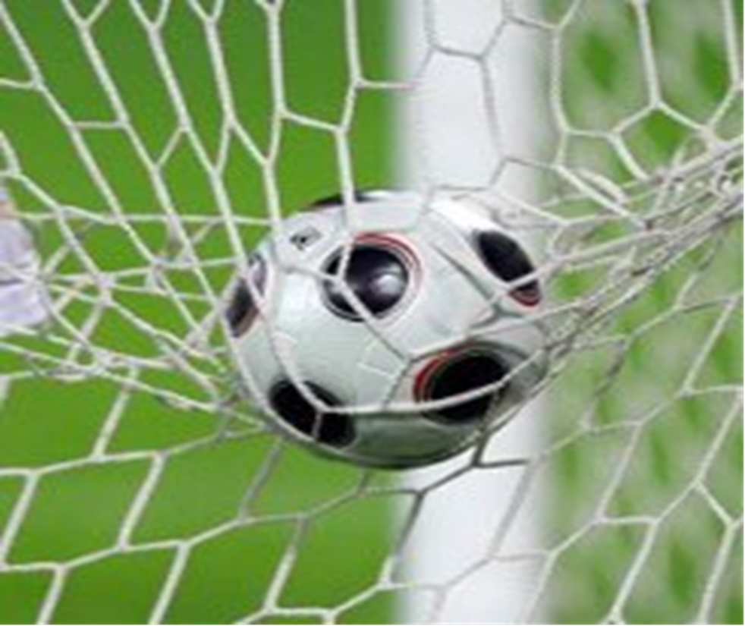

Slide 17
Dialogue 1
– You see in his commentary Mr.Smart said that the
Tigers were nervous/nervously. Do you agree with him?
Yes, I agree with him. I think that the Tigers played nervous/nervously because their great forward
Ben Black left their team.
More than that the Bears played brilliant/brilliantly.
I’m of the same opinion. And the game was exciting/excitingly.

Slide 18
Dialogue 2
I want to say that the match was really difficult/difficultly both for the Tigers and for the Bears.
But the Bears didn’t give up easy/easily.
You are right. And what a brilliant/brilliantly goalkeeper is Jim Stabber!
Yes, he is. He made ten fantastic/fantastically saves.

Slide 19
Dialogue 3
When Misha ran quick/quickly towards the Bears goal I didn’t believe that it was a good idea.
Neither did I. To my mind everybody was shocked when he dodged three defenders. And he did it excellent/excellently.
I absolutely agree with you. I was great/greatly surprised when he scored.

Slide 20
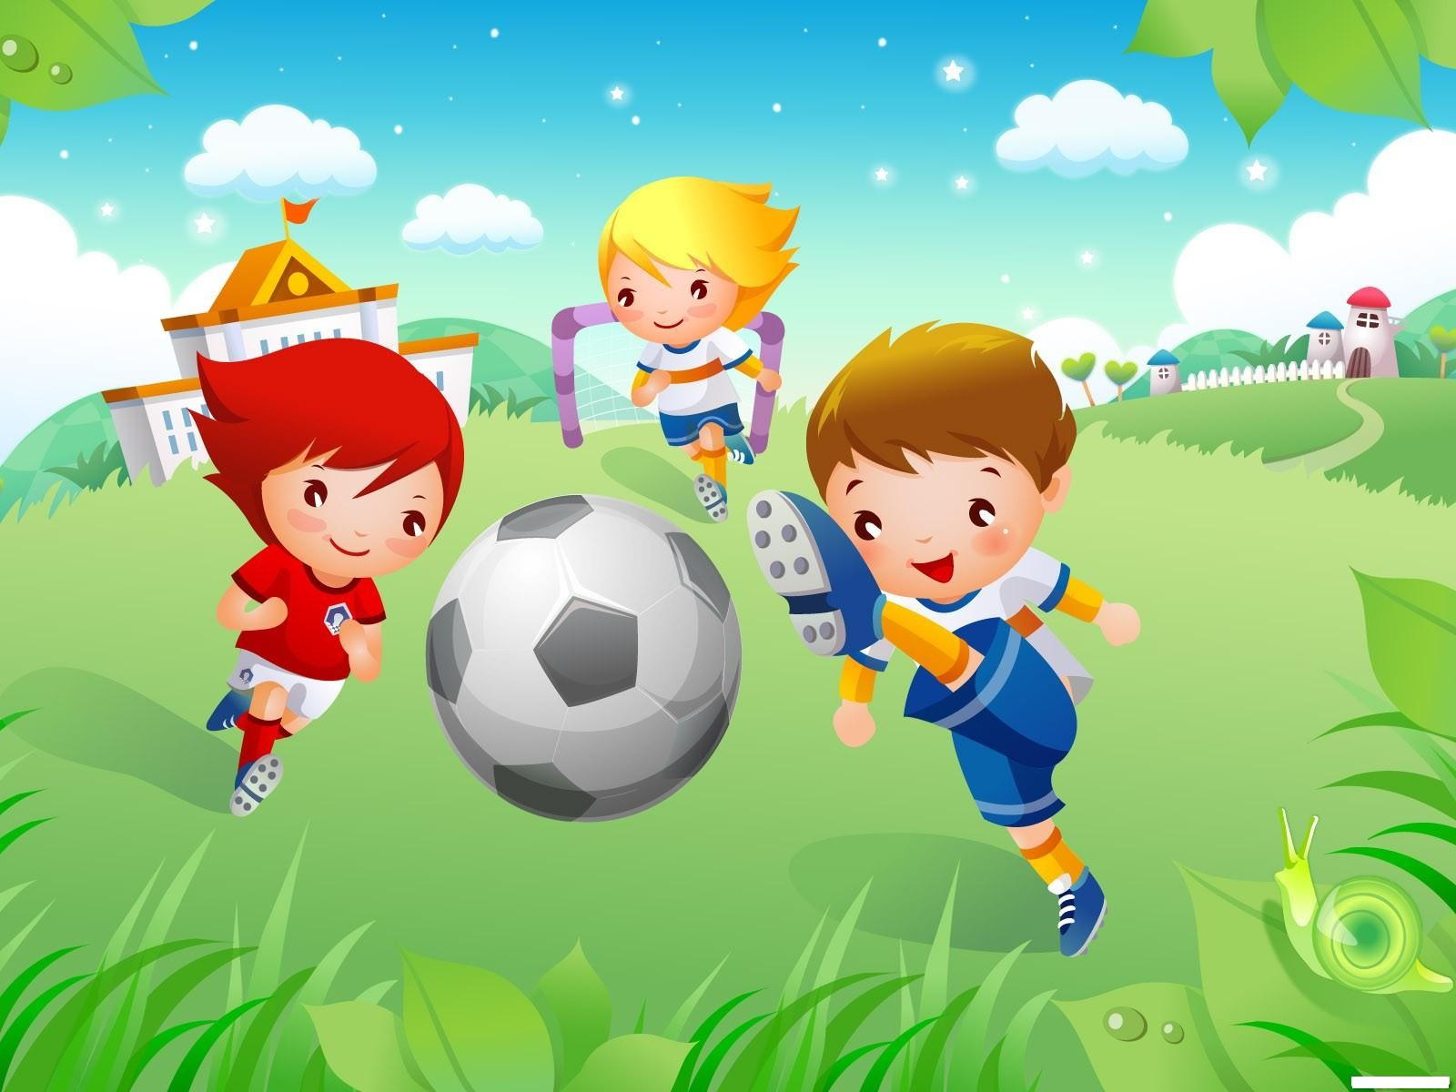
Homework
Ex.7 p. 181 Imagine that you are journalists take an interview with the questions given in the exercise.
Ex. 1 p 179 Write down the new words in your vocabularies and learn them by heart.

