Slide 1
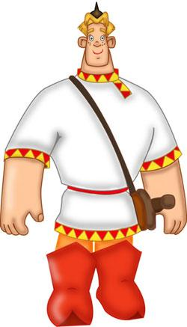
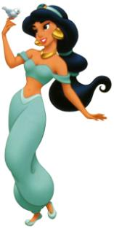
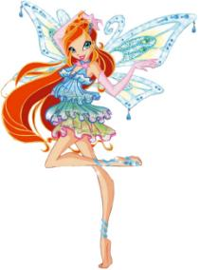
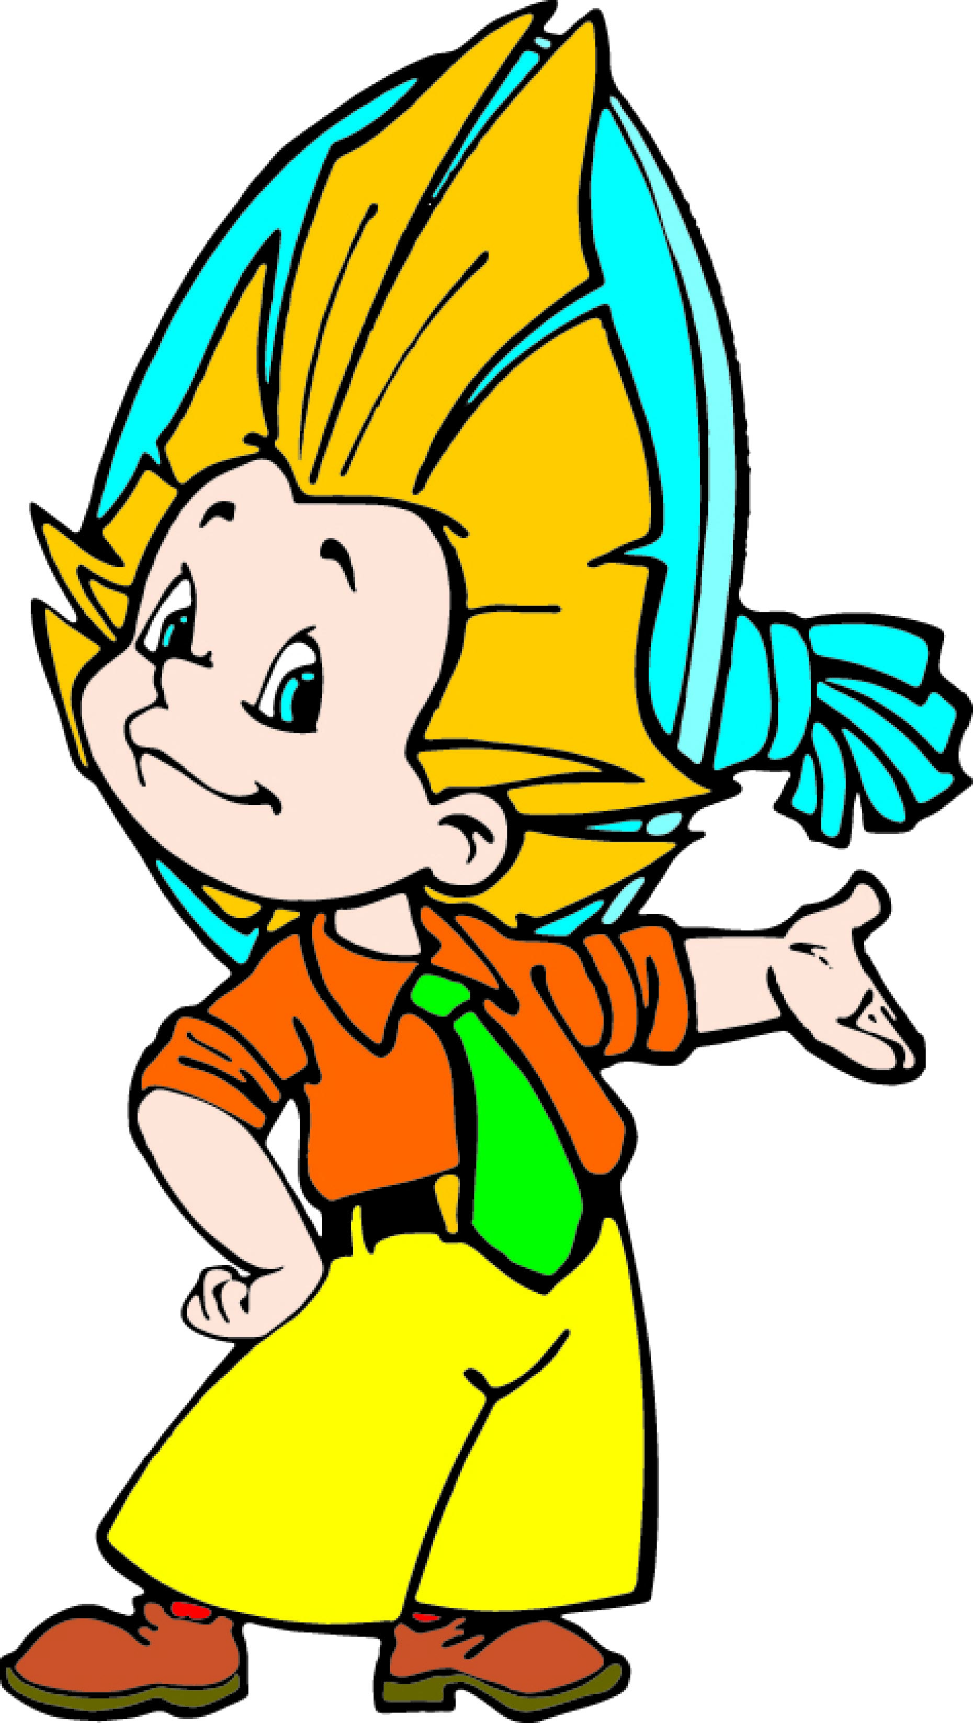
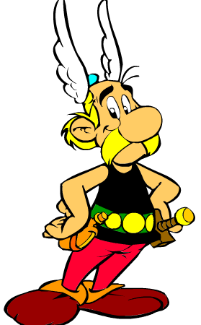
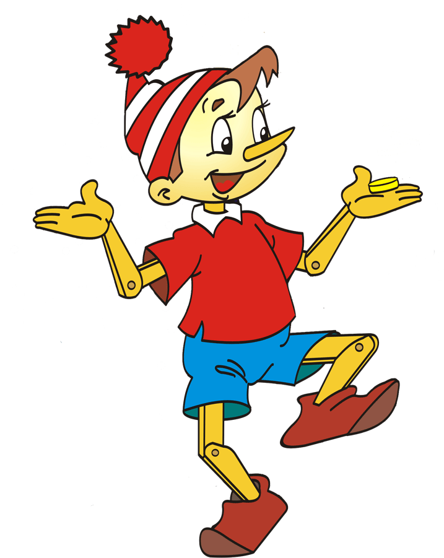

Slide 2




Phonetic practice
like, kind, time
funny, uncle, plump
is, he, children, slim
ball, tall, small

Slide 3
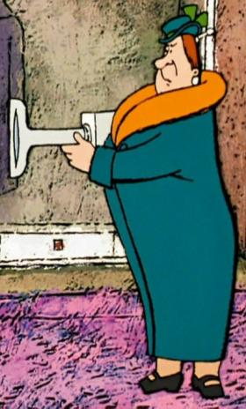
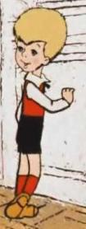
tall
short
She’s tall.
He’s short.

Slide 4
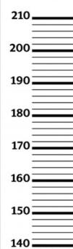
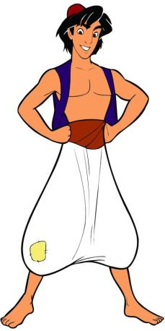
He’s
.
He’s
.

Slide 5
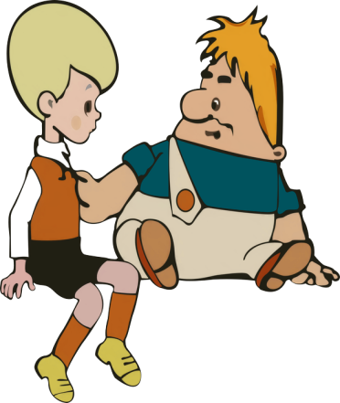
He’s plump.
He’s slim.
slim
plump

Slide 6
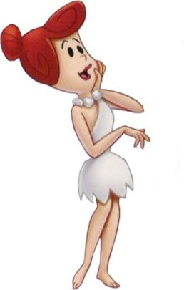
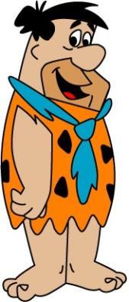
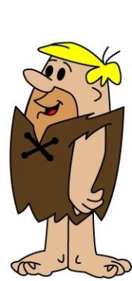
What does Wilma look
like?
What does Barney look like?
What does Fred look like?
Fred is tall and plump.
Wilma is
tall
Barney is
short
and
slim
.
and
plump
.

Slide 7
dark hair
fair hair
He’s got dark hair.
He’s got fair hair.

Slide 8
Match the opposites
tall
slim
short
dark
long
short
fair
plump

Slide 9
Check your answers
tall
slim
short
dark
long
short
fair
plump

Slide 10
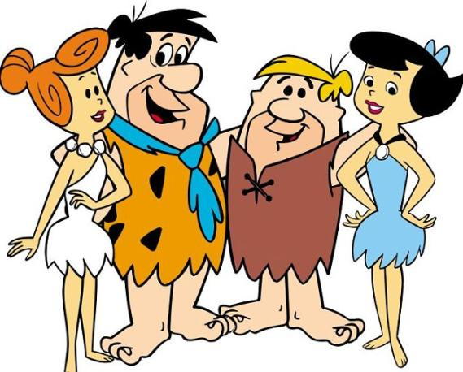
This person is tall and slim and she’s got fair hair. Who is this?
Wilma !

Slide 11
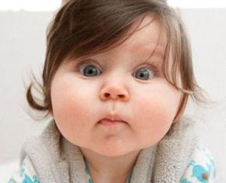
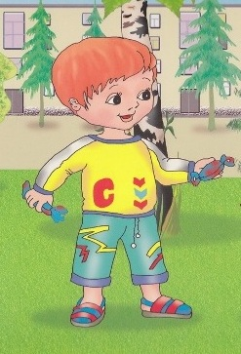
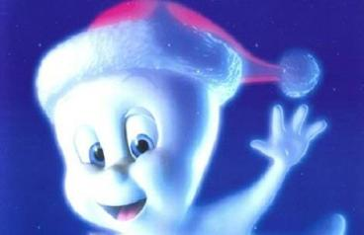
What are they like?
friendly
funny
kind

Slide 12
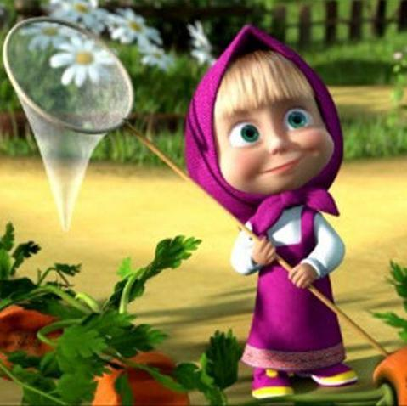
What does Masha look like? She’s short and slim and she’s got fair hair.
What’s Masha like?
She’s funny.
Now look at your friend. What does he/she look like? What’s he/she like?

Slide 13
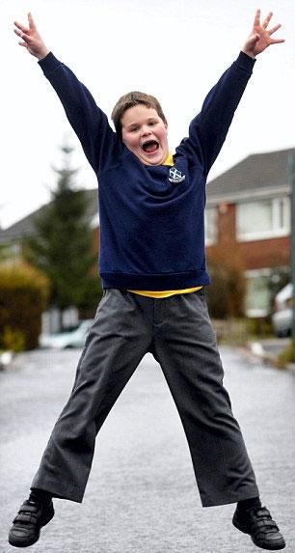
This is my friend Robby. He is tall and quite plum. He’s got dark hair. Robby is kind and friendly.

Slide 14
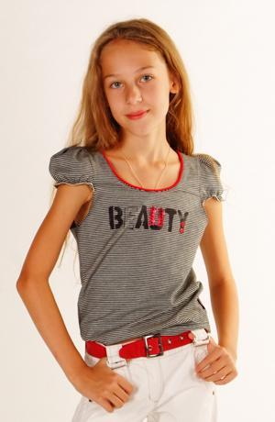
This is my friend Wendy. She is .
and
.
She’s got long
hair.
Wendy is very
and
.

Slide 15
Good-bye!

