Slide 1
Тема «Пассивный залог»
Форма проведения урока: викторина

Slide 2
Цели урока:
1. Совершенствование грамматических навыков по теме «Пассивный залог».
2. Развитие внимания и мышления.
3. Поддержание интереса к изучению английского языка.

Slide 3
am, is, are + V3
was, were + V3
shall be, will be + V3

Slide 4
Do think give
have say see
be build write
eat swim learn
send buy hear
take speak make

Slide 5


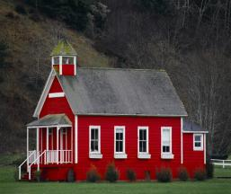

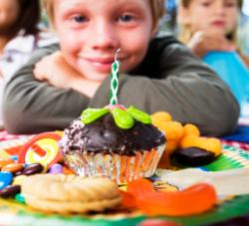

last year
yesterday
tomorrow
last week
next Friday
every day

Slide 6
- This house was built in 1991. (What ?)
- The TV set was bought in the shop. (Where ?)
- Football is played all over the world because it is a very popular game.
(Why ?)
- English is spoken in Great Britain. (What language ?)
- Cheese is made from milk. (What ?)
- The letter will be answered next week. (When ?)
- The pupils will be met in the garden. (Where ?)

Slide 7
1 Discovered, in, America, 1942, was.
2 In the morning, the newspaper, not, brought, is.
3 Monday, written, next, the letter, will be.
4 Every, two, given, are, apples, day.
5 Yesterday, photo, taken, that, was.
6 Not, tomorrow, be, will, the news, old.

Slide 8
1 Ann cleans her room every week.
2 People build new houses in big cities.
3 We bought oranges and peas in the shop.
4 They sold stamps in the post office.
5 Children will play hide-and-seek in the park.
6 Pupils didn’t visit the boy last week.
7 We don’t translate poem at home.

Slide 9
Thank you for the game!
Good bye!

