Slide 1
English for children
Презентация к уроку во 2 классе
Учитель английского языка
Михальчик Галина Петровна
Гимназия 441 г.Санкт-Петербурга

Slide 2
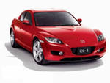
Game 1
Is it a car ?
1) Yes
2) No

Slide 3

->
Well done!

Slide 4

->
Sorry!

Slide 5
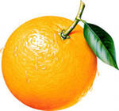
Game 2
Is it an apple?
1)Yes
2)No

Slide 6
->
Well done!

Slide 7
->
Sorry!

Slide 8
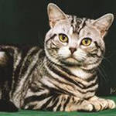
What is it?
Game 3
1)Cat 2)Dog 3)Mouse

Slide 9
->
Well done!

Slide 10
->
Sorry!

Slide 11
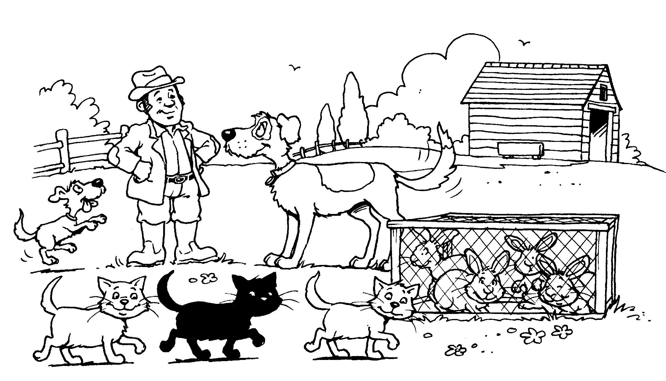
Game 4
I have a big dog and little dog. The little dog is yellow. The big dog is grey white. I have one black cat and two grey cats. I have three brown rabbits and one white rabbit.
->

Slide 12
Game 5
1) The little dog is yellow. 1) Yes 2) No

Slide 13
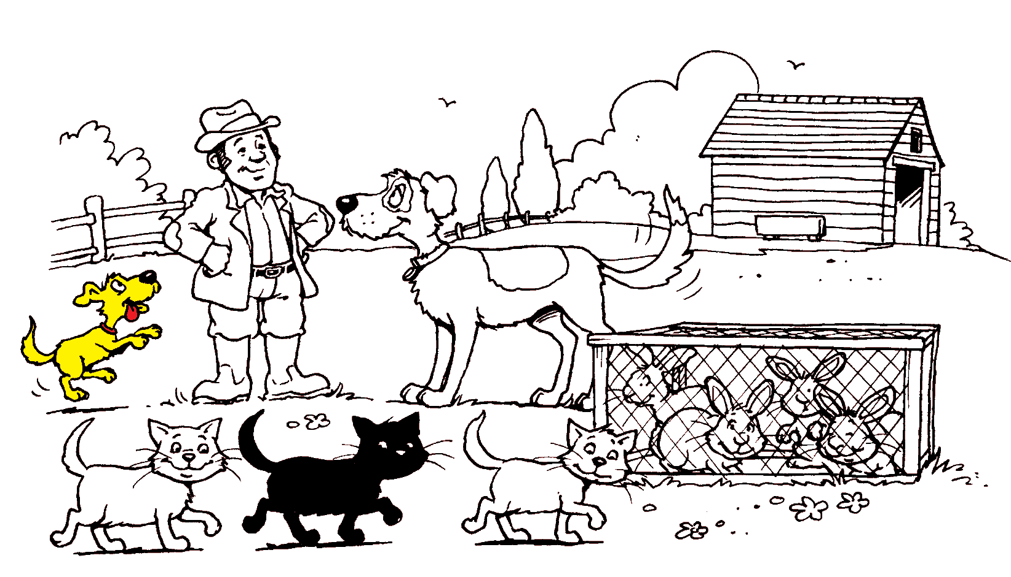
->
Game 5
YES ->

Slide 14
->
Game 5
NO ->

Slide 15
Game 5
2) The big dog is black. 1)Yes 2)No

Slide 16
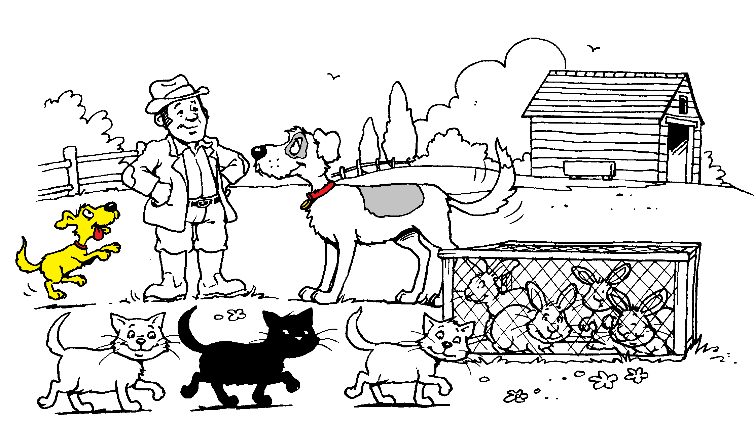
->
Game 5
YES ->

Slide 17
->
Game 5
NO ->

Slide 18
Game 5
3) One cat is black. 1) Yes 2)No

Slide 19
->
Game 5
YES ->

Slide 20
->
Game 5
NO ->

Slide 21
Thanks for the game

Slide 22
Информационные ресурсы:
1. Учебник для 2 класса Way Ahead
2. http://images.yandex.ru
3. http://www.ymk.ru
4. http://www.art.con.ru

