Slide 1

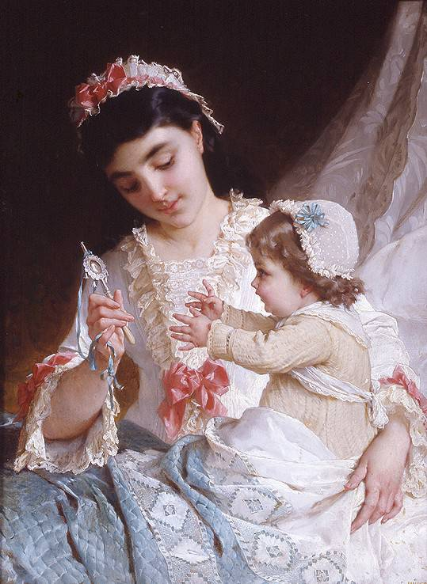

Mother's Day

Slide 2
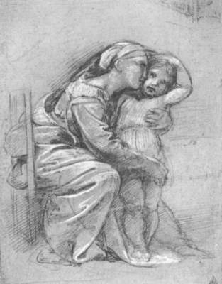
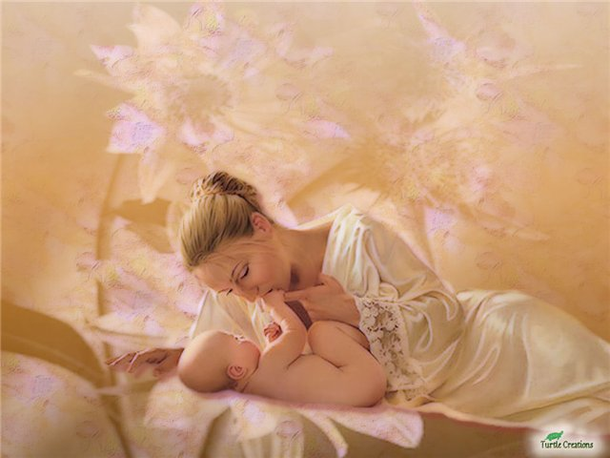

Slide 3
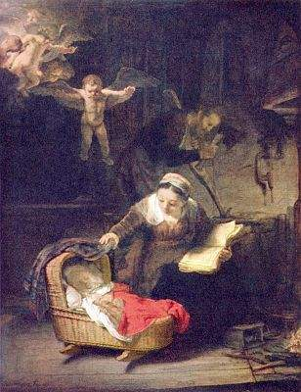

Slide 4
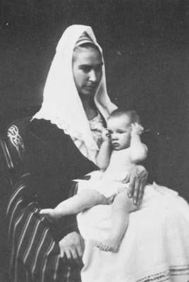
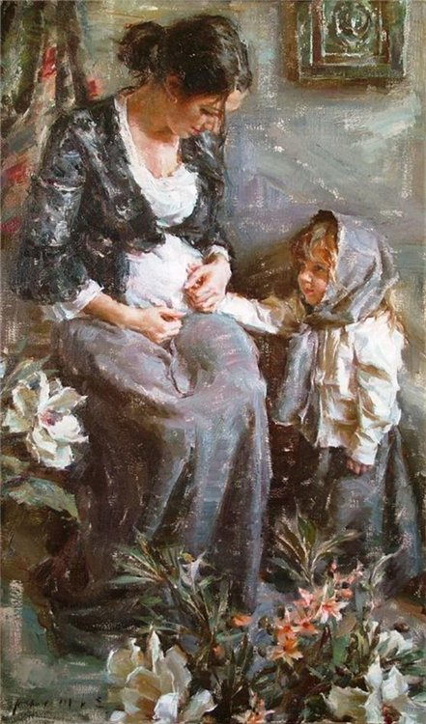

Slide 5
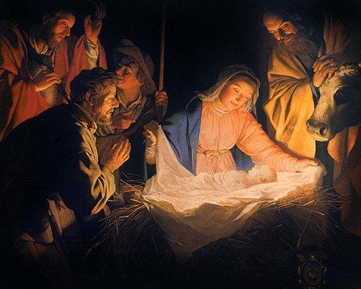

Slide 6
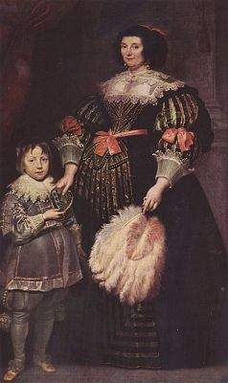
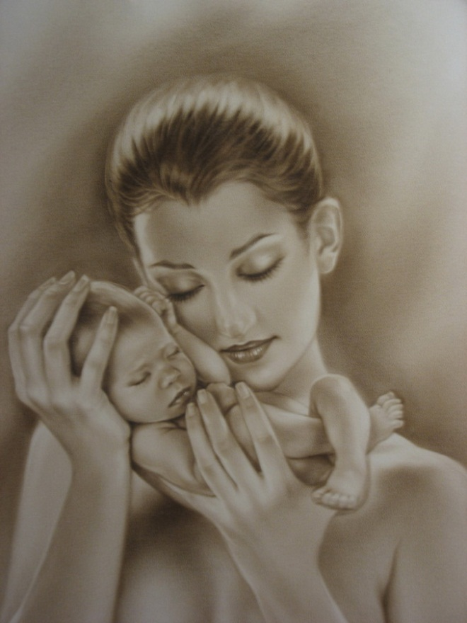

Slide 7
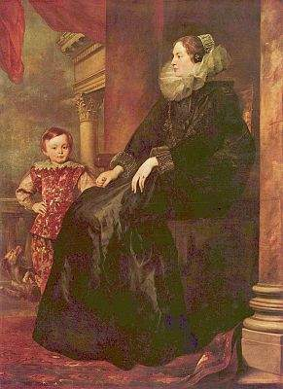
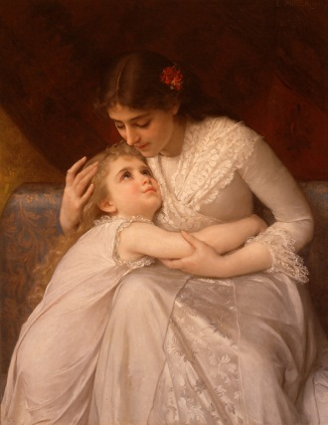

Slide 8
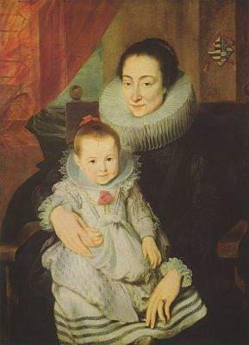
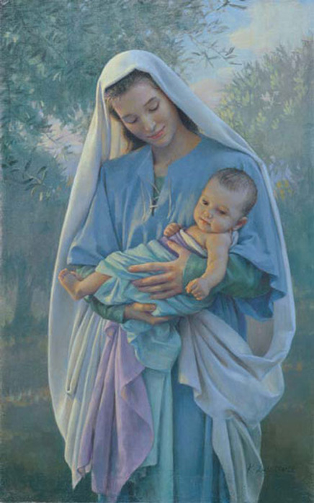

Slide 9
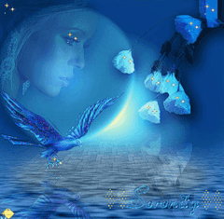
Тихая моя, нежная моя, добрая моя мама!

Slide 10
Bb Cc Dd Ee Gg Hh Ii Jj Kk Ll Mm Nn Oo Pp Qq Rr Tt Uu Vv Xx Yy Zz

Slide 11
Aa Bb Cc Dd Ee Ff Gg Hh Ii Jj Kk Ll Mm Nn Oo Pp Qq Rr Ss Tt Uu Vv Ww Xx Yy Zz

Slide 12
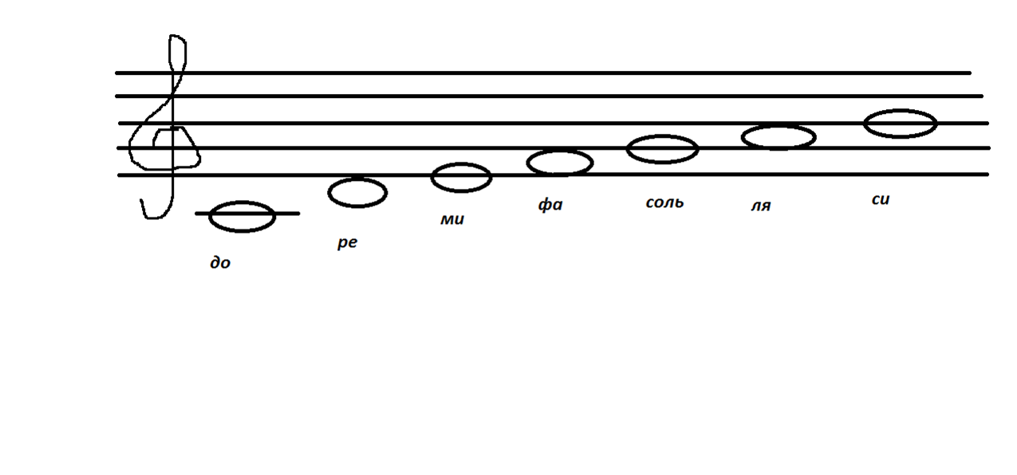

Slide 13
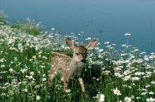
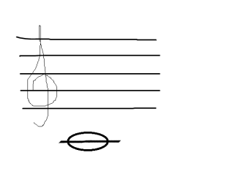
Doe, a deer, a female deer

Slide 14
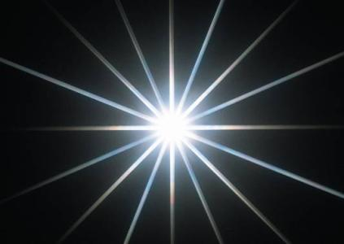
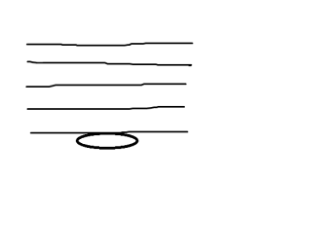
Ray, a drop of golden sun,

Slide 15

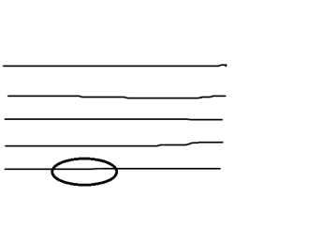
Me, a name, I call myself,

Slide 16

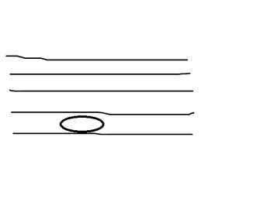
Far, a long, long way to run,

Slide 17

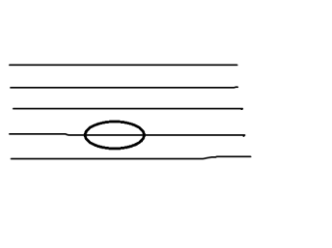
Sew, a needle, pulling thread

Slide 18
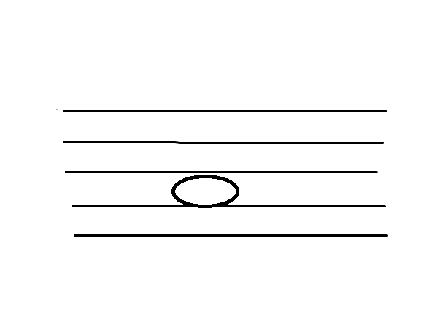
La, a note to follow sew,

Slide 19
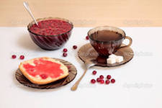
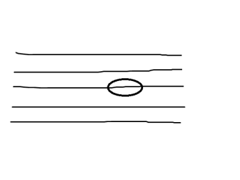
Tea, I drink with jam and bread,

Slide 20
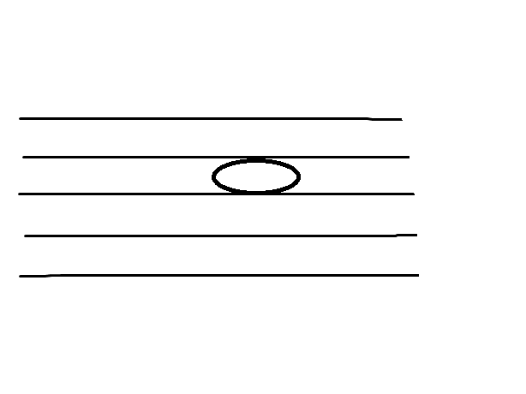
That will bring us back to doe, oh, oh, oh…

Slide 21


Slide 22
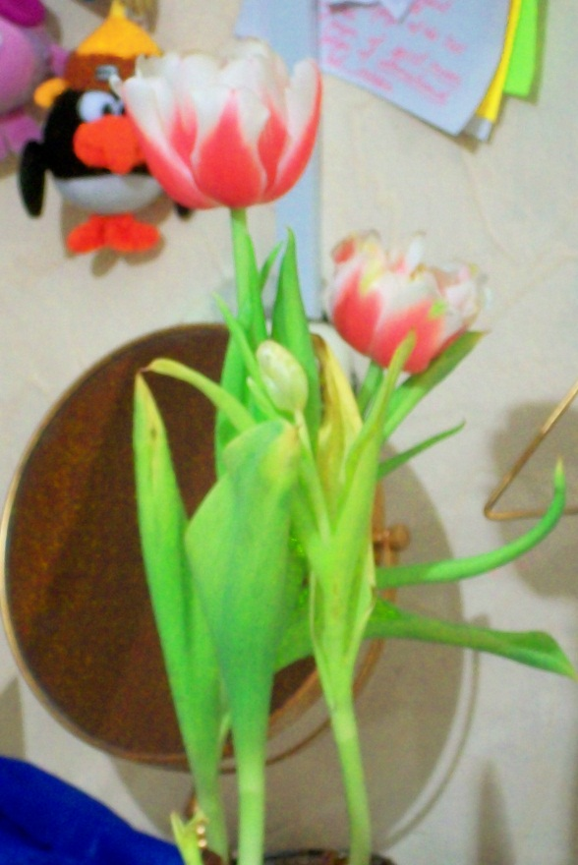
My family

Slide 23

My family

Slide 24
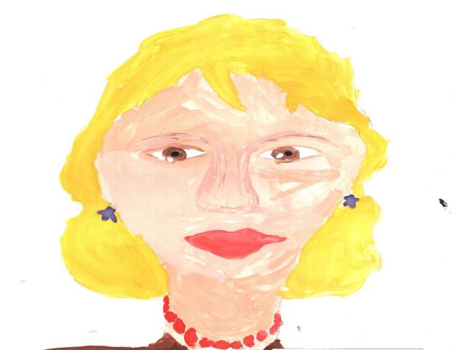
Mother, Mummy HER

Slide 25
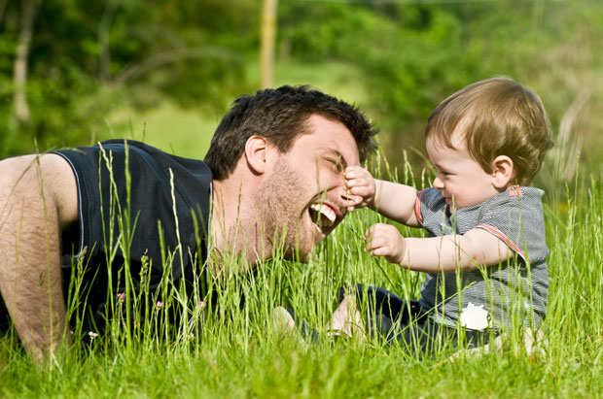
Father, Dad HIS

Slide 26

Sister HER

Slide 27
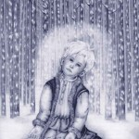
Brother HIS

Slide 28
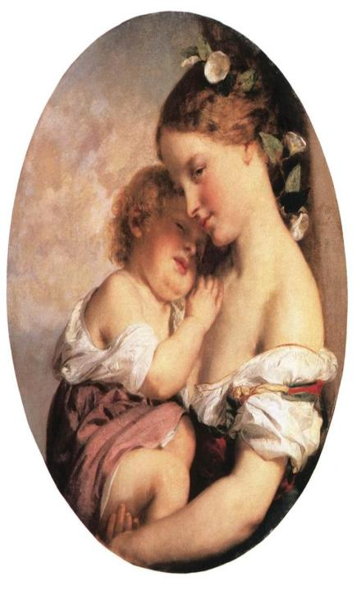
Mummy.
1.In tender morning my mummy wakes me, and I wake up with smiling.
Mummy, mummy, beauty and kindness and tender.
2.Mummy may sing me a beautiful song. And it is honey and sweetly.
Mummy, mummy, beauty and kindness and tender.
3.We sing a happy and thankful song for our grannies and mothers
Mummy, mummy, beauty and kindness and tender.

Slide 29
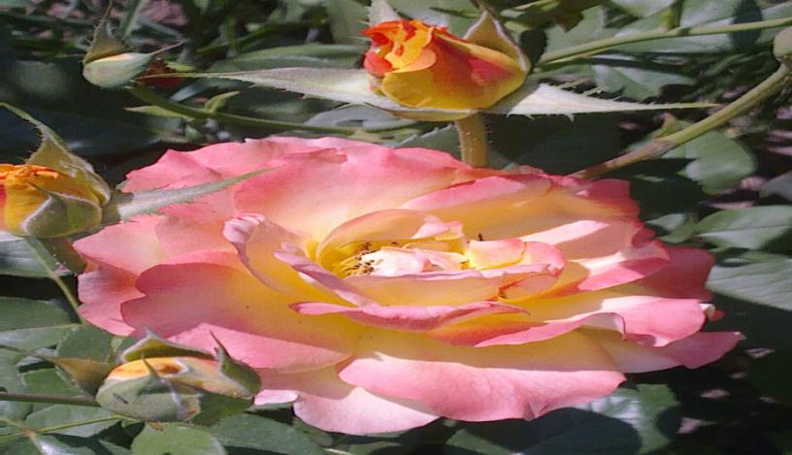
Thanks for your attention and participation

Slide 30
В презентации использовались ресурсы (иллюстрации):
Mr-msk.ru=mama
rebzi.ru
Mojmalysh.ru
mamzmam/.ru
paint.kards.qip.ru
Kalyamalya.ru
sunHome.ru
Family.kodotel.ru

