Slide 1
Let’s practice to pronounce English sounds
[eI] - glazier, courageous
[w] - qualified, persuasive
[a:] - architect
[ͻ:] - rewarding
[∆] - comfortable
[I] - experience
[ŋ] - tiring
[æ] - understanding
[ɜ:] - surgeon
[aI] - exciting, miner
[ͻ] - florist, responsible
[e] - dedicated

Slide 2
JOBS AND PROFESSIONS
Miner шахтер
Architect архитектор
Flight attendant бортпроводник
News reporter репортер
Florist продавец цветов Glazier стекольщик
Surgeon хирург
Hotel receptionist администратор
гостиницы

Slide 3
qualities
Dedicated - преданный
Creative - творческий
Courageous - мужественный
Helpful -готовый помочь
Careful - осторожный
Confident - уверенный
Patient - терпеливый
Persuasive - убедительный
Understanding - понимающий
Polite - вежливый
Responsible - ответственный
Stressful - стрессовая
Rewarding - благодарный

Slide 4
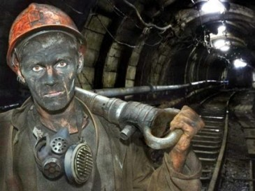
MINER
Works underground
Brave (храбрый), dedicated (преданный), courageous (мужественный)
PROS: well paid, respectable (пользующаяся уважением)
CONS: dirty, dangerous, life threatening, tiring (утомительная)
A: - Have you ever considered becoming a miner?
B: - Yes, I have. Miners are brave, dedicated and courageous.
A: - In fact, it is dangerous and tiring to work underground.
B: - That’s true, but this job is respectable and well paid.
Notes:
ve

Slide 5
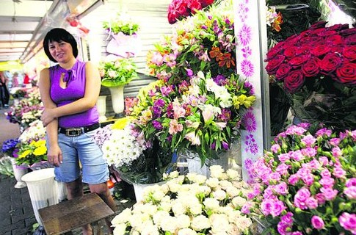
FLORIST
Sells flowers, make bouquets
Creative (творческий), helpful (готовый помочь), deals with people (работает с людьми)
PROS: easy, funny, creative, self-employed (сам себе работодатель)
CONS: tiring (утомительная), not so well paid (не очень хорошо оплачиваемая)
A: - Have you ever considered becoming a florist?
B: - Yes, I have. Making bouquets is a creative job.
A: - In fact, it is not so well paid.
B: - That s true. As for me, I like dealing with flowers and people.

Slide 6
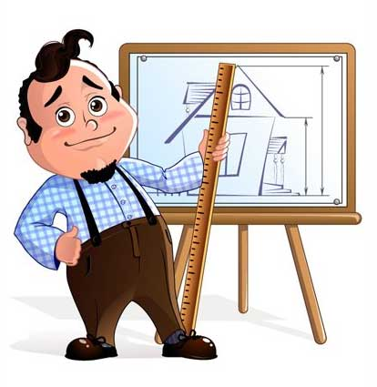
ARCHITECT
Well-educated, creative
PROS: interesting, well-paid, quiet
CONS: mistakes are unacceptable (ошибки недопустимы)
A: - Have you ever considered becoming an architect?
B: - Yes, I have. Designing buildings is an interesting job.
A: - In fact, it is quiet and well paid as well.
B: - As far as I know, it is also responsible because mistakes are unacceptable.

Slide 7

GLAZIER
Demanding and demanded (ответственная и востребованная), precise (точная)
PROS: highly qualified (высоко квалифицированная), well-paid
CONS: dangerous, not so creative (не слишком творческая)
A: - Have you ever considered becoming a glazier?
B: - No, I haven’t. This job is dangerous and not so creative.
A: - In fact, it is dangerous, but highly qualified, well-paid and demanded.
B: - That’s true, but I don’t like working indoors.

Slide 8

SURGEON
Respectable (пользующаяся уважением), demanding (ответственная), creative, brave
PROS: well paid, highly educated (высокообразованный), save speople, rewarding (благодарная), responsible for people’ s lives (ответственный)
CONS: not always pleasant, mistakes may cost lives (ошибки могут стоить жизней)
A: - Have you ever considered becoming a surgeon?
B: - Yes, I have. Surgeons are brave, dedicated and courageous.
A: - In fact, surgeons should be highly educated and creative but their job is not always pleasant.
B: - Helping people is a responsible job. Surgeon’s mistakes may cost lives.

Slide 9
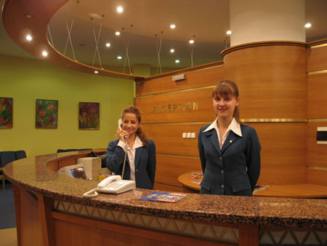
HOTEL RECEPTIONIST
Interesting, patient and polite
PROS: works indoors, meets interesting people, speaks foreign languages
CONS: tiring (утомительная), not well paid
A: - Have you ever considered becoming a hotel receptionist?
B: - Yes, I have. I like meeting new interesting people.
A: - In fact, hotel receptionists should be polite, patient and helpful. Their job is tiring and not well paid.
B: - But I like working indoors and speaking foreign languages.

Slide 10

FLIGHT ATTENDANT
Interesting, demanding, active
PROS: travels a lot, speaks foreign languages, helps people, brave
CONS: rare at home (редко бывать дома)
A: - Have you ever considered becoming a flight attendant?
B: - No, I haven’t. They travel all the time, and I like being at home.
A: - In fact, helping people is a good job. Besides, they speak foreign languages and meet new interesting people.
B: - I am afraid, I am not brave and patient enough to be a flight attendant.

Slide 11
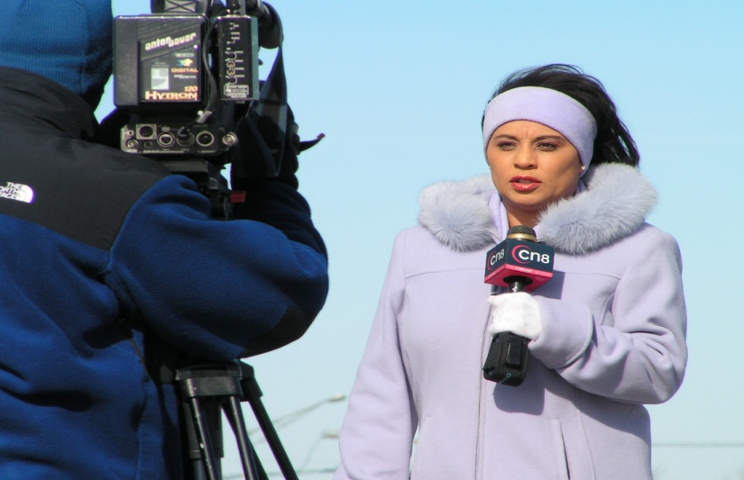
NEWS REPORTER
Brave, persuasive (убедительный), sociable (общительный)
PROS: exciting (захватывающий), travels around the world and meets people
CONS: stressful (стрессовый), dangerous
A: - Have you ever considered becoming a news reporter?
B: - Yes, I have. They travel around the world and meet different people.
A: - As far as I know, this job is rather stressful and dangerous.
B: - It is. At the same time it is very exciting.

