Slide 1

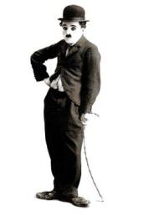
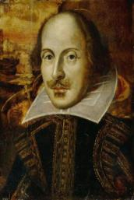
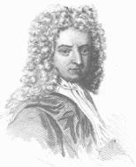
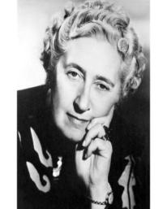
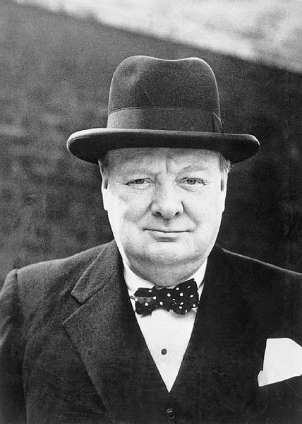
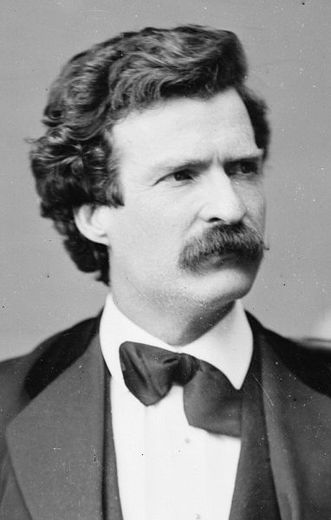
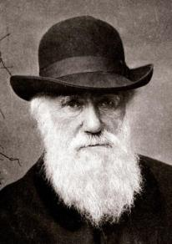
FAMOUS PEOPLE

Slide 2
Read the words and devide them into several groups
opera-dancer scientist writer musician
doctor teacher driver businessman banker
politician architect linguist sportsman
fireman artist seller actor biologist

Slide 3
-er -or | - ist | -ian | -man
opera-dancer writer teacher driver baker actor doctor | scientist artist linguist biologist | musician politician | businessman sportsman fireman

Slide 4
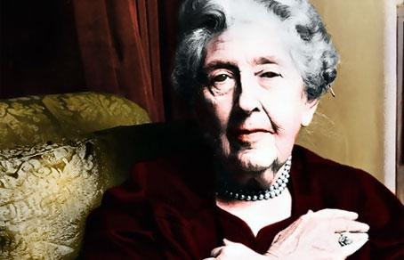

Agatha Christie

Slide 5
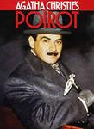
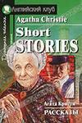
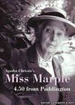

Slide 6


Slide 7
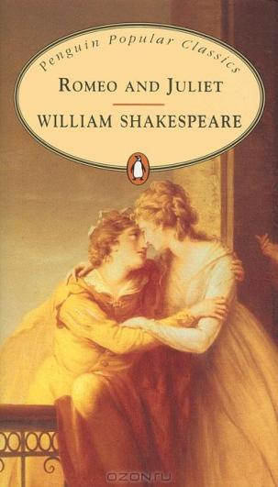
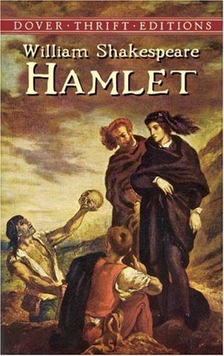

Slide 8

Daniel Defoe

Slide 9
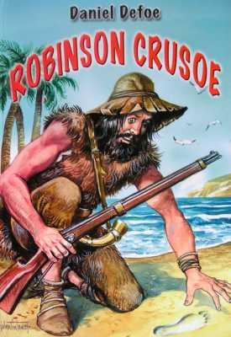

Slide 10
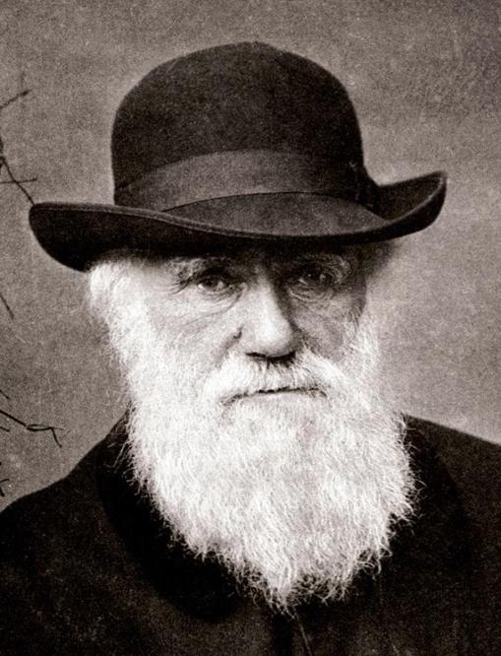
С Darwin

Slide 12
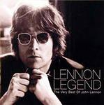
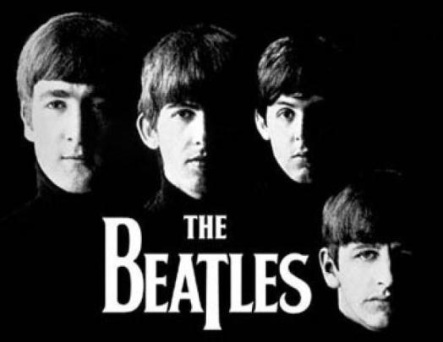

Slide 13
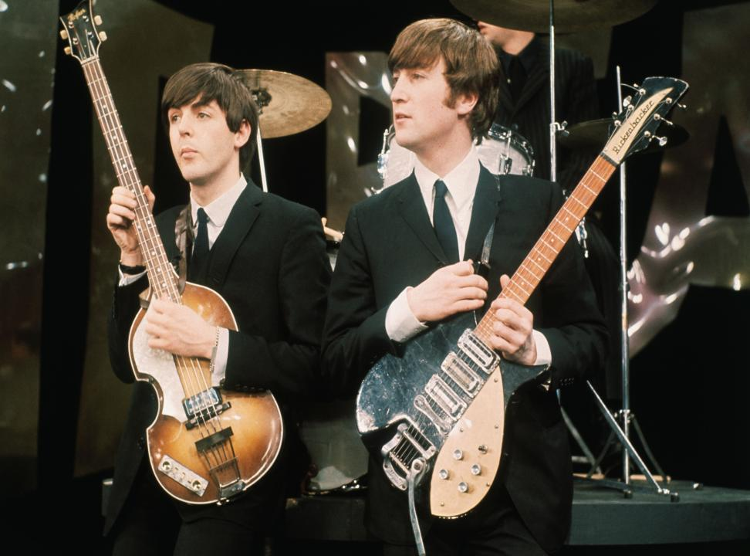

Slide 14
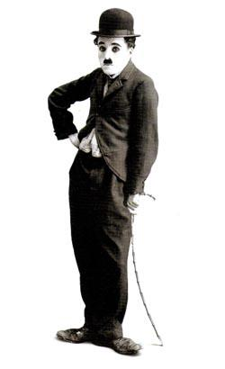

Slide 15
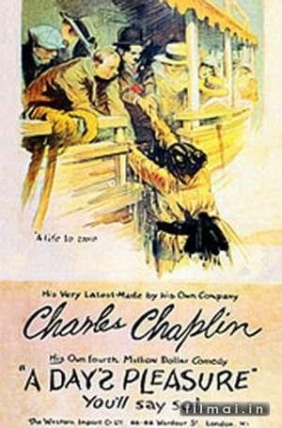

Slide 16
Sir Winston Churchill

Slide 17
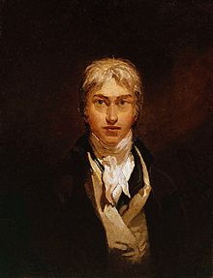
Joseph Turner

Slide 18
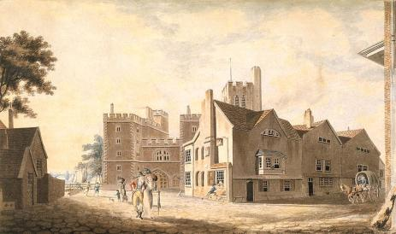
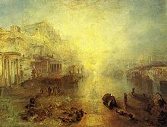
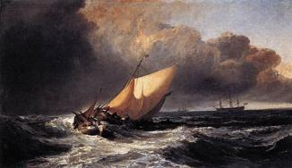
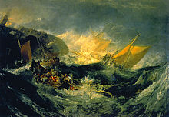
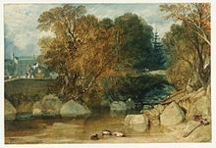
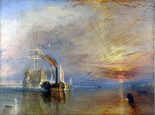

Slide 19
DIALOGUE
Guess a famous person!!!

Slide 20
CROSSWORD

Slide 21
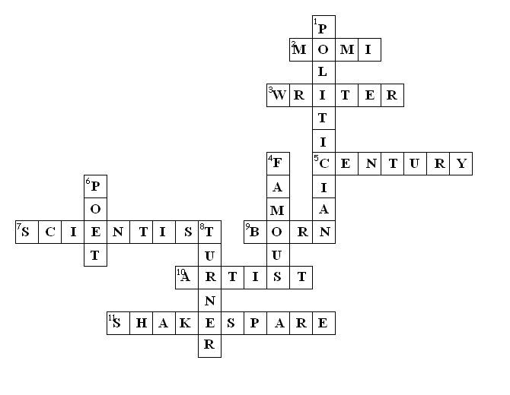

Slide 22
Listen and complete the task

Slide 23
Vocabulary:
names: Andy Griffiths, Enid Blyton, Philip Pullman, Anthony Buckeridge, Jennings, Derbyshire
- hilarious- very funny, merry
- tears - a drop of salty liquid that comes out of your eye when you are crying.
- a dragon- a large imaginary animal that has wings and a . long tail and can breathe out fire.
Task.
1 . .... were running down her face.
2. It was a …... story.
3. You can read about …...... in many legends around the world, different cultures have stories about these monsters.

Slide 24
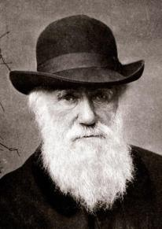
FAMOUS PEOPLE

