Slide 1

Государственное бюджетное общеобразовательное учреждение
специального профессионального образования
Зарайский педагогический колледж имени В.В. Виноградова
Московская область
Обобщающий урок
по теме:
«Еда и напитки»
Студенты 2 «Б» курса
школьного отделения
Преподаватель:
Минаева Р.В.

Slide 2



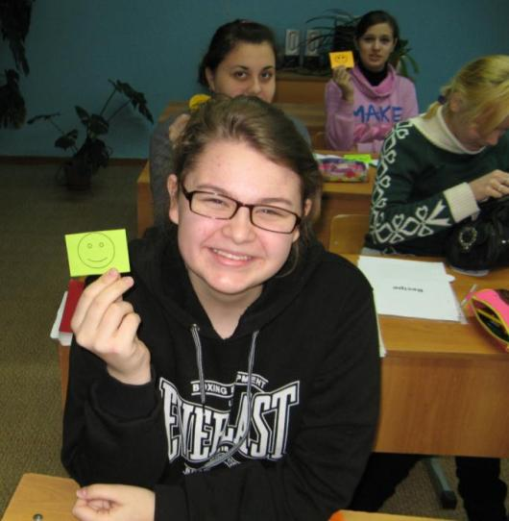


How do you
feel today?

Slide 3
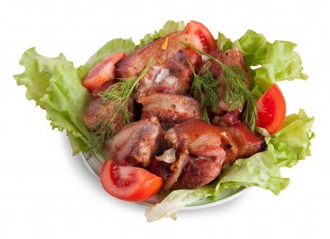
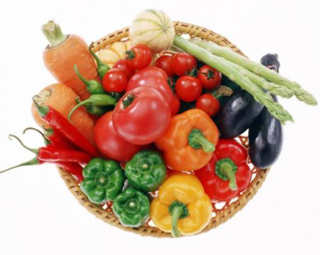
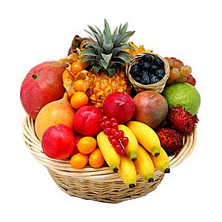
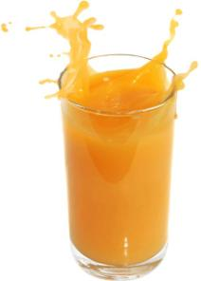
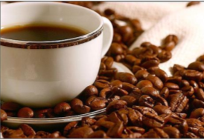
Food and drink

Slide 4
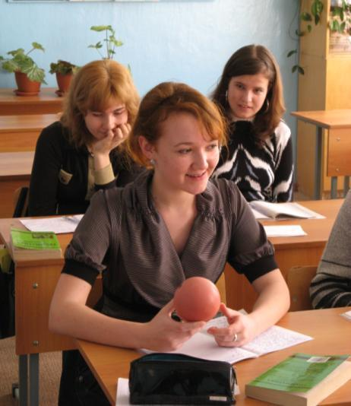


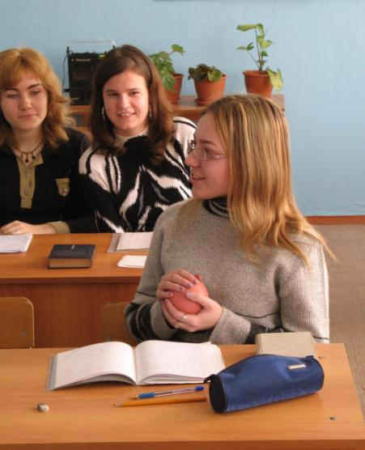

Slide 5
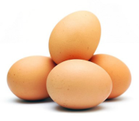


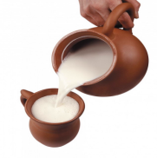
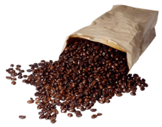

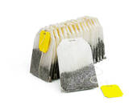

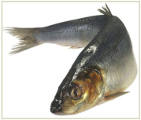
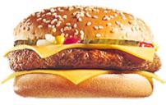
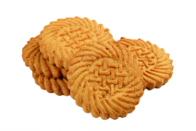
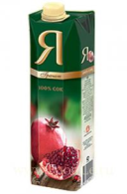
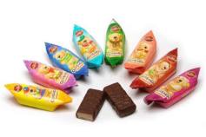
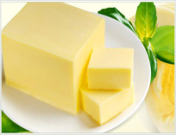
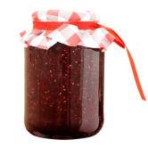
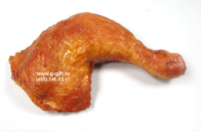
Meat
Biscuits
A sandwich
Water
Butter
Juice
Eggs
Bread
An ice-cream
Coffee
Tea
Milk
Fish
Jam
A cake
Sweets

Slide 6

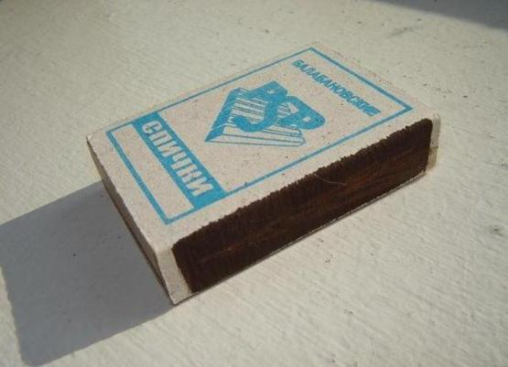
Magic hat

Slide 7

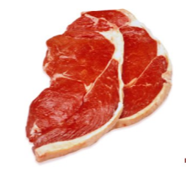
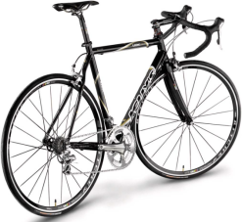
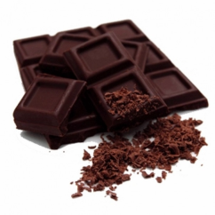
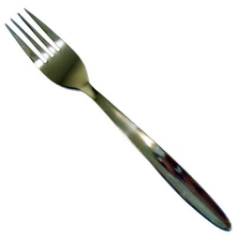
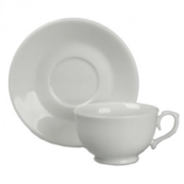
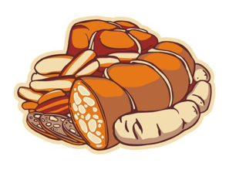

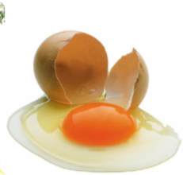
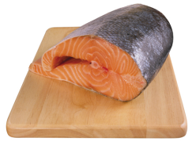

Countable or uncountable

Slide 8

Write a/an or some
Cards:
… book
…sugar
…stamp
…car
…money
…bread
…meat
…information
…orange

Slide 9
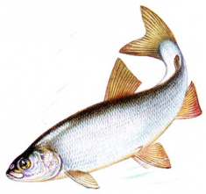
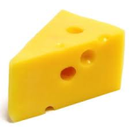
Potatoes
Roast chicken
Chocolate
cake
Eggs
Cornflakes
Ham
Carrots
Orange juice
Toast
Cornflakes
Herring
salad
Pork chops
Milk
Fish soup
Cheese
Bananas
Lettuce
Sandwich
Yoghurt
Soup
Breakfast | Lunch | Dinner

Slide 10










Ann |  |  | + | + | + | + |  | + | +
 |  | + |  |  |  |  | +
Sveta |  | + | + |  | + | + |  |  | +
 |  |  |  | + |  |  | + | +
Irina |  | + | + | + |  | + | +
 |  |  |  |  | + |  |  | + | +
…

Slide 11
Защита
проектов

Slide 12
Students
Teaches

Slide 13
Listening
The Smiths’ favourite restaurant (true/false)
1. La Strada is a pub.
2. La Strada is near Paul and Sue’s house.
3. You can’t have breakfast at La Strada.
4. La Strada is very expensive.
5. La Strada is a small family restaurant.
6. Spaghetti is Paul’s favourite dish.
7. Spaghetti is Sue’s favourite dish.
8. Mark and Mary aren’t at La Strada tonight.

Slide 14

Key:
1 – F
2 – T
3 –T
4 – F
5 – T
6 – F
7 – T
8 – T

Slide 15





Puzzle
,
,,,,
=
+
,,,,
,,,,
b
,,,,
+
+
+
=

Slide 16


Find the words:
A | S | J | U | I | C | E | E
F | R | A | J | E | T | R | Y
A | P | P | L | E | R | B | T
B | O | W | E | Y | K | R | P
A | O | K | U | K | U | E | I
C | P | A | S | T | A | A | M
O | K | I | T | A | A | D | Y
N | Z | U | R | E | K | R | X

Slide 17
Match the words with their meanings:
Meal a) a person who makes food
Dish b) a particular style of cooking
Food c) the separate stages in which a meal is served
Course d) food which is eaten at the same time each day
Cook e) things that people eat , such as vegetables and
meat
Cuisine f) food prepared in a particular way, typical of a
particular area
Portion g) a small amount of food between main meals or
instead of a meal
8. Snack h) an amount of food for one person, when served in a
restaurant.

Slide 18

Key:
1-d
2-f
3-e
4-c
5-a
6-b
7-h
8-g

Slide 19


Past Simple
Positive sentence:
Negative sentence:
ed
V
V
.
did not
…
!
Questions:
Did
V
?
?
did
V
?
! Who
V
?

Slide 20
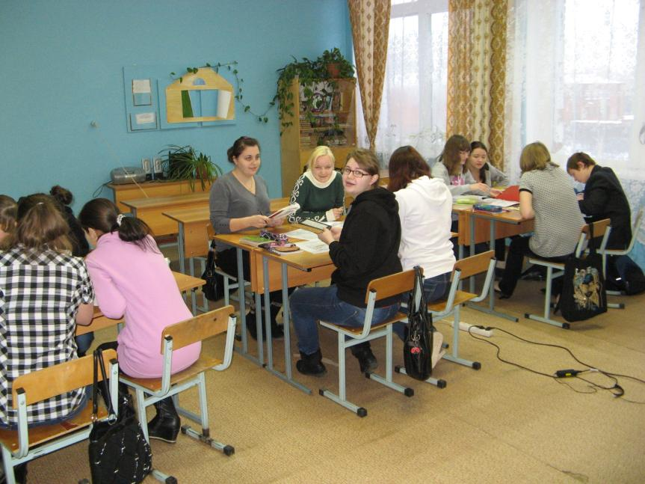

Slide 21
Homework:
p.34 № 5

Slide 22
Список литературы:
http://images.yandex.ru/yandsearch?text=%D1%8F%D0%B1%D0%BB%D0%BE%D0%BA%D0%BE&img_url=http%3A%2F%2Fspim.ru%2Fi%2Ftolk%2Fyabloko.jpg&pos=2&rpt=simage&lr=213&noreask=1
http://images.yandex.ru/yandsearch?text=%D0%B3%D1%80%D1%83%D1%88%D0%B0&pos=2&rpt=simage&img_url=http%3A%2F%2Fwww.fruitnews.ru%2Fupload%2Fiblock%2Faaa%2F%25203.jpg
http://img0.liveinternet.ru/images/attach/c/0/39/707/39707464_858.jpg
http://s=0&rpt=simage&img_url=http%3A%2F%2Fwebcommunity.ru%2Fwp-content%2Fuploads%2F2009%2F12%2Fbanan1.jpg
http://images.yandex.ru/yandsearch?text=%D0%BF%D0%B5%D1%80%D1%81%D0%B8%D0%BA&img_url=http%3A%2F%2Ffiles.myopera.com%2Fhealthlife%2Fblog%2FPeaches.jpg&pos=0&rpt=simage&lr=213&noreask=1
http://images.yandex.ru/yandsearch?text=%D0%BA%D0%BB%D1%83%D0%B1%D0%BD%D0%B8%D0%BA%D0%B0&pos=19&type=clipart&rpt=simage&img_url=http%3A%2F%2Fdnz41.klasna.com%2Fuploads%2Feditor%2F3638%2F302304%2Fsitepage_36%2Fklubnika_1920x1200.jpg
http://images.yandex.ru/yandsearch?text=%D0%B0%D0%BD%D0%B0%D0%BD%D0%B0%D1%81&pos=7&rpt=simage&img_url=http%3A%2F%2Flive4fun.ru%2Fsmall_pictures%2Fimg_7120701_2903_1.jpg
http://images.yandex.ru/yandsearch?text=%D0%BC%D0%B0%D1%81%D0%BB%D0%BE&pos=0&rpt=simage&img_url=http%3A%2F%2Fwww.ayzdorov.ru%2Fimages%2FLechenie%2Fmaslo.jpg
http://cs5471.userapi.com/v5471226/2b6/WYMv6voZfx8.jpg
http://images.yandex.ru/yandsearch?p=1&text=%D1%82%D0%BE%D1%80%D1%82&pos=44&type=clipart&rpt=simage&img_url=http%3A%2F%2Fs56.radikal.ru%2Fi153%2F1010%2F9a%2F0777e4f6b985.png
http://images.yandex.ru/yandsearch?text=%D1%8F%D0%B9%D1%86%D0%B0&pos=0&type=clipart&rpt=simage&img_url=http%3A%2F%2Fimg.lenta.ru%2Fnews%2F2009%2F04%2F06%2Feggs%2Fpicture.jpg
http://images.yandex.ru/yandsearch?text=%D0%BA%D0%BE%D0%BD%D1%84%D0%B5%D1%82%D1%8B&pos=6&type=clipart&rpt=simage&img_url=http%3A%2F%2Fwww.skf.uniconf.ru%2Fimage%2Fsite_pics%2F4408.jpg
http://images.yandex.ru/yandsearch?text=%D0%BC%D0%BE%D1%80%D0%BE%D0%B6%D0%B5%D0%BD%D0%BE%D0%B5&pos=12&type=clipart&rpt=simage&img_url=http%3A%2F%2Fwww.mirsmazok.ru%2Fimages%2Fice%2520cream2.jpg
http://images.yandex.ru/yandsearch?text=%D1%81%D1%8D%D0%BD%D0%B4%D0%B2%D0%B8%D1%87&pos=10&type=clipart&rpt=simage&img_url=http%3A%2F%2Fwww.calorizator.ru%2Fsites%2Fdefault%2Ffiles%2Fproduct%2Fcheeseburger-royal.jpg
http://images.yandex.ru/yandsearch?p=1&text=%D0%BF%D0%B0%D0%BA%D0%B5%D1%82%20%D1%81%D0%BE%D0%BA%D0%B0&pos=33&type=clipart&rpt=simage&img_url=http%3A%2F%2Fmarket.v-lazer.com%2Fimg%2Fcatalog%2F5_119221_1.jpg
http://images.yandex.ru/yandsearch?text=%D0%BC%D0%BE%D0%BB%D0%BE%D0%BA%D0%BE&pos=2&type=clipart&rpt=simage&img_url=http%3A%2F%2Fdietnica.ru%2Fwp-content%2Fuploads%2F2010%2F06%2Fmoloko.jpg
http://images.yandex.ru/yandsearch?text=%D1%81%D1%82%D0%B0%D0%BA%D0%B0%D0%BD%20%D0%B2%D0%BE%D0%B4%D1%8B&pos=6&type=clipart&rpt=simage&img_url=http%3A%2F%2Fwebcommunity.ru%2Fwp-content%2Fuploads%2F2010%2F04%2Fa_glas_of_water_sas.jpg
http://images.yandex.ru/yandsearch?text=%D0%BA%D0%BE%D1%84%D0%B5%20%D0%B2%20%D0%B7%D0%B5%D1%80%D0%BD%D0%B0%D1%85&pos=5&type=clipart&rpt=simage&img_url=http%3A%2F%2Fcnt-design.ru%2Fphotos%2Feda%2F30084.jpg
http://images.yandex.ru/yandsearch?text=%D0%BF%D0%B5%D1%87%D0%B5%D0%BD%D1%8C%D0%B5&pos=20&type=clipart&rpt=simage&img_url=http%3A%2F%2Fs57.radikal.ru%2Fi157%2F1012%2F87%2F469412464883.jpg
http://images.yandex.ru/yandsearch?text=%D0%B3%D1%80%D1%83%D1%88%D0%B0&pos=18&type=clipart&rpt=simage&img_url=http%3A%2F%2Fs014.radikal.ru%2Fi326%2F1011%2F68%2Fc9bb217598b1t.jpg

Slide 23
http://images.yandex.ru/yandsearch?text=%D0%B2%D0%B8%D1%88%D0%BD%D1%8F&pos=5&type=clipart&rpt=simage&img_url=http%3A%2F%2Fallfreed.ru%2Fuploads%2Fposts%2F2009-04%2F1238966375_ss-fruit-berries-vegetables15.jpg
http://images.yandex.ru/yandsearch?text=%D0%BC%D0%BE%D1%80%D0%BA%D0%BE%D0%B2%D0%BA%D0%B0&pos=5&type=photo&rpt=simage&img_url=http%3A%2F%2Fs48.radikal.ru%2Fi120%2F1103%2Fd8%2F1484172113ab.png
http://images.yandex.ru/yandsearch?text=%D0%B1%D0%B0%D0%BD%D0%B0%D0%BD&pos=5&type=photo&rpt=simage&img_url=http%3A%2F%2Fhometowncolumbia.files.wordpress.com%2F2010%2F03%2Fbanana1.jpg
http://static.diary.ru/userdir/1/0/1/9/1019355/36342442.jpg
http://images.yandex.ru/yandsearch?p=3&text=%D1%81%D1%8B%D1%80&pos=114&type=clipart&rpt=simage&img_url=http%3A%2F%2Fg-ecx.images-amazon.com%2Fimages%2FG%2F01%2Faskville%2F2956658_answers%2F1340136065245_cheese.jpg
http://images.yandex.ru/yandsearch?p=1&text=%D1%80%D1%8B%D0%B1%D0%B0&pos=32&type=clipart&rpt=simage&img_url=http%3A%2F%2Fold.uralpress.ru%2Fshow_thumbinail.php%3Fw%3D140%26image%3Dimg%2F75344_sig.jpg
http://images.yandex.ru/yandsearch?text=%D0%BD%D0%B0%D0%BF%D0%B8%D1%82%D0%BE%D0%BA%20&pos=19&type=clipart&rpt=simage&img_url=http%3A%2F%2Fs18.rimg.info%2F688a3616c51063684e070865ab507be9.gif
http://images.yandex.ru/yandsearch?text=%D0%B5%D0%B4%D0%B0&pos=11&type=clipart&rpt=simage&img_url=http%3A%2F%2Fs3.rimg.info%2Fd8679edab585b323c82d629cb5aace9c.gif
http://www.google.com/imgres?q=%D0%BE%D1%82%D1%80%D1%8B%D0%B2%D0%BD%D0%BE%D0%B9+%D0%BA%D0%B0%D0%BB%D0%B5%D0%BD%D0%B4%D0%B0%D1%80%D1%8C&start=193&hl=en&sa=X&tbo=d&biw=1680&bih=897&tbm=isch&tbnid=r6LbUWWcSqRayM:&imgrefurl=http://jenskaya-konsultaciya.ru/etot-raznyj-kalendar/&docid=HxCyN1WPkC1phM&imgurl=http://jenskaya-konsultaciya.ru/wp-content/uploads/2012/11/kalendar.jpg&w=265&h=190&ei=NYrMUIOYLsb-4QSUuoBg&zoom=1&iact=hc&vpx=101&vpy=277&dur=2922&hovh=152&hovw=212&tx=82&ty=55&sig=103571896422278719081&page=4&tbnh=151&tbnw=211&ndsp=69&ved=1t:429,r:51,s:200,i:157
http://www.google.com/imgres?q=%D1%81%D0%BC%D0%B0%D0%B9%D0%BB%D0%B8%D0%BA%D0%B8&hl=en&tbo=d&biw=1680&bih=835&tbm=isch&tbnid=rrKKvDwYs-mq_M:&imgrefurl=http://kladovka.kg/tags/%25D1%25EC%25E0%25E9%25EB%25E8%25EA%25E8/&docid=qU9G1J5BWsMqGM&imgurl=http://kladovka.kg/uploads/posts/2010-11/1290027722_smilik-2.jpg&w=1191&h=1091&ei=p4vMUJP_Na6L4gTGnYHwBw&zoom=1&iact=hc&vpx=372&vpy=493&dur=987&hovh=215&hovw=235&tx=116&ty=118&sig=103571896422278719081&page=1&tbnh=140&tbnw=153&start=0&ndsp=47&ved=1t:429,r:30,s:0,i:181

