Slide 1

Let’s cook!

Slide 2
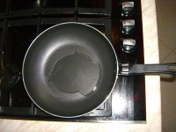
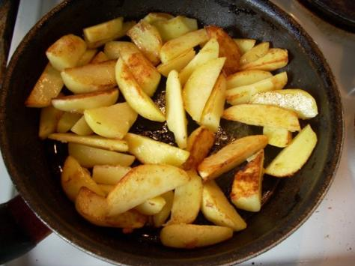
fry
Can you fry potatoes?

Slide 3
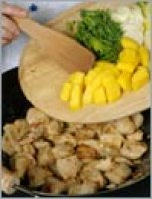
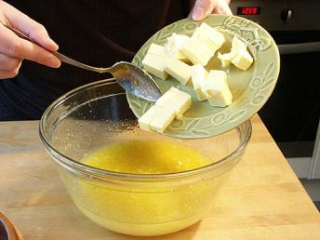
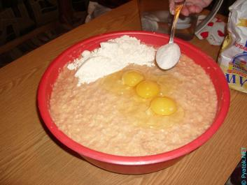
add
Spell this word, please.

Slide 4
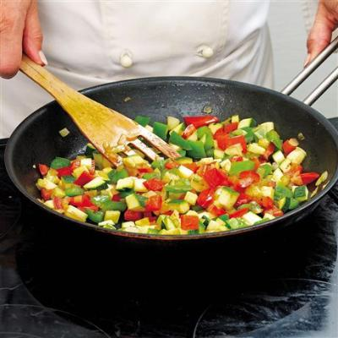
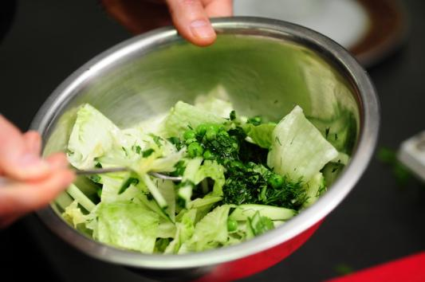
mix
What’s the first letter?

Slide 5
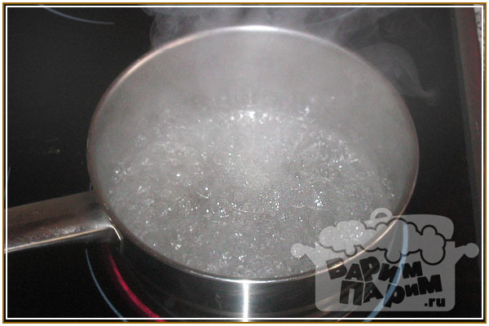
boil
How many letters are there?

Slide 6
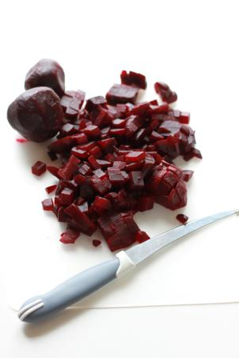
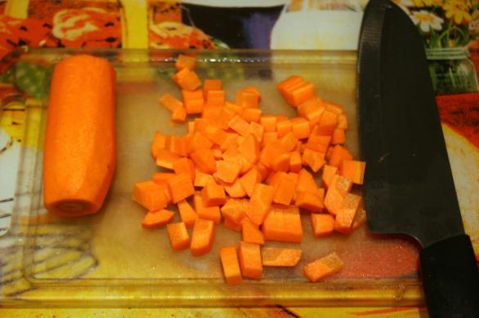
dice
Can you dice milk?

Slide 7
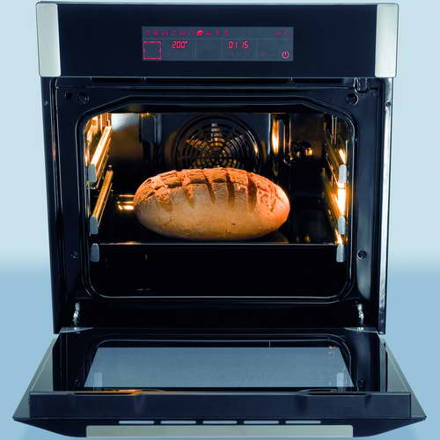
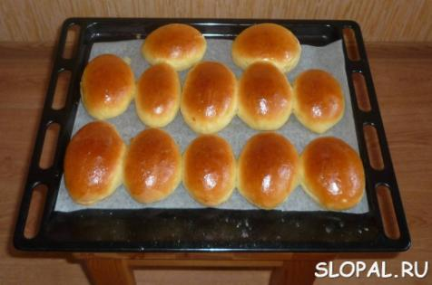
bake
Can you bake a cup of tea?

Slide 8
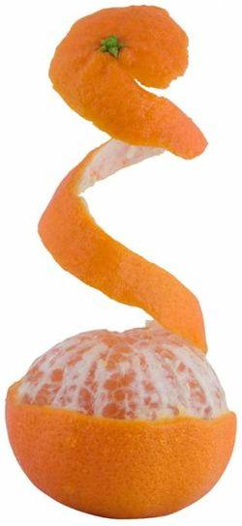
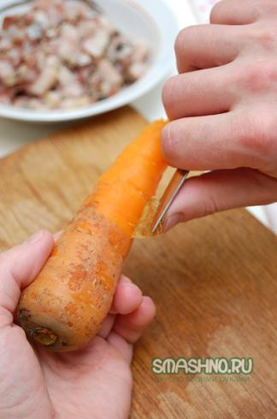
Can you peel an egg?
peel

Slide 9
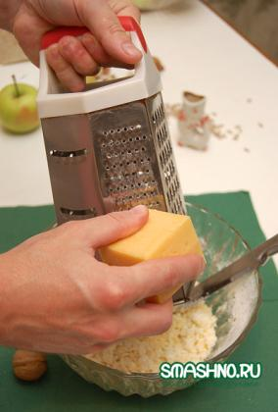
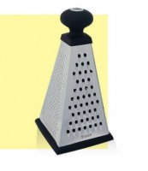
grate
Did you grate an apple yesterday?

Slide 10
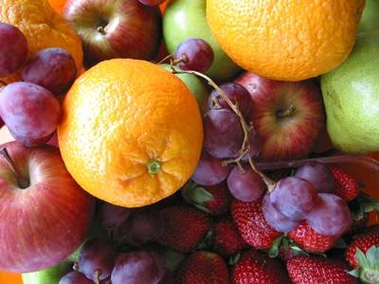

Slide 11
/η/ - spring, king, morning, evening
Add – adding
Melt –

Slide 12
Add – adding
Melt – melting
Taste –

Slide 13
Add – adding
Melt – melting
Taste – tasting
Put –

Slide 14
Add – adding
Melt – melting
Taste – tasting
Put – putting
Cut –

Slide 15
Add – adding
Melt – melting
Taste – tasting
Put – putting
Cut – cutting
Chop -

Slide 16
Add – adding
Melt – melting
Taste – tasting
Put – putting
Cut – cutting
Chop - chopping

Slide 17
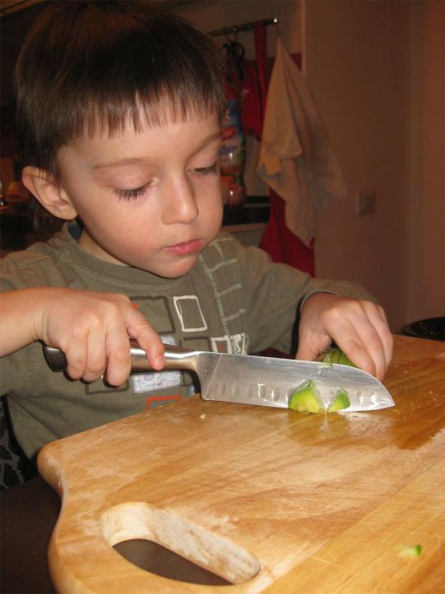

Slide 18
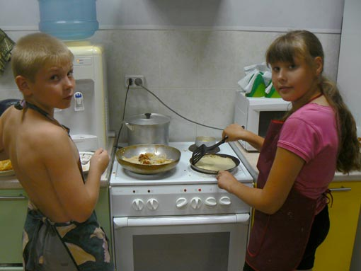

Slide 19
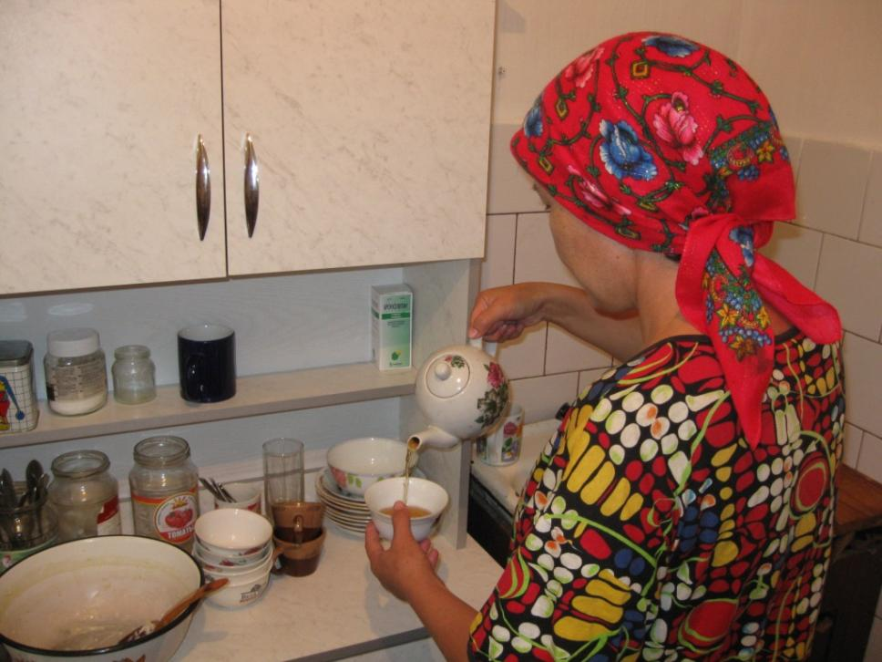

Slide 20
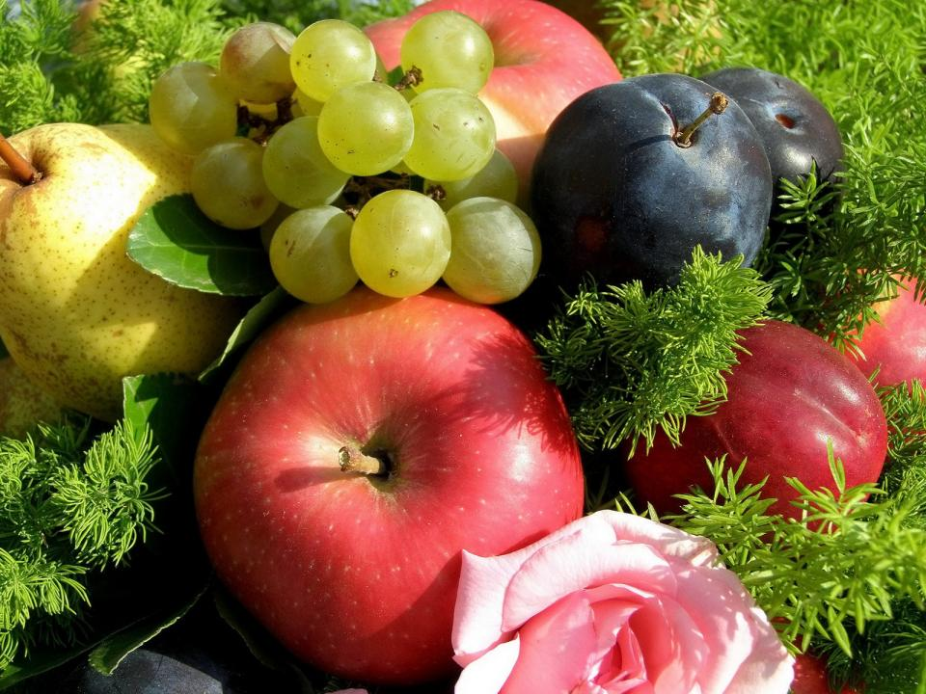

Slide 21
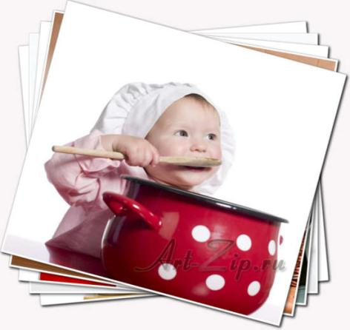
H/t – St.b. p.90 ex.5 – portfolio
(write a recipe)

Slide 22
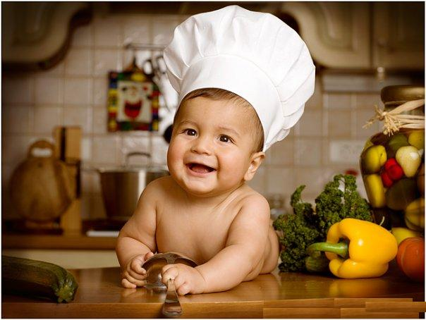
Enjoy your meal!

Slide 23

Очень понравилось, хочу еще!

Slide 24

Понравилось, но не все понятно?!

Slide 25

Не понравилось…

