Slide 1
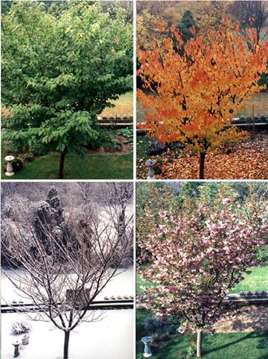
Seasons and Weather

Slide 2
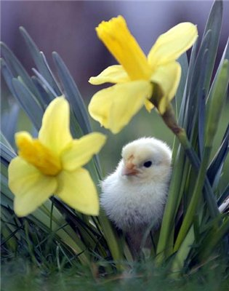

Spring! What a lovely season!

Slide 3
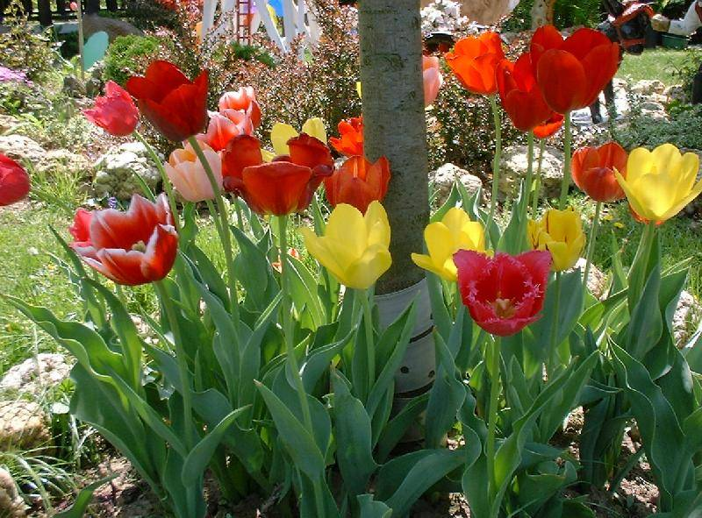
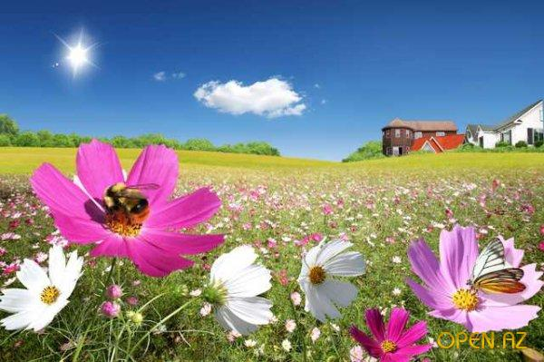
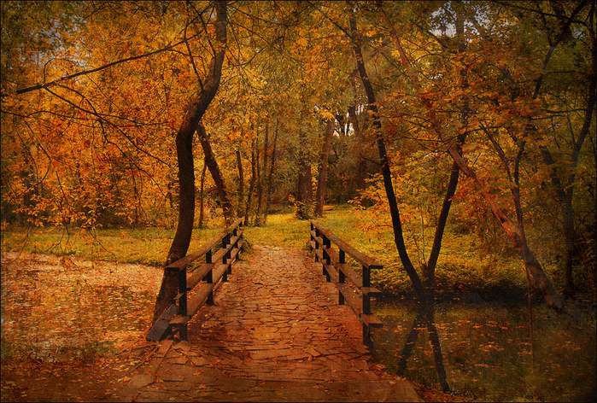
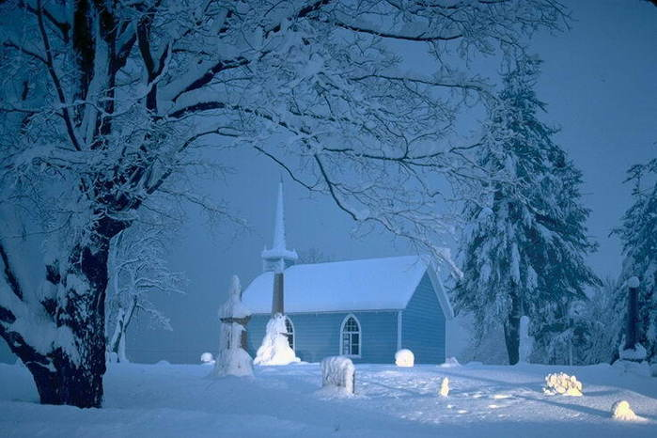
SEASONS
sPRING
SUMMER
Autumn
winter

Slide 4
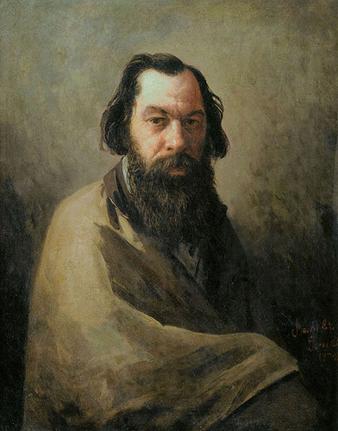
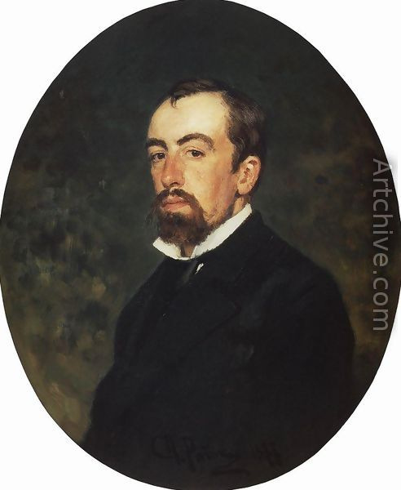
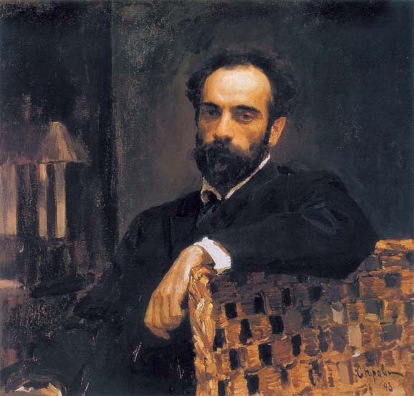
Russian painters
A. Savrasov
v. Polenov
I. Levitan

Slide 5
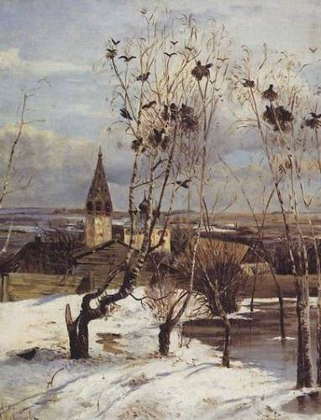
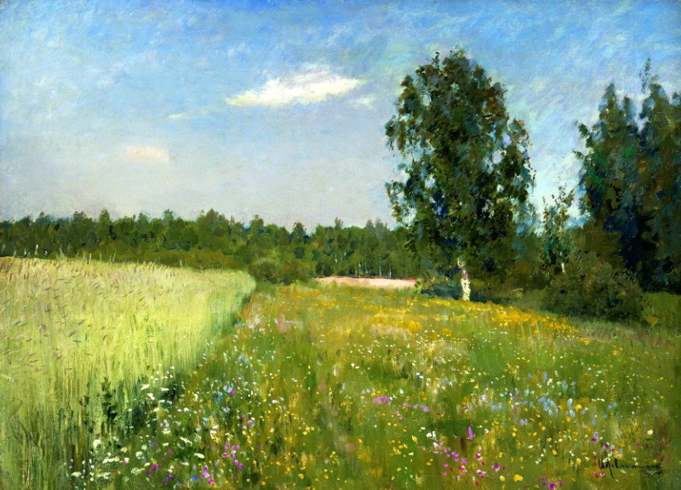
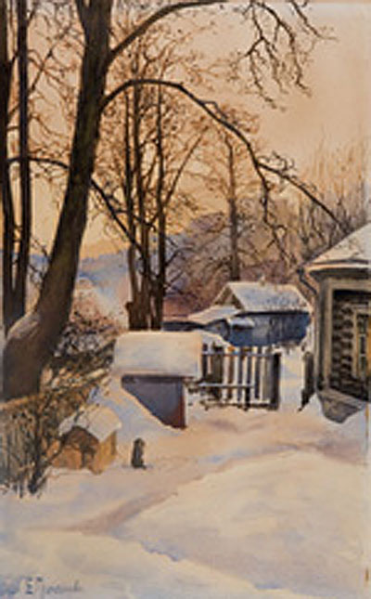
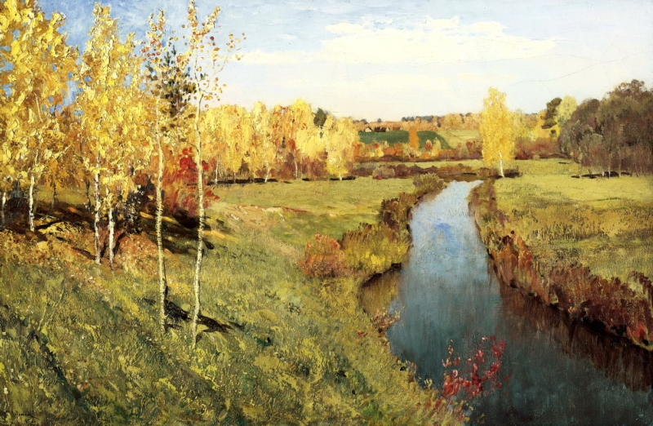
Their pictures

Slide 6
Solve the riddles
I think it is ….

Slide 7
Past simple
Past simple = V + ed
enjoy – enjoyed
thank- thanked
count -counted

Slide 8
Past simple | Present simple
decided
started
was
were
changed
wanted

Slide 9
Past simple | Present simple
decided | decide
started | start
was | be
were | be
changed | change
wanted | want

Slide 10

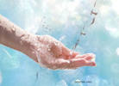
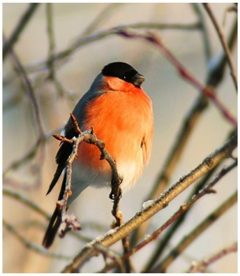
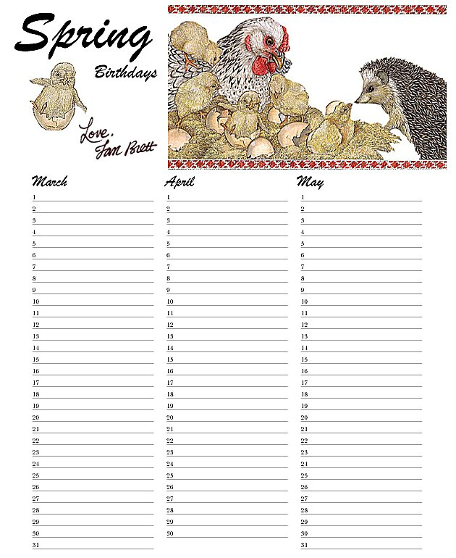

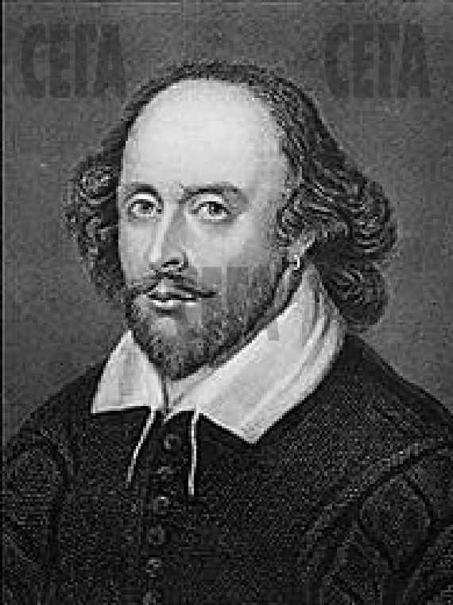
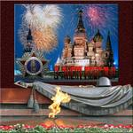
Spring calendar
The 8th of March
The 22nd of March
The 1st of April
The 22nd of April
The 23rd of April
The 9th of May

Slide 11
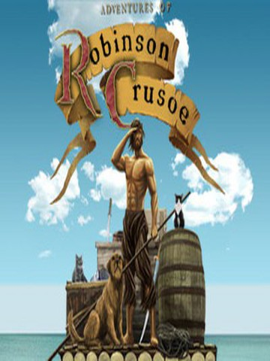
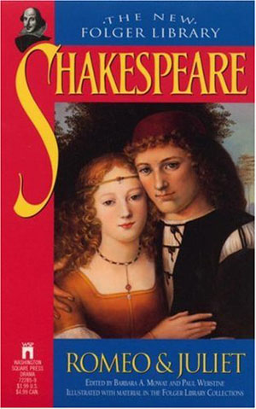
It’s interesting to know:
Daniel Defoe, the author of the novel Robinson Crusoe, was born on 13th of April 1660.
William Shakespeare, the author of the tragedy “Romeo and Juliet”, was born on the 23rd of April 1564.

Slide 12
Найдите соответствия
SPRING
1. On the 8th of March we have … | a) Birds Day
2. The 22nd of March is … | b) Mother’s Day.
3. The 1st of April is … | c) Earth Day.
4. The 22nd of April is … | d) Water Day.
5. On the 23rd of April 1564 … was born. | e) Victory Day.
6. The 9th of May is … | f)William Shakespeare

Slide 13
Spring calendar
The 8th of March
The 22nd of March
The 1st of April
The 22nd of April
The 23rd of April
The 9th of May

Slide 14
SPRING
1. On the 8th of March we have … | b) Mother’s Day.
2. The 22nd of March is … | d) Water Day.
3. The 1st of April is … | a) Birds Day.
4. The 22nd of April is … | c) Earth Day.
5. On the 23rd of April 1564 … was born. | f) William Shakespeare
6. The 9th of May is … | e) Victory Day.

Slide 15
Thank you!

