Slide 1
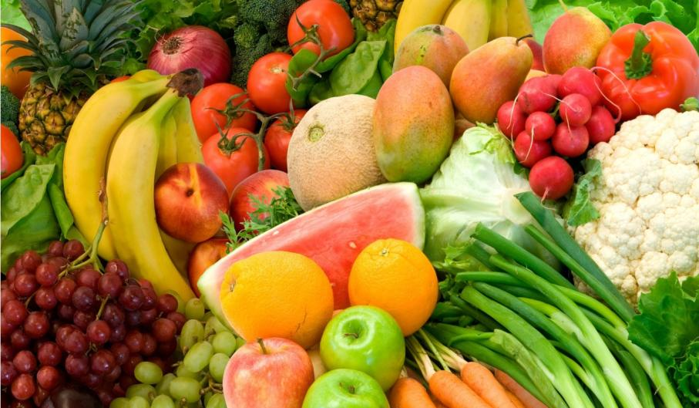
Favourite recipes

Slide 2

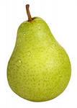
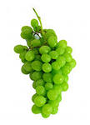
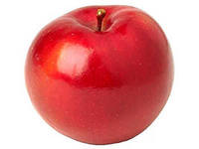
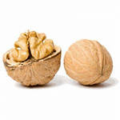
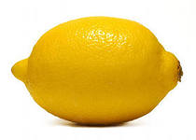
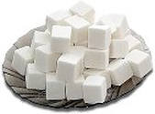

Slide 3
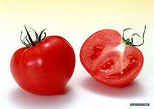
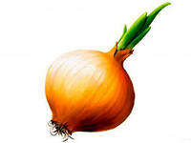
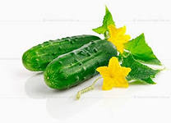
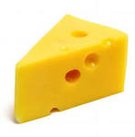
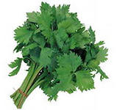
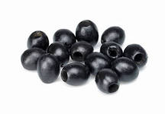
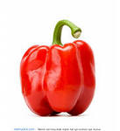

Slide 4
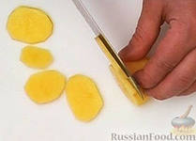
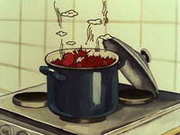
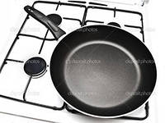
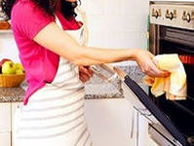
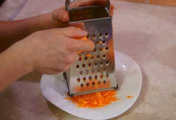
Grate, slice, bake, fry, boil

Slide 5
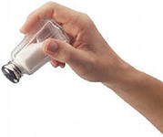
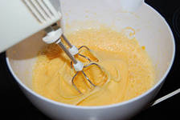
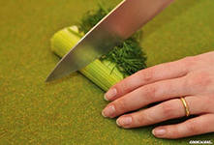
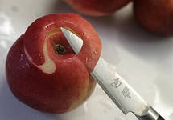
mix, sprinkle, peel, cut

Slide 6
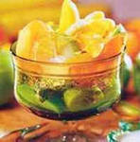
a) Take three bananas and an apple.
b) Wash the fruit.
c) Cut it into pieces.
d) Add some lemon juice.
e) Mix with cream.
f) Add some tomatoes.
g) Put some pieces of orange on the top.

Slide 7
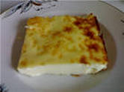
Omelette Recipe
Ingredients | Verbs
2 eggs | put
A cup of milk | add
Oil | mix
Salt & pepper | fry
 | serve

Slide 8
Cooking instructions: Put 2 eggs and a cup of milk into a bowl. Add some salt and pepper and mix. Put the mixture into a frying pan with oil. Fry it for 7 minutes. Sprinkle the omelette with cheese. Serve with pieces of toasts.

Slide 9
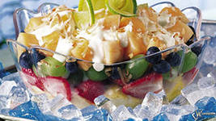
Fruit Iceberg salad recipe

Slide 10
Ingredients | Verbs
Some apples | take
2 bananas | mix
5 strawberries | cut
A spoonful of yogurt | wash
Some ice cream | add
 | put

Slide 11
Cooking instructions
_____ some_____ and _____ them. Take 2 bananas. _____ the fruit into pieces. _____ 5 strawberries. _____ with a _____. You don’t need any sugar. ____ some _____ on the top. Enjoy your fruit salad.

Slide 12
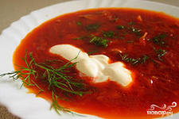
Homework: Borsch recipe

