Slide 1

The Russian National Emblem

Slide 2
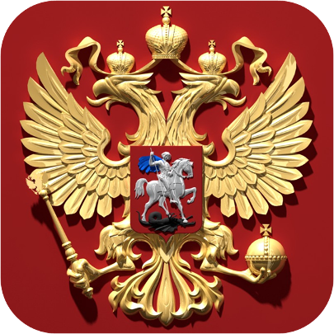
The Russian National Emblem is the golden DOUBLE-HEADED eagle with a horseman ( St George) on a shield on eagle’s breast with a red background.

Slide 3
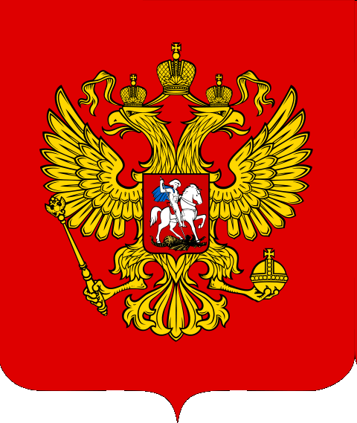
Above the two heads of the eagle there is an historical crown.

Slide 4
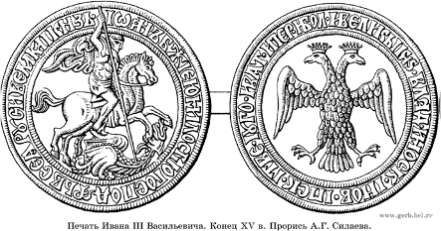
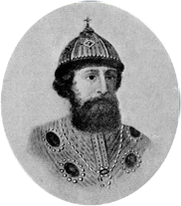
The first emblem of the double-headed
eagle was introduced in 1480 by Prince Ivan III.
It was at the time of establishment of the Russian state system and the emblem which symbolised the supreme power and sovereignty of the of the state.

Slide 5

Since then, the double-headed eagle has been the main part of the emblem of our country.
But the crown is the symbol of sovereignty both of the Russian Federation ( as a whole ) and of its parts (subject of the Federation).

Slide 6
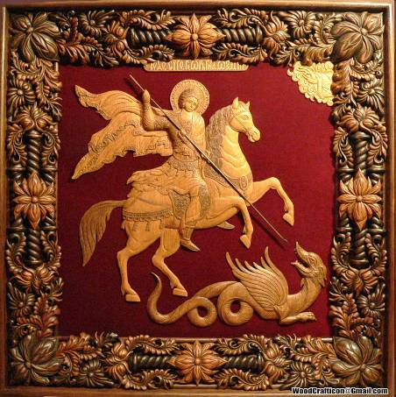
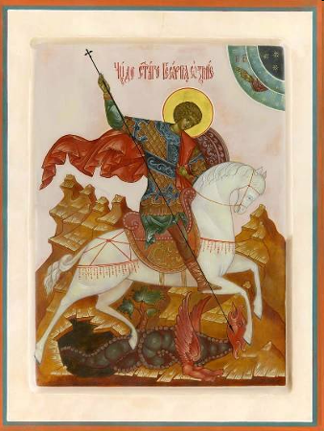
The state emblem shows our patron saint George, who helped our country at times of war.

Slide 7
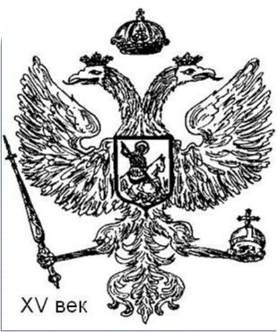
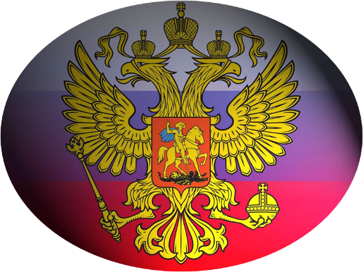
The state emblem appeared in Russia in 1480.
It is the оldest state emblem in history and contributes to our country’s traditions.

Slide 8
В презентации использованы материалы:
kartinki-na-rabochiy-stol.ru
ai-cdr.ucoz.ru
wwwboards.auto.ru
gr.neftegaz.ru
vse-foto.ru
art-teks.ru
peoples.ru
clubs.ya.ru
old.stjag.ru

