Slide 1
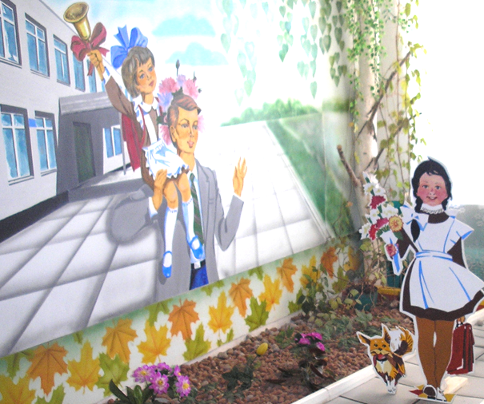
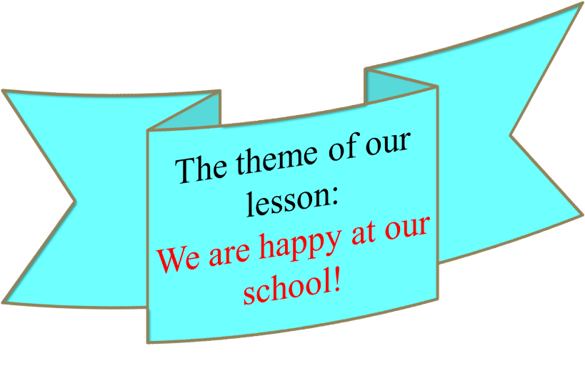
The 17th of October, Wednesday.

Slide 2
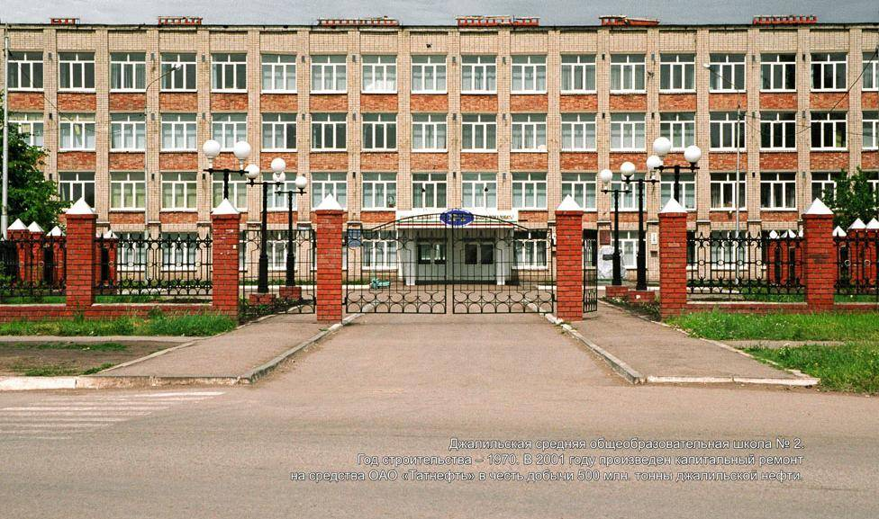

Mind the clock
And keep the rule;
Try to come
In time to school!

Slide 3

Let’s play the game
“The broken type-writer”
A_t H_st_ry
_hysi_al Educ_ti_n
Sc_ence t_m_table
ni_kn_me Engli_h
_nfo_mation l_ngu_ge,
les_on s _bject

Slide 4

Connect the words:
care of
weekends
to spend
Maths lessons
to go
abroad
to miss
pictures
shopping
to take
money
parents

Slide 5



Tell about your first day at school
-get up early
-(not) be nervous
-have breakfast
-take flowers
-go to school with parents
-be happy to meet old friends
-give flowers to a teacher
-make a video of classmates
-be tired

Slide 6
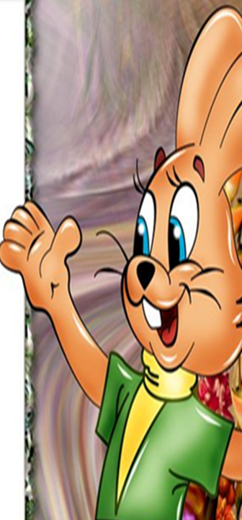
What do teachers and pupils do at school?
-give nicknames
-ask clever questions
- discuss problems
-explain grammar rules
-learn poems by heart
-give instructions
-talk during the break
-do homework every day
-give bad marks
-get good marks

Slide 7
Teachers | Pupils
ask clever questions | give nicknames
discuss problems | learn poems by heart
explain grammar rules | talk during the break
give instructions | do homework every day
give bad marks | get good marks

Slide 8



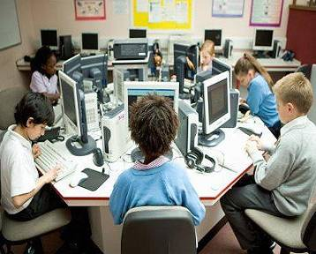
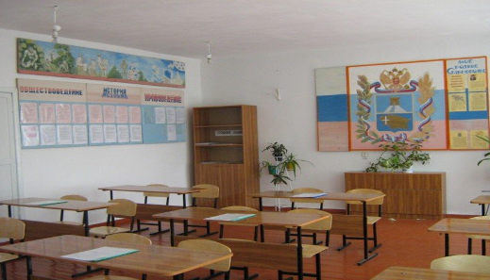
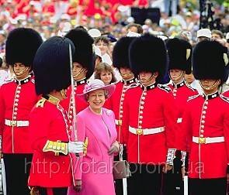

Slide 9


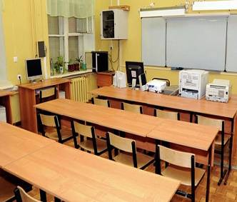
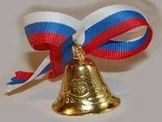
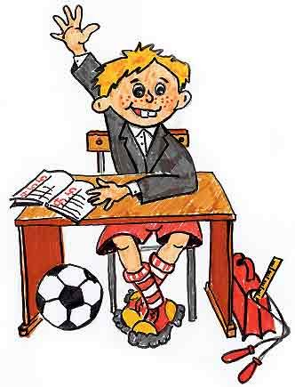
RUSSIA

Slide 10


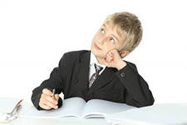

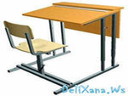
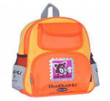
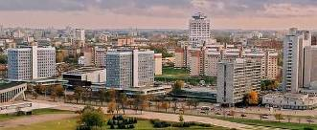
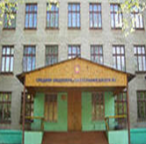
 |  | `

Slide 11
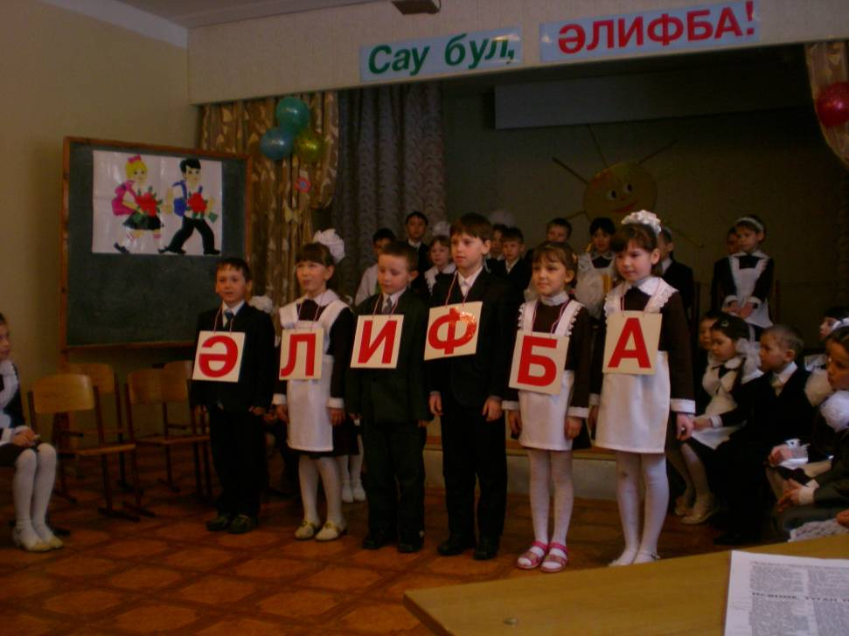
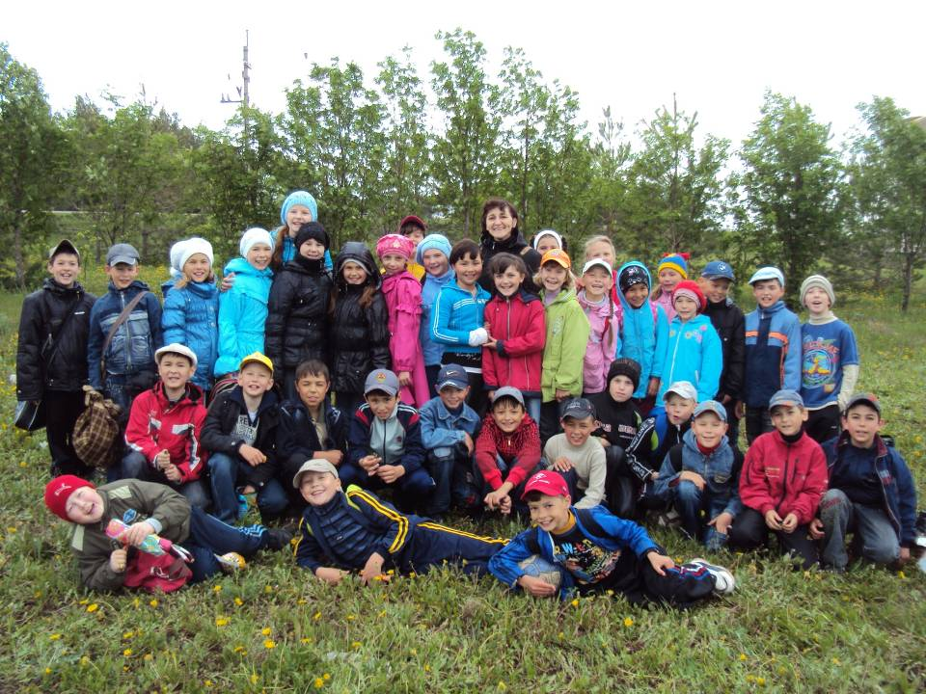
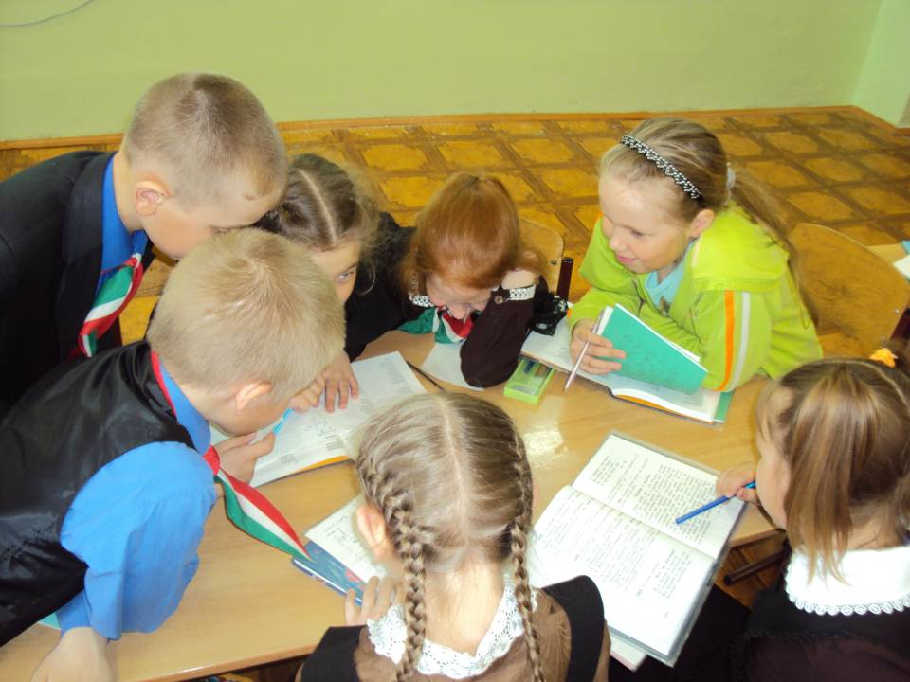
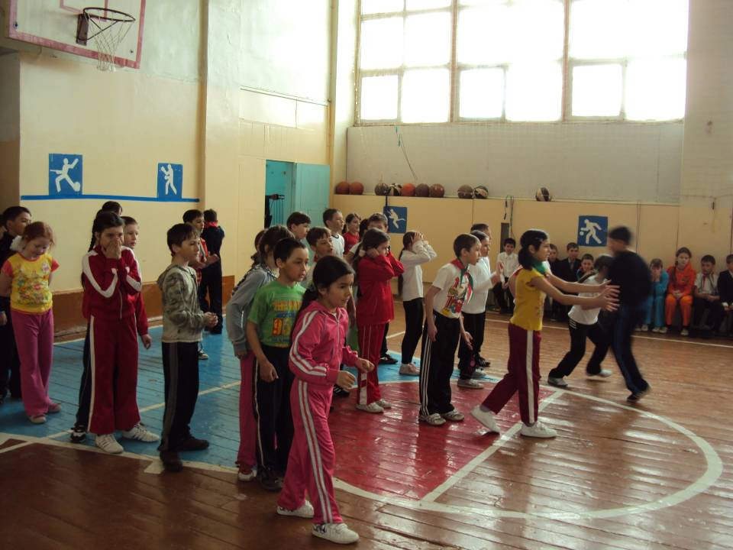
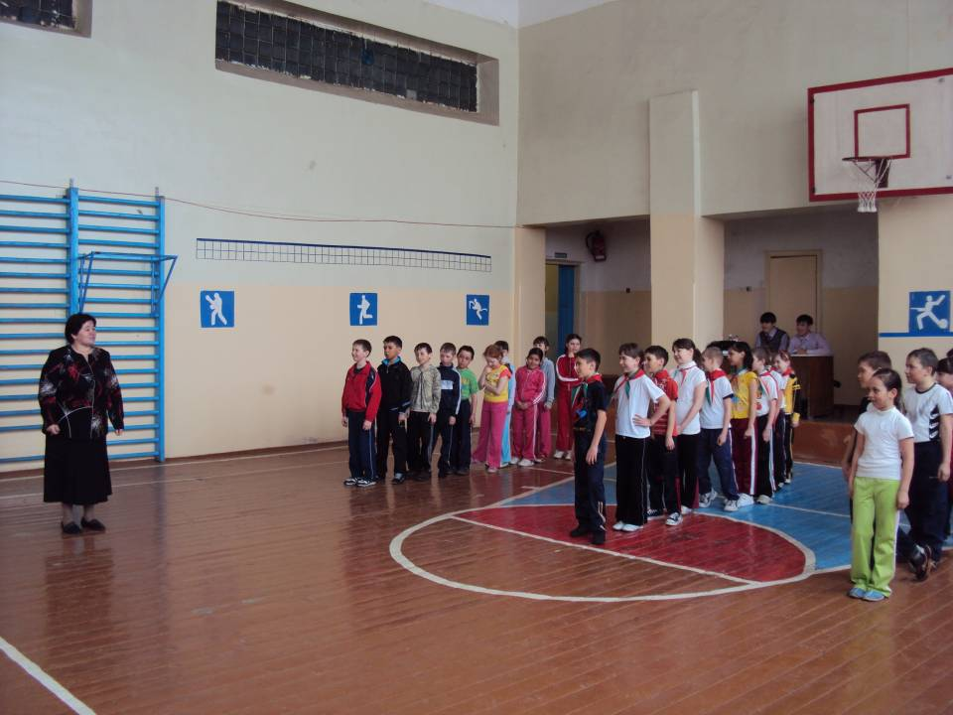

Slide 12
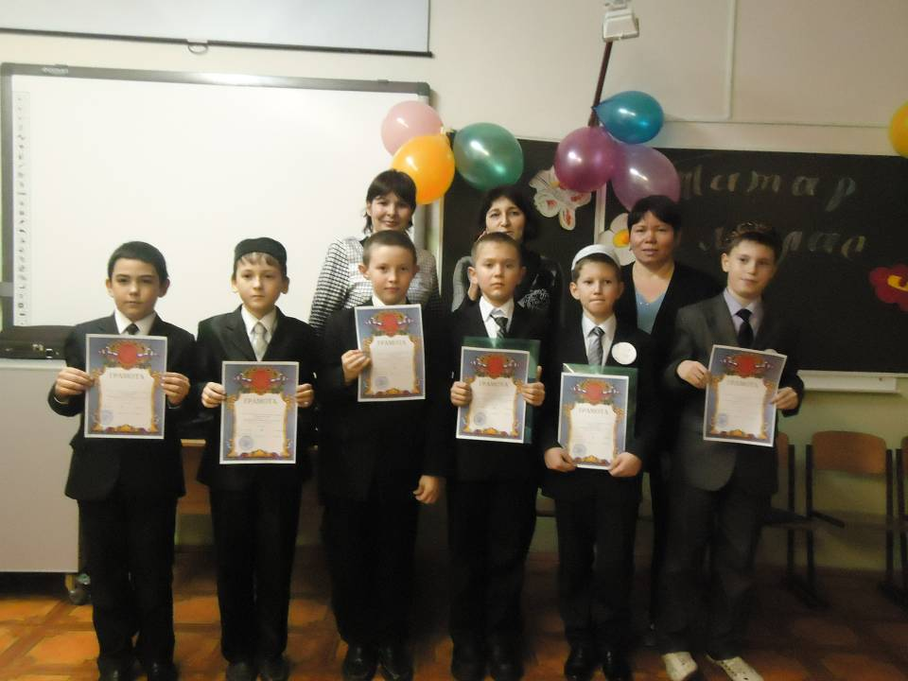
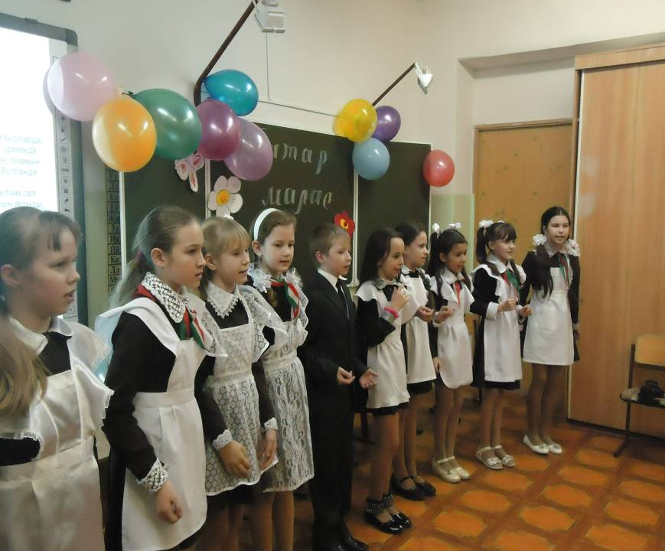

Slide 13
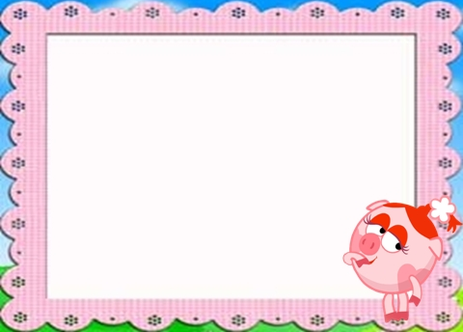
Choose the right answer:
1.Children … to school every day.
a)go b)will go c)went
2.A pupil … a book last week.
a)reads b)will read c)read
3.Adilya … good English. She is my friend.
a)speaks b)will speak c)spoke
4.I … in the sixth form next year.
a)am b)will be c)was
5.I often … a good mark.
a)get b)will get c)got

Slide 14
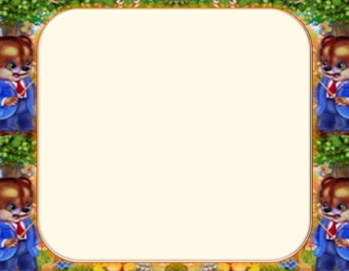
Ask questions to these sentences:
1)He usually reads detective stories.
Does … ?
What … ?
Who … ?
2)They played jokes yesterday.
Did … ?
When … ?
Who …?
3)You will learn a poem by heart tomorrow.
Will … ?
When …?
Who …?

Slide 15

Thank you for your work! See you tomorrow!
HW написать сочинение «Моя школа» (5-10пред)

