Slide 1
Looking for a Job
Job Interview
Form 10

Slide 2

A JOB INTERVIEW

Slide 3

?
What do you know about our company?

Slide 4

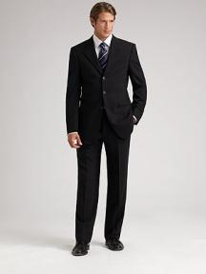

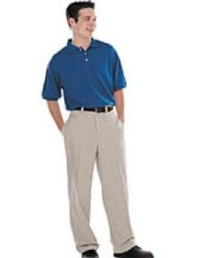
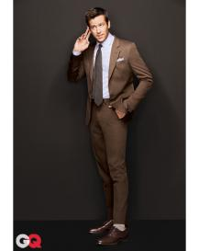

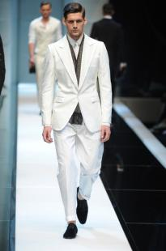
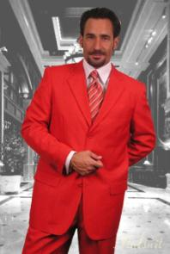
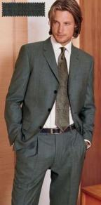
Dress Code

Slide 5
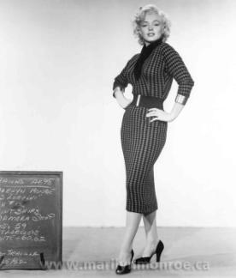

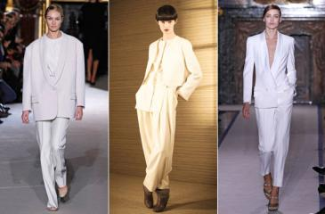

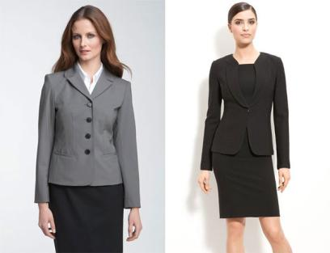

Dress Code

Slide 6



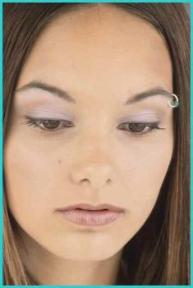
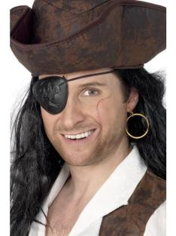

Make-up and Piercing

Slide 7
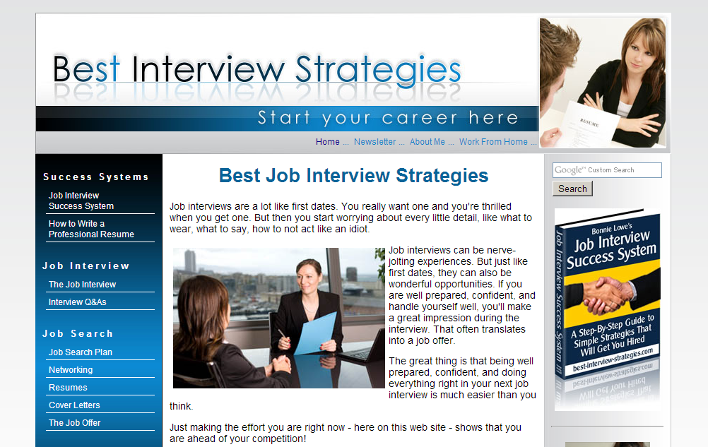

Slide 8
make-up
appropriate clothes
perfume
handshake
cell phone
smile
copy of your CV
eye contact
personal questions
business card
assessing your weak points
things to say about yourself

Slide 9
The most commonly asked interview questions
- Tell me about yourself.
- What is your experience in the field?
- What was the reason for leaving your previous job?
- Do you believe you are successful?
- What would your co-workers say about you?
- What can you tell me about our company?
- Do you consider yourself a team player?
- Why should we choose you for the position?

Slide 10

http://www.best-interview-strategies.com
When can you start?

