Slide 1


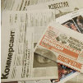

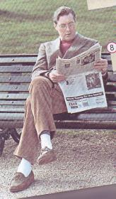

Mass Media

Slide 2
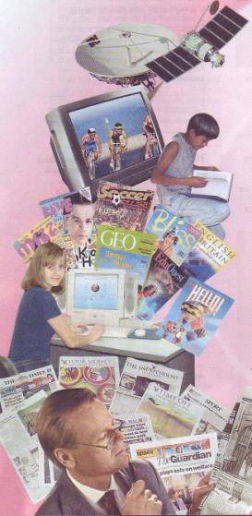
Mass Media
Television (satellite/ cable)
Newspaper (daily/ weekly)
Tabloid
The Internet
Radio

Slide 3
The disadvantages of different Mass Media
If we watch TV a lot we………
When we often use the Internet we ……….
When we play computer games a lot we…….

Slide 4





TV broadcasting companies
Russia
The USA
Britain
Canada

Slide 5
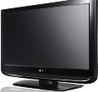
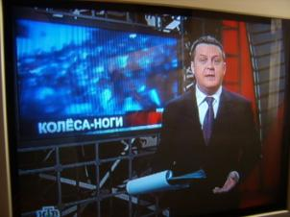
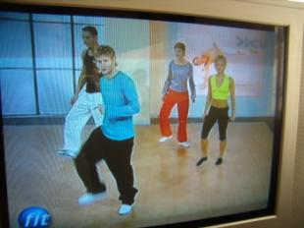
Television What do you like to watch on TV?
Talk shows
Sport programmes
Films
News

Slide 6
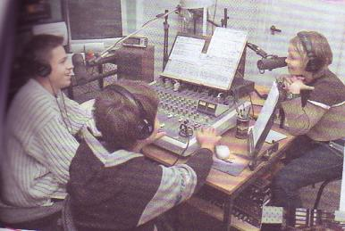
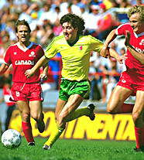
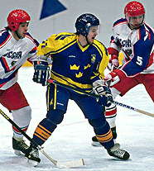
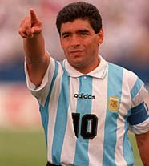
TV commentators

Slide 7
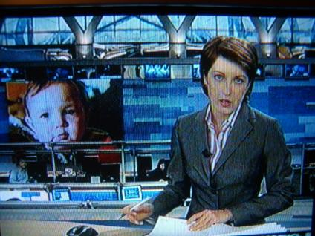
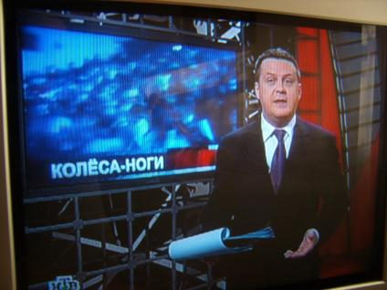
The Newsreader is an image of the channel.

Slide 8
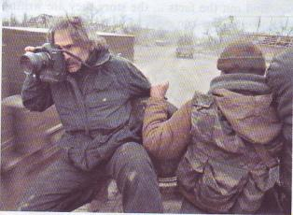
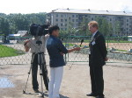
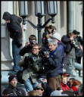
A reporter Is being a reporter a dangerous job?

Slide 9
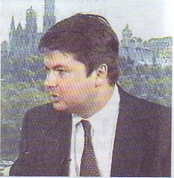
International journalist, Artyom Borovik
He was 39.
He began his career as a war correspondent in Afghanistan.
He became the special Correspondent and interpreter in Moscow for the most popular weekly TV news show in the US, «60 Minutes».
He was the first Russian to win a top American Overseas Press Award.

Slide 10
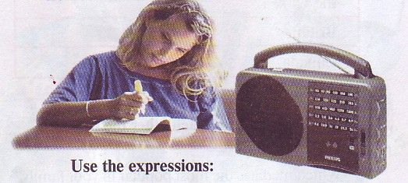
Radio

Slide 11
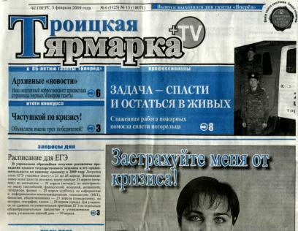
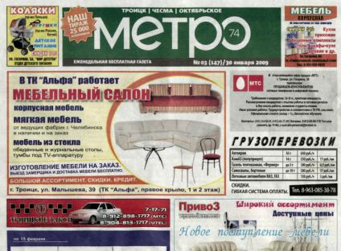
Our local Newspapers

Slide 12
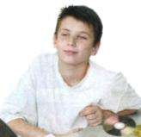
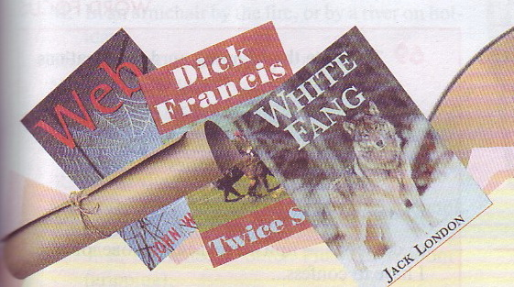
Books Are books Media too?

Slide 13
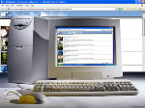

The most modern way of communication is the Internet.

Slide 14
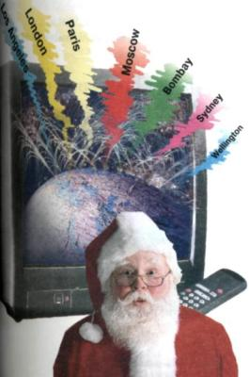



Means of communication are our teachers, advisers, partners, friends and the most amusing company.

