Slide 1

ENGLAND
England is the largest part of the UK.

Slide 2
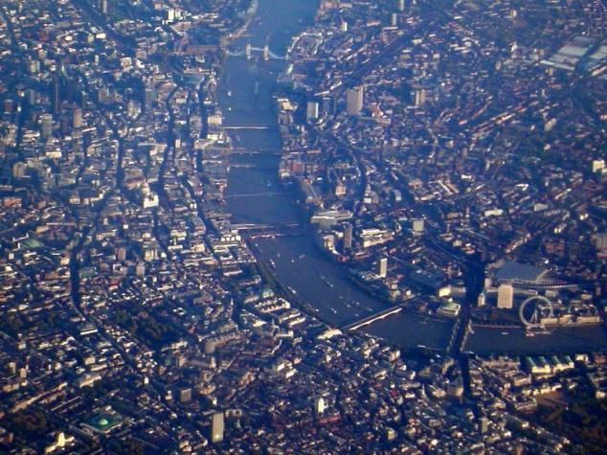
The capital of England is London

Slide 3
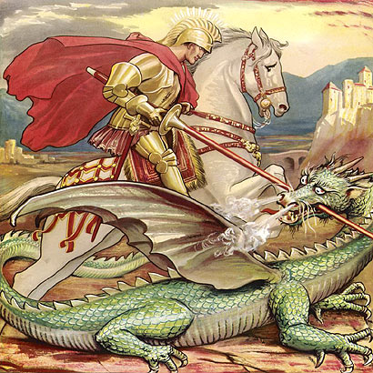
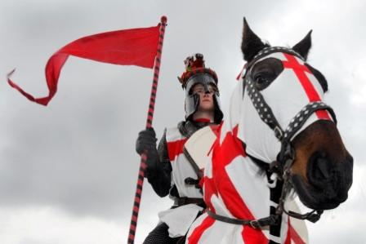
Saint Patron of England is St.George

Slide 4

The symbol of England is a red rose

Slide 5
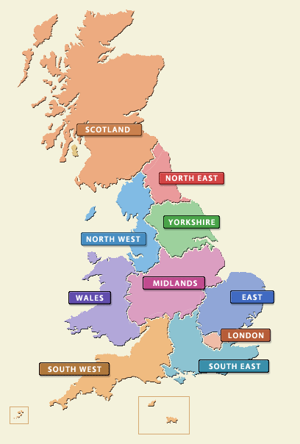
The Regions of England
This part includes several regions:
The Southeast
The Southwest
East Anglia
The Midlands
The North of England

Slide 6
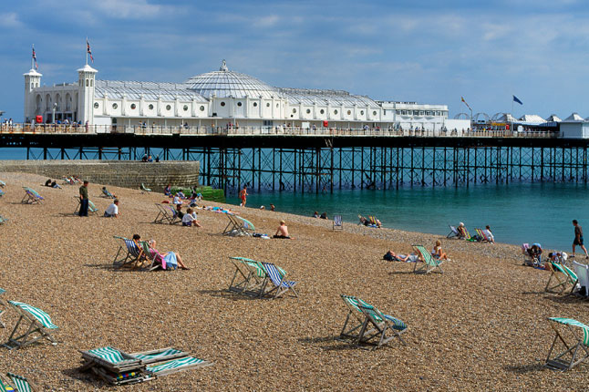
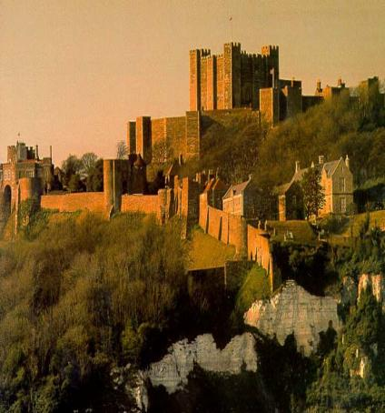
The Southeast
Such historical cities as Brighton and Dover are situated here.

Slide 7
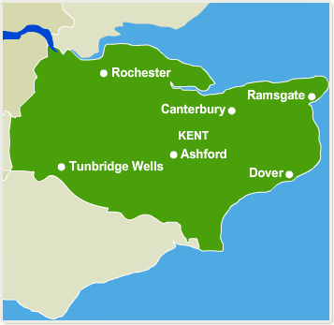
The Southeast
The County of Kent known as the garden of England is situated in the Southeast.

Slide 8

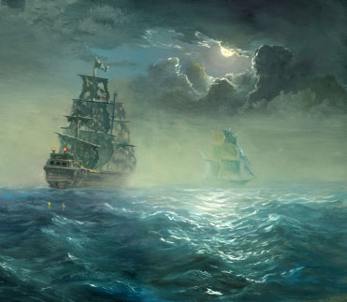
The Southwest
It is famous for its farming, but in the past it used to be known for its pirates.

Slide 9
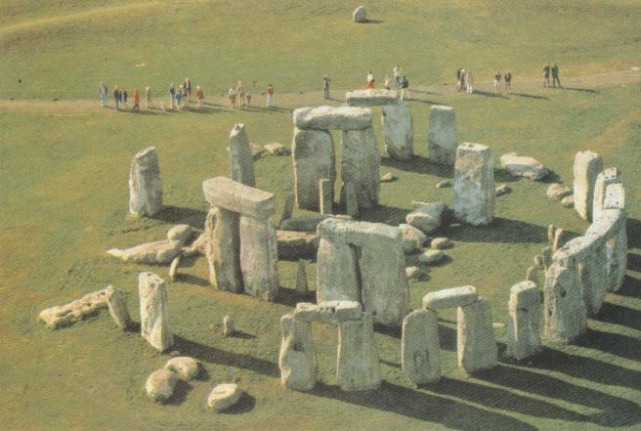
The Southwest
Stonehenge, a pre-historic monument is located here.

Slide 10
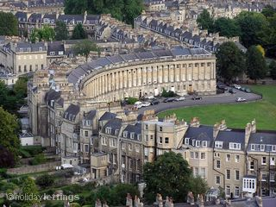
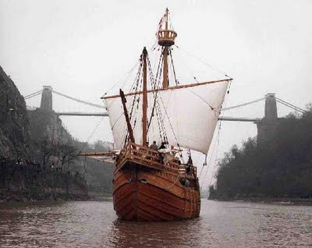
The Southwest
Bath and Bristol are located here too.

Slide 11
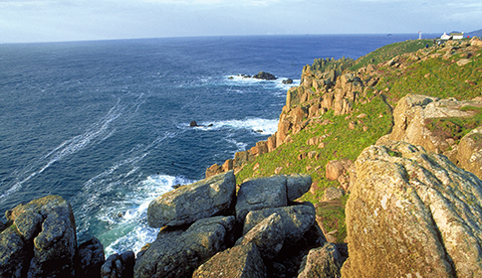
The Southwest
“Land’s End” is the most westerly point of Great Britain.

Slide 12
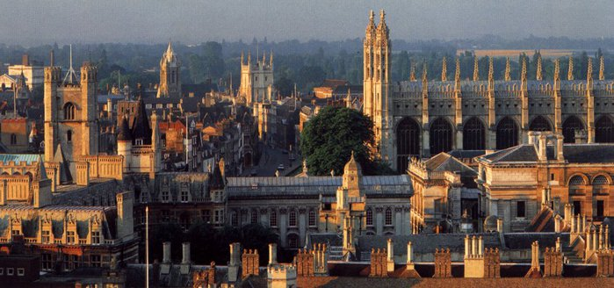
East Anglia
Cambridge, where the second oldest British university was founded, is in East Anglia.

Slide 13
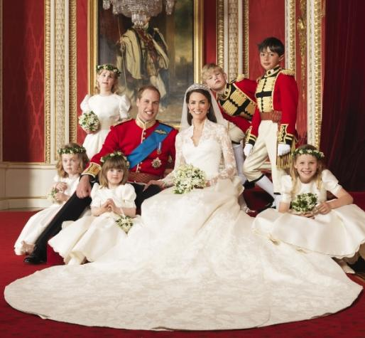
The Duchess of Cambridge
Kate Middlton was given the title of the Duches of Cambridge

Slide 14
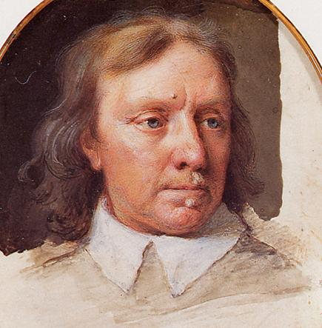
East Anglia
Oliver Cromwell, a famous British general and politician, was born here.

Slide 15

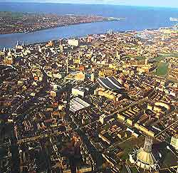
The Midlands
Manchester, Liverpool and Sheffield are situated in the heart of England, which is the Midlands.

Slide 16
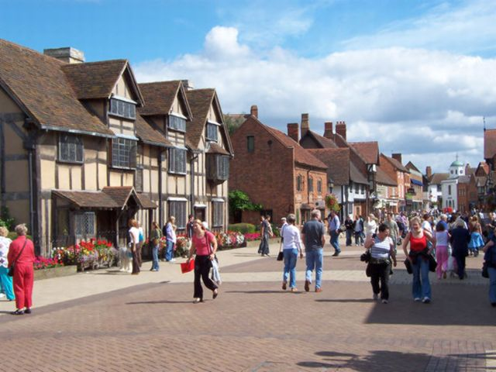
The Midlands
Stratford-upon-Avon, Shakespeare’s birthplace, is popular with tourists.

Slide 17
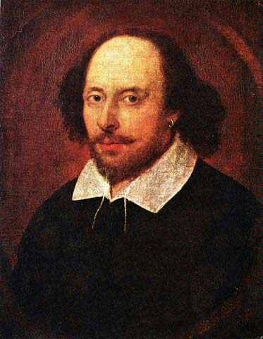
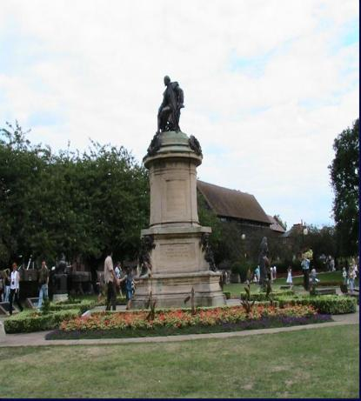
The Midlands
William Shakespeare is one of the world’s famous writers, poets and playwrights.

Slide 18
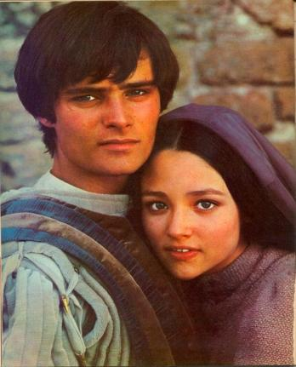
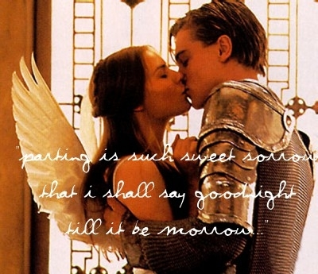
Romeo and Juliet
It’s one of the most famous tragedies by W. Shakespeare.
The film of Franco Zeffirelli
The film of Baz Luhrmann

Slide 19
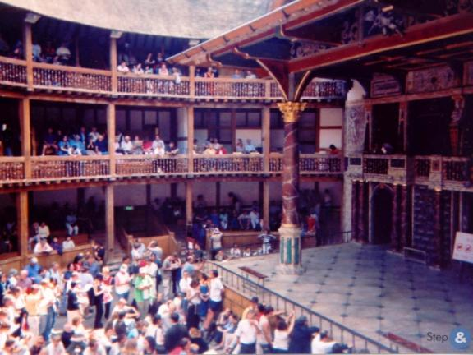
The Globe Theatre
W. Shakespeare wrote a lot of plays for the theatre. Most of his plays were performed in the New Globe Theatre.

Slide 20
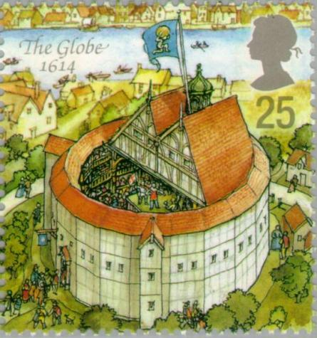
The Globe Theatre in Shakespeare’s time.

Slide 21
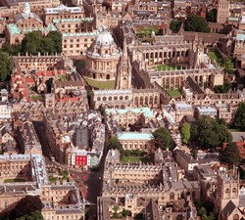
The Midlands
Oxford, another famous university city, is also connected with English culture.

Slide 22
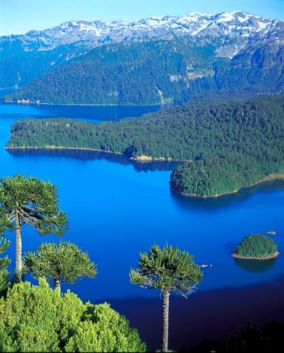
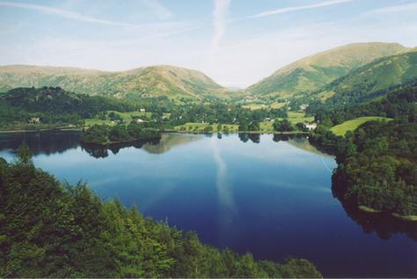
The North of England
The Lake District attracts crowds of tourists.

Slide 23
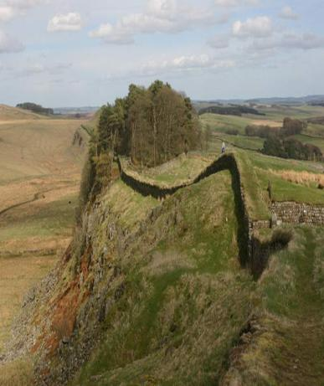
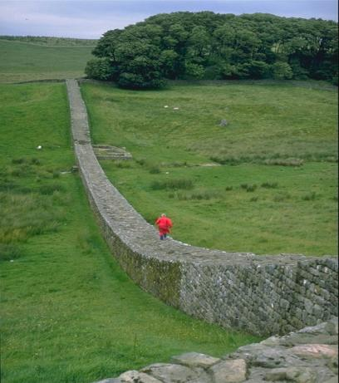
The North of England
Tourists come to see the ruins of the Roman Hadrian’s Wall.

Slide 24
Использованные материалы
Картинки из Google и Yandex.
Учебник О.В. Афанасьевой, И.В. Михеевой для VI класса школ с углубленным изучением английского языка, лицеев и гимназий.

