Slide 1
“ Places Where Animals Live (Habitat)”
Урок английского языка в IV классе по учебнику М.З. Биболетовой «Enjoy English»
Разработчик слайдов
Учитель английского языка Искендерова С.Н.

Slide 2
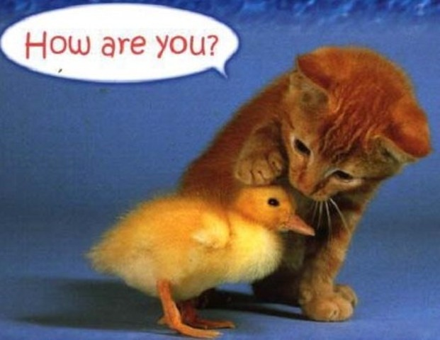
Good morning boys and girls! I am glad to see you!

Slide 3
The theme of our lesson is “ Places Where Animals Live (Habitat)”
Тема нашего урока – «Среда обитания животных»
Today, we will practise the use of the key words on the topic “Habitat”.
We will do some listening, reading and speaking.
We will learn some new words and practise them.
You will make up the dialogue, listen to the dialogue and act it out.

Slide 4
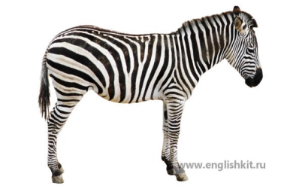
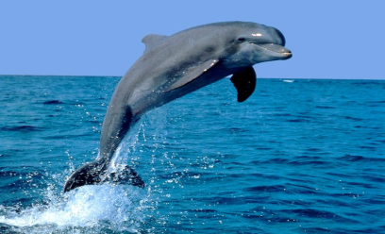
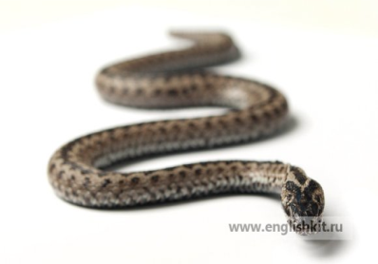
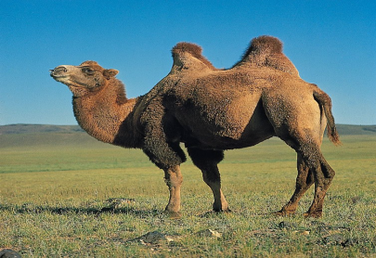
Let`s start our lesson!

Slide 5
Let’s practise English sounds. Repeat after me, please.
[ æ ] | [ aı ] | [ ı ] | [ ʌ ]
a parrot | a tiger | thing | a duck
a camel | a python | windy | under
carry | a crocodile | big | a monkey
bad | nice | dig | sunny
Africa | wide | river | month

Slide 6

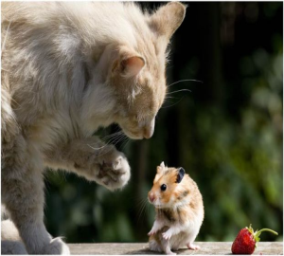

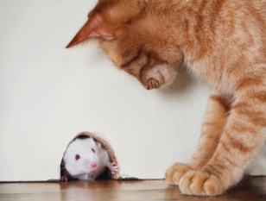
LET`S READ THE RHYME
Little mouse, little mouse,
Where is your house?
Little cat, little cat,
I have no flat.
I`m a poor mouse,
I have no house
Little mouse, little mouse
Come to my house
Little cat, little cat
I can not do that,
You want to eat me.

Slide 7
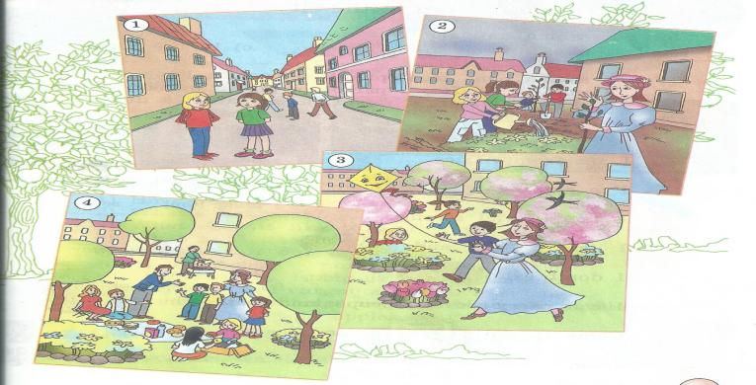
Let`s check your homework:
Ex.26 p.42 Read and translate the story. Answer the question:
«Who becomes happy is the town»
The Green Garden.

Slide 8
Ex.32 p.44 Say which animals live:
a) on a farm
a hen
a cockerel
a pig
a horse
a sheep
a rabbit
a duck
a cow
b) in the zoo
an elephant
a lion
a giraffe
a parrot
a monkey
a tiger
a kangaroo
a fox
a bear
a wolf
c)in the forest
a fox
a bear
a wolf

Slide 9






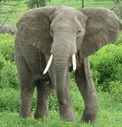
Ex.33, p.44. Complete the text and guess what animal it is.
I am from Africa.
I`ve got big . . .
I am big and strong.
I like fr]frf and . . .
I don`t eat . .
I can carry things, people and water the .
Come to the and see me.
I am … .
(an elephant)
carry [kærı]переносить
thing[θıŋ ]-вещь

Slide 10

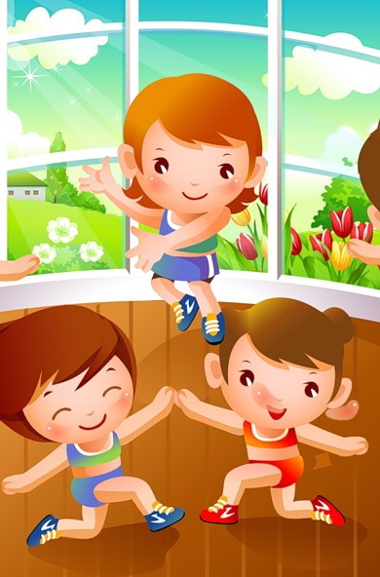
Let`s have a rest and sing song:
Clap Your Hands
Clap, clap, clap your hands
Clap your hands together.
Stamp, stamp, stamp your feet
Stamp your feet together!
Touch, touch, touch your ears,
Touch your ears together.
Touch, touch, touch your cheeks,
Touch your cheeks together!
Shake, shake, shake your hands,
Shake your hands together.
Smile, smile at your friends,
Let us smile together!

Slide 11
Ex.34 p.45 Listen and read:
[ i:] - please, field, sea, eagle
[e] - weather, elephant, desert
[əu] – cold, road, most, ocean
[au]- town, flower, cloudy, mountain
[ ei ]- game, today, change, favourite, whale

Slide 12
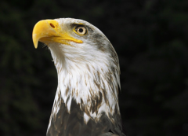
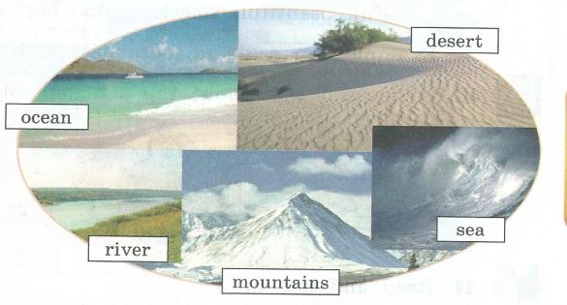
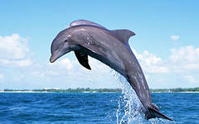
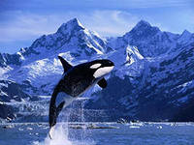
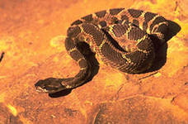
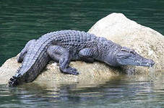
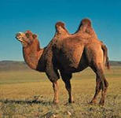
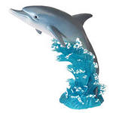
Ex.35 p.45Helps to find animals to their homes.
Example: The eagle lives in the mountains
desert
ocean
eagle
sea
river
sea
mountains
dolphin
whale
snake
camel
crocodile

Slide 13
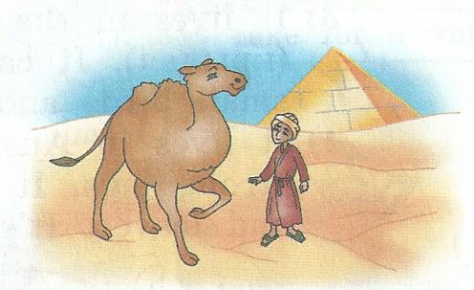
Ex.36 p.45 Match and read the dialogue
1) Have you got a pet?
c) Yes. I`ve got a camel.
2)What`s its name?
a) Ashby.
3)What does it like to eat?
e)Gras and apples.
4)What is it like?
b)Ashby is big, kind and strong.
5)What can it do?
d) Ashby helps my father to carry things.

Slide 14
Ex.37 p.45 Listen and check. Act out the dialogue.

Slide 15
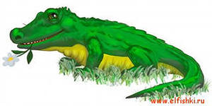
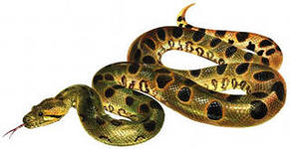
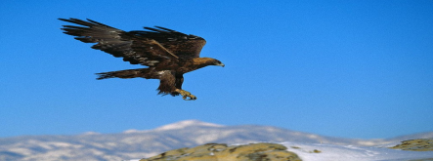
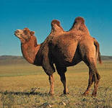
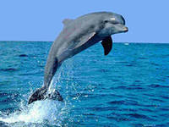
Workbook
Ex.12,13 p.25
4)snake
1) crocodile
5) camel
2) eagle
3)whale
6) dolphin

Slide 16
Homework:
(S.B) ex.41 p.46 read and match
(W.B) ex.15 p.26

Slide 17

The lesson is over

