Slide 1
Let’s go to the shop!
Урок для 4 класса по М.З. Биболетовой
Автор: Чубенко Н.Г.,
учитель английского языка,

Slide 2
Phonetic exercises
[ou]: hope, clothes, show, coat
[ei]: away, play, raincoat, trainers
[S]: shirt, T-shirt, shoes, shorts
[e]: red, help, dress, sweater
[u:]: room, blue, boots, shoes

Slide 3
Do you like shopping?
How often do you go shopping?
What do you like to buy?
What are your favourite shops?

Slide 4
Names of Shops
-Greengrocer`s - Butcher`s
-Dairy - Newsagent`s
-Sweet shop - Florist`s
-Book shop - Chemist`s
-Toys shop
-Clothing shop
-Baker`s

Slide 5
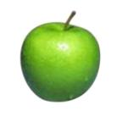
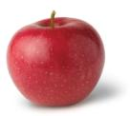
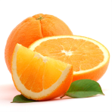
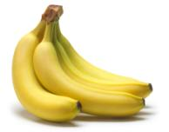
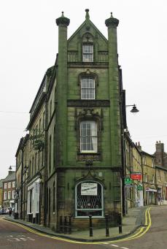

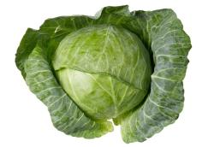
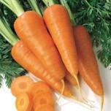
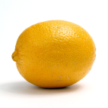
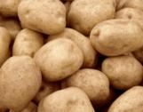
Let’s go to The Greengrocer`s!
What things can you see in The Greengrocer`s?
I can see … in The Greengrocer`s.
What would you like to buy in The Greengrocer`s?
I would like to buy … in The Greengrocer`s.
The Tall Green Shop
Notes:
The Tall Green Shop in England - http://www.flickr.com/photos/c-l-english/5142056099/
Cabbage - http://rastimsami.ru/uploads/posts/2011-01/1294232156_ttar_cabbage_03_h_launch.jpg&imgrefurl
Carrot - http://istarted.ru/wp-content/uploads/2010/10/carrot.jpg&imgrefurl
Tomato - http://www.wowoman.ru/wp-content/uploads/2010/02/tomato.jpg&imgrefurl
Potato - http://lenob.ru/wp-content/uploads/2010/08/potato-potassium-lg.jpg&imgrefurl
Banana - http://liveseed.net/uploads/posts/2010-12/1291722103_banana.jpg&imgrefurl
Green apple - http://www.asia.ru/images/target/photo/50616959/Green_Apple.jpg&imgrefurl
Red apple - http://ru-iphone.com/files/apple_1.jpg&imgrefurl
Lemon - http://marinadedave.files.wordpress.com/2008/04/lemon1.jpg&imgrefurl
Orange - http://img0.liveinternet.ru/images/attach/c/1//56/766/56766260_1269193900_798orange.jpg&imgrefurl

Slide 6
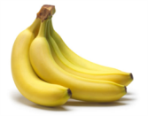

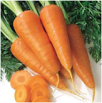
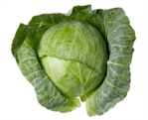
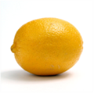
An apple - яблоко
A babana - банан
An orange - апельсин
A tomato - помидор
A carrot - морковь
A cucumber-огурец
Lettuce - салат
Cabbage - капуста
a potato - картошка
A lemon - лимон

Slide 7
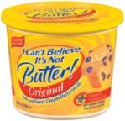
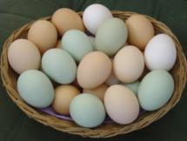
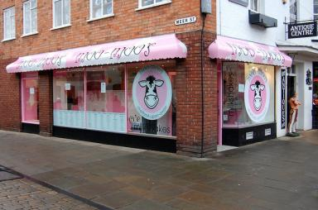
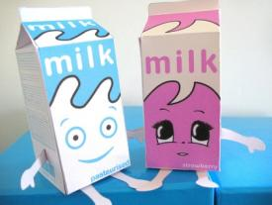
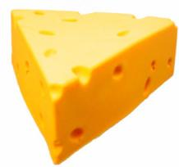
Let’s go to The Dairy!
What things can you see in The Dairy?
I can see … in The Dairy.
What would you like to buy in The Dairy?
I would like to buy … in The Dairy.
Moo-Moo's Milk Shake Shop
Notes:
Moo-Moo's Milk Shake Shop - http://www.flickr.com/photos/21428529@N00/5479499880/
Butter - http://popsop.ru/
Milk - http://img0.liveinternet.ru/images/attach/c/2//71/75/71075740_1298400474_PaperMilk.jpg&imgrefurl
Eggs - http://family-planet.ru/wp-content/uploads/2011/03/eggs1.jpg&imgrefurl
Cheese - http://www.cheesemania.ru/cpics/whence_cheese1.jpg&imgrefurl

Slide 8
Milk - молоко
Cheese - сыр
Eggs - яйца
Butter – сливочное масло
Ice-cream–мороженое
Cream - сметана

Slide 9
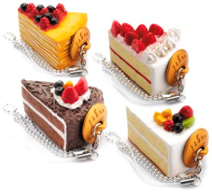
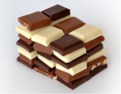
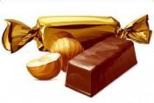
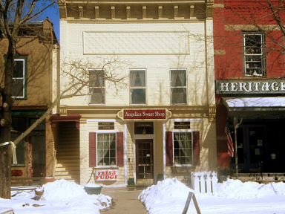
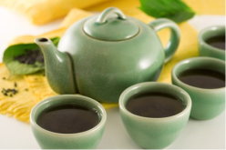
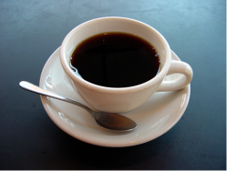
Let’s go to The Sweet Shop!
What things can you see in The Sweet Shop?
I can see … in The Sweet Shop.
What would you like to buy in The Sweet Shop?
I would like to buy … in The Sweet Shop.
Angelica, NY : Angelica Sweet Shop
Notes:
Angelica, NY : Angelica Sweet Shop - http://www.city-data.com/picfilesc/picc24101.php
Coffee - http://dic.academic.ru/pictures/wiki/files/65/A_small_cup_of_coffee.JPG&imgrefurl
Tea - http://dobrochan.ru/src/jpg/1004/tea.jpg&imgrefurl
Cakes - http://tortemm.altervista.org/images/cake-royale.jpg&imgrefur
Chocolate - http://dic.academic.ru/pictures/wiki/files/67/Chocolate.jpg&imgrefurl
Bread - http://free-extras.com/images/pumpkin_bread-863.htm

Slide 10
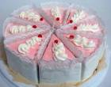

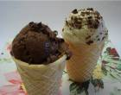
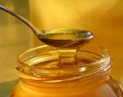
Sweets - конфеты
Cakes - торты
Juice - сок
Lollipops - леденцы
Ice-cream - мороженое
Jam - джем
Chocolate - шоколад
Honey - мёд

Slide 11
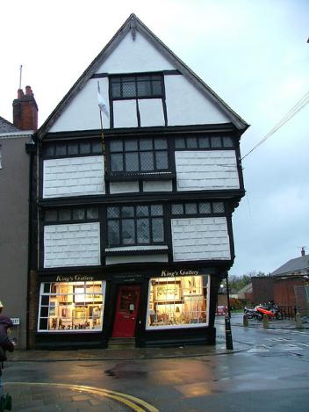
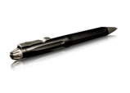


Let’s go to The Book Shop!
What things can you see in The Book Shop?
I can see … in The Book Shop.
What would you like to buy in The Book Shop?
I would like to buy … in The Book Shop.
The Old King’s School Shop
Notes:
The Old King's School Shop - http://www.flickr.com/photos/bixentro/319693840/
Pen - http://files.ladoshki.com/data/news/2008-10/SureFire_Pen_1.jpg&imgrefurl
Book - http://img1.liveinternet.ru/images/attach/c/1//55/782/55782266_open_book.jpg&imgrefurl
Bag - http://1form.ru/wp-content/uploads/2010/01/school_bag.jpg&imgrefurl
Pencil - http://www.happy-pm.com/images/pencils3.jpg&imgrefurl

Slide 12


Slide 13

Books

Slide 14
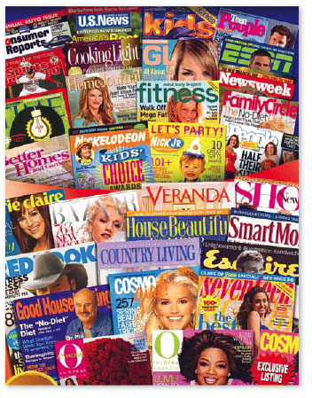
Magazines

Slide 15
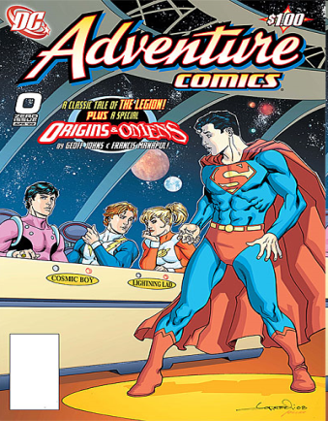
Comics

Slide 16
a book –книга
a pen – ручка
a pencil –карандаш
a ruler – линейка
an exercise book – тетрадь
a CD disc- диск
a magazine – журнал
comics - комиксы

Slide 17
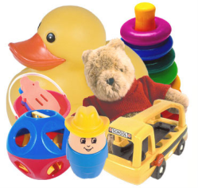
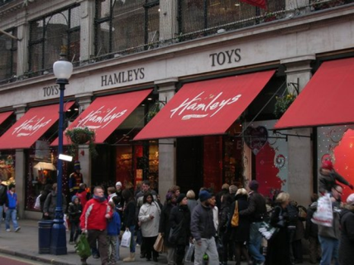
Let’s go to The Toys Shop!
What things can you see in The Toys Shop?
I can see … in The Toys Shop.
What would you like to buy in The Toys Shop?
I would like to buy … in The Toys Shop.
Hamleys
Notes:
Hamleys - http://www.yelp.co.uk/biz_photos/SApdMneCNUC0SKMZblXiRg?select=5ZDOAuk60PieGmB8LmxZ2g
Toys - http://www.pm-plus.ru/Img%2520new/s_toys.jpg&imgrefurl

Slide 18
Toys - игрушки
A teddy bear – плюшевый мишка
A doll – кукла
A ball – мяч
Lego – лего
Cars – машинки
A bike -велосипед

Slide 19
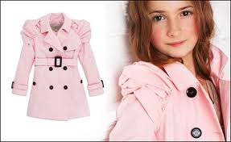
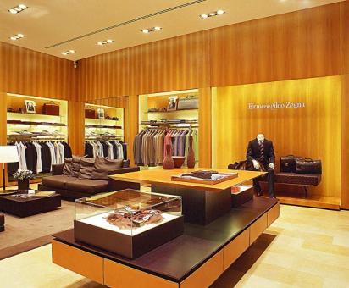
Let’s go to The Clothing Shop!
What things can you see in The Clothing Shop?
I can see … in The Clothing Shop.
What would you like to buy in The Clothing Shop?
I would like to buy … in The Clothing Shop.
Notes:
Pets - http://zoofun.com.ua/media//pets.jpg&imgrefurl
Pet Shop - http://3.bp.blogspot.com/-Undc7ZJKq1U/TV_Kq5foWMI/AAAAAAAAAWE/btntC6XTiI0/s1600/pet_shop_600.jpg&imgrefurl
19

Slide 20
Shopping for clothes
a T-shirt shoes
a sweater jeans
a cap trainers
a suit mittens
a raincoat shorts
a coat boots
an umbrella dresses
a scarf trousers
a hat clothes
SEE: Student’s book – Unit6, p. 25, ex. 1

Slide 21
Grammar Rule !!!
Слова trousers, jeans, shorts, clothes употребляются только во множественном числе.
My jeans are blue. How much are the trousers? His shorts were dirty.

Slide 22
Action time: Let`s sing and dance
Clap clap clap
Clap! Clap! Clap! Stamp! Stamp! Stamp!
Hear what a lovely noise we make. Stretch up high! Shake! Shake! Shake!
Are we wide awake?
Clap! Clap! Clap! Stamp! Stamp! Stamp!
Hear what a lovely noise we make. Stretch up high! Shake! Shake! Shake!
Are we wide awake?
Now wiggle your fingers. Scrunchy up your nose. Touch your head, shoulders, knees and toes. Dance all around, sing tra-la-la-la-la. Now run on the spot and stop!

Slide 23
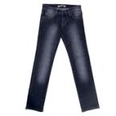
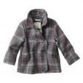
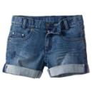
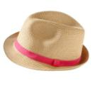
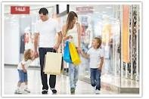
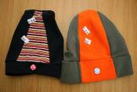
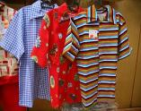
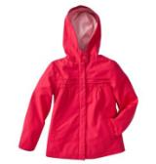
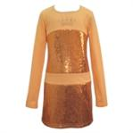
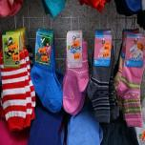
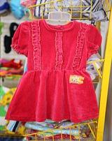
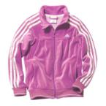
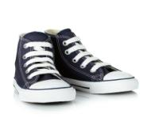
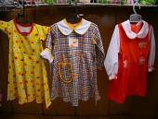
Let’s go shopping!
Notes:
Kitchen - http://www.countryliving.com/cm/countryliving/images/Tp/kitchen-reno-1-de.jpg&imgrefurl
Sandwich - http://www.cimus.ru/i/catalog/big/502.jpg&imgrefurl
Porridge - http://www.beingdiabetic.co.nz/images/2010/porridge.jpg&imgrefurl
Butter - http://popsop.ru/
Milk - http://img0.liveinternet.ru/images/attach/c/2//71/75/71075740_1298400474_PaperMilk.jpg&imgrefurl
Eggs - http://family-planet.ru/wp-content/uploads/2011/03/eggs1.jpg&imgrefurl
Cheese - http://www.cheesemania.ru/cpics/whence_cheese1.jpg&imgrefurl
Coffee - http://dic.academic.ru/pictures/wiki/files/65/A_small_cup_of_coffee.JPG&imgrefurl
Tea - http://dobrochan.ru/src/jpg/1004/tea.jpg&imgrefurl
Cakes - http://tortemm.altervista.org/images/cake-royale.jpg&imgrefur
Chocolate - http://dic.academic.ru/pictures/wiki/files/67/Chocolate.jpg&imgrefurl
Bread - http://free-extras.com/images/pumpkin_bread-863.htm
Juice - http://www.smorodinka.net/images/orange-juice.jpg&imgrefurl
Nuts - http://scienceblog.ru/wp-content/uploads/2008/12/nut_splash.jpg&imgrefurl
Honey - http://molozhe.ru/wp-content/uploads/2010/05/Honey-massage.jpg&imgrefurl
Jam - http://home-jams-pickles.ru/wp-content/uploads/2009/07/Jam-from-apricots.jpg&imgrefurl
Ice cream - http://our-daily.com/wp-content/uploads/2010/08/ice-cream-cone1.jpg&imgrefurl

Slide 24
Dialogue: Fill in the missing words
At the Clothing shop
Miss Chatter: Hello!
Shop assistant: Hello, Madam! Can I ___you?
Miss Chatter: I would ___ to try a T-shirt and jeans.
Shop assistant: What colour?
Miss Chatter: Blue, ____.
Shop assistant: Any ____, Madam?
Miss Chatter: I`d like a smaller ___!
Shop assistant: Here ___ are.
Miss Chatter: Does it ____ me?
Shop assistant: It ____ good.
Miss Chatter: How ____ are the jeans and a T-shirt?
Shop assistant: 25 pounds.
WORDS :much, looks, please, like, you, problem, suit, size, help.

Slide 25
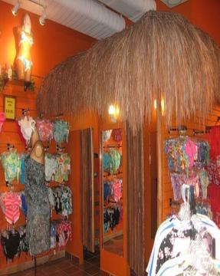
DIALOGUE: At the clothing shop
Miss Chatter: Hello!
Shop assistant: Hello, Madam! Can I help you?
Miss Chatter: I would like to try a T-shirt and jeans.
Shop assistant: What colour?
Miss Chatter: Blue, please.
Shop assistant: Any problem, Madam?
Miss Chatter: I`d like a smaller size!
Shop assistant: Here you are.
Miss Chatter: Does it suit me?
Shop assistant: It looks good.
Miss Chatter: How much are the jeans and a T-shirt?
Shop assistant: 25 pounds.
Now act out the dialogue!
Notes:
Kitchen table - http://styleandinterior.ru/wp-content/uploads/2011/03/kitchen-table-480.jpg&imgrefurl
Family at the table - http://www.flickr.com/photos/tonynewell/2149144869/

