Slide 1
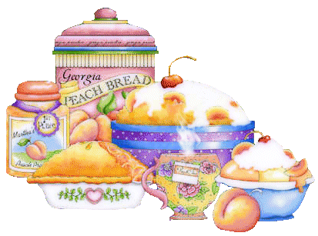
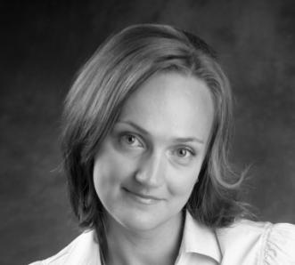
Презентация к уроку
Food.
Table manners.
Автор:
Измайлова Любовь Александровна
ГБОУ СОШ № 583
Г. Санкт-Петербург

Slide 2



Речевая разминка “What Do I Like?”
I
She
I
He
I
She
I you
Do you me ?

Slide 3

Team competition: “Let’s train using Irregular Verbs”
Oranges
Apples
Get up
Have
Give
See
Come
Drink
I am afraid you’re not right.
Go
Say
Take
Eat
Can
Put
Yes, you are right.

Slide 4

New Irregular Verbs
Read the verbs after me
Say tat you did it too.
Swim-swam
[swӀm]-[swᴂm]
Run – ran
[rʌn]-[rᴂn]
Know –knew
[nәƱ]-[ nju:]
Think-thought
[θӀηk]-[θɔ:t]
I swam in the swimming pool yesterday.
I ran at the stadium in the morning.
I knew his mother.
I thought so.

Slide 5

New Words.
word | transcription | Picture/translation | Example
potato | [po’teitәu] |  | This is a potato. Your parents like to eat meat and potatoes.
buy- bought | [‘bai] [‘bɔ:t] |  | You always buy food in the shop.
tasty | [‘teisti] | вкусный | Sweets are very tasty.

Slide 6

Name the given sounds. “Green” will read the words with[ i: ], “Red” will read the words with [e] , “Blue” will read the words with [u:]
“Green” | “Red” | “Blue”
[ i: ] | [e] | [u:]
Eat, door, bread, sweet, hot-dog, parents, bed, breakfast, cheese, hide-and-seek, sport, usually, juice, please, meat, ate, soup, bird, clean, teacher, cat, tea, said, could, two, ice cream, twelve, many, drank , every, blue

Slide 7
“Green” | “Red” | “Blue”
blue
eat
cheese
hide-and-seek
clean
every
ice-cream
teacher
sweet
tea
bread
usually
breakfast
ate
meat
soup
please
bed
many
two
said
juice
twelve
could

Slide 8



Let’s Check Your Home-task
Dino! Would you like some___?
Yes, ___.
Here you are.
Thank you. May I have some ___ , please?
Of course! Help yourself!
___ you.
You are welcome!

