Slide 1

Мы умеем говорить и читать по английски

Slide 2
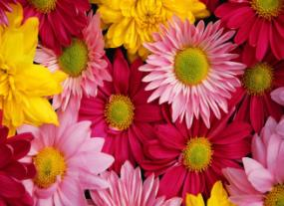
Two teams:
I TEAM
“STARS “
II TEAM
“FLOWERS”

Slide 3
Phonetic exercise-речевая зарядка
“Good morning,good morning,
good morning to you,
Good morning,good morning,
I`m glad to see you.”

Slide 4
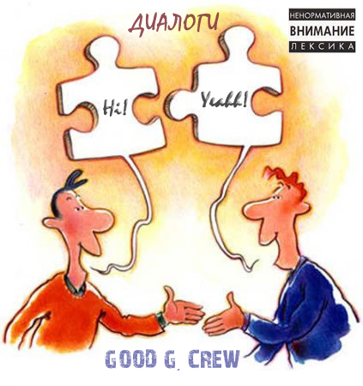
Dialogue-knowing-диалог
- Good morning.
- Hello!
- What is your name?
- My name is … .And what is your name?
- My name is … .How old are you ?
- I`m … and you?
- …

Slide 5
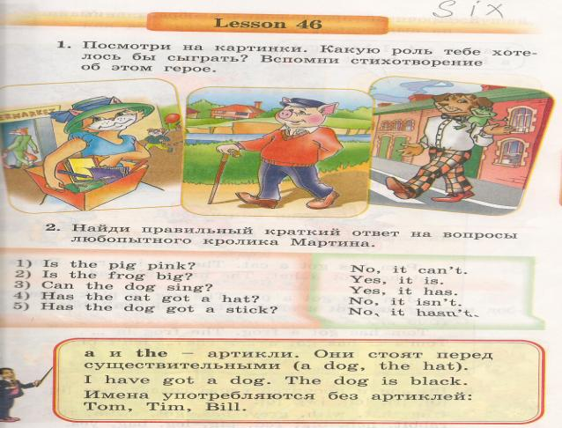
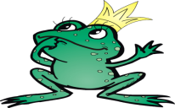
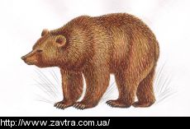
Poems-стихи
A cat with a hat. A pig with a stick. A dog with a frog.
Green frog.
Brown bear

Slide 6
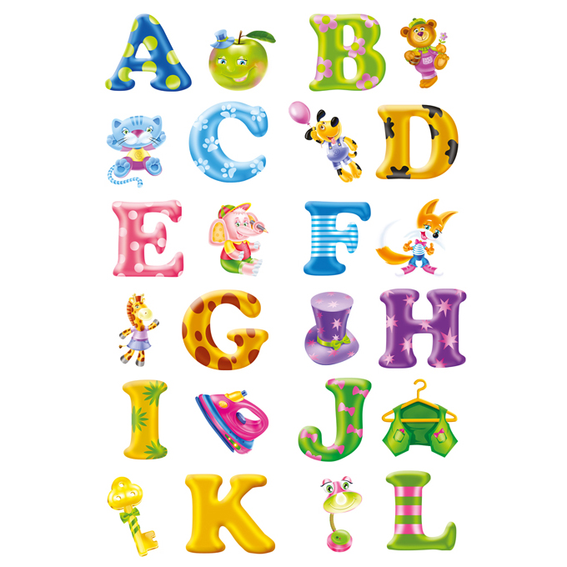
Alphabet

Slide 7
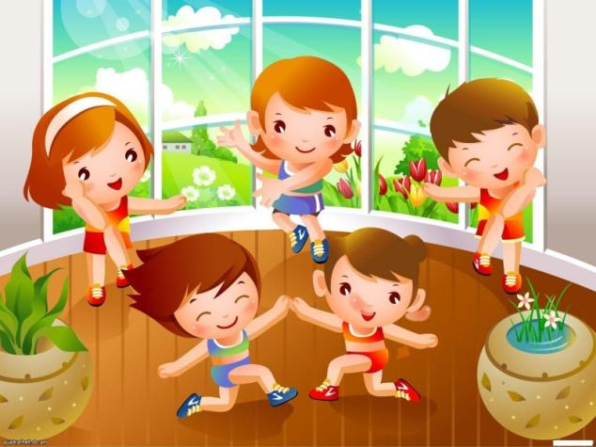
Action time-физкультминутка

Slide 8
Reading-чтение
a cat
ten
fox
bad
pen
clock
fat
pencil
frog
a big rabbit
seven
dog
a fat pig
red
The frog can jump.
Six rabbits can skip.
a red pencil
Jim has got a pen.
Sam has got a red hen.
The cockerel has got a clock.
The cat has got a hat.
The fox has got a box.
The pig has got a long stick.
Nick has got a red pen.
The pig is pink.

Slide 9
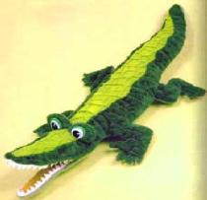
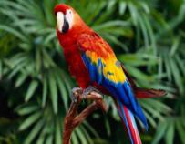
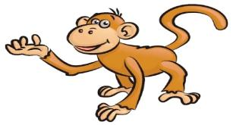
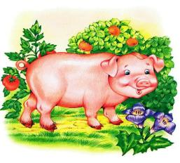
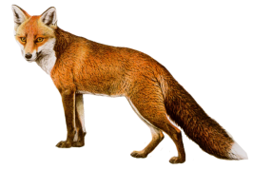
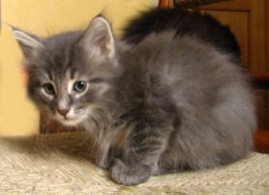
Riddle-загадки
(a parrot)
(a crocodile)
(a monkey)
(a fox)
(a pig)
(a cat)

Slide 10
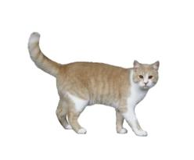
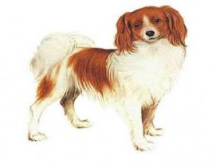
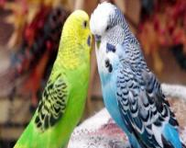
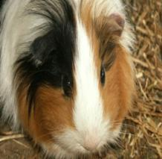
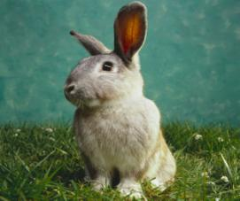
My pet-мой питомец
I have got a…
It is …
It can …

Slide 11
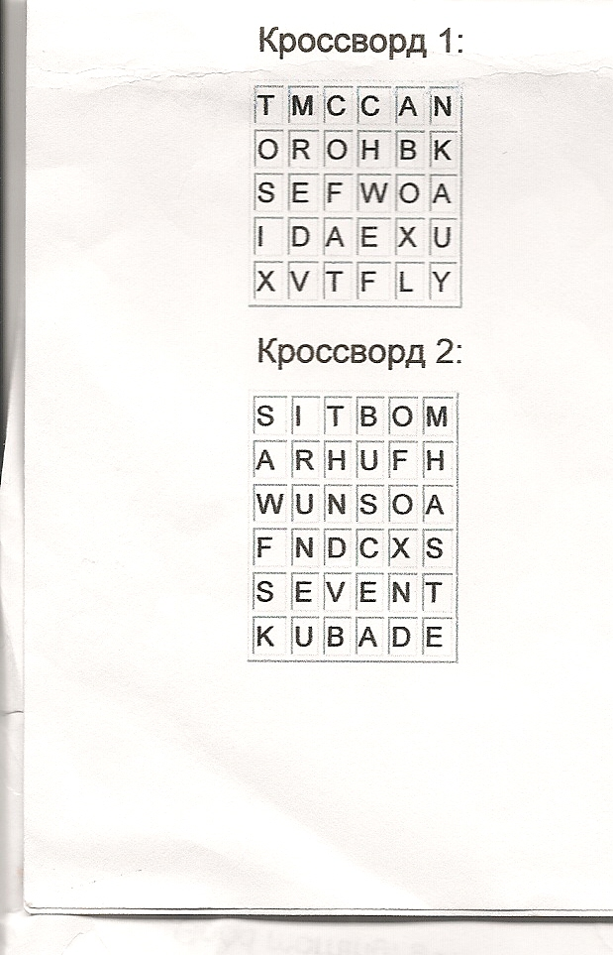
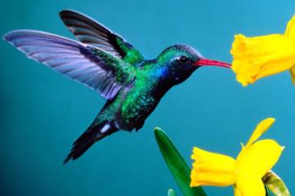
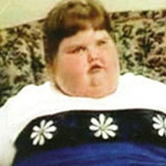
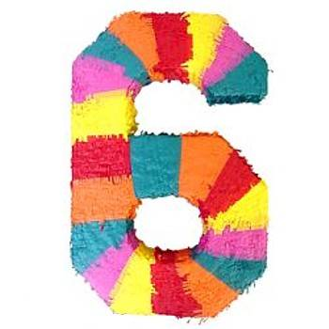
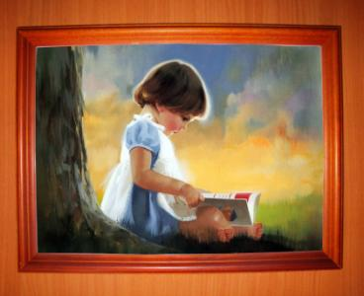
Сrossword puzzle I-кроссворд

Slide 12
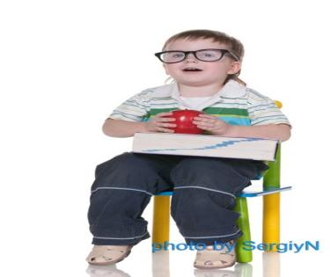
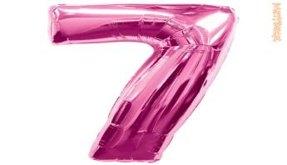
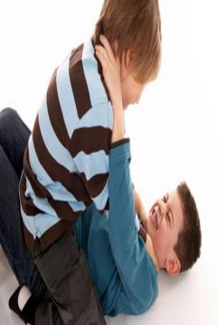
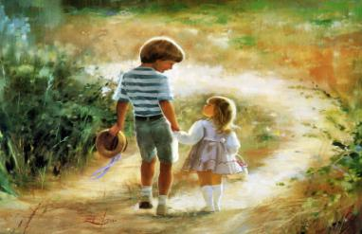
Сrossword puzzle II-кроссворд2

Slide 13
Put the words-вставить слова
… cat is black.(hat/his)
He has got a … . (big/pig)
Tom`s … can jump. (bad/cat)
Ann`s … is red. (his/hat)
I have got a … . (pig/big)
His got is not … . (fat/cat)

Slide 14
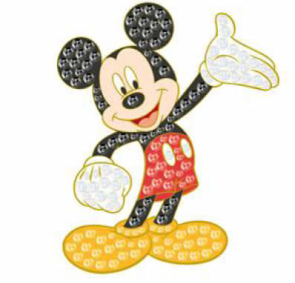
Thank you very much!
Goodbye!

