Slide 1
“In nature there are neither rewards nor punishments- there are consequences” R.G. Ingersoll (1833 – 1899), an American political leader and orator

Slide 2


OUR FRAGILE PLANET
Урок в 6-ом классе по теме
« Ecology»
к УМК О.В. Афанасьевой,
И.В. Михеевой

Slide 3
Nuclear pollution
Environmental
problems
The destruction of the
ozone layer

Slide 4
Air pollution
Nuclear pollution
The growth of
population
Environmental
problems
The destruction of the
ozone layer
Water pollution
Shortage of natural
resources

Slide 5
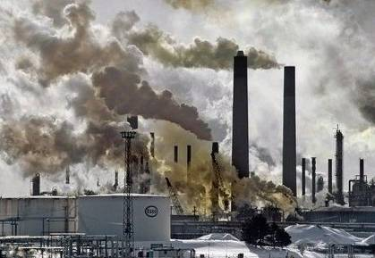
http://www.youtube.com/watch?v=bHUnzPEy-nA&feature=related

Slide 6
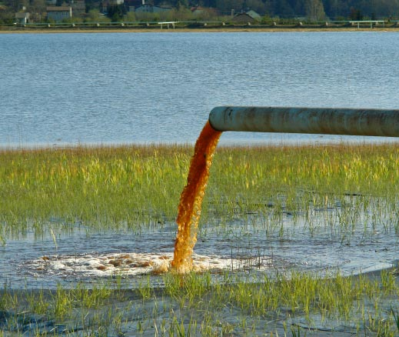
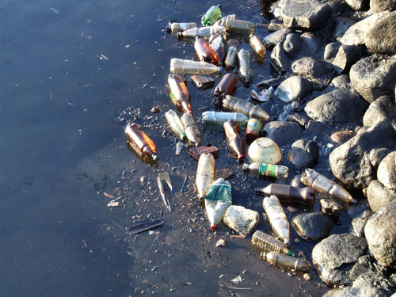
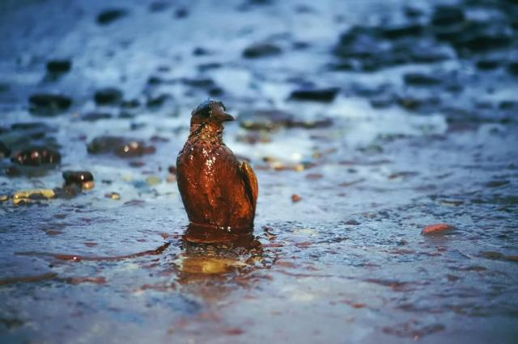

Slide 7
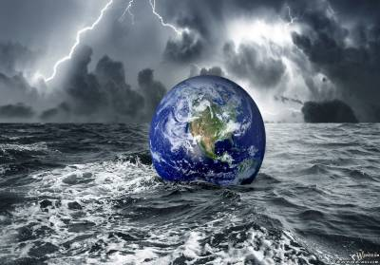
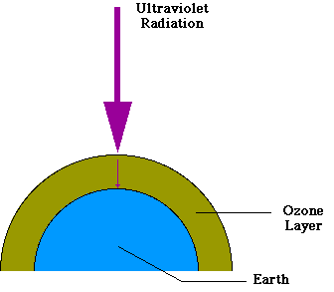
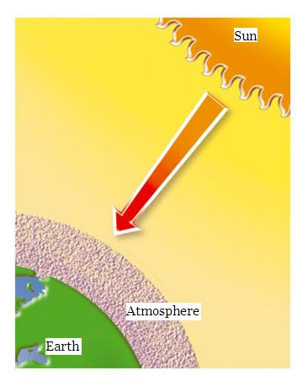
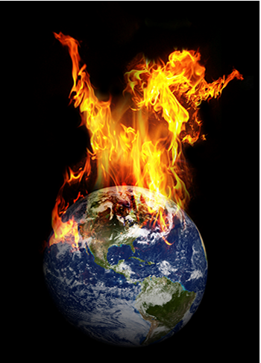

Slide 8
GAP-FILLING
FILL IN THE GAPS IN THE TEXT BELOW WITH THE WORDS FROM THE TABLE.
recycling – toxic - dirty – dumping – poisons – smoke - waste- dangerous
The main reason for pollution is (1)_____________- something which is no longer needed. Waste can be many things: it can be yesterday’s newspaper, an old car,(2)________bath water, or (3) __________from factories. Some waste is (4)__________ , because it contains (5)_____________. This kind of waste is called (6)__________waste. If you want to do something better than (7)__________, you can change waste into something different. You can sort out your waste so that paper, metal and clothes, for example, can be sold to dealers for (8)___________.

Slide 9
CHECK YOURSELVES:
The main reason for pollution is (1) waste - something which is no longer needed. Waste can be many things: it can be yesterday’s newspaper, an old car, (2) dirty bath water, or (3) smoke from factories. Some waste is (4) dangerous, because it contains (5) poisons. This kind of waste is called (6) toxic waste. If you want to do something better than (7) dumping, you can change waste into something different. You can sort out your waste so that paper, metal and clothes, for example, can be sold to dealers for (8) recycling.

Slide 10
GRAMMAR FOR REVISION
Future Simple Present Simple
shall if V
will + V Vs
Example: pollute rivers- fewer fish die
If we don’t pollute rivers, fewer fish will die.
use filters- have more drinking water
If people use filters at home, they will have more drinking water.
destroy rainforests - rare plants and animals survive
protect wildlife- save endangered species
use bicycles and walk more – reduce air pollution
dump waste into rivers- animals leave their habitats
recycle paper, glass, cans – save important resources

Slide 11
HOW TO SOLVE THE ENVIRONMENTAL PROBLEMS?
What should or shouldn’t we do to protect our environment? Use the verbs
in the box to complete the sentences.
cut down, destroy, plant, protect, recycle, save, throw away, waste
We should | We shouldn’t
_____tropical rainforests | _______trees
_____more trees | _______ forests
_____paper | _______plastic bags
_____endangered species, such as pandas | _______energy and water

Slide 12
CHECK YOURSELVES:
We should | We shouldn’t
save\protect tropical rainforests | cut down trees
plant more trees | destroy forests
recycle paper | throw away plastic bags
save\protect endangered species, such as pandas | waste energy and water

Slide 13


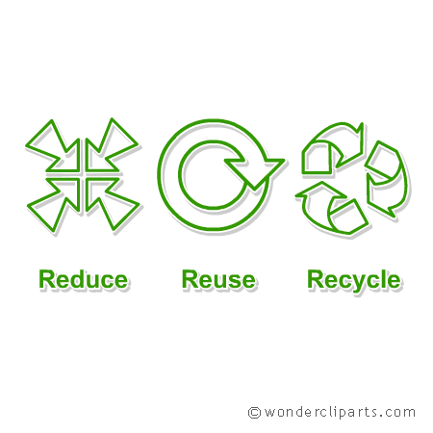
THE 3 R’S RULE
http://www.youtube.com/watch?v=G1yBQv1hLRY&feature=related

Slide 14
SUMMARY
Problem: | Solution:
Water pollution
Air pollution
Dumping

Slide 15
HOMEWORK:
Ex. 20 p. 75-77
THANK YOU!

Slide 16
FIND TEN WORDS ON THE TOPIC “MAN AND THE NATURAL WORLD”.
THEY GO ACROSS, DOWN AND AT THE ANGLE
Q | I | S | K | B | T | D | D | U | M | P
W | O | D | L | N | Y | F | L | B | R | O
E | P | F | Z | M | U | G | A | N | O | L
W | A | S | T | E | O | H | Z | M | Z | L
R | A | F | U | Q | P | J | X | Q | O | U
E | N | V | I | R | O | N | M | E | N | T
T | C | G | X | W | V | S | A | F | E | I
Y | A | H | C | E | A | I | C | W | T | O
N | U | C | L | E | A | R | V | E | Y | N
U | S | J | V | R | S | K | V | E | U | I
D | E | S | T | R | U | C | T | I | O | N

Slide 17
CHECK YOURSELVES:
ENVIRONMENT
POLLUTION
SURVIVE
WASTE
DESTRUCTION
DUMP
OZONE
CAUSE
SAFE
NUCLEAR

Slide 18
Q | I | S | K | B | T | D | D | U | M | P
W | O | D | L | N | Y | F | L | B | R | O
E | P | F | Z | M | U | G | A | N | O | L
W | A | S | T | E | O | H | Z | M | Z | L
R | A | F | U | Q | P | J | X | Q | O | U
E | N | V | I | R | O | N | M | E | N | T
T | C | G | X | W | V | S | A | F | E | I
Y | A | H | C | E | A | I | C | W | T | O
N | U | C | L | E | A | R | V | E | Y | N
U | S | J | V | R | S | K | V | E | U | I
D | E | S | T | R | U | C | T | I | O | N

