Slide 1
«Who is in charge of Our Planet?»
Презентация к открытому уроку в 8 классе

Slide 2
 | n | a | t | u | r | e
 |  |  |  |  | a | c | i | d
 |  |  |  | s | m | o | k | e
 |  |  |  |  | p | l | a | n | t | s
 |  |  |  | s | m | o | g
 | g | a | r | b | a | g | e
h | e | a | l | t | h | y
Check
We are surrounded by plants and animals. So, what is around us?
What harmful rain do you know?
What do we get as a result of burning fuel in cars and lorries?
Polluted air is bad for people, animals and…
Dirty air is called …
People throw away a lot of …
We don’t want to be ill. We want to be …

Slide 3




Other environmental organizations:
The World Wide Fund for Nature (WWF) is an international non-governmental organization.
The European Environmental Bureau (EEB).
The United Nations Forum on Forests (UNFF).

Slide 4
Pollution
Pollution is the introduction of contaminants
into a natural
environment.

Slide 5
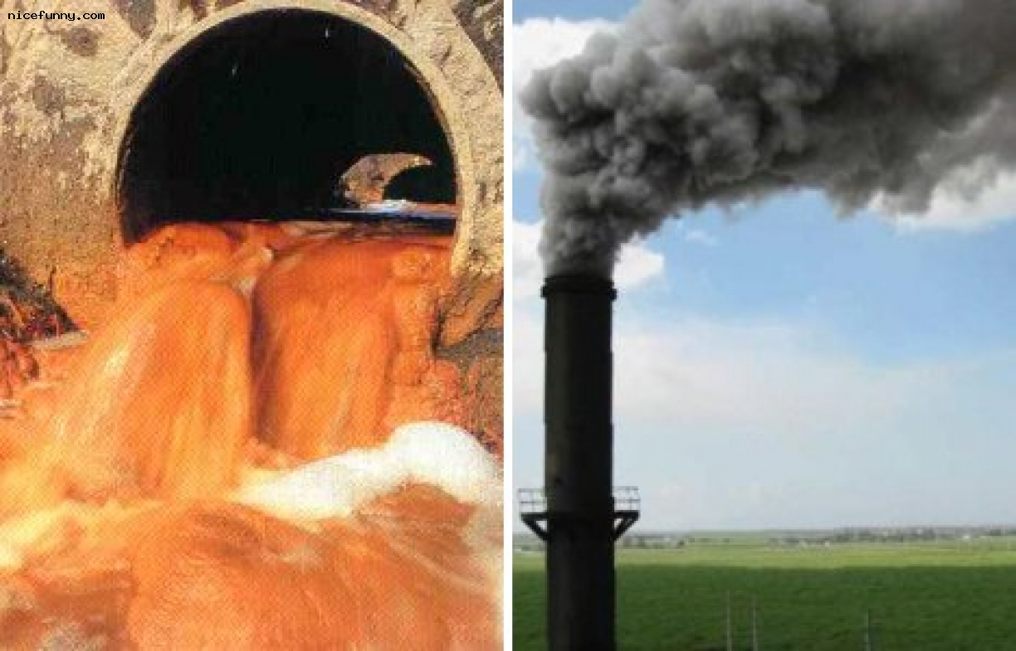

Slide 6
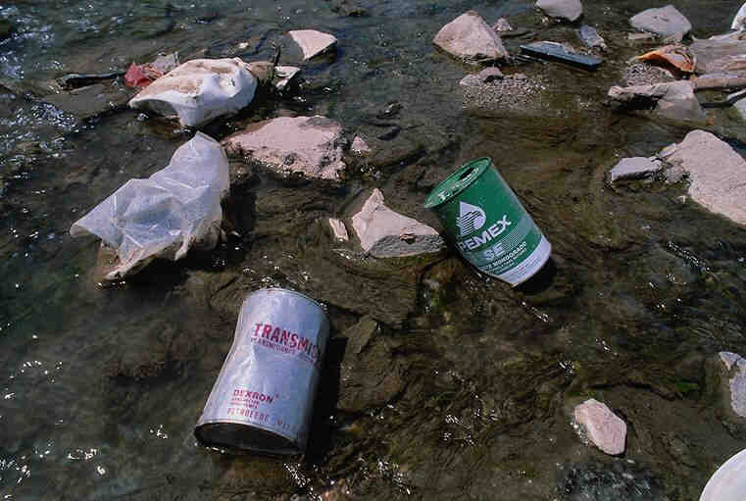

Slide 7
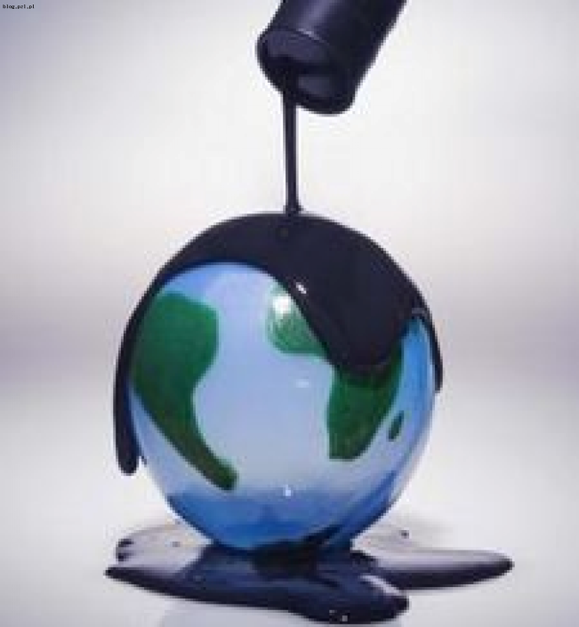

Slide 8
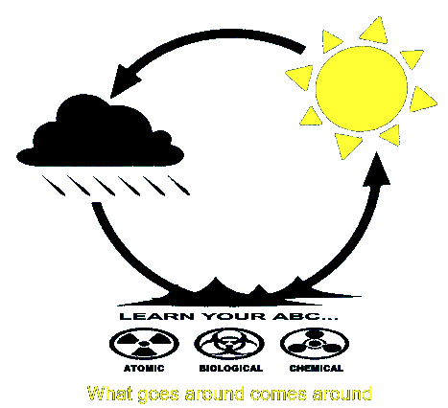

Slide 9
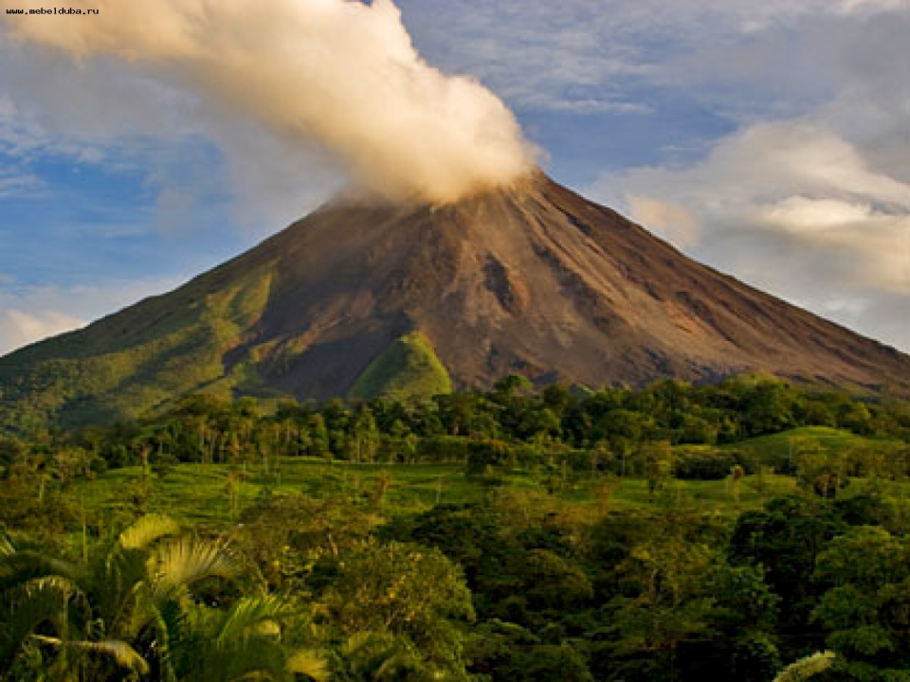

Slide 10
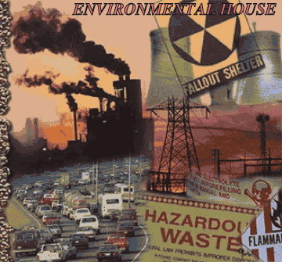

Slide 11
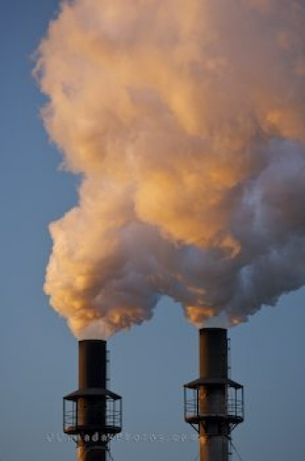

Slide 12


Slide 13
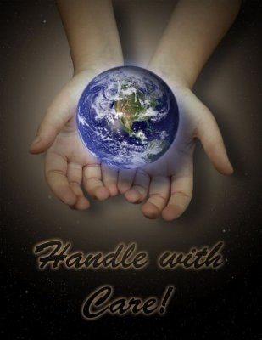

Slide 14
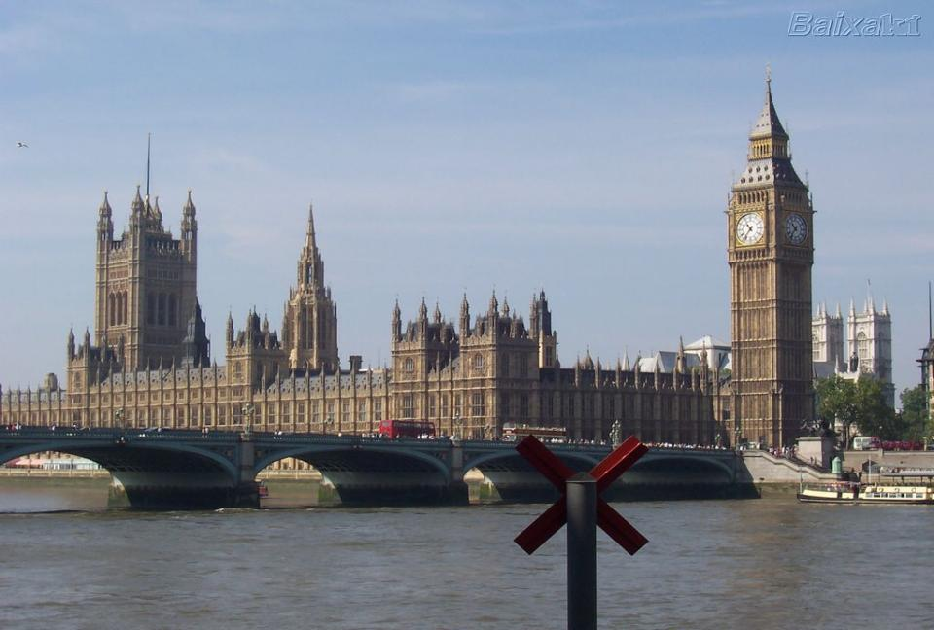
British parliament

Slide 15




Slide 16
Conditional I
If + the present simple + will + I form
1) If companies don't dump waste, our atmosphere will be much cleaner.
2) If you think about our nature, you won't put litter on the grass.
Conditional II
If + the past simple + would + I form
1) If we opened more national parks, we would save wild animals.
2) If I were you , I would call her right now.

Slide 17
First Conditional
a) the trees (cut down), the forest (die)
b) paper (recycle), nature (not damage)‏
c) nature (not polluted), wild animals (not hurt)‏
d) animals (save), nature (not polluted)‏

Slide 18
Slogans:
a) Put your litter in the bin!
b) Keep dogs under control!
c) Keep off the grass!
d) Keep your country tidy!

Slide 19
Be/get|used to|somthing,doing something –привыкнуть к чему-либо, иметь привычку делать что-либо.
Word focus:be/get used to smth/to doing smth
1. We were/are used to having breakfast together. | Мы имеем привычку/привыкли завтракать вместе.
2.She isn’t used to the strange weather in this country. | Она не привыкла к странной погоде в этой стране.
3.People got used to polluting the planet. | Люди привыкли загрязнять планету.
4.We aren’t used to recycling waste products. | Мы ее привыкли перерабатывать отходы.

Slide 20
Соедини слова
environment
pollution
wild life
nature
ecology
to protect
to reduce
cut down
litter
recycling
использовать еще раз
экология
природа
дикий мир
окружающая среда
уменьшать
защищать
мусор
загрязнение
вырубать
EXERCISE IS DONE

