Slide 1


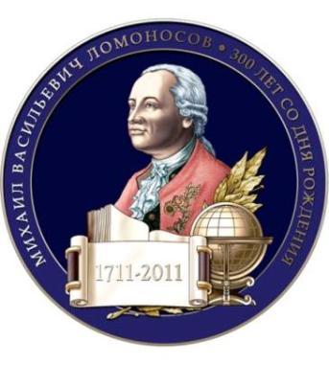


M.V.Lomonosov

Slide 2

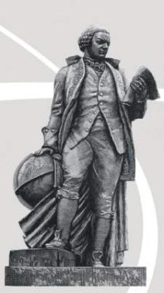
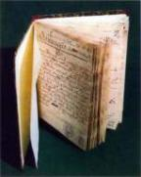
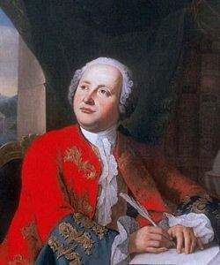
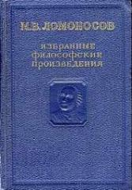
Mikhail Vasilievich Lomonosov
M. V. Lomonosov, is known as the father of Russian science, an outstanding poet, founder of Russian literature and creator of the Russian language.

Slide 3
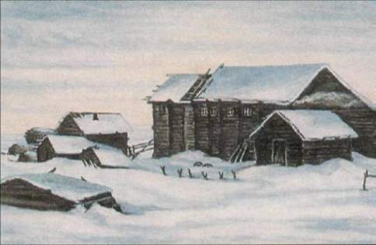
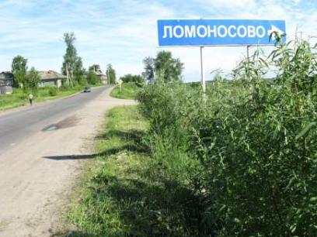
M.V. Lomonosov was born on the 19th of November 1711 in a fisherman’s family near Kholmogory in the village of Denisovka (later renamed Lomonosovo in his honor) not far from Arkhangelsk .

Slide 4
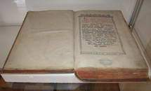
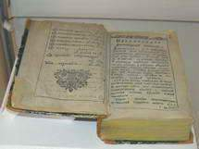
Learning was his passion. At an early age Mikhail learned to read and write through church books. When he was fourteen Lomonosov was given copies of “Modern Church Slavonic” (a grammar book) and Leonty Magnitsky’s “Arthimetic.”

Slide 5
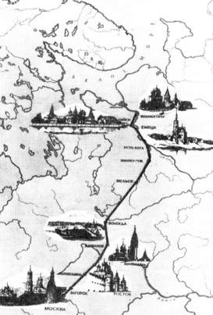
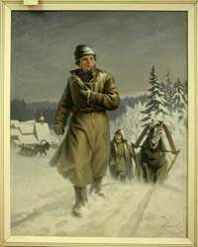
When he was 19, Lomonosov went on foot to Moscow where he entered the Slavic Greek Latin Academy. The Academy was closed to peasants and Lomonosov had to hide his peasant origin. He pretended to be of noble birth.
Kholmogory
Moscow

Slide 6
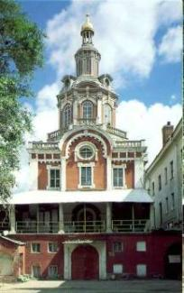
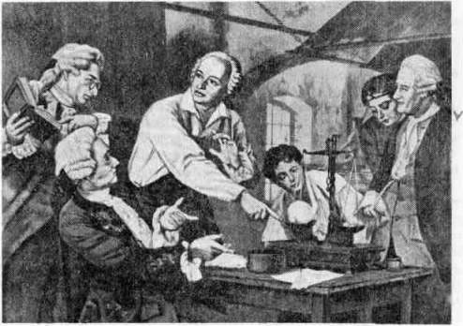
Here he studied Latin and mastered it in a short period of time. He completed a twelve-year study course in only five years, graduating at the top of his class.

Slide 7
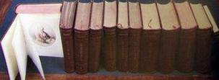
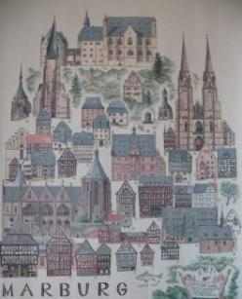
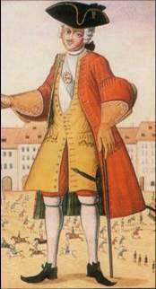
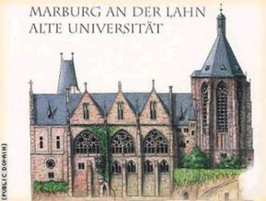
He was a brilliant pupil and in 1736 he was sent abroad at the University of Marburg. While abroad Lomonosov studied philosophy, physics, mathematics and foreign languages and even began writing poetry. He also developed an interest in German literature.

Slide 8
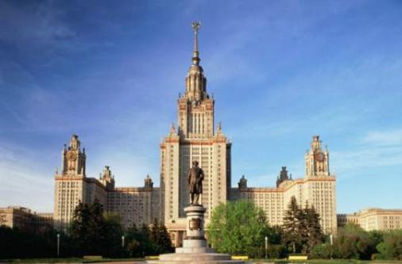
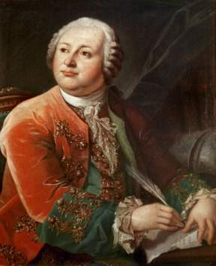
Lomonosov founded Moscow State University in 1755. This university, officially named after Lomonosov, is at the apex of the Russian system of higher education.

Slide 9
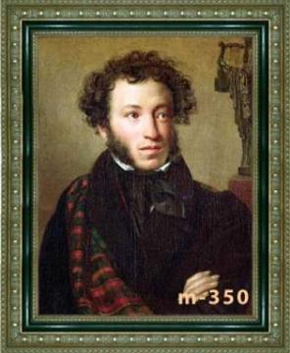
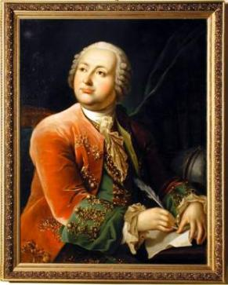
A. Pushkin said about Lomonosov:
«Lomonosov was a great man…. He founded the first Russian university: or to express it more correctly he himself was our first university».

Slide 10
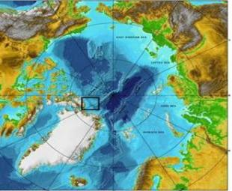
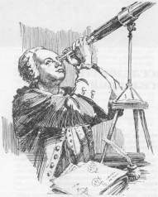
M.V.Lomonosov made many important discoveries in different fields of science: physics, chemistry, astronomy. The last period of Lomonosov’s activity was connected with his scientific invesnigation in navigation. He tried to find a short sea route from the West to the East through the Arctic Ocean.

Slide 11
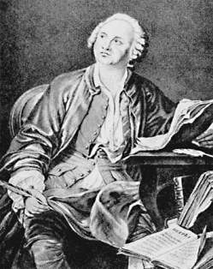
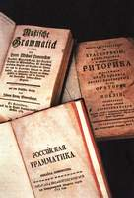

His literary works remain one of the most significant pages of Russian literature in the 18 th century.

Slide 12
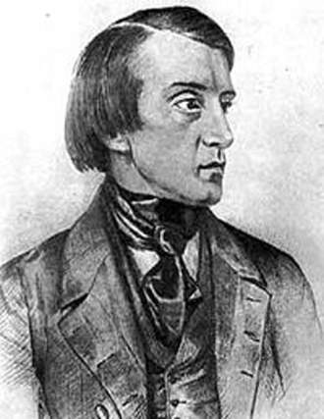
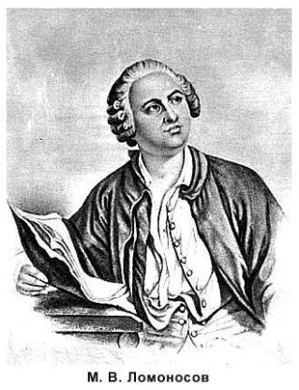
Russian critic Belinsky wrote of Lomonosov, «Our literature begins with Lomonosov; he was its father and mother,he was its Peter the Great ».

Slide 13
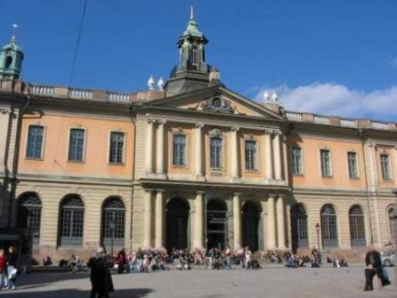
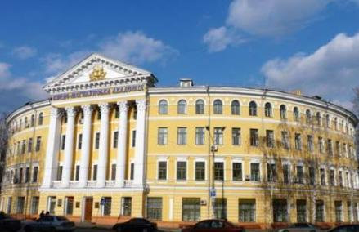
At the end of his life in 1764 Lomonosov was elected honorary member of the Stocholm and Bologna Academies

Slide 14
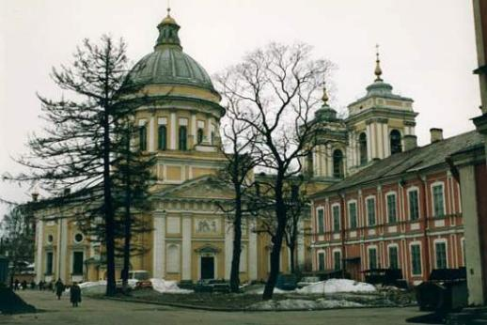
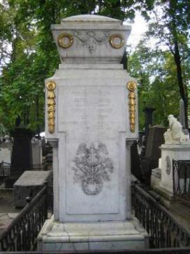
In 1765, Lomonosov caught a cold and died on the 15 th of April 1765 at age 54. He is buried in the cemetery of Alexander Nevsky Monastery in St Petersburg .

Slide 15
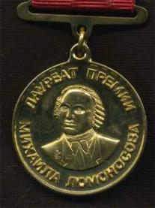
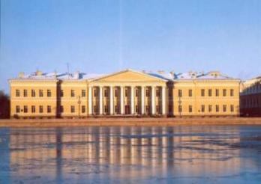
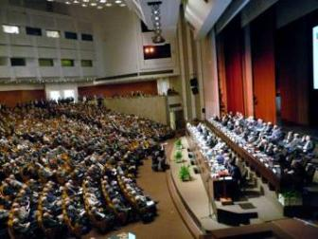
Lomonosov is widely known and honoured in our country. The Russian Academy of Sciences awards Lomonosov honorary medals in scientific achievement - one to a Russian and one to a foreign scientist.

Slide 16
After reading activities
What are these historical dates remarkable for?
1711; 1736; 1755; 1764; 1765.

