Slide 1
The Golden Age of
Russian Literature

Slide 2
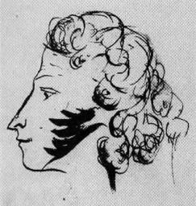
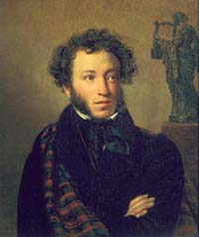
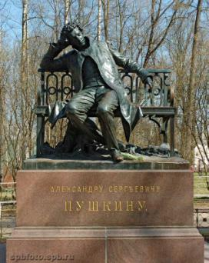
Alexander Pushkin
(1799 - 1837)

Slide 3
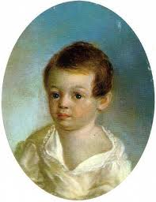
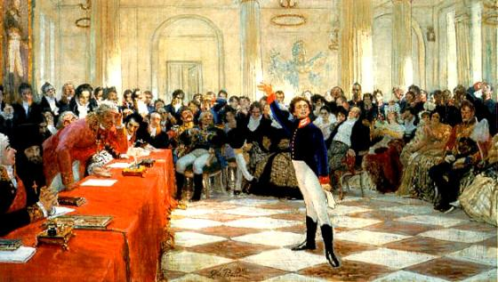
Alexander Pushkin, the father of Russian letters, was the author of over seven hundred lyric poems. He wrote also the volumes of narrative poetry, dramatic works, short stories, and made adaptations of Russian fairy tales.

Slide 4
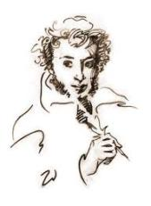
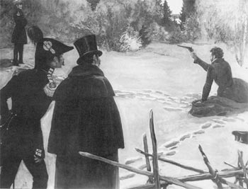
It is one of the Russia's tragedies that Pushkin, involved by the court into a duel over his wife's honour, died when he was only 37 years old.

Slide 5
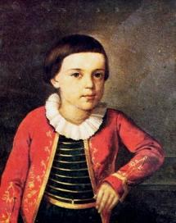
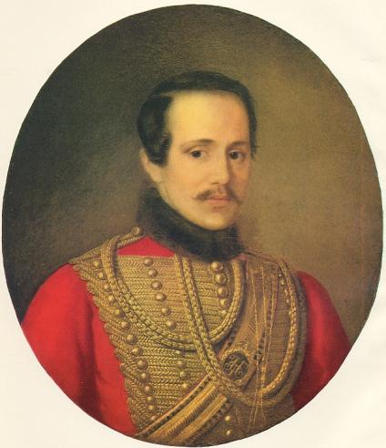
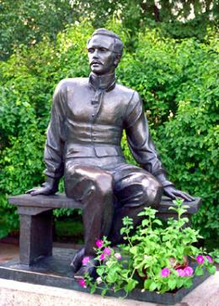
Mikhail Lermontov
(1814 - 1841)

Slide 6
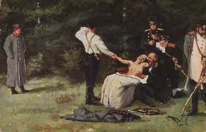
A young hussar officer, Mikhail Lermontov, expressing his wrath against the society and his sorrow about Pushkin's death, wrote the verses The Death of the Poet. Lermontov was arrested for his apparent call for freedom and exiled to the Caucasus. In Caucasus, he started writing his most celebrated work, A Hero of Our Time.

Slide 7
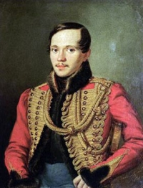
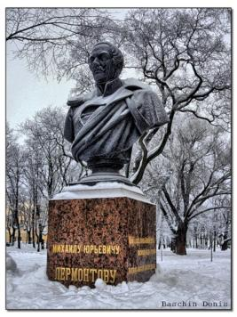
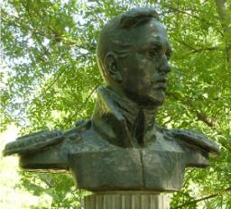
So remarkable is his craftsmanship that Anton Chekhov recommended anyone to read the first chapter of this novel in order to learn how to write. In 1841, the rebellious poet was also killed in a duel.

Slide 8
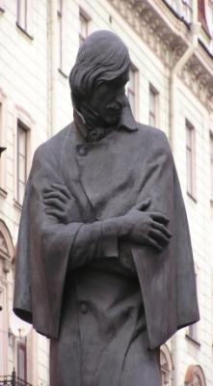
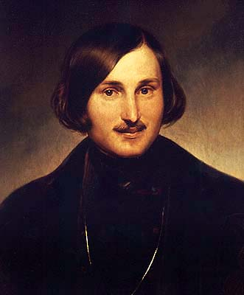
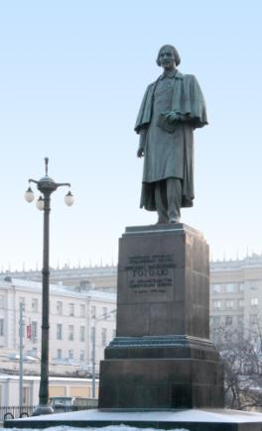
Nicholai Gogol
(1809 - 1852).

Slide 9
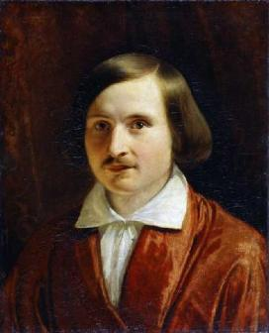
The real master of the art of satire was Nicholai Gogol. When he arrived to St. Petersburg Pushkin encouraged him as a writer. Gogol is best known as the author of The Government Inspector and Dead Souls. He is famous for telling bitter truths about Russia's troubles.

Slide 10
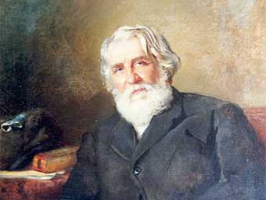
Ivan Turgenev
(1818 - 1883)

Slide 11
Novels of Ivan Turgenev were translated into several languages long before the works of any other Russian writer. His first published work Sportsman's Sketches, demonstrated the author's gift for depicting Russian nature and characters. Turgenev became famous with his Nest of Gentlefolk and his masterpiece Fathers and Sons.

Slide 12
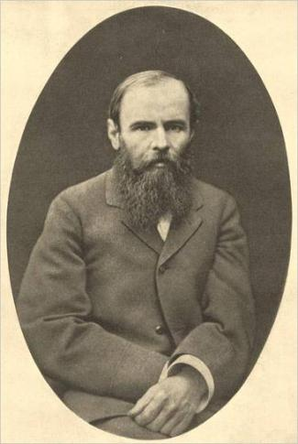
Feodor Dostoevsky
(1821 – 1881)

Slide 13
Feodor Dostoevsky established his name in the literature with his novel Crime and Punishment, published in 1866. This novel made him famous not only at home but also in the whole world. In this work, Dostoevsky gave the brilliant analysis of the Russian character. The hero, Raskolnikov, after committing a crime, experienced deep feeling of repentance.

Slide 14
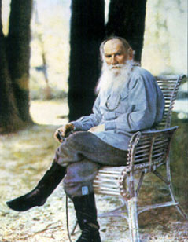
Leo Tolstoy
(1828 - 1910)

Slide 15
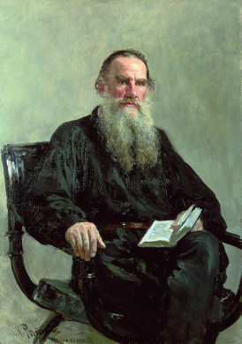
Dostoevsky, the real master of psychological prose, is often compared with Leo Tolstoy. Tolstoy is the greatest Russian thinker and one of the world's supreme novelists. The secret of Tolstoy's literary success lays in his truthfulness to life.
Tolstoy was born in 1828 at the family estate in Yasnaya Polyana. As a young man, he served in the army in the Caucasus and in the Crimea.

Slide 16
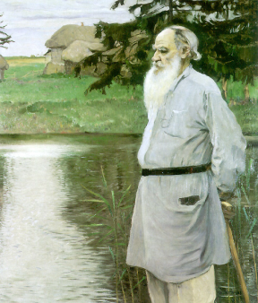
There he wrote his first Sevastopol's Stories. After marriage to Sophia Behrs in 1862, he spent the next fifteen years in the countryside where he finished his War and Peace in 1869 and Anna Karenina in 1877. Two years later he came to deep spiritual crisis, described in his Confession.

Slide 17
Rejecting the inventions of urban civilization, Tolstoy declared a return to the simplicity of primitive agricultural life. He was deeply unhappy about the fact that he was living in conditions of luxury while surrounded by poverty. In the end of his life Tolstoy left Yasnaya Polyana forever at the age of eighty-two.

