Slide 1

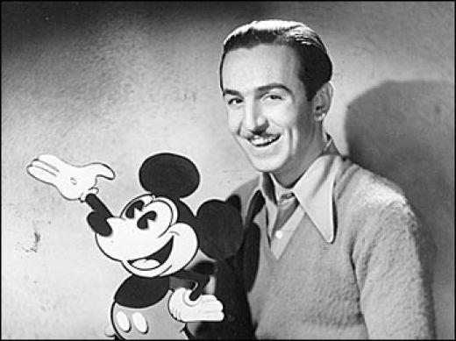
Walt Disney
Презентация
по английскому языку
ученицы 7в класса
гимназии №17
Шишковой Екатерины

Slide 2
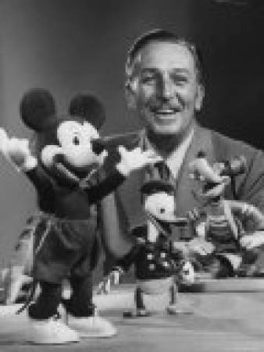
Wizard of animation, giving joy to millions of children around the world, the father of the famous Mickey Mouse, Bambi, Pluto the dog, Donald Duck and many other animation heroes, Walt Disney may rightly be considered one of the most important people in the world of cinema.

Slide 3
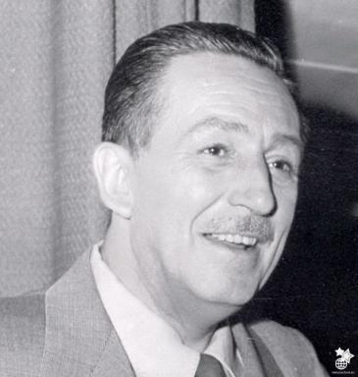
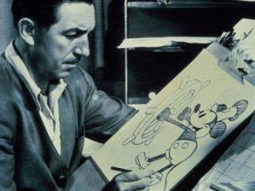
Walt Elias Disney was born on December 5, 1901 in Chicago, he was the son of Elias and Flora Disney. When the boy became older, his family moved to a farm in Missouri, where he spent his childhood.
Walt loved to draw. He sold his drawings to neighbors. It was very helpful, as Disney’s family had five children. Walt tried to earn money not only by selling paintings, he also sold newspapers and popcorn in the trains, and later helped his father to deliver the mail.

Slide 4
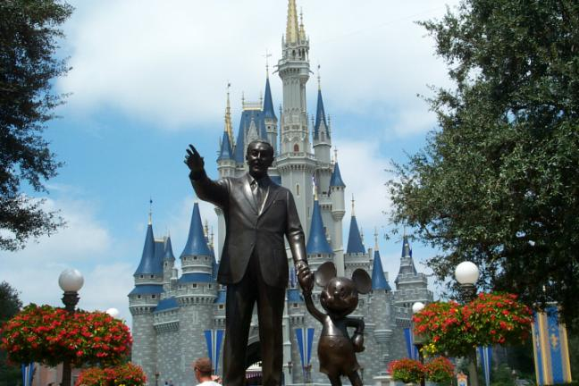
When Walt Disney grew up, he began to create cartoons, and one day he had an idea to make a mouse the main character of the cartoons. Mickey Mouse appeared on the screen in 1928 in the film “Steamer Willie”, and he has remained one of the main symbols of the vast empire of Disney.

Slide 5
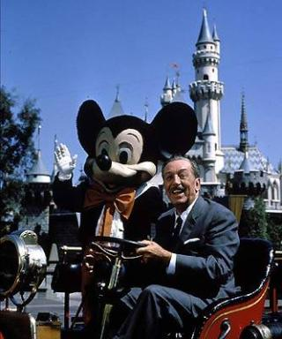
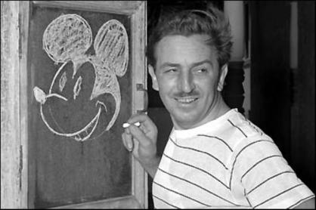
Walt Disney died on December 15, 1966 from cardiac arrest.
However, Disney continues to live today, and for many he is still the greatest storyteller of our time.

