Slide 1
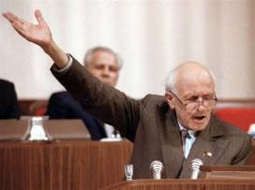
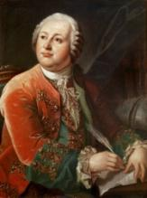
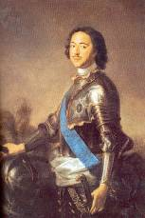
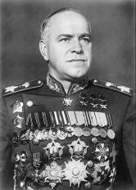
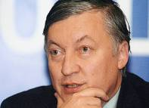
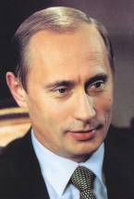
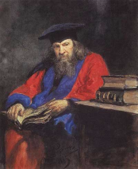
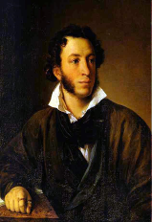
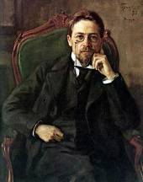
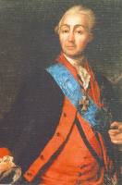
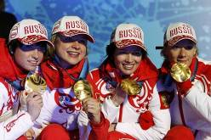
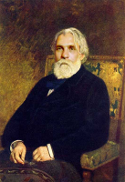
The way to
success

Slide 2
Our goals today:
  to practice the vocabulary on the topic;
  to develop speaking abilities;
  to practice reading & listening for gist.

Slide 3
Active vocabulary practice
Beautiful
Successful
Talented
Handsome
Well-known
Famous
Great
athlete
writer
actor
artist
performer
politician
actress

Slide 4
hardworking lazy clever
talented to become famous creative
you should/shouldn’t
be
rich
beautiful brave active

Slide 5
Do you want to be famous? Why?
What do you do to be famous?

Slide 6
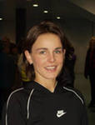
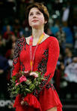
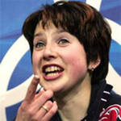

Listening

Slide 7
Feedback
What have you learned today?
What was difficult (interesting) for you today?
Estimate you classmates’ work at the lesson.

