Slide 1

Unit 4. Sport Is Fun
Урок 95. Олимпийские игры
(активизация лексических навыков)

Slide 2
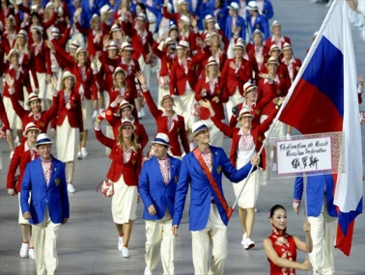
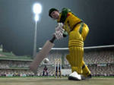
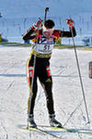
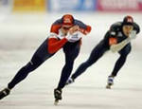
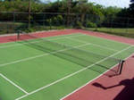
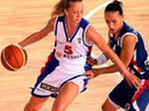

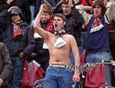
Find the rhyme!
Kate
We
Scream
May
Ticket
Man
Name
Boughtt

Slide 3
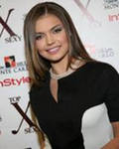
Answer the questions!
What kind of sport is this woman famous for?
a. skiing
b. gymnastics
c. shooting

Slide 4
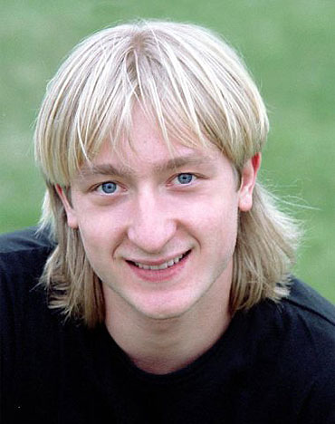
Answer the questions!
What kind of sport is this man famous for?
a. football
b. hockey
c. figure-
skating

Slide 5
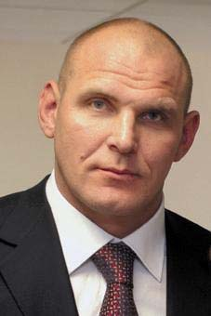
Answer the questions!
What kind of sport is this man famous for?
a. boxing
b. bobsleigh
c. wrestling

Slide 6
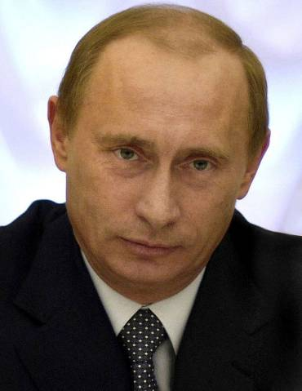
Answer the questions!
What kind of sport is this man famous for?
a. judo
b. swimming
c. fencing

