Slide 1
Education in the UK
TEST1
1.British children start schooling at the age of
5 b) 6 c)7
2.Cumpulsory secondary education lasts ….. years
5 b) 6 c) 7
3.How old are British students when they go to the first form?
a) 5 b) 7 c) 11
4……..per cent of British students attend comprehensive schools.
5 b) 20 c) 80
5. At the end of the school year in secondary schools all pupils move to the new class
a) automatically b) if they pass the exam
6.Pupils take the exam for the General Certificate of Secondary Education(GCSE) at the end of ………. form.
a) the fifth b) the sixth c) the ninth
7 The sixth form lasts…… years
1 b) 2 c)3
8. Students sit “A” level Exam at the end of …….form
a) the fifth b) the sixth c) the ninth

Slide 2
Education in the USA
Test2 : Say true or false.
1.Public school in the USA is private school.
2. 85 per cent of students attend free school.
3. Students attend school for 10 years.
4. Students of elementary school don’t study a foreign language.
5. Secondary schools offer 4 “core “ subjects-PE, Social Studies , Safety of the life and English.
6.In all schools students move from elementary to high school automatically.
7. Schools prepare students for specific jobs.

Slide 3
New York , the USA
18/01/2012
Dear friends,
You’re interested in my school. I can tell you about it a little.
My school’s big. We have all grades from kindergarten to the 12-th in one building unlike other schools where elementary and high schools are in different buildings . Pupils in the kindergarten play, draw pictures and listen to the stories with headphones in the special places. In elementary classes the teachers have assistants who help them at the lessons and during the break. We leave our things in the lockers in the corridors. All our classes have computers and interactive boarders. In Math classes we often play Math games. In History classes we discuss problems and do the projects together. The students in the grades are mixed every year . Each grade prepares a certain project which is shown at the end of the school year in the Assembly Hall. There we show concerts, performances on some occasions.
.
That’s all for now . What is you school like? What’s your favorite subject? Why? What do you do during the lesson?
best regards,
Julia.
168 words

Slide 4
Education in the USA

Slide 5
Stages of Schooling
Elementary school including Kindergarten (1-6 grades)
High school (7-12 grades)
College
University

Slide 6
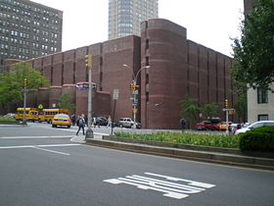
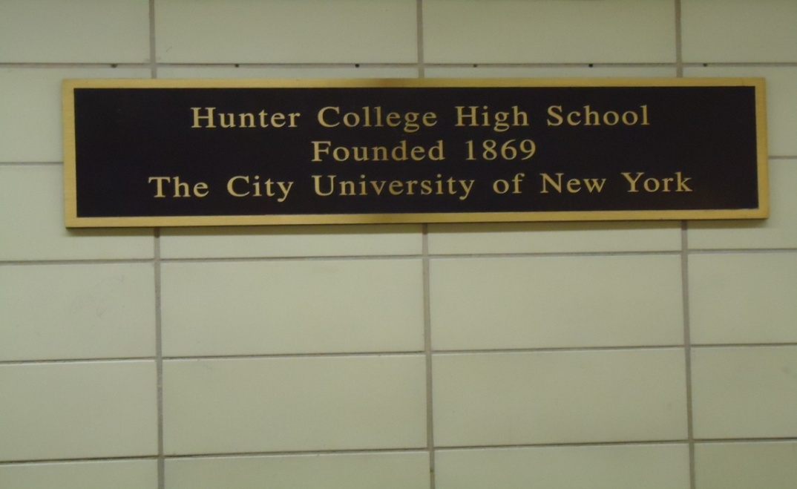
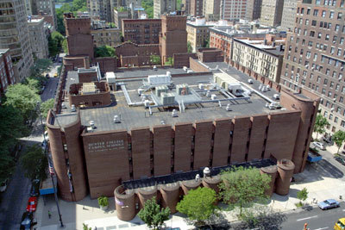
The name of the school

Slide 7
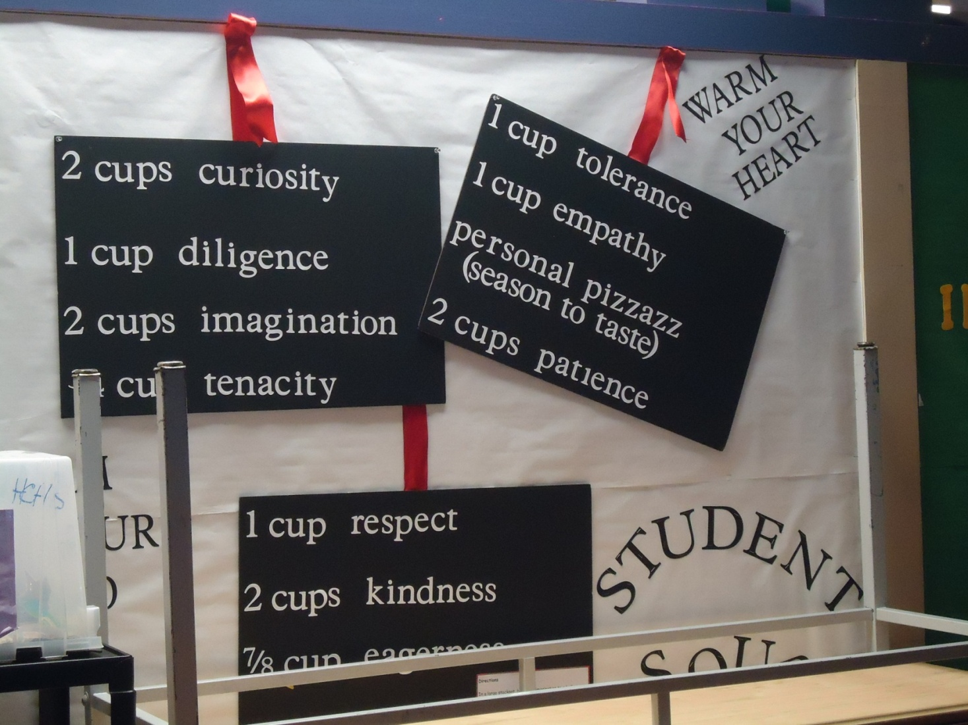
The motto of the school is: Mihi Cura Futuri (Забота о Будущем Зависит от Меня
The Care of the Future Depends on Me)

Slide 8
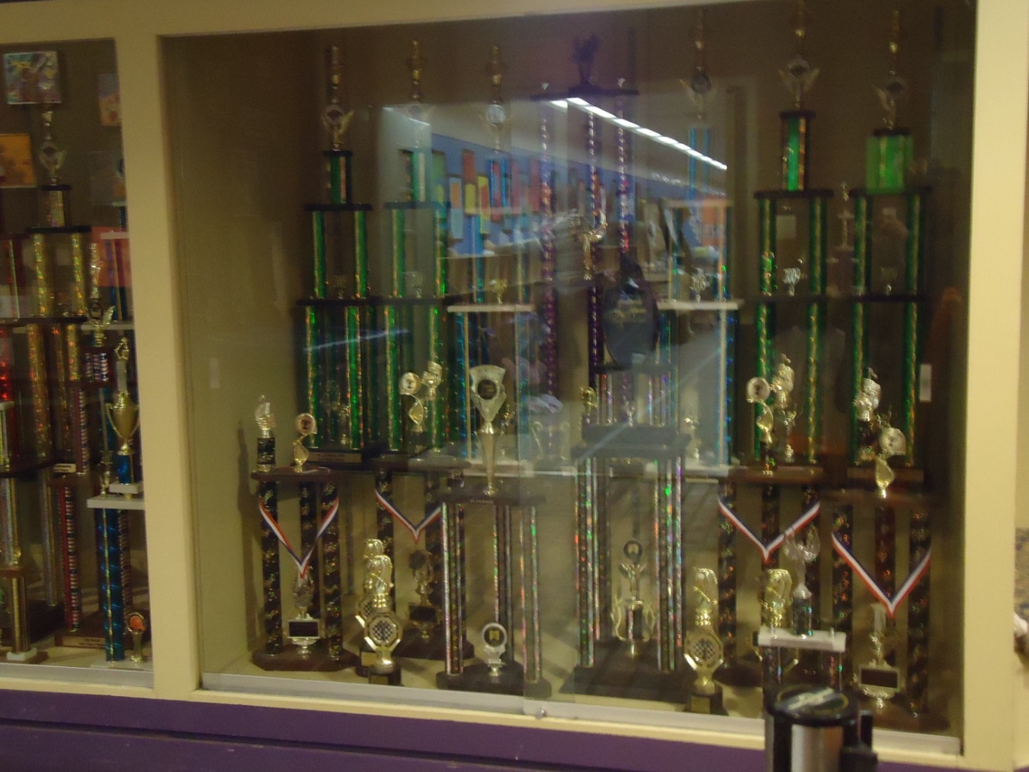
Rewards

Slide 9
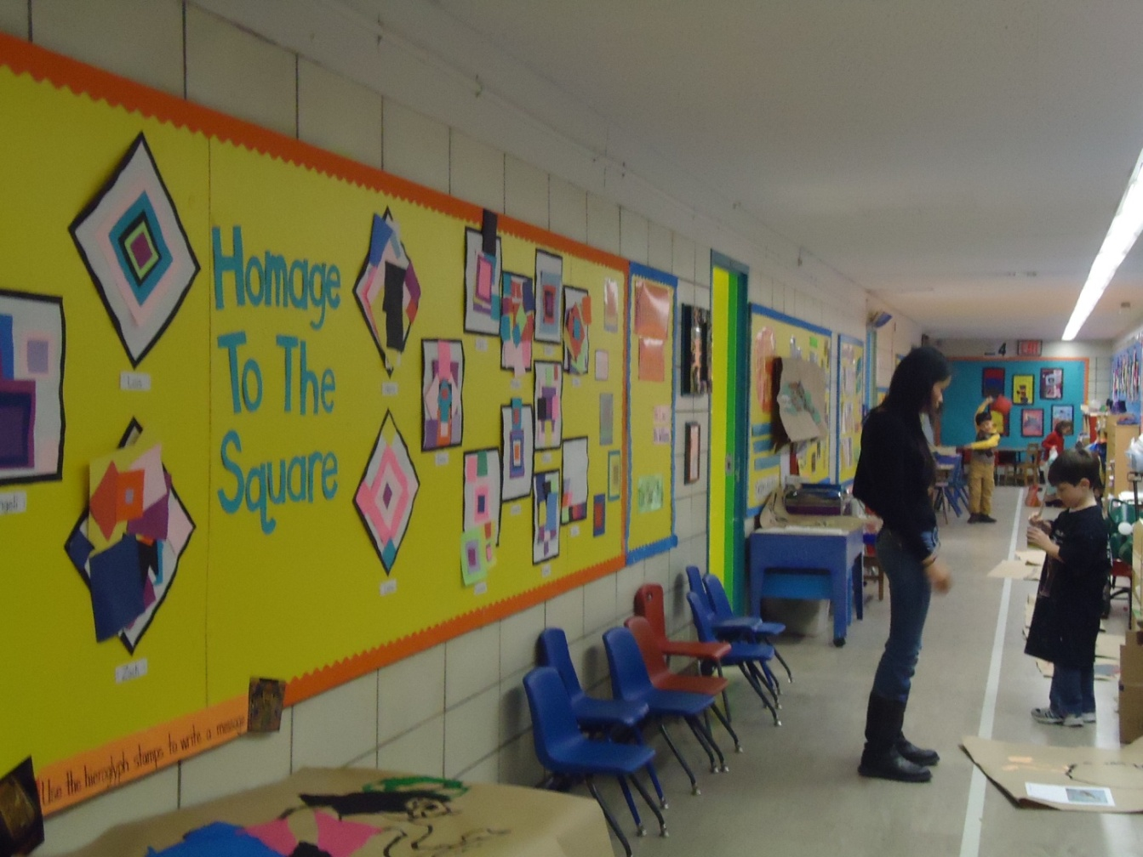
Kindergarten

Slide 10
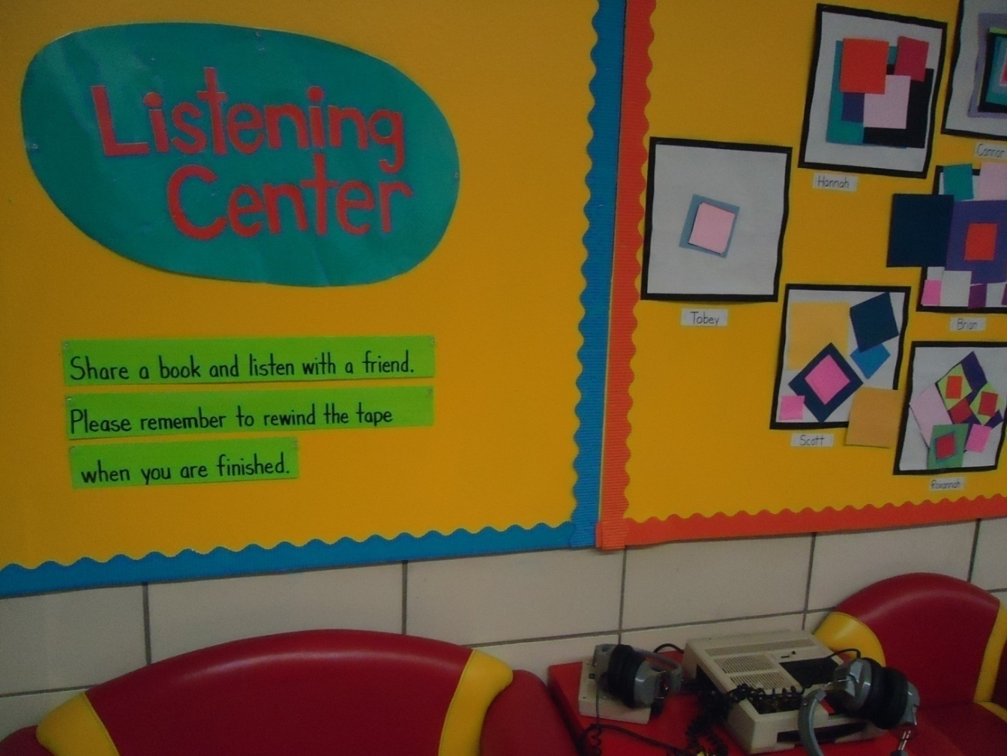
In the Kindergarten

Slide 11
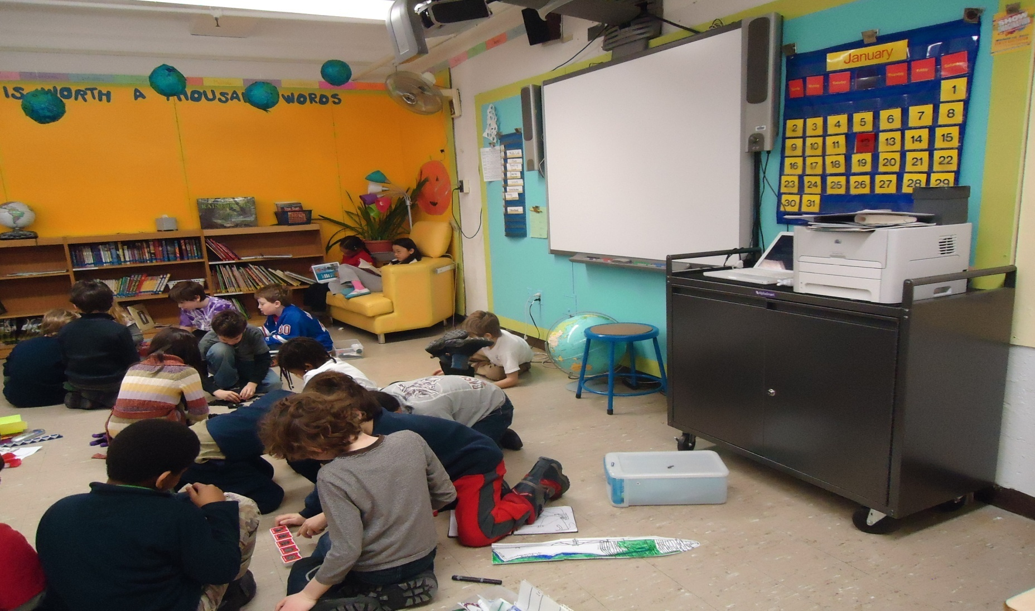
Elementary school

Slide 12
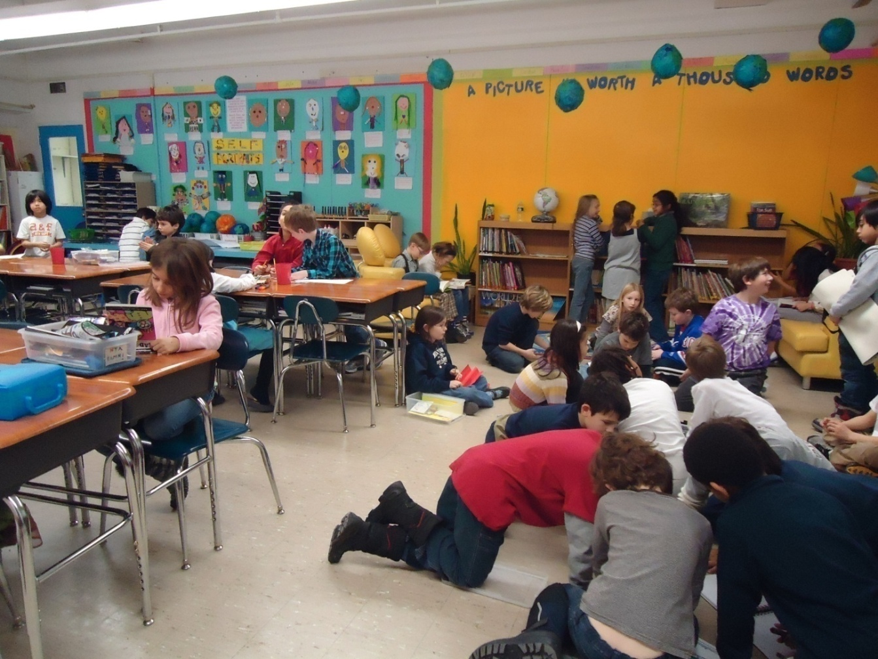
The 3 grade during the break

Slide 13
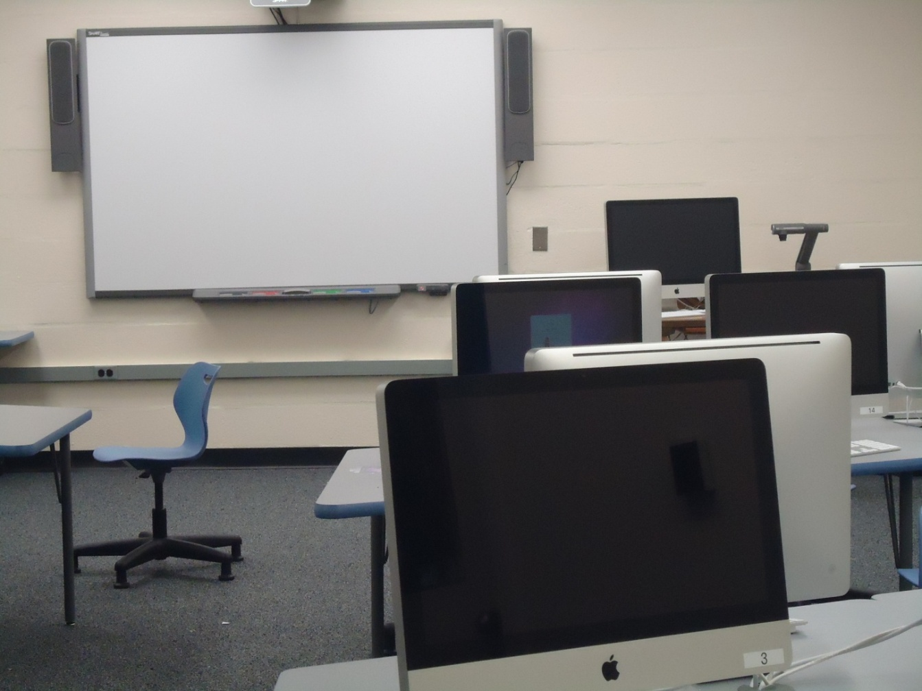
Computer classroom

Slide 14
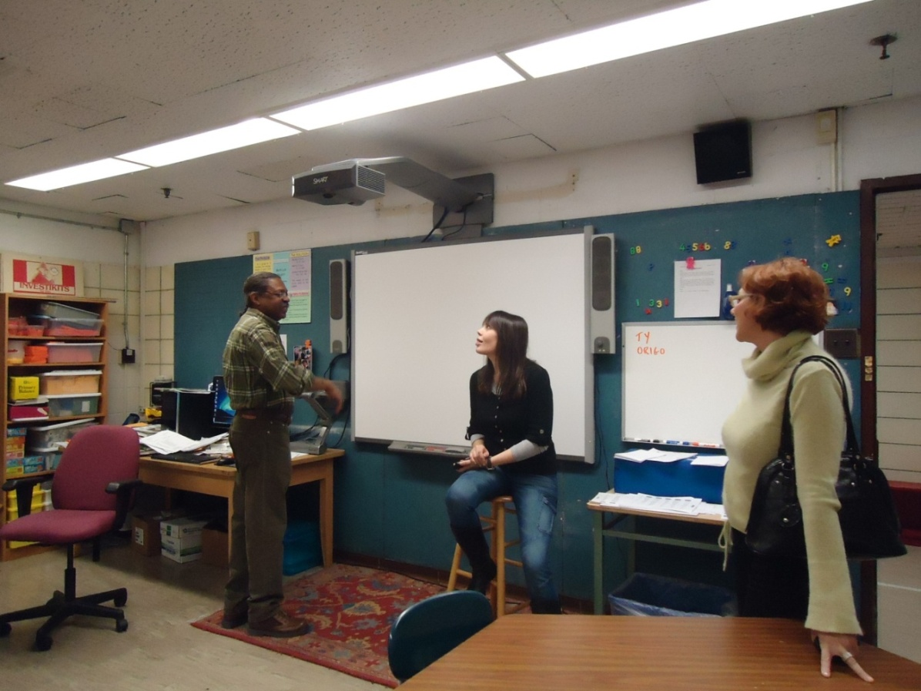
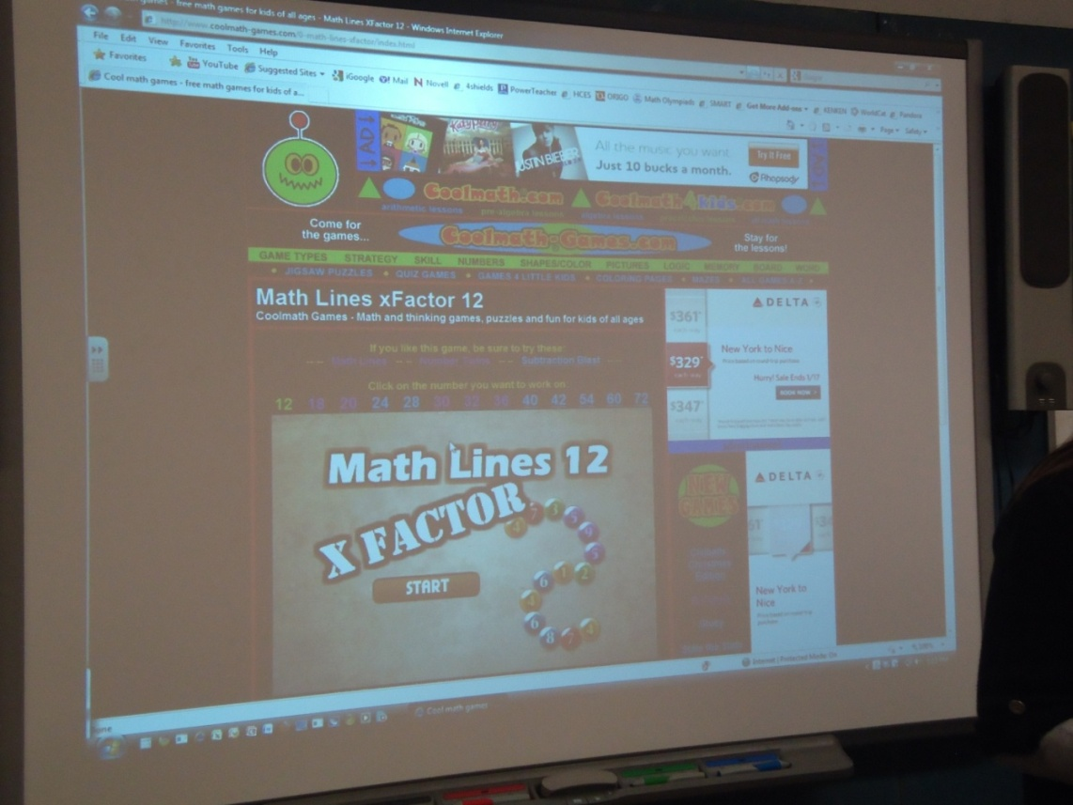
In the Maths classroom

Slide 15
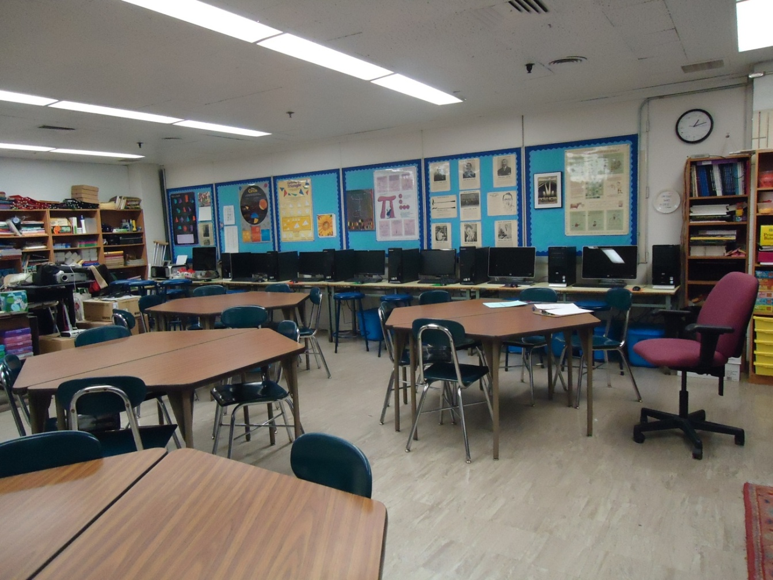
In the History Classroom

Slide 16
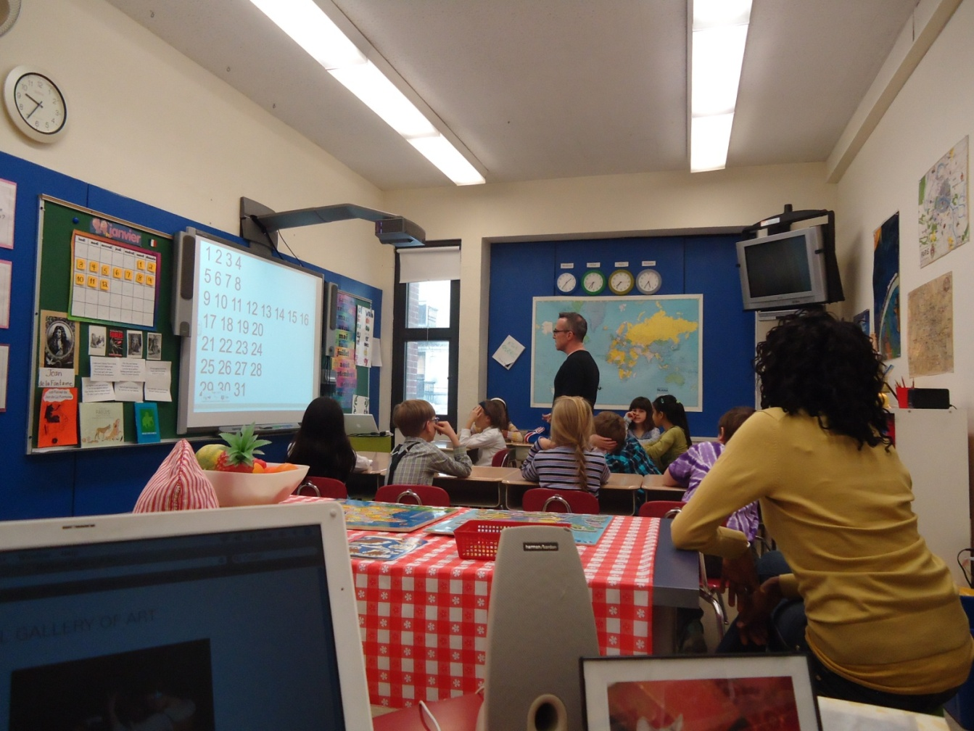
At the French lesson

Slide 17
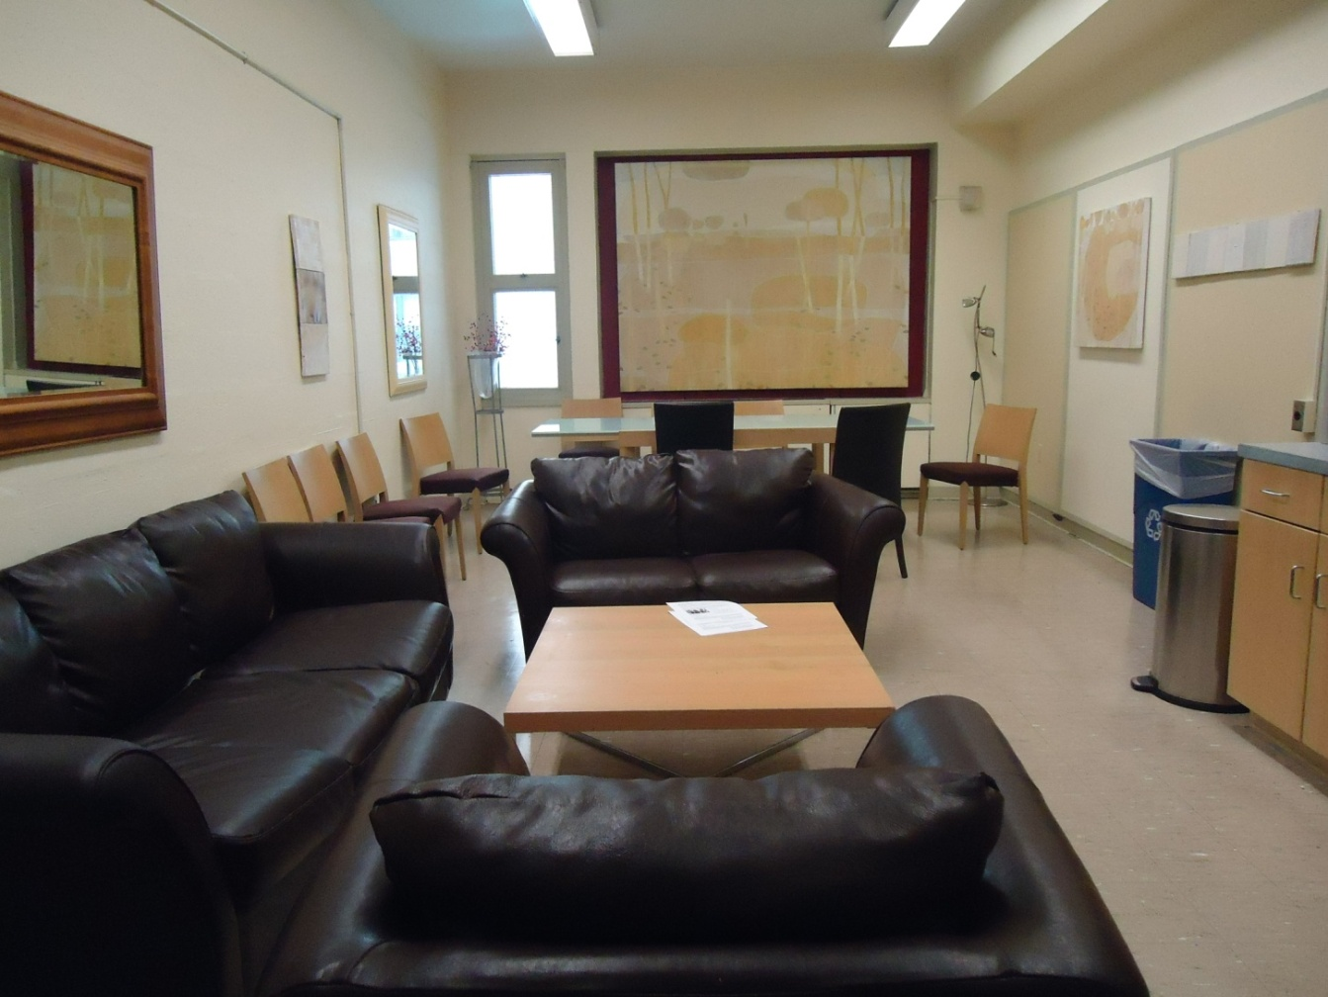
FACULTY LOUNGE

Slide 18
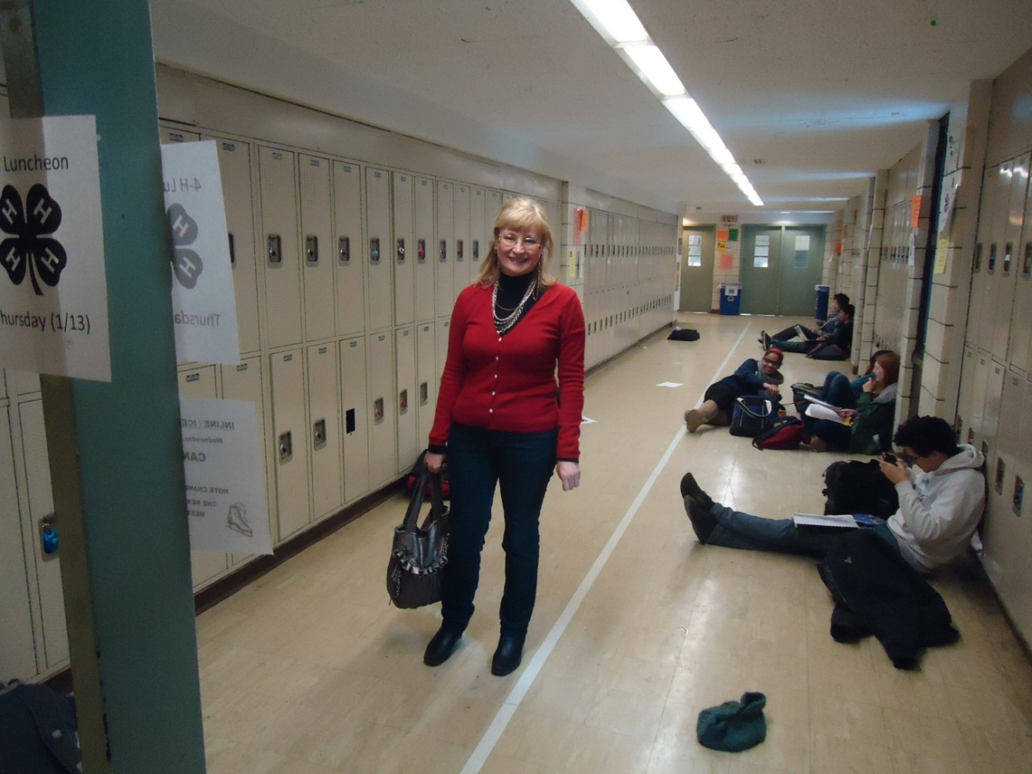
In the High School

Slide 19
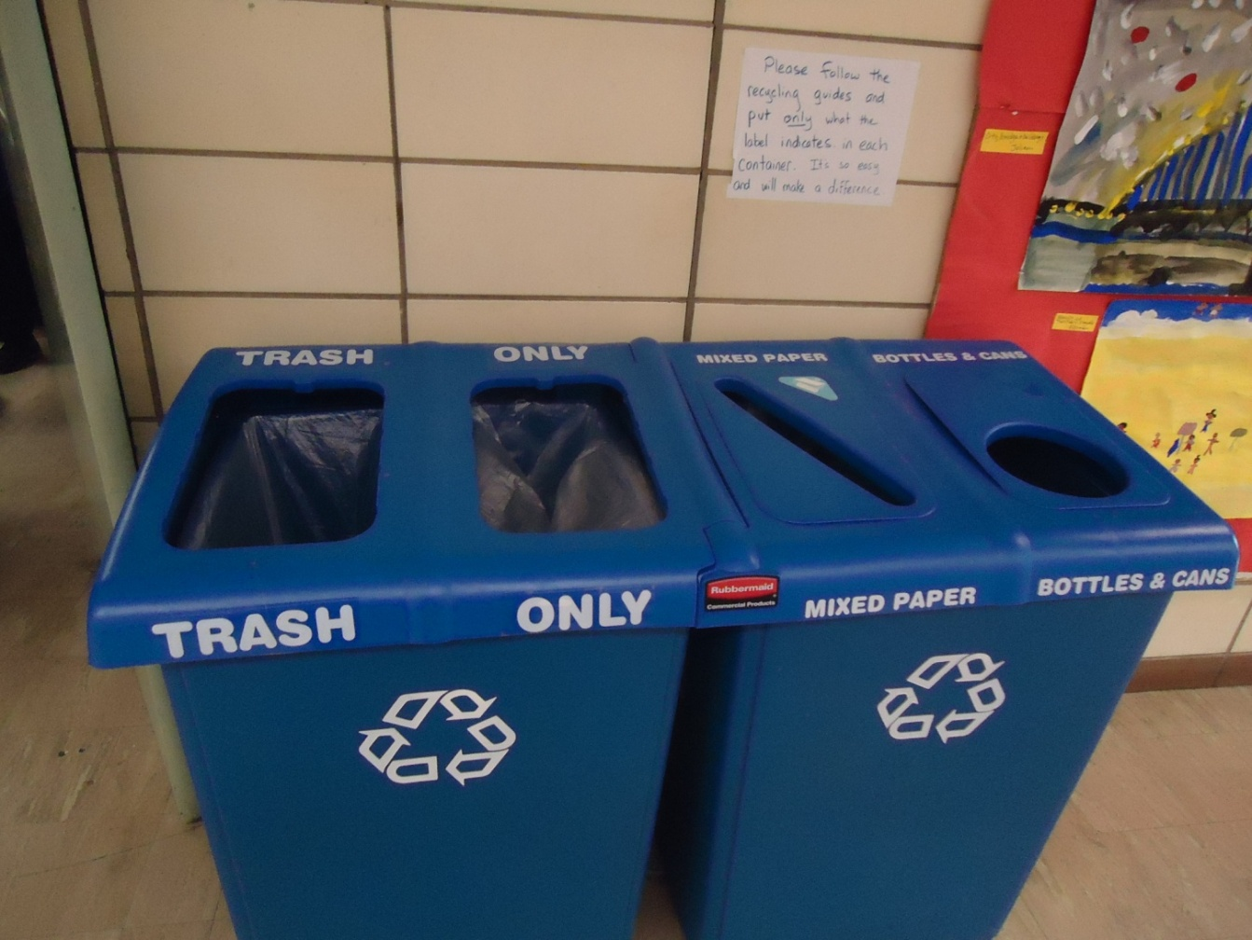
Please follow the recycling guides and put only what the label indicates in each container. It’s so easy and will make a difference.

Slide 20
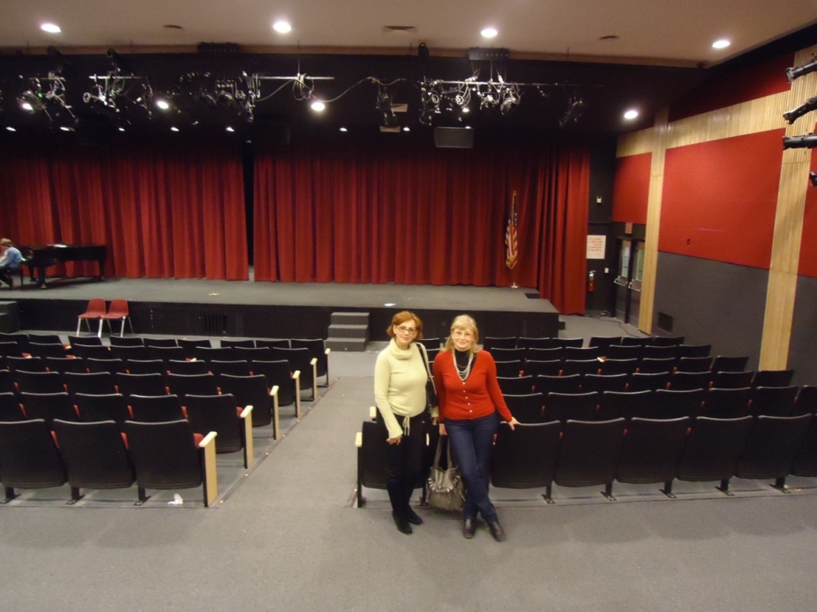
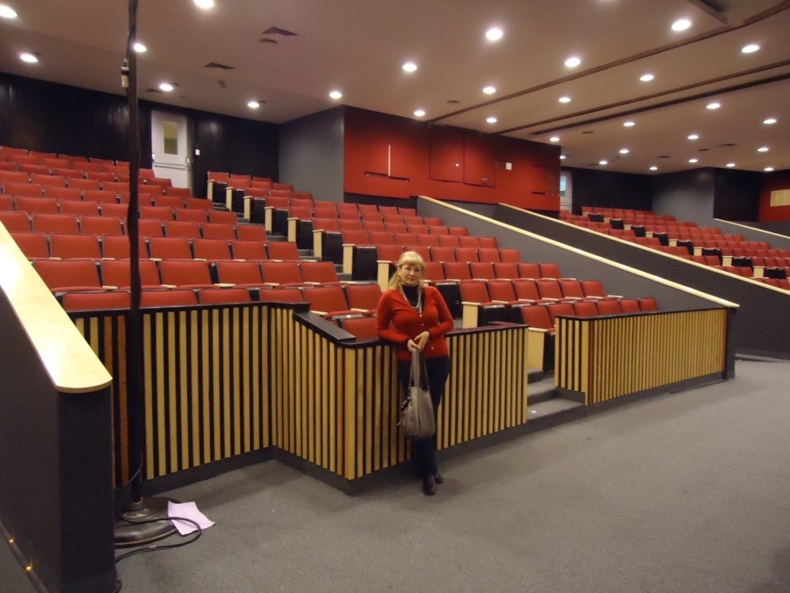
Assembly Hall

Slide 21
Some interesting facts
All doors in the classrooms have windows, that everyone could see what is going on inside.
The students in the grades are mixed every year.
Each grade prepares a certain project which is shown at the end of the school year.

Slide 22
New York , the USA
18/01/2012
Dear friends,
You’re interested in my school. I can tell you about it a little.
My school’s big. We have all grades from kindergarten to the 12-th in one building unlike other schools where elementary and high schools are in different buildings . Pupils in the kindergarten play, draw pictures and listen to the stories with headphones in the special places. In elementary classes the teachers have assistants who help them at the lessons and during the break. We leave our things in the lockers in the corridors. All our classes have computers and interactive boarders. In Math classes we often play Math games. In History classes we discuss problems and do the projects together. The students in the grades are mixed every year . Each grade prepares a certain project which is shown at the end of the school year in the Assembly Hall. There we show concerts, performances on some occasions.
.
That’s all for now . What is you school like? What’s your favorite subject? Why? What do you do during the lessons?
best regards,
Julia.
168 words

Slide 23
An informal letter consists of:
An informal greeting ( Dear Ken/ Dear aunt Joan…)
An introduction in which you thank for the letter
A main body in which you write the main subject(s)
A conclusion in which you write your closing remarks( That’s all my news/ Write back soon/ Give your mum a big hug from me/ Tell me about…) mention your further contacts.
An informal ending (Lots of love/Best wishes / See you/etc + your first name)

Slide 24
New York , the USA
18/12/2011
Dear friends,
You’re interested in my school. I can tell you about it a little.
My school’s called the Hunter College High School . We have all grades from kindergarten to the 12-th in one building unlike other schools where elementary and high schools are in different buildings. Pupils in the kindergarten play, draw pictures and listen to the stories with headphones in the special places In elementary classes the teachers have assistants who help them at the lessons and during the break. Each grade prepares a certain project which is shown at the end of the school year in the Assembly Hall. There we show concerts, performances on some occasions . I’m in the 8-th form and take courses in Communications and Theater . I like drama and French but I hate Science. It’s so boring.
That’s all for now . Write back.
Best wishes,
Julia
128слов

Slide 25
THANKS

