Slide 1
Intellectual
MARATHON

Slide 2
The 1st round
The 2nd round
The 3rd round

Slide 3
The 1st round
Symbols
Persons
Dates
Traditions
100
200
300
400
500
100
200
300
400
500
100
200
300
400
500
100
200
300
400
500
back

Slide 4
The 2nd round
Days of Saints
Easter
Christmas
Guy Fawkes’ day
100
200
300
400
100
200
300
400
100
200
300
400
100
200
300
400
back

Slide 5
The 3rd round
1
2
3
4
5
6
7
8
9
10
11
12
back

Slide 6
100 Call the symbols of St. Valentine’s Day.
answer

Slide 7
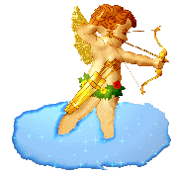


The symbols of St. Valentine’s Day are Cupid, a valentine and a heart.
back

Slide 8
200 Call the symbols of Midsummer’s Day.
answer

Slide 9
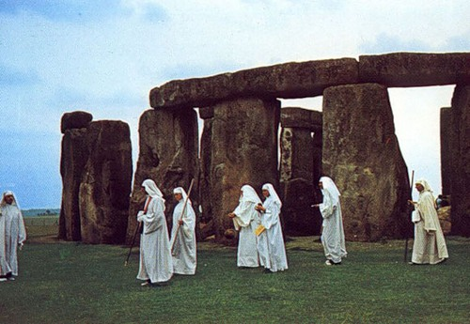
The symbols of Midsummer’s Day are the sun, Stonehenge, and a Druid.
back

Slide 10
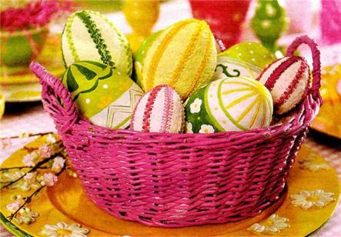
300 Call the symbols of Easter.
answer

Slide 11
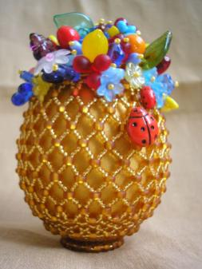
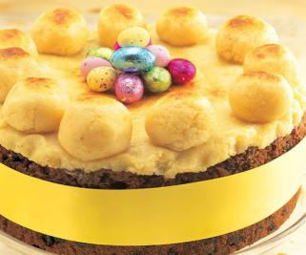
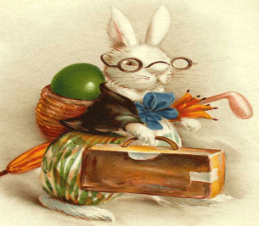
The symbols of Easter are an egg, Easter Simnel cake and the Easter rabbit.
back

Slide 12
400 Call the symbols of Halloween.
answer

Slide 13
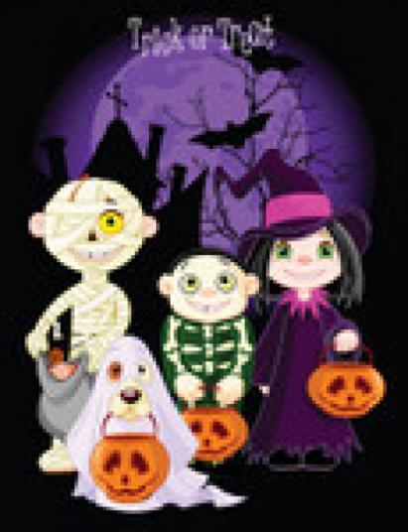
The symbols of Halloween are
a bat,
a pumpkin,
a witch,
a ghost.
back

Slide 14
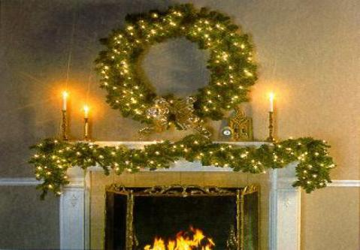
500 Call the symbols of Christmas.
answer

Slide 15
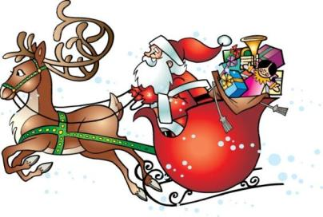
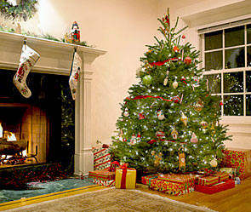
The symbols of Christmas are
Santa Claus,
Christmas tree,
stocking,
gift,
elf,
deer,
garland
and wreath.
back

Slide 16
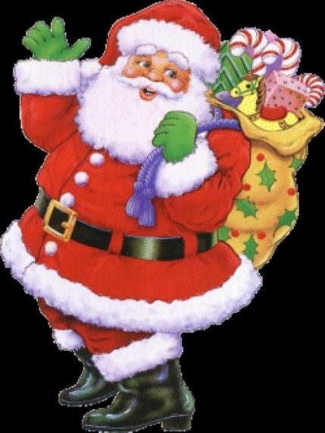
100 Who is he?
answer

Slide 17
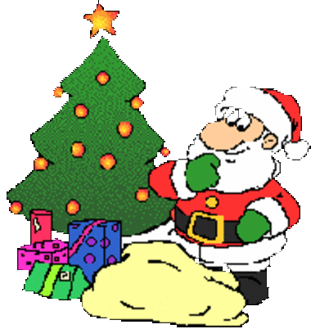
He is Santa Claus.
back

Slide 18
200 Which person from Britain has 2 birthdays?
answer

Slide 19
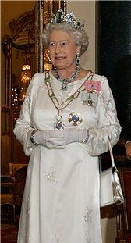
Queen Elizabeth the 2nd
back

Slide 20
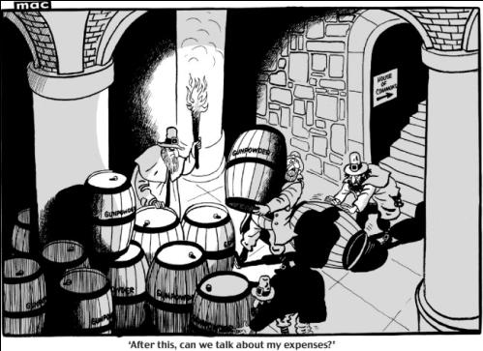
This person made a Gunpowder plot with aim to blow up the Parliament.
Name him.
answer

Slide 21
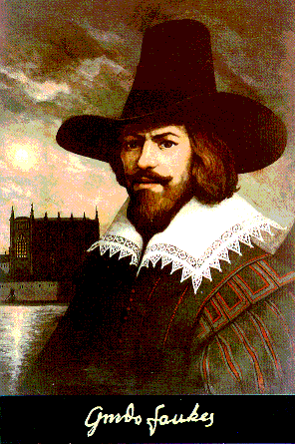
Guy Fawkes
back

Slide 22
400 These persons are the old men, who have a long white beard and govern nature’s powers.
answer

Slide 23
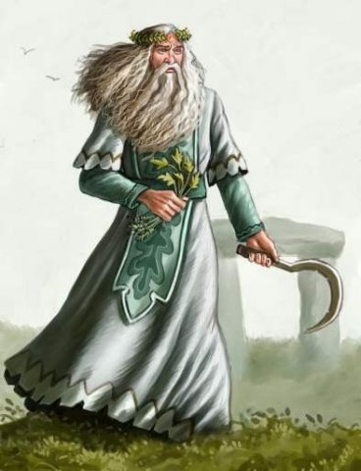
They are Druids
back

Slide 24
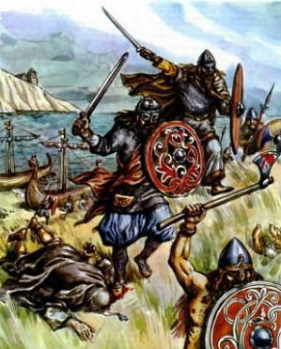
500 Name these persons and say what they did.
answer

Slide 25
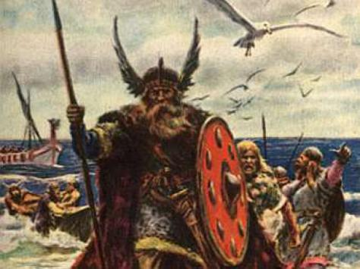
They are Vikings.
They fought with other people for Power
and
Treasure.
back

Slide 26
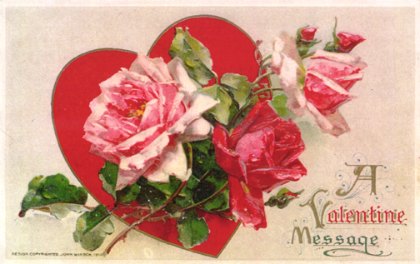
100 When is St. Valentine’s Day celebrated?
answer

Slide 27
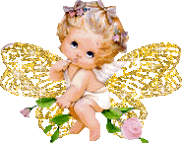
St. Valentine’s Day is celebrated on the 14th of February
back

Slide 28
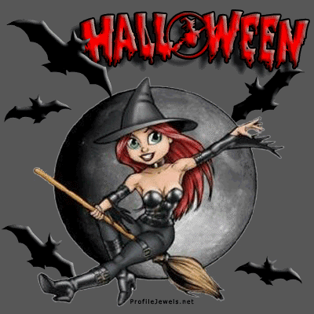
200 When is Halloween celebrated?
answer

Slide 29
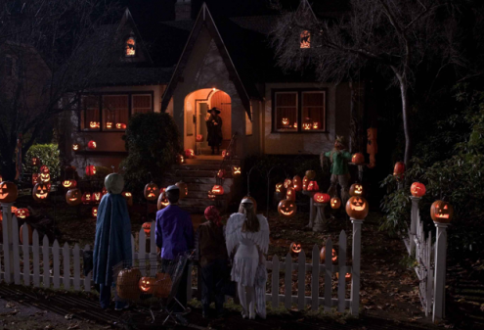
Halloween is celebrated on the 31st of October.
back

Slide 30
300 When is Guy Fawkes Day celebrated?
answer

Slide 31
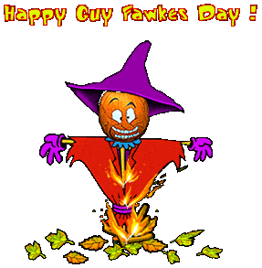
Guy Fawkes’ Day is celebrated on the 5th of November.
back

Slide 32
400 When is the New Year celebrated?
answer

Slide 33
The New Year is celebrated on the 1st of January.
back

Slide 34
500 When is Mother’s Day celebrated?
answer

Slide 35
The Mother’s Day is celebrated on the 26th of March.
back

Slide 36

100 Tell about traditions of the celebration of Mother’s Day.
answer

Slide 37
On this day children give bunches of flowers to their mothers and grandmothers and do domestic chores instead of them.
back

Slide 38
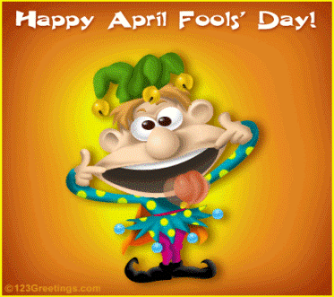
200 How was April Fool’s Day celebrated in the Middle Ages?
answer

Slide 39
Masters and slaves swapped around on that day in the Middle Ages.
back

Slide 40
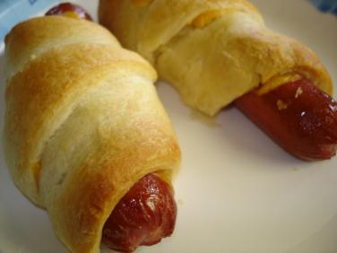
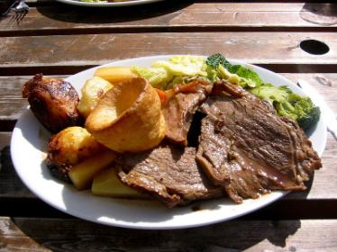
300 In which day you can see the tradition English food Yorkshire pudding, hot dogs and roast beef on the tables of many Englishmen?
answer

Slide 41
St George’s Day
back

Slide 42
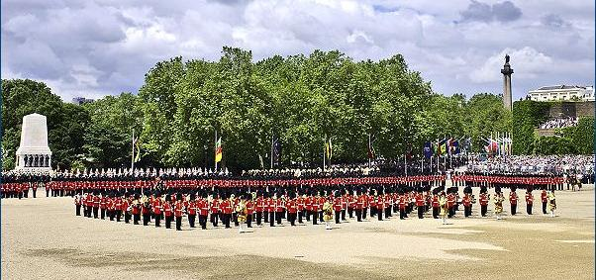
400 In which day in the June, according to English tradition, parade is organized?
answer

Slide 43
It is organized on the 2nd Saturday of June in the Queen's official birthday.
back

Slide 44
500 Tell about traditions of the celebration of Halloween.
answer

Slide 45
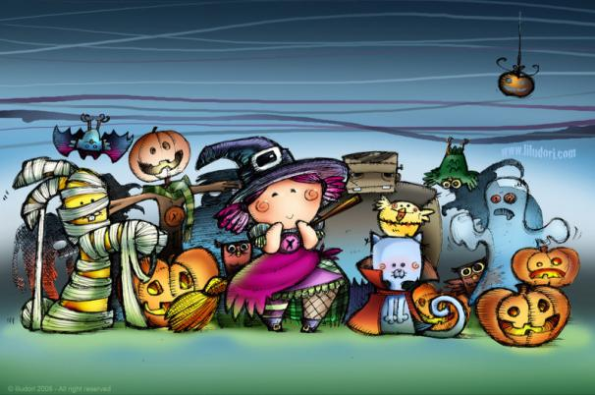
In our times Halloween is celebrated funny and noisy. The children wear like monsters and witches; go to the neighbors’ houses with words “trick or treat!” ask to give them sweets.
back

Slide 46
100 Who is the protector of England?
answer

Slide 47
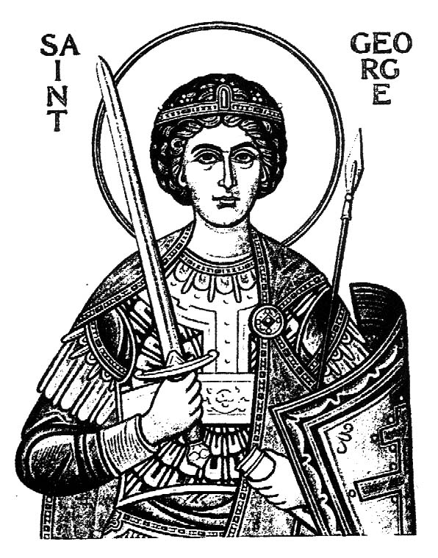
Saint George is the protector of England.
back

Slide 48
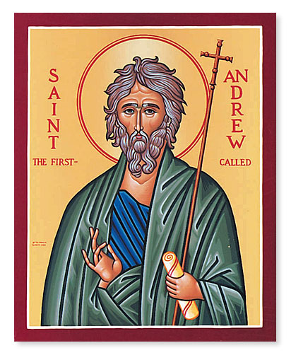
200 When is celebrated St. Andrew’s Day?
answer

Slide 49
St. Andrew’s Day is celebrated on the 30th of November.
back

Slide 50
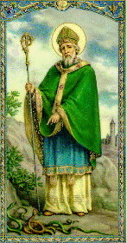
300 Name this person and say which part of UK is protected of him?
answer

Slide 51
He is Saint Patrick. St. Patrick is the protector of Northern Ireland.
back

Slide 52
400 Name the protector of Wells and say when do people is celebrate his day.
answer

Slide 53
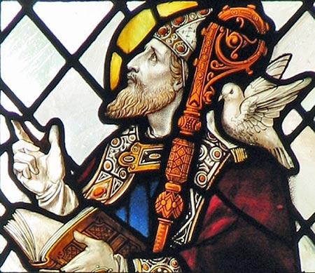
The protector of Wells is Saint David. St. David’s Day is celebrated on 1st of March.
back

Slide 54
100 With ending which of fast is celebrated Easter?
answer

Slide 55
Easter is celebrated after Lent.
back

Slide 56
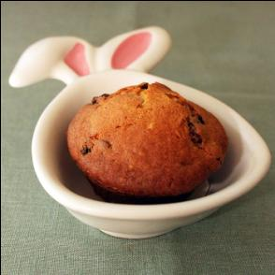
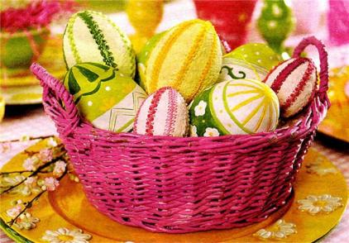
200 The symbols of Easter are an egg, Easter Simnel-cake and Easter rabbit. What does an egg symbolize?
answer

Slide 57
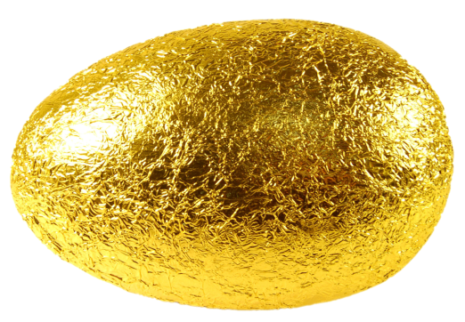
An egg symbolizes New life.
back

Slide 58
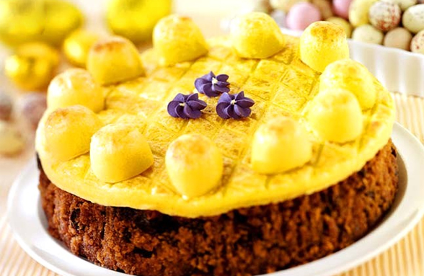
300 What do Martipans on Simnel cake symbolize?
answer

Slide 59
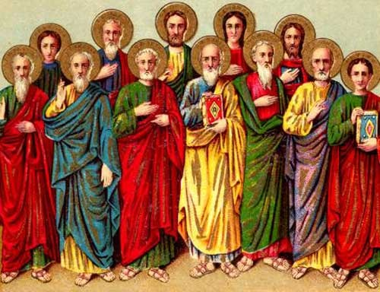
They symbolize 12 apostles of Jesus Christian
back

Slide 60
400 How is Easter celebrated?
answer

Slide 61
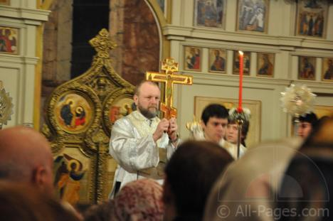
On this day most English people attend Easter service on Saturday evening which starts at 9.30 and finishes at 12 p.m.
After service people come to home and eat Simnel Cake.
back

Slide 62
100 What is the day before Christmas?
answer

Slide 63
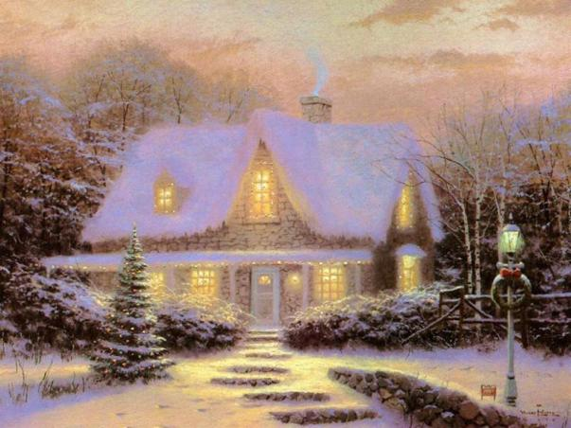
The day before Christmas is called Christmas Eve.
back

Slide 64
200 What does Santa Claus do all the year?
answer

Slide 65

Santa Claus reads the children’s letters and he makes gifts with help of Elves.
back

Slide 66
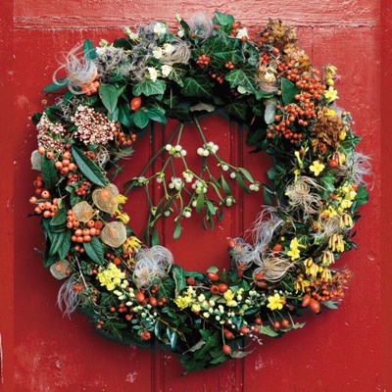
300 For what the British hang mistletoe wreaths?
answer

Slide 67
Mistletoe scare away evil spirits.
back

Slide 68
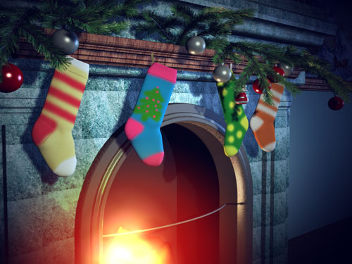
400 Tell us story about tradition to hang stockings above fireplace.
answer

Slide 69
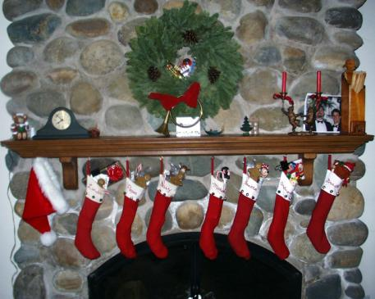
Tradition to hang stockings above fireplace comes from England.
There were 3 dowerless girls. They were daughters of poor man.
Once upon a time on the Christmas Eve they washed up the stockings, hung them above the fireplace, prayed and went to bad. In the morning they found the gold bullions in their stockings, which Santa Claus put there.
back

Slide 70
100 What is another name for Guy Fawkes’ Day?
answer

Slide 71
Bonfire Night.
back

Slide 72
200 How many barrels were there under the Parliament?
answer

Slide 73

There were 36 barrels.
back

Slide 74
300 What were the names of Guy Fawkes’ friends who helped him with Plot?
answer

Slide 75
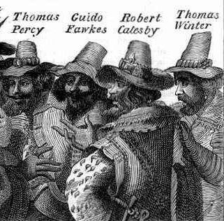
Their names were
Thomas Persy,
Thomas Winter,
Robert Catesby
back

Slide 76
400 Which traditions does Guy Fawkes’ Day have?
answer

Slide 77

Several days earlier Guy Fawkes’ Day people make straw man of Guy Fawkes.
They carry it on the street with words "Pence for the Guy!”, burn it on the bonfire, bakes jacket potatoes and chestnuts.
back

Slide 78
Why do children put cakes with meat and carrots under Christmas tree on Christmas Eve?
answer

Slide 79
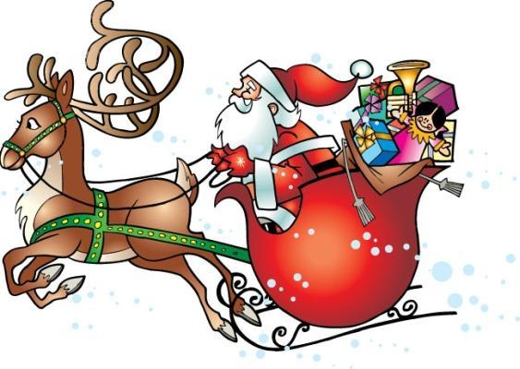
Children put cakes with meat for Santa Claus and carrots for deer on Christmas Eve.
back

Slide 80
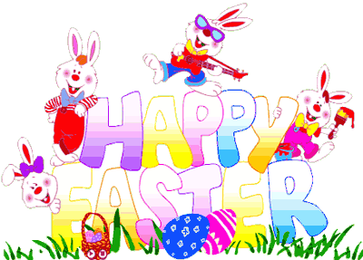
What does Easter rabbit do on Easter?
answer

Slide 81
Easter rabbit brings basket with colored eggs in it, but he can make a joke to hide them throughout the house. Children like to play this game. The people, who find more eggs, win.
back

Slide 82
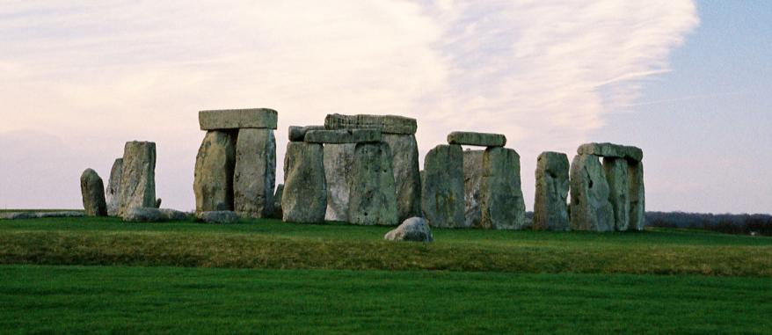
Call this place.
answer

Slide 83
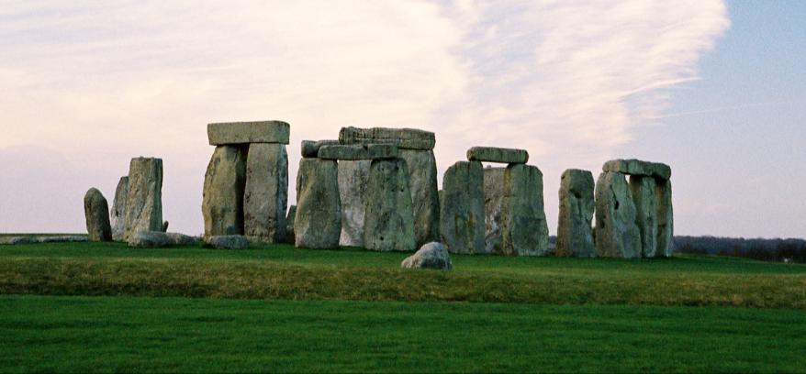
This is Stonehenge, which is situated on the Salisbury Plain. It is known as place for gathering of Druids.
back

Slide 84
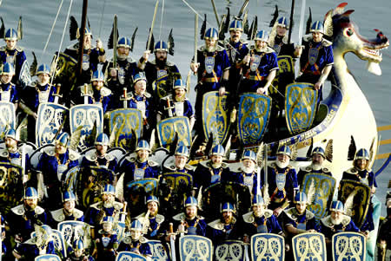
Tell about celebration of Up-Helly – Aa.
answer

Slide 85
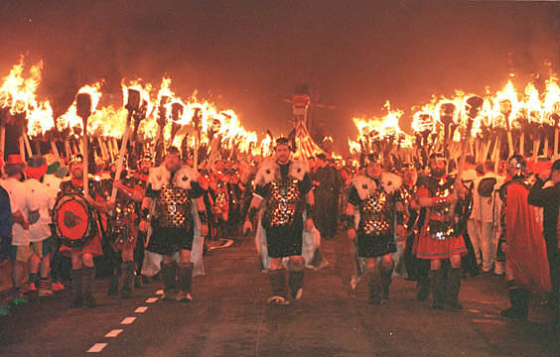
In the 9th century the Vikings attacked Scotland’s islands.
This event is celebrated by people from small town Lerwick every winter. They make ship with the dragon on the bow of it; wear clothes of Vikings and carry the ship through the town to the sea. And then following tradition of Vikings to bury their warriors they burn down it with a formal ceremony.
back

Slide 86

What is the second name of England’s flag?
answer

Slide 87
Cross of Saint George.
back

Slide 88
Call the longest Day in the year.
answer

Slide 89
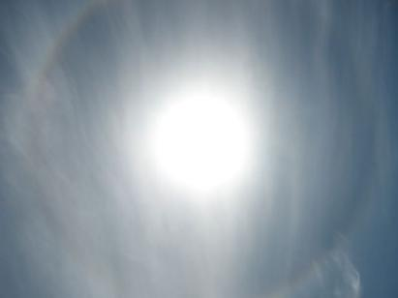
The longest day in the year is Midsummer’s day on 24th of June
back

Slide 90

Why Queen Elizabeth has 2 birthdays?
answer

Slide 91

У королевы Елизаветы 2 дня рождения. Первый - это день когда она появилась на свет 21апреля. В этот день все британцы, весь мир и все газеты, радио- и телевизионные станции поздравляют королеву с ее днем рождения.
Второй день это официальный день рождения правящего монарха который празднуется во вторую субботу июня.
Он отмечается церемониальным парадом в Уайтхолле на котором присутствует королевская семья, приглашенные ею гости и просто зрители. )
back

Slide 92

Tell legend about appearance of St. Valentine’s Day.
back

Slide 93

Tell the story of appearance Mother’s Day.
answer

Slide 94
В викторианские времена детей посылали работать вдали от дома в раннем возрасте, а деньги, заработанные ими, пересылали в семейный бюджет.
Один день в году детям разрешалось провести дома вместе с родителями. Они приносили матерям (и бабушкам) небольшие подарки, такие, как букетики цветов или свежие яйца.
back

Slide 95
Which feat made St. George after he became protector of England?
answer

Slide 96

Покровитель Англии, святой Джордж, убил дракона, который терроризировал несколько английских деревень.
back

Slide 97
How much time does the Advent last?
answer

Slide 98

The Advent lasts 4 weeks.
back

Slide 99

When is celebrated Boxing Day. Tell about traditions Boxing Day.
answer

Slide 100
Boxing day occurs on 26th of December.
Название этого праздника происходит совсем не от бокса, а от слова 'box' (коробка, ящик). По традиции в этот день в церквях открывают коробки с пожертвованиями и их содержимое раздается бедным.
back

