Slide 1
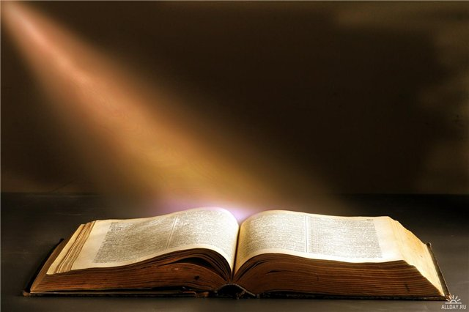
BOOKWORMS
The pleasure of reading.
From very beginning of our life we are closely connected with books.

Slide 2
I тип II тип III тип IVтип
STAPLE
RAVEN
FAT
START
CARE
DARK
SKATE
DARE

Slide 3

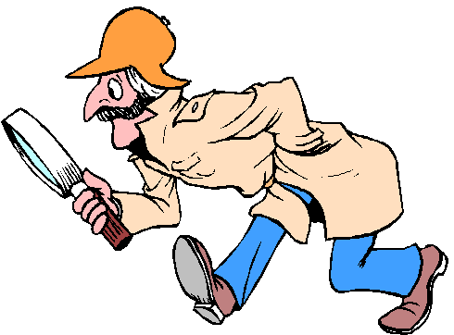

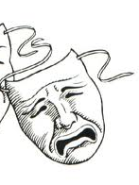
Detective
Adventure
Drama
Comedy

Slide 4

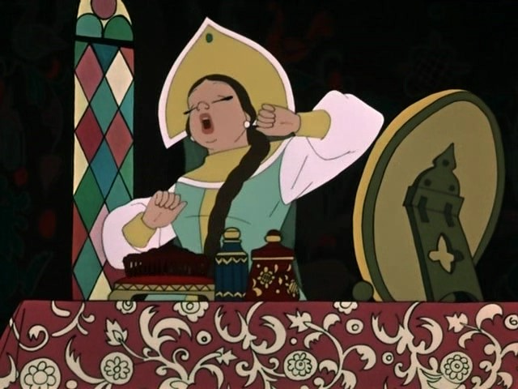
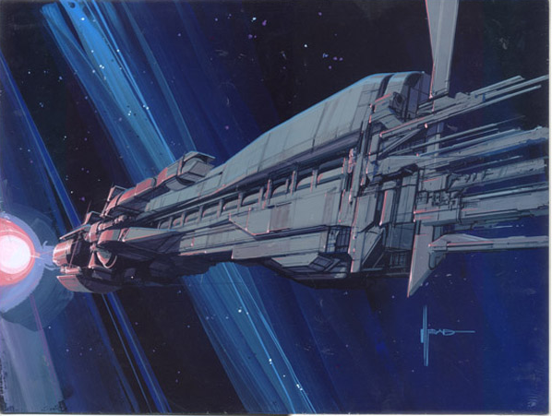
Humorous story
Fairy tale
Science fiction

Slide 5

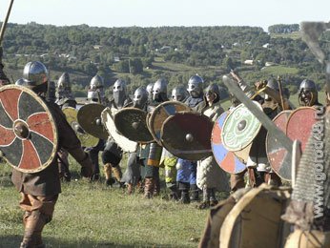

Novel
History
Biography

Slide 6
Adventure
Drama
Detective
Science fiction
Fairy tale
Humorous story
Comedy
Novel
History
Biography

Slide 7
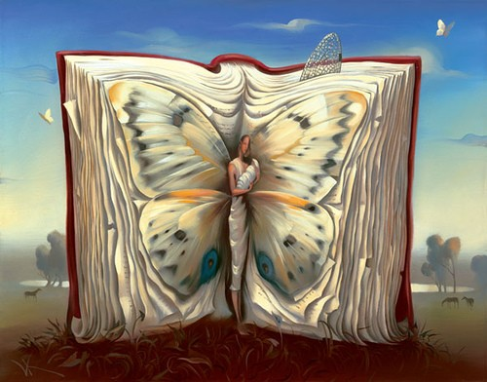
A story with a hero in a dangerous travelling –
A funny story –
A story in future or in space –
A story for theater –
A story of life written by another person –
A story about a strange event –
A very interesting adventure story -
adventure
humorous
Science fiction story
drama
biography
mystery
Suspense story

Slide 8
A(n) story is an exciting story about a hero who goes on an unusual journey and does new and dangerous things.
A story is about events that take place in the future or in space and usually describes strange creatures and robots
A is a serious and emotional play? Written for the theatre, television or radio.
A is a story about a crime or a strange event that is difficult to explain.
A(n) is a funny story with a happy ending.
A is the story of a person’s life written by another person.
Adventure
Science fiction
Drama
Mystery
Humorous story
Biography
2) A. Mystery
B. Drama
C. Science
fiction
4)A. Mystery
B. Legend
C. Fairy
tale
5) A. Adventure
B. Myth
C. Humorous
story
6) A. Novel
B. Biography
C. History
A. Comedy
B. Adventure
C. Suspense
3) A. Drama
B. Comedy
C. Novel

Slide 9
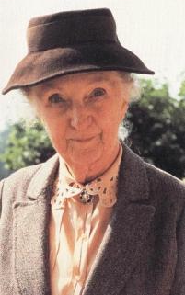
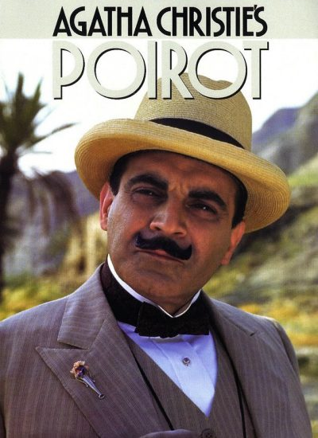
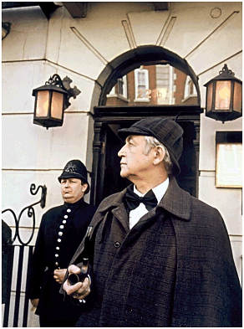

Hercule Poirot
Miss Marple
(Agatha Christie)
Sherlock Holmes
(Sir Arthur Conan Doyle)
Captain Nemo
(Jule Verne)

Slide 10
Драматург
A dramatist
Автор
A writer
A novelist
An author
Писатель
Романист
A person, who writes books
Юморист
Поэт / поэтесса
A humorist
A poet/a poetess
Детский писатель
A children’s writer
Conan Doyle is a ………….
Shakespeare is a ………….

Slide 11
Превосходный
Great
Хороший
Interesting
Famous
Good
Интересный
Известный
Adjectives
Классический
Classical
Талантливый
Talented
Узнаваемый
Современный
Well-known
Modern
Conan Doyle is a ………………………writer.

Slide 12
Оригинальный
Original
Приятный
Скучный
Entertaining
Boring
Enjoyable
Развлекательный
Books can be
Остроумный
Мощный
Witty
Забавный
Powerful
Amusing
Захватывающий
Exciting
Conan Doyle`s books is …………..

Slide 13
Narration
Beginning the story | Continuation | Finishing the story
First (сначала) | Next (затем) | In the end (в конце)
First of all (прежде всего) | Then (потом) | Finally (наконец)
 | After that (после чего) | Eventually (в конце концов)
 | Afterwards (потом)

Slide 14
Connectors
So | Таким образом Поэтому
As | Поскольку
However | Однако
Because | Потому что
That’s why | Вот почему

Slide 15
As soon as
When
After
Until
then
Как только
когда
после
до
затем

Slide 16
I watched the film after/when I read the book.
Until/as soon as I cooked dinner we eat.
When/after he saw her he fell in love.
We saw a snake in the fountain and until/then had a shock.
after
as soon as
When
then

Slide 17
SPEAKING
С3
Task 1
Give a 2-minute talk on your favourite book.
Remember to say :
What kind of book it is
Who the main characters are and whether you like them
What happens in the book
Why it is your favourite

Slide 18
My favourite book
My favourite book is………………
It’s a (detective, humorous, short) story (novel,poem).
It’s author is…………….
He is a talented (creative,extraordinary………).
The main character(s) of this book is (are)….
I like him (her) because he (she) is kind,……..
The story (poem, novel) tells about love,(friendship, nobility,……
I like it because it teaches life, kindness,……….
(Don`t forget about linking words!)

Slide 19


Slide 20

Please try again

Slide 21
Драматург
A dramatist
Автор
A writer
A novelist
Писатель
An author
Романист
A person, who writes books
Юморист
Поэт / поэтесса
A humorist
A poet/a poetess
Детский писатель
A children’s writer
Conan Doyle is a ………….
Shakespeare is a ………….

Slide 22
Превосходный
Great
Хороший
Interesting
Famous
Good
Интересный
Известный
Классический
Classical
Adjectives
Талантливый
Talented
Узнаваемый
Современный
Well-known
Modern
Conan Doyle is a ………………………writer.

Slide 23
Оригинальный
Приятный
Original
Enjoyable
Скучный
Entertaining
Boring
Развлекательный
Остроумный
Witty
Books can be
Забавный
Мощный
Amusing
Захватывающий
Powerful
Exciting
Conan Doyle`s books is …………..

Slide 24
Приключения Детектив Драма Комедия Научная фантастика Юмористич. история Сказка Биография Роман История Ужас Классика | Adventure Detective Drama Comedy Science fiction Humorous story Fairy tale Biography Novel History Horror Classic

Slide 25
Приключения Детектив Драма Комедия Научная фантастика Юмористич. история Сказка Биография Роман История Ужас Классика
Novel
History
Adventure
Fairy tale
Drama
Comedy
Classic
Detective
Humorous story
Biography
Horror
Science fiction

