Slide 1

Тема урока: «Pastimes»
6 класс
КЛАСС

Slide 2
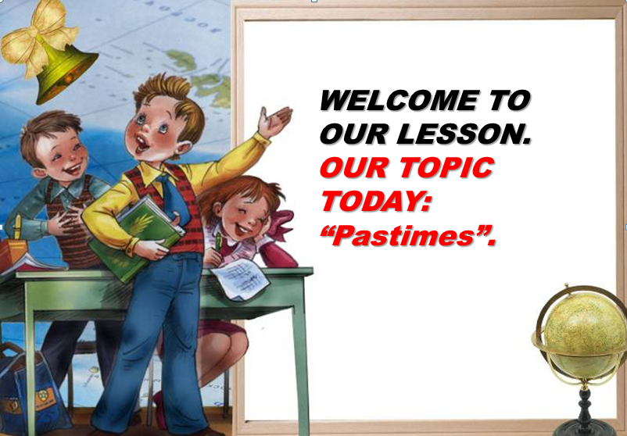


Slide 3
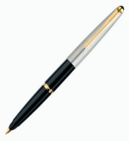
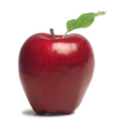

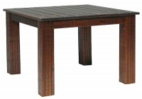
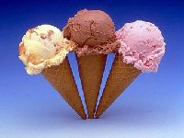


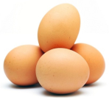
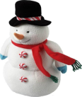
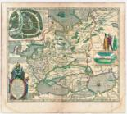

Warm -up activities:
P
A
S
T
I
E
S
M

Slide 4
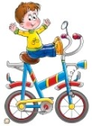
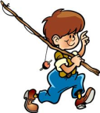

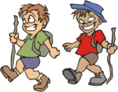


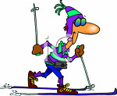

Leisure activities:

Slide 5


The most popular hobbies in
Russia
Great Briatan
gardening
shopping
hunting
watching TV
going out
reading
gardening
fishing
sleeping
hiking

Slide 6

Tick the correct answer:
Alex hates
A) actors.
В) drama clubs.
С) plays.
Alex thinks acting is
A) exciting.
В) dull.
С) fun.
Sally doesn't like
A) writing.
В) working.
С) acting.
The club meetings are on
A) Mondays.
В) Tuesdays.
С) Thursdays

Slide 7

Name
Full name
Country
Class
Activities
Where

Slide 8
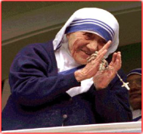
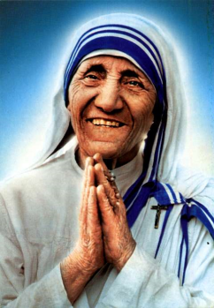
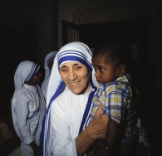
Mother Teresa is a great example of charity
Mother Teresa

Slide 9

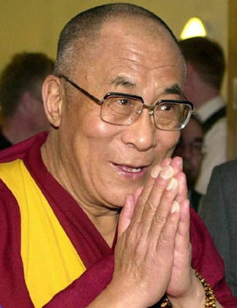





Dalai Lama XIV
Dainzin Gyaco

Slide 10

WE WANT OUR PEACE TO BE A BETTER ONE.

Slide 11


Thank you!

