Slide 1

WebQuest “THE UN”
THE UNITED NATIONS ORGANIZATION

Slide 2
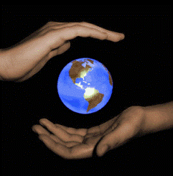



THE CONTENTS
Title
Introduction
Task
Process
Evaluation
Conclusion
Reflexion (cinquain)
References

Slide 3

TITLE
During two weeks you are going to do a study of the United Nations Organization. You will explore websites that help you to understand the history of the UN, its structure and bodies. You will follow the development of the UN, its missions and great achievements that have a great influence on people's lives all over the world.

Slide 4

INTRODUCTION
The United Nations is an international organization designed to make the enforcement of international law, security, economic development, social progress, and human rights easier for countries around the world. As the most representative inter-governmental organization of the world today, the United Nations' role in world affairs is irreplaceable by any other international or regional organizations. The United Nations has made enormous positive contributions in maintaining international peace and security, promoting cooperation among states and international development. Today, people of the world still face the two major issues of peace and development. Only by international cooperation can mankind meet the challenges of the global and regional issues. The United Nations can play a pivotal and positive role in this regard. As it was in the past, the main function of the UN today is to maintain peace and security for all of its member states.
We, people of the world, can't imagine our life without United Nations Organization nowadays.

Slide 5

Watch the video below and answer the question:
- Does the UN do a lot for the mankind?
United Nations - a digital story

Slide 6
TASK
1. Study the websites and resources in order to find out and learn the information about the United Nations Organization and its great achievements.
2. Make a presentation "The UN Contribution to the world society".
3. Present your presentation to the class.
4. Write an opinion essay "The United Nations as a peacekeeping organization".
Below you can see two tasks: writing an opinion essay and making a presentation. Study these two papers very carefully in order to understand clearly both tasks.

Slide 9
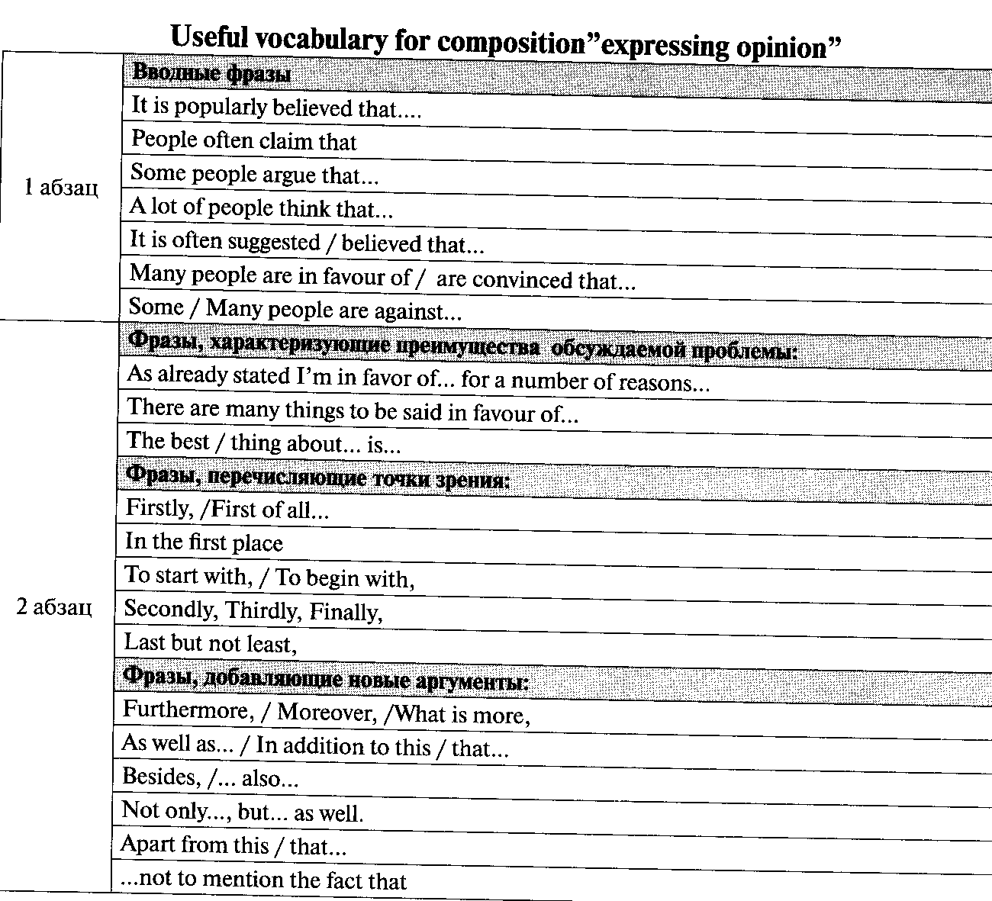

Slide 10
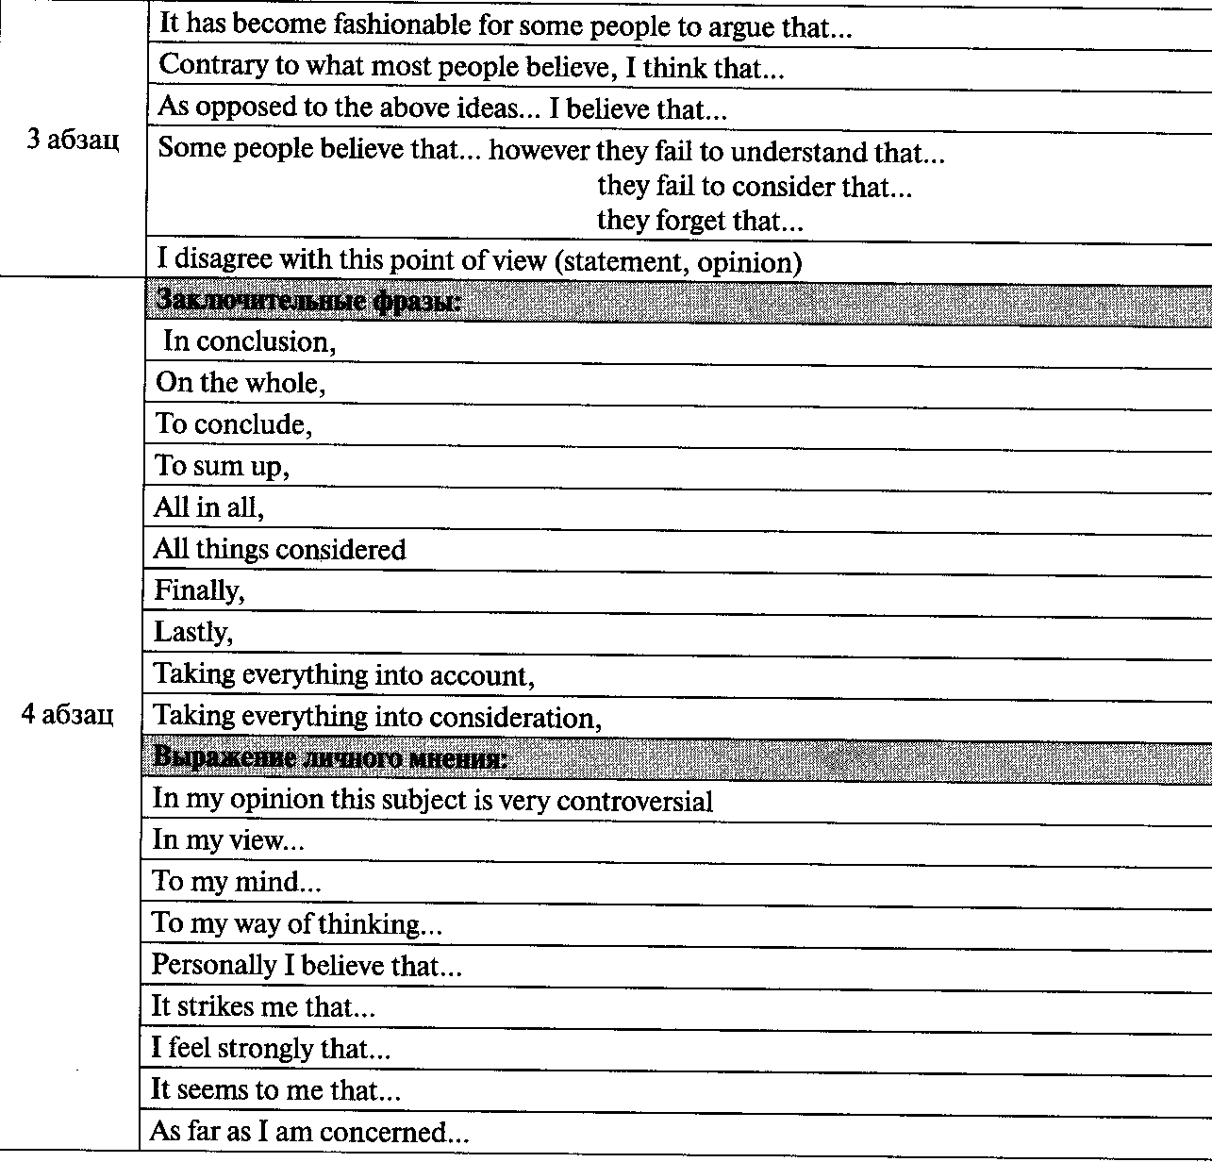

Slide 11
ATTENTION
While working at the computer remember the time you spend for it.
You are able to work at the computer no more than 30 minutes during a session. And during the second session you are able to work no more than 20 minutes.
Take care of your health and eyes!

Slide 12


PROCESS
Study file "The UN vocabulary". These words and word combinations are necessary to cope with the information about the UN.

Slide 15
Study file site Quizlet. You will find the main items and terms connected with the UN there.
You also can hear them.
The UN terms

Slide 16
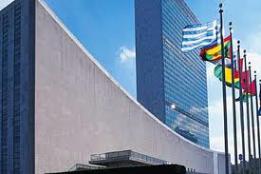
Session 1
Study general facts about the UN, its history and structure
Task for presentation
What are the main aims and principles of the UN?
Choose one principle organ of the UN and describe its functions and work.

Slide 17

The United Nations Organization (UN) -
is an international organization whose stated aims are facilitating cooperation in international law, international security, economic development, social progress, human rights, and achievement of world peace.

Slide 18
The UN was founded in 1945 after World War II to replace the League of Nations, to stop wars between countries, and to provide a platform for dialogue.
US President Franklin Roosevelt was a driving force behind the creation of the United Nations.
The name “United Nations” was used by Roosevelt to describe the alliance fighting the Axis powers in World War 2.

Slide 19
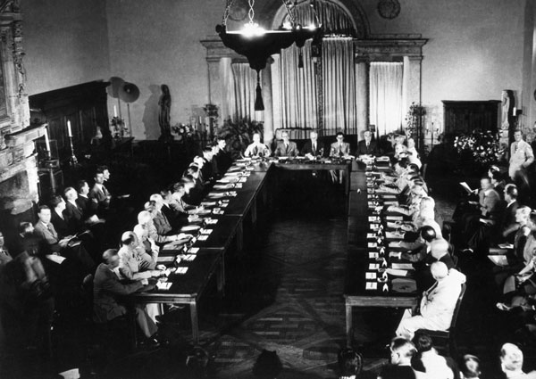
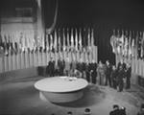
In 1945, representatives of 50 countries met in San Francisco at the United Nations Conference on International Organization to draw up the United Nations Charter.
The Charter was signed on 26 June 1945 by the representatives of the 50 countries.
Poland signed it later and became one of the original 51 member states.
UN officially comes into existence on 24 October 1945.

Slide 20

The United Nations logo shows
the world held in the
“ olive branches of peace”
The logo of the United Nations was designed by Donal McLaughlin, who worked for the Office of Strategic Services (OSS), the precursor of the CIA. Donal described the UN logo as an "azimuthally equidistant projection showing all the countries in one circle, flanked by crossed olive branches." The logo was first designed as a lapel pin.

Slide 21
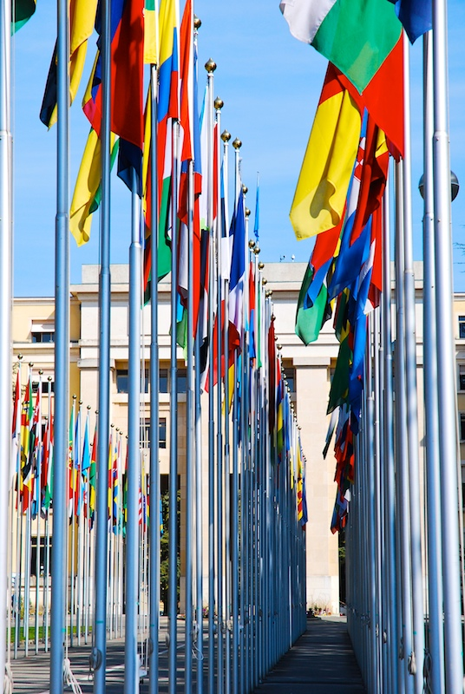
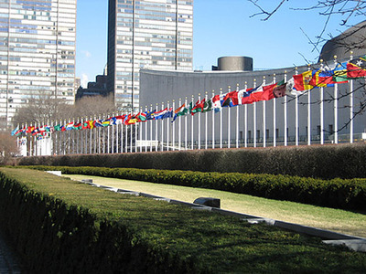
There are currently 193 member countries in the UN now.

Slide 22
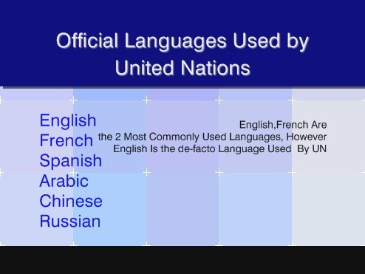

Slide 23
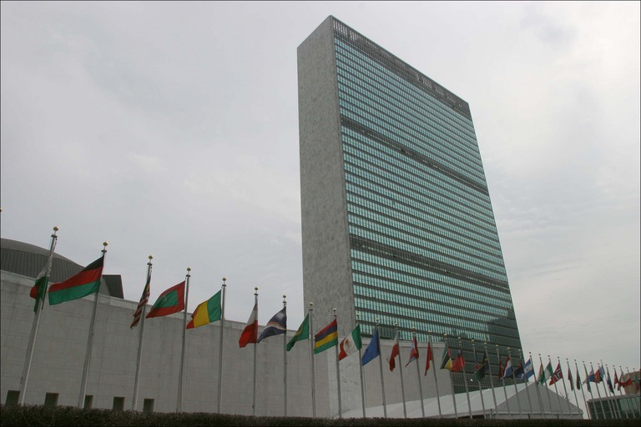

United Nations Headquarters are in New York City. It is a separate and independent entity with its own flag, post office and postage stamps, and its buildings are located on international territory of New York.

Slide 24
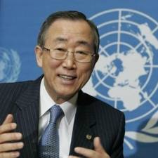
The current Secretary-general of the United Nations
Ban Ki-moon,
since 1 January 2007

Slide 25
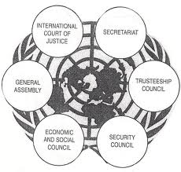
The United Nations' system is based on five principal organs:
the General Assembly
the Security Council
the Economic and Social
Council (ECOSOC)
the Secretariat
the International Court of Justice

Slide 26
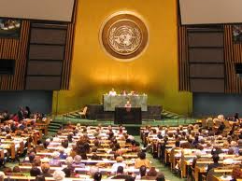
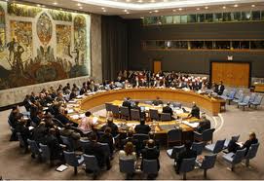
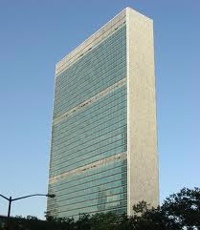
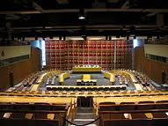
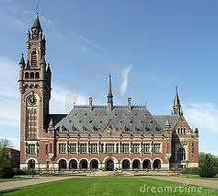
The General Assembly is the main deliberative assembly of the United Nations. Composed of all United Nations member states, the assembly meets in regular yearly sessions under a president elected from among the member states.
The Security Council is charged with maintaining peace and security among countries.
The United Nations Secretariat is headed by the Secretary-General, assisted by a staff of international civil servants worldwide.
The Economic and Social Council (ECOSOC) assists the General Assembly in promoting international economic and social cooperation and development.
The International Court of Justice (ICJ), located in The Hague, Netherlands, is the primary judicial organ of the United Nations.

Slide 27
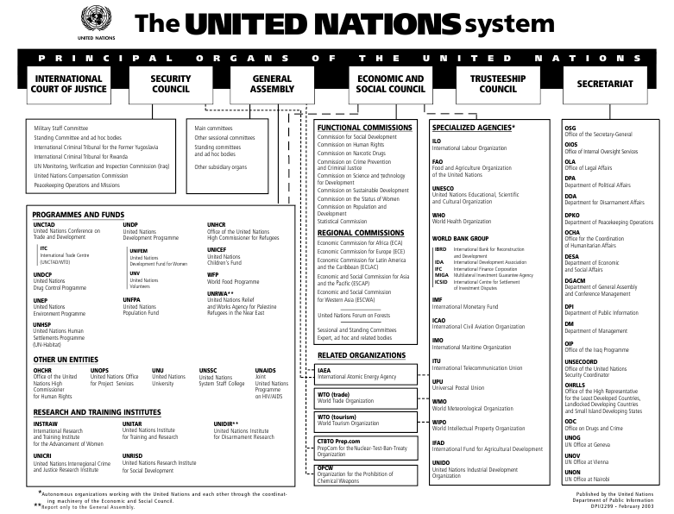

Slide 28
Self-studying
- The United Nations (article from Wikipedia)
History of the United Nations
Watch a video “Signing the UN Charter”
The member states of the United Nations
Principal organs of the United Nations
Organization and principles
Watch a presentation "The United Nations"
The Security Council
Make a virtual trip on the UN
Do a quiz and check your knowledge about the Security Council

Slide 29
Session 2
Study the UN documents
Task for presentation
Introduce 2-3 articles from the UN Charter. Why were they necessary to be admitted at that time?
Introduce 2-3 articles from the Universal Declaration of Human Rights and illustrate them with examples how these rights are observed or violated.
Introduce 2-3 articles from the Conventions of Children’s Rights. Are these rights observed in your life?
Describe 2 important UN resolutions. What significance for the word do they have?
Choose 2 Millennium Development Goals of the UN. What are the ways to achieve them?

Slide 30
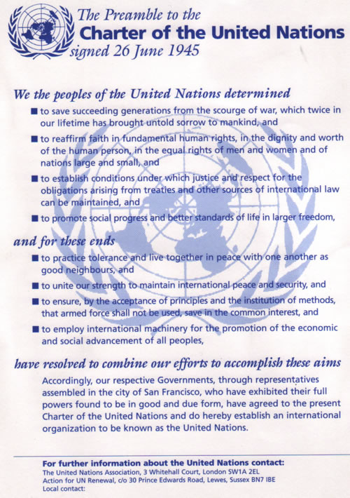
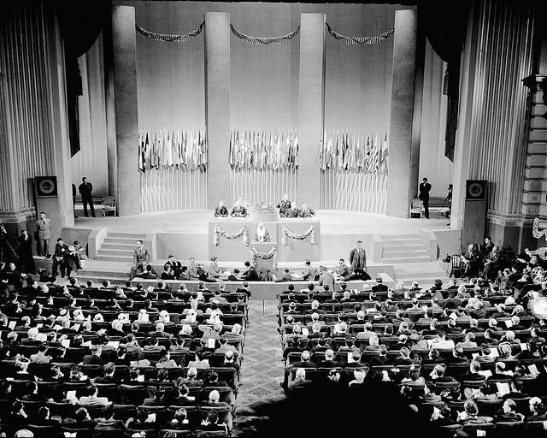

Slide 31
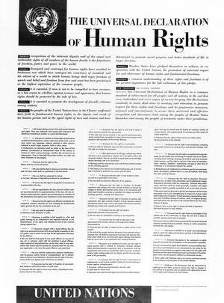

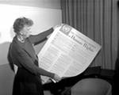
The Universal Declaration of Human Rights
The Universal Declaration of Human Rights (UDHR) is a declaration adopted by the United Nations General Assembly (10 December 1948 at Palais de Chaillot, Paris). The Declaration arose directly from the experience of the Second World War and represents the first global expression of rights to which all human beings are inherently entitled. It consists of 30 articles which have been elaborated in subsequent international treaties, regional human rights instruments, national constitutions and laws.

Slide 32
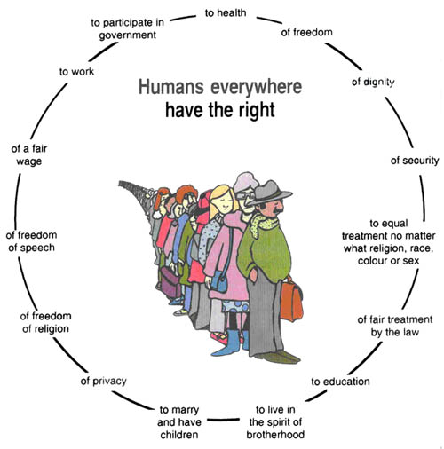
United Nations
International
Declaration of
Human Rights (1948)

Slide 33
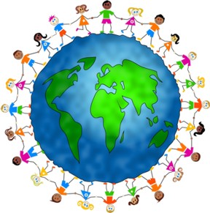

Convention on the Rights of the Child
The United Nations Convention on the Rights of the Child (commonly abbreviated as the CRC, CROC, or UNCRC) is a human rights treaty setting out the civil, political, economic, social, health and cultural rights of children.
The United Nations General Assembly adopted the Convention and
opened
it for signature on
20 November 1989.

Slide 34
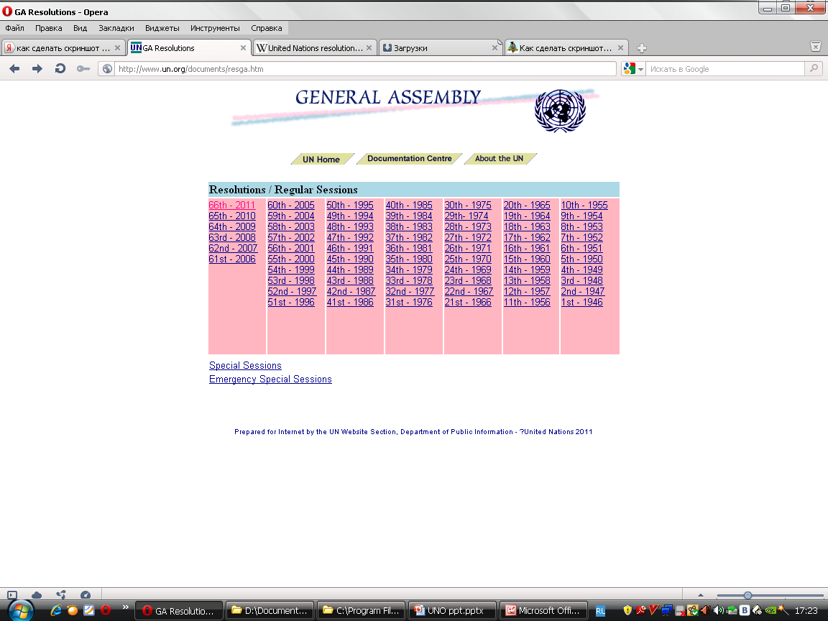
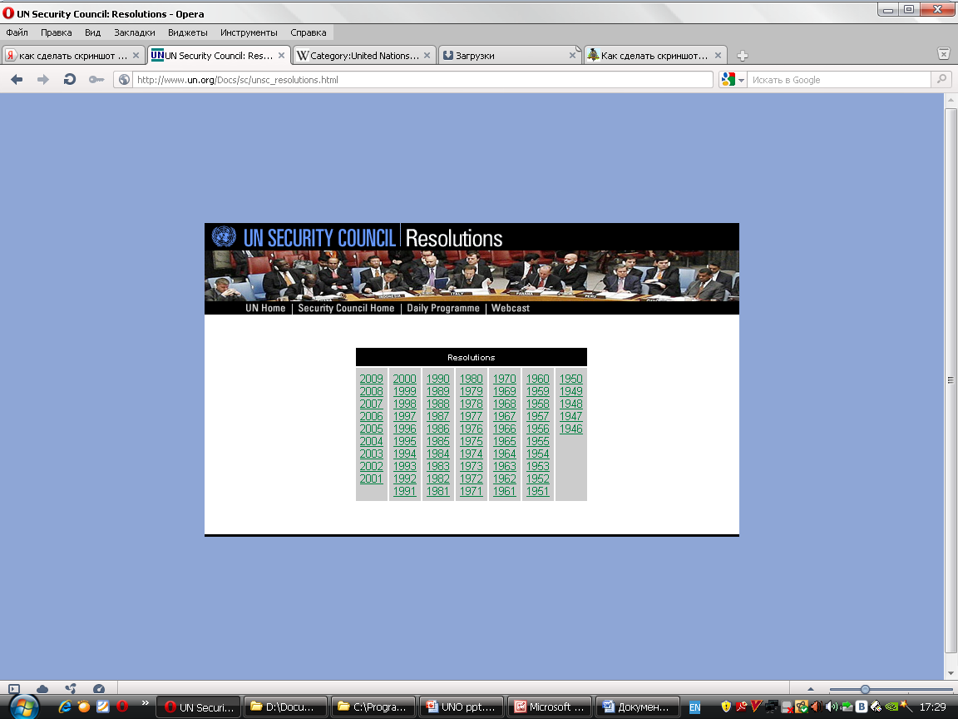
UN RESOLUTIONS
A United Nations resolution (UN resolution) is a formal text adopted by a United Nations (UN) body. Although any UN body can issue resolutions, in practice most resolutions are issued by the Security Council or the General Assembly.

Slide 35
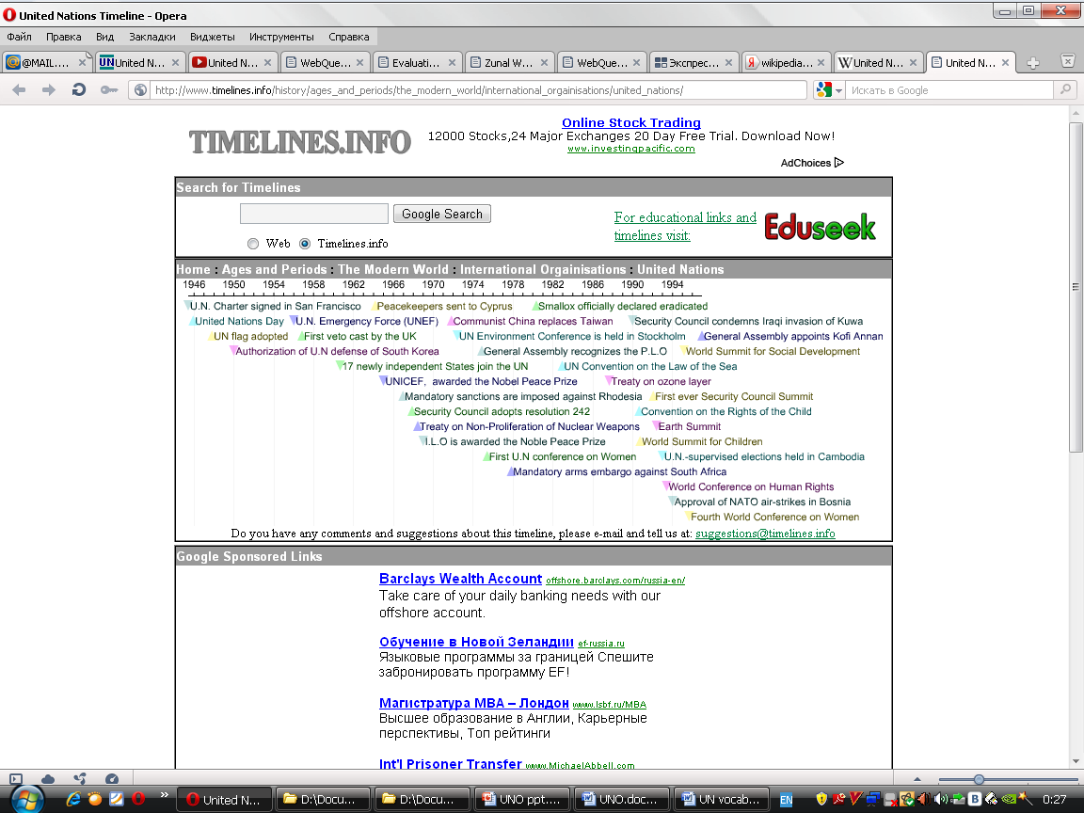
The most important resolutions 1946-1994

Slide 36
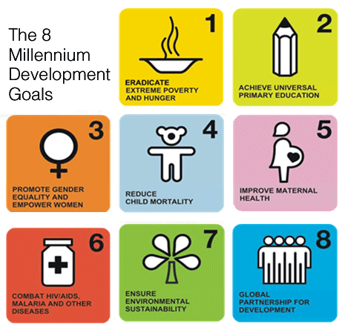
Millennium Development Goals
The Millennium Development Goals (MDGs) are eight international development goals that all 193 United Nations member states and at least 23 international organizations have agreed to achieve by the year 2015. They include eradicating extreme poverty, reducing child mortality rates, fighting disease epidemics such as AIDS, and developing a global partnership for development.

Slide 37
Self-studying
Collection of the UN documents
Charter of the United Nations
The universal declaration of human rights
-Watch a video "The universal declaration of human rights“
Convention on the rights of the child
Convention on the rights of the child (Wikipedia article)
Security Council resolutions
General Assemlbly resolutions
Millennium development goals
Watch a video "Millennium development goals for 2015

Slide 38
Session 3
Study information about Specialized Agencies, Related Organizations, Funds, and other UN Entities
Task for presentation
Choose one UN program, or fund, or specialized agency and describe its main aims and work.

Slide 39

Many UN organizations and agencies exist to work on particular issues.

Slide 40
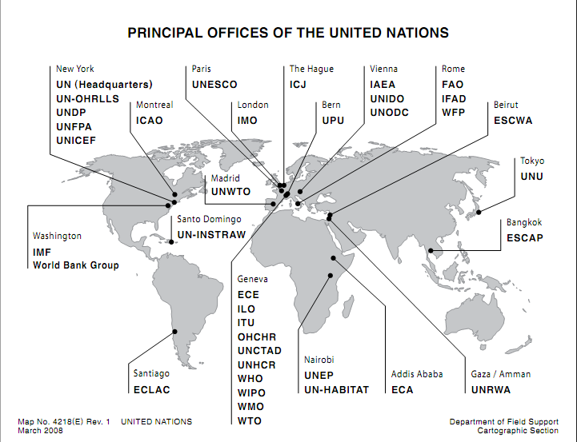

Slide 41











Slide 42
Self-studying
The list with the UN agencies, funds, programmes
The UN agencies (Wikipedia article)
Do a quiz and check your knowledge about the UN agencies

Slide 43
Session 4
Study the UN peacekeeping missions
Task for presentation
Describe 1-2 UN peacekeeping missions. What help did the organization offer?

Slide 44
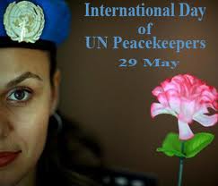

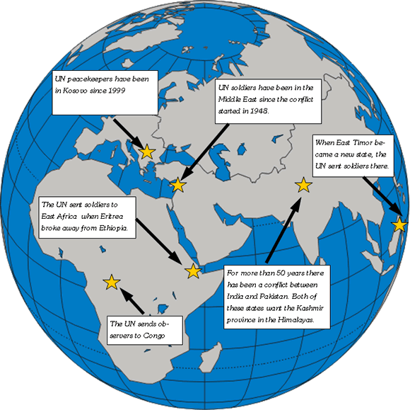
Peacekeeping and security
The UN, after approval by the Security Council, sends peacekeepers to regions where armed conflict has recently ceased or paused to enforce the terms of peace agreements and to discourage combatants from resuming hostilities. Since the UN does not maintain its own military, peacekeeping forces are voluntarily provided by member states of the UN. The forces, also called the "Blue Helmets“.

Slide 45
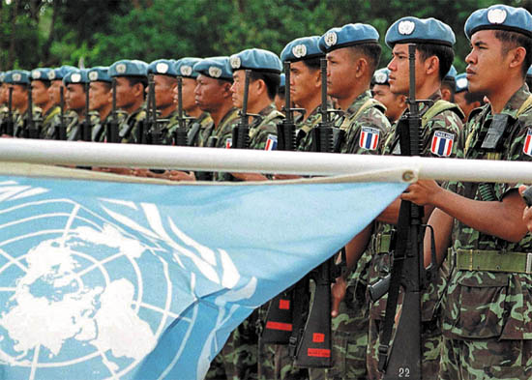
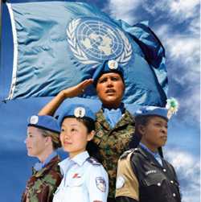
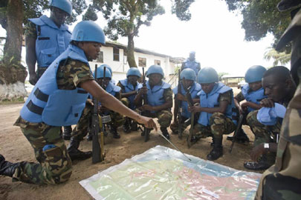
UN peacekeeping operations
The first ever UN peacekeeping mission established in the Middle East in 1948 is still continuing.
At present, there are 40,000 UN peacekeepers serving all over the world.
The UN has no military force of its own, and is dependent on other countries to provide military forces.

Slide 46
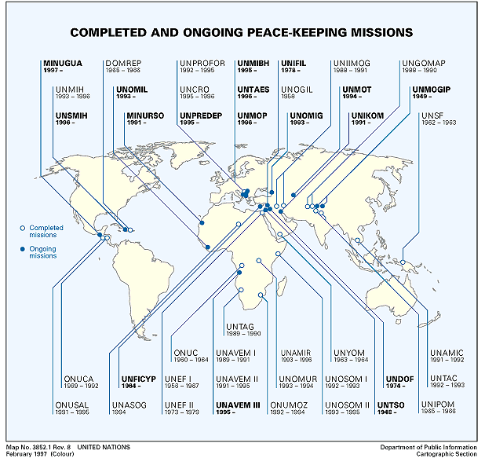

Slide 47
Self-studying
United Nations peacekeeping operations
United Nations peacekeeping (Wikipedia article)
United Nations peacekeeping
List of all UN peacekeeping missions
Timeline of UN peacekeeping missions
Search this site for videos about the UN missions and operations
Search this site for video news about UN peacekeeping missions
- Do a quiz and check your knowledge about United Nations peacekeeping missions

Slide 48
Session 5
Study the information about UN holidays
Task for presentation
Describe 2 International Days of the UN. What are the reasons for celebrating them?

Slide 50
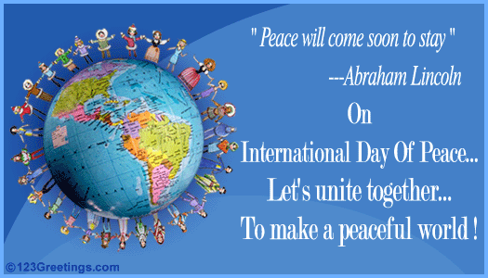
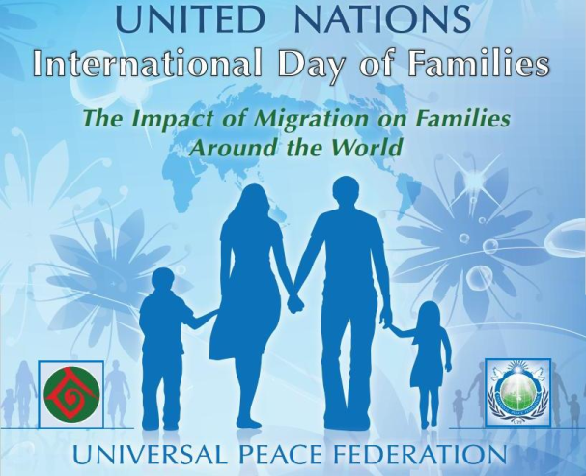


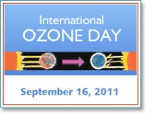


Slide 51
Self-studying
UN Day
Watch a presentation "United Nations Day“
United Nations Day, 24 October 2011
United Nations Day (Wikipedia article)
United Nations Day
Human Rights Day
Watch a presentation "Human Rights Day“
Human Rights Day, 10 December 2011
Human Rights Day (Wikipedia article)

Slide 52
Self-studying
World Environment Day
World Environment Day (Wikipedia article)
Watch a presentation "World Environment Day"
International Day of the UN Peacekeepers
- International Day of the United Nations peacekeepers (Wikipedia article)
International day of the UN peacekeepers

Slide 53
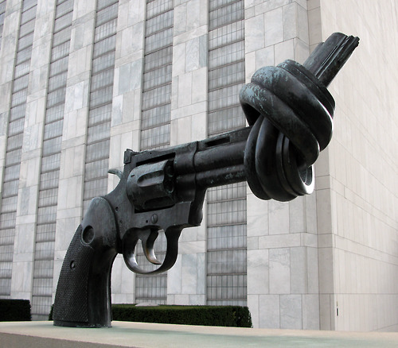
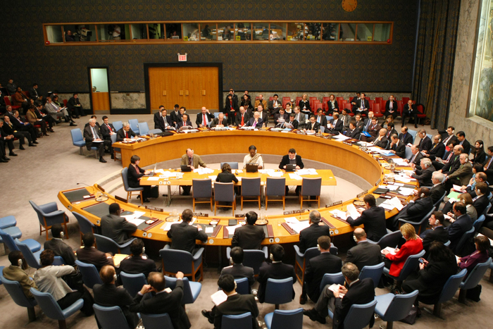
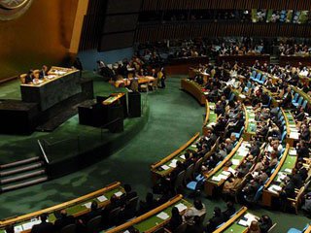
Session 6
Check how much you’ve learnt about the UN

Slide 54
Self-control
Listen to the text about the UN
and answer the questions
Do quizzes
1
2
3
4
5
6
7
8
9 (advanced level)
1. When was the United Nations established?
2. What did the UN want to do?
3. Who is the main spokesperson for the UN?
4. What does the main spokesperson do?
5. What are some of the successes of the United Nations listed in the article?
6. What happened in Somalia?
7. According to some critics, why is the UN inefficient?
8. According to the article, what happened in 1988?
9. Who won the Nobel Prize in 2001? Why?
10. How many nations belong to the United Nations?

Slide 55
Session 7
Make a conclusion
Task for presentation
Make a conclusion for your presentation. What is the UN contribution to the world society?
Think and try to introduce ideas about your own small contribution to the UN.

Slide 56

EVALUATION
You are going to create two products: a multimedia presentation and an opinion essay. Each product will be graded. While making a presentation and writing an essay check with the help of these criterions how successful you are.

Slide 57
Критерии оценки выполненной мультимедийной презентации

Slide 61

CONCLUSION
After completing this webquest you will be able to understand a great influence of the UN on the world society. You have analyzed its main principles and goals. Also you have seen a number of the greatest achievements and contributions that the UN provides to the world. You have known all human rights and tried to support them. And even you have tried to think what you could do help to spread peace and development throughout not the whole world but among your own surroundings.
It's your World...

Slide 62
Reflexion
Cinquain
After finishing your webquest try to think and analyze the information that you’ve learnt about the UN.
Do it in the form of a cinquain.
1line - write the name of the organization – 1 word (noun)
2line – write the description of the organization – 2 words (adjectives)
3 line – write the actions that connected with the organization – 3 words (verbs)
4 line – write your opinion about the organization – 4 words
5 line – write the key word of the organization – 1 word

Slide 63
References
http://www.un.org/en/
http://en.wikipedia.org/wiki/United_Nations
http://www.elcivics.com/united_nations_1.html
http://www.timelines.info/history/ages_and_periodson
http://www.headsupenglish.com/index.php?option=com
http://learningtogive.org/lessons/unit65/lesson2.html
http://www.english-online.at/government/united-nations/un.htm

