Slide 1
Моё Таврово! Дивный край!
На карте мал, но так прекрасен,
Здесь побывать, ну просто рай!
Здесь небосвод и чист и ясен…
Welcome to Tavrovo!

Slide 2
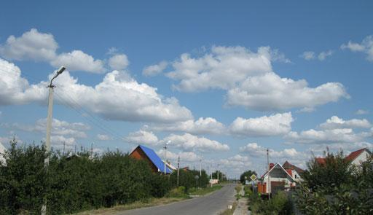
Country mornings are
flowers and sky,
With feather clouds
floating by.
Country mornings are
song and sun,
And happy birds
having fun.

Slide 3
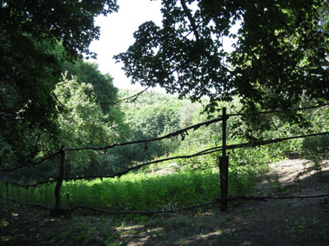
When you get up
just look around,
And see the things
that can be found.
No matter where you
live or stay,
Be happy for a
bright new day!

Slide 4
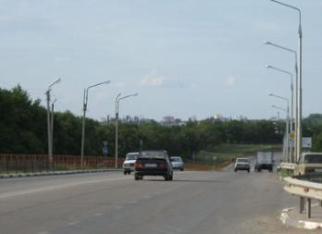
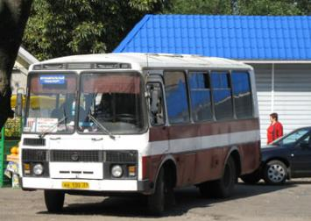
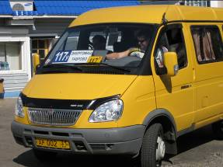
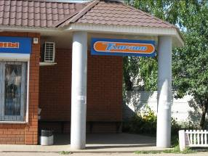
If you start from Belgorod the bus 177 ^{“U”} will bring you to Tavrovo.
It is one of the old village in the south of the Belgorod Region.

Slide 5
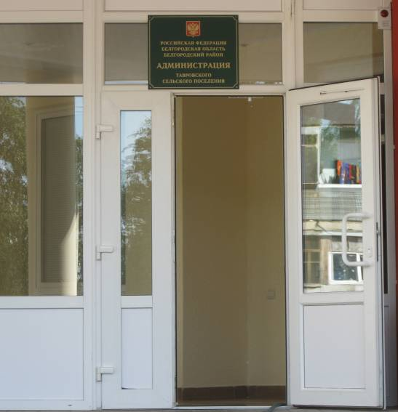
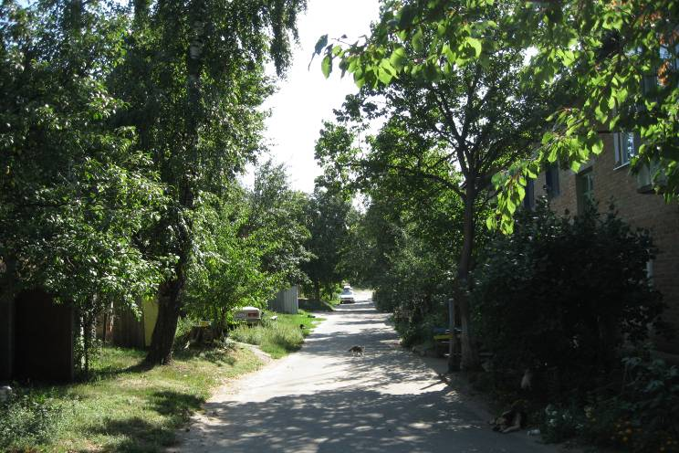
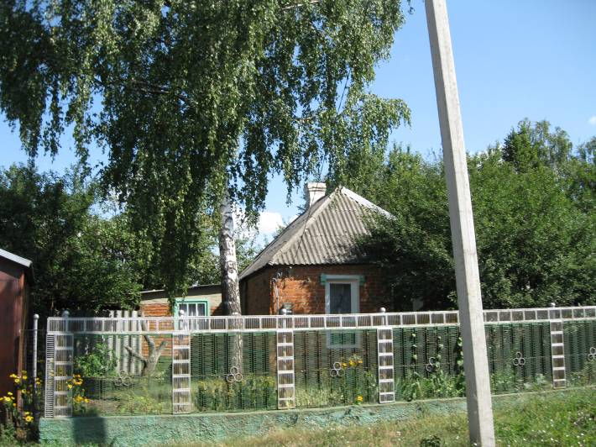
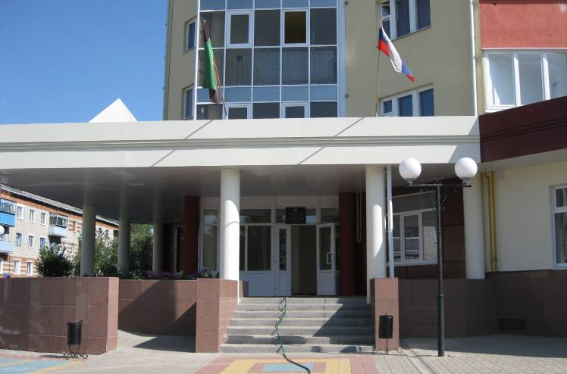
Everything is simple and quiet here.
But we love our village.
We love it because it’s our birthplace,
because our parents and friends live here.

Slide 6
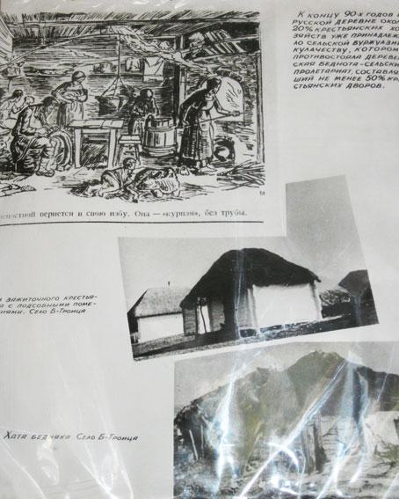
The first mention of Tavrovo can be found in the Russian chronicles dated back to the 17th century. If we turn back to the history it would be interesting to know that the village arose at the end of the 18th century as a village – “sloboda”. And in the year 1882 it was a settlement of 307 people and 67 houses.

Slide 7
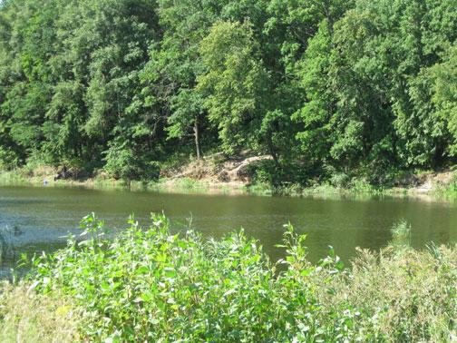
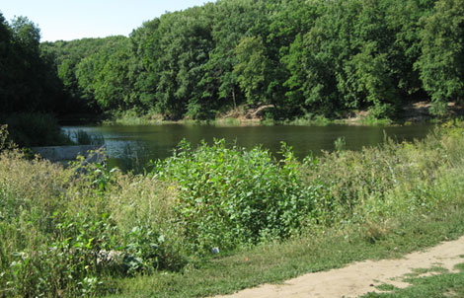
There are several versions of the origin of the word “Tavrovo”. According to the legend, a rich man was traveling. Going past our village he saw a green countryside and a beautiful landscape and exclaimed: “Vrovo!” (Beautifully! or Beauty!)
Gradually the letters “ta” (ta – there) was added and our village got the name “Tavrovo” (Там красиво).

Slide 8
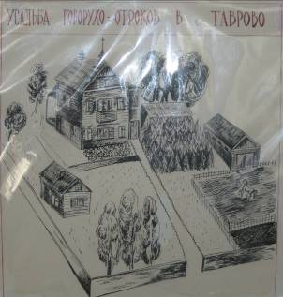
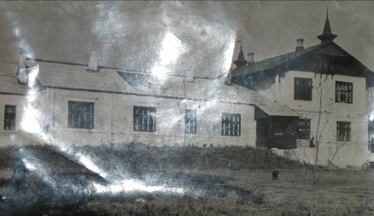
In 1696 after the war between Russia and Turkey the government presented the villages to the heroes of this war. One of them was Nikolai Govorukho-Otrok. He bought 7 families in Tavriya (the Nikolaev region) and decided to found a village. To this fact the word “Tavrovo” came from “Tavriya”.
In the centre of his country-seat (усадьба) he built a two-storeyed house with a yard and park. It was called “Pansky Yard” (Панский двор).
The Govorukho-Otroks had owned Tavrovo up to 1917.

Slide 9
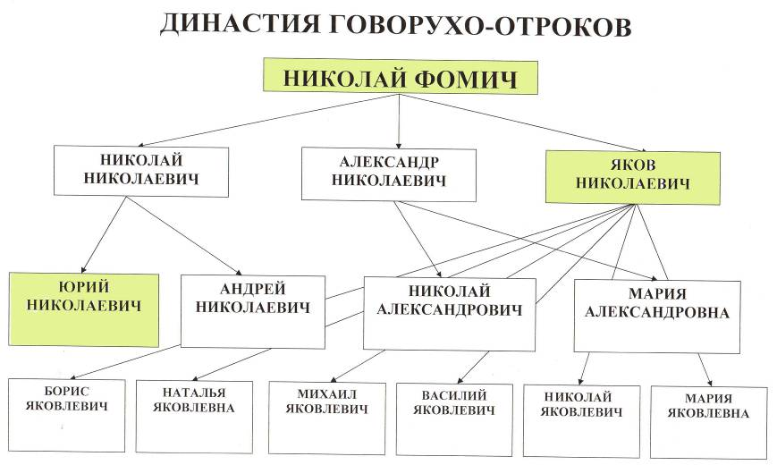

Slide 10
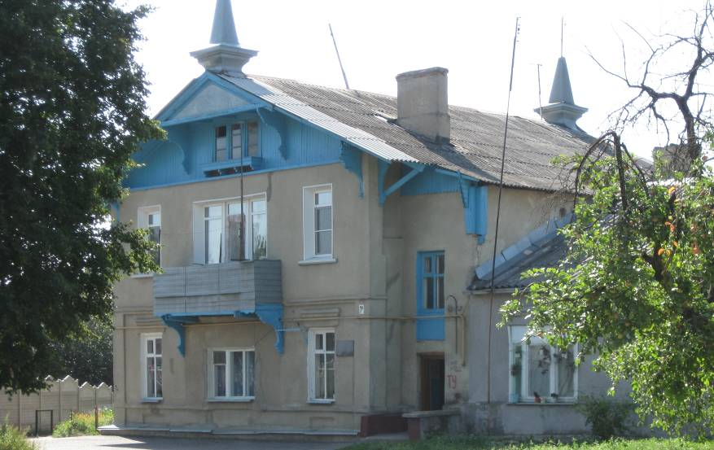
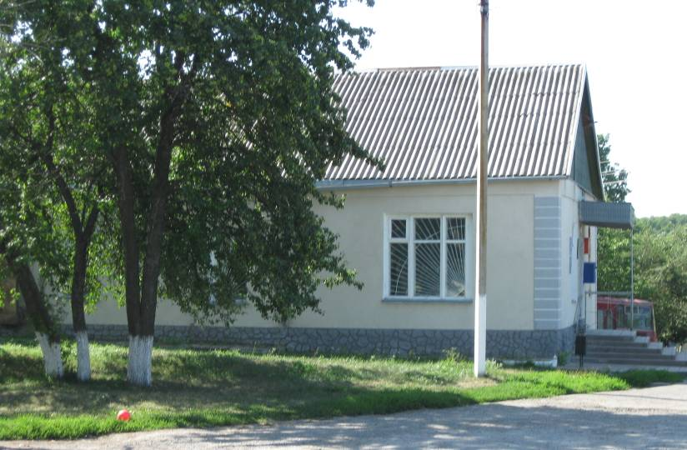
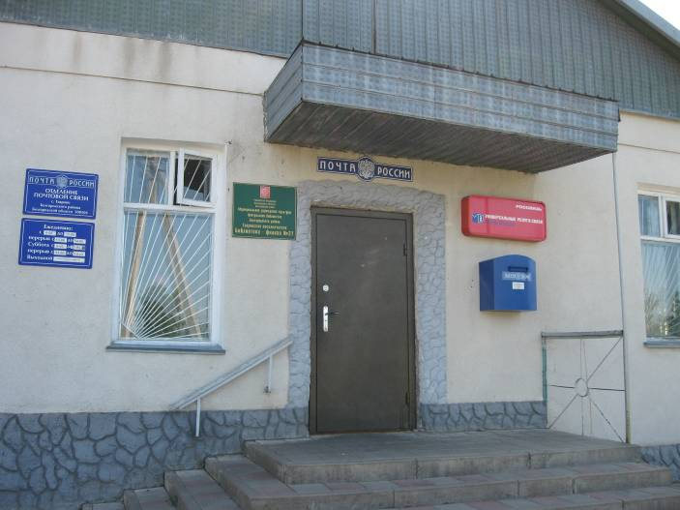
Nowadays there are people’s flats, a post office and a library in this house.

Slide 11
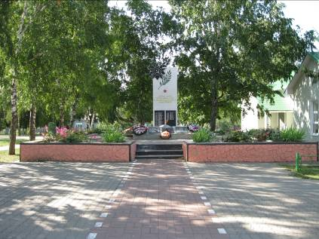
If you want to see the places of interest in our village, you can walk to the centre of it. In the centre there is a monument to honour the people who died in war time that we might live.
Everybody remembers that this is a very place where our defenders were burred. It was during the Great Patriotic war in 1943.
Our village was occupied by German fascist and on the 7th of August, 1943 the soviet soldiers got free our village.
We celebrate the day of the village on the 12th of September.

Slide 12
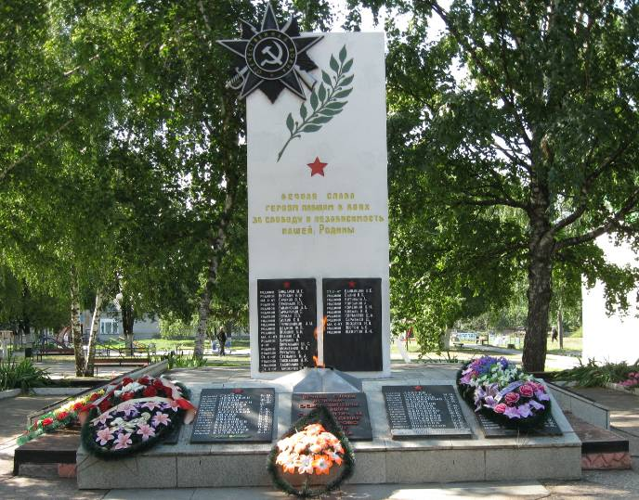
There is the Eternal Flame at the monument.
There are a lot of flowers at their feet.

Slide 13
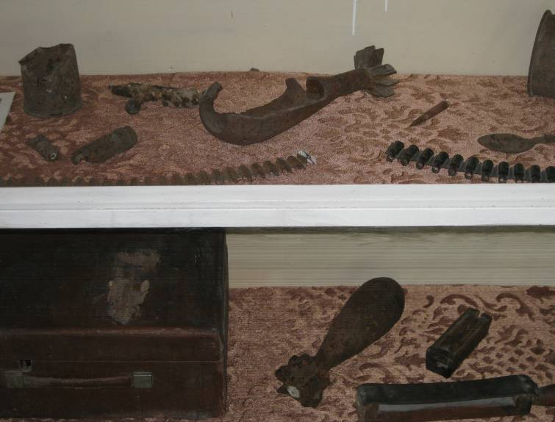
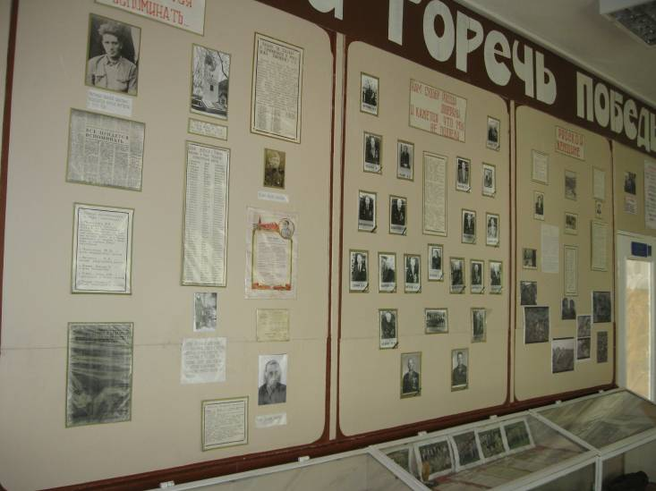
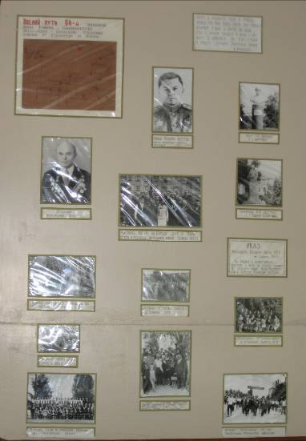
In our school museum there are names of our heroes.
And we try to find out some information about them.

Slide 14
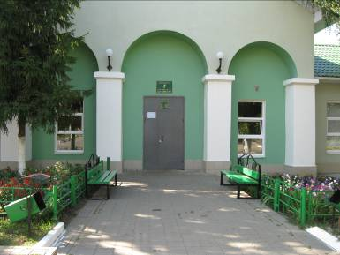
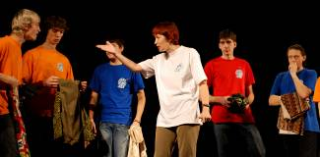
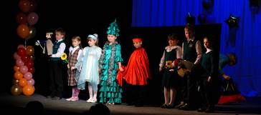

On the right of the monument there is a House of Culture. Cultural life is rich enough for the village.
The theatre “Okno” is very famous not only in the Belgorod region but in Russia.

Slide 15
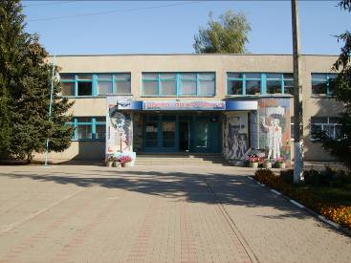
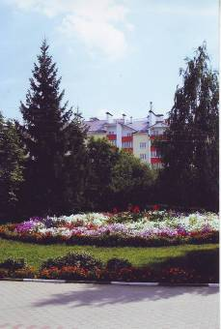
The history of our school began in 1899, when the first building of the primary school was opened. This school was named after Yakov Nikolaevich Govorukho-Otrok. Yakov was involved in politics and served his country best as a chair man of Zemstvo in the Kursk region.
In September, 1984, a new building of the school was opened. It has two floors. There are a lot of different classrooms, a gymnasium, a dining-room here.
More than 300 pupils study in our school and about 20 teachers work there. We like our school very much.

Slide 16
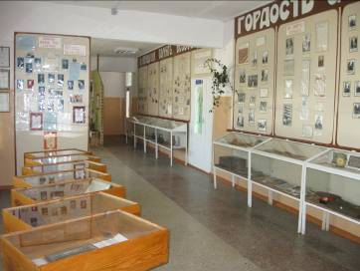
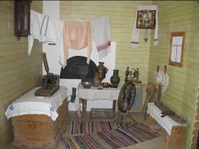
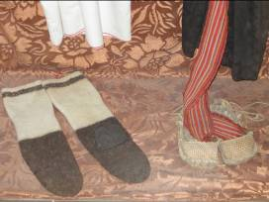
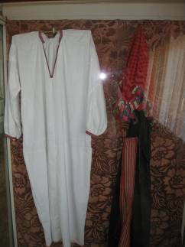
There is a museum in our school. It was founded on the 5th of October in 1999.
Our museum is one of the best school museums in the Belgorodsky district.

Slide 17
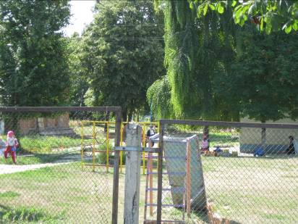
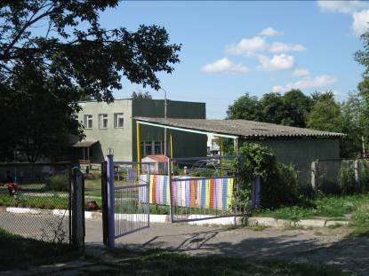
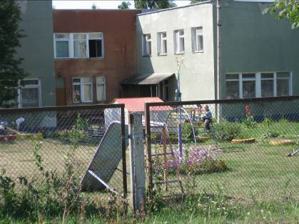
To the left of our school there is a kindergarden. The new building was built in 1981.

Slide 18
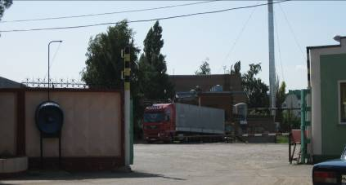
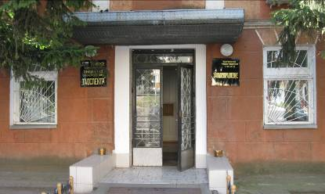
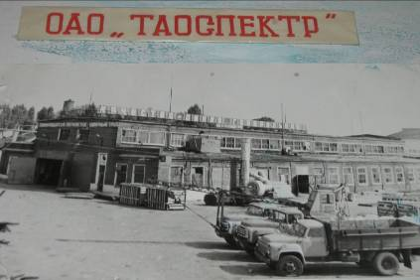
There is a small factory in our village.
The history of it began in 1930. And in our school museum you can see some exhibits connected with it.

Slide 19
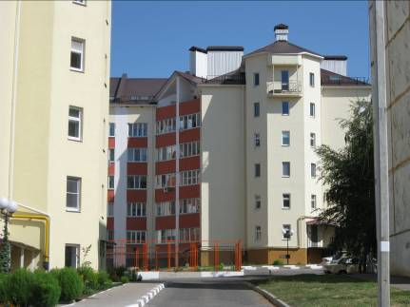
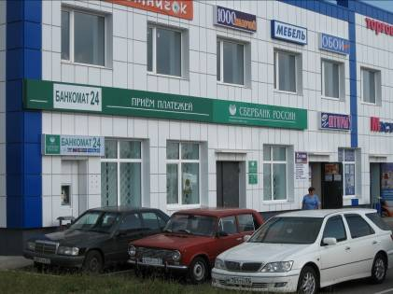
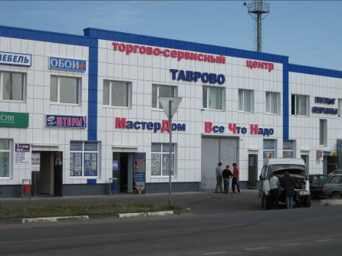
Now Tavrovo is a modern and nice village.

Slide 20
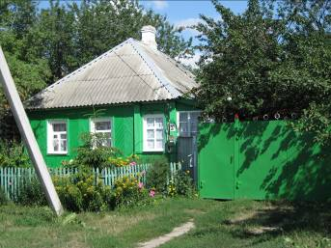
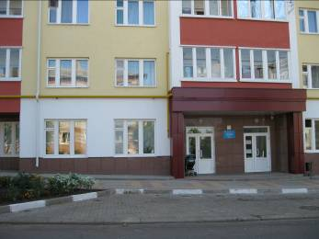
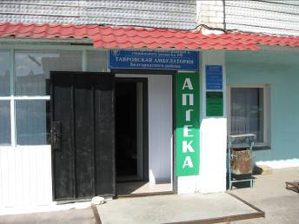
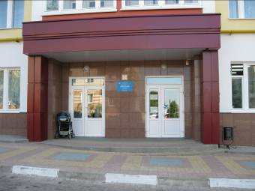
The streets of our village are not long but there are lots of modern and old buildings, a hospital and shops.

Slide 21
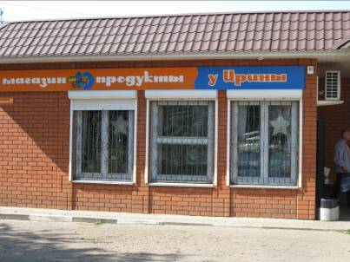
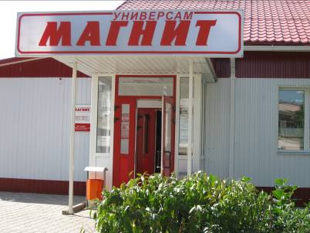
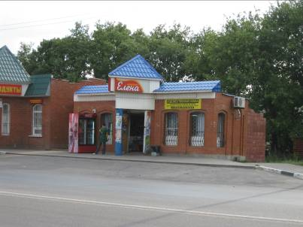
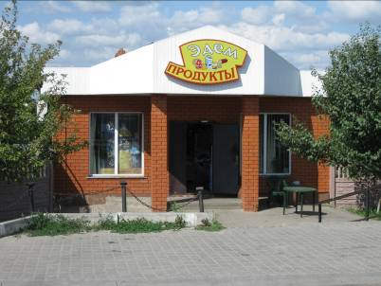

Slide 22



In Tavrovo there is a park and a children’s yard. In their free time and on holidays the people like to walk in the park with their children.

Slide 23



But what is really beautiful in our village and its suburbs are our landscapes. Different trees and flowers are growing in our area.
It is pleasant to walk in our forest and enjoy fresh air.
We admire our nature and advise everybody to visit our village.

Slide 24

Nikolai Govorukho-Otrok’s grandson Yuri Nikolaevich was famous as a talented writer and outstanding literary critic and a theatre scientist.
He was born in Tavrovo in 1854.
Unfortunately he was not known as a writer in our country for a long time. And we don’t know many details about his life.

Slide 25

But thanks the professor Zoya Timofeevna Prokopenko now his name is known in the world. He left a good memory of himself. We are proud and look up to him.

