Slide 1
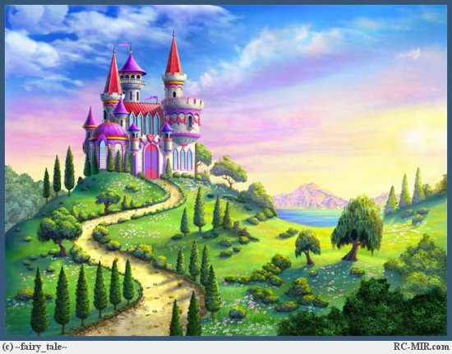

THE KINGDOM OF THE
LETTER A

Slide 2
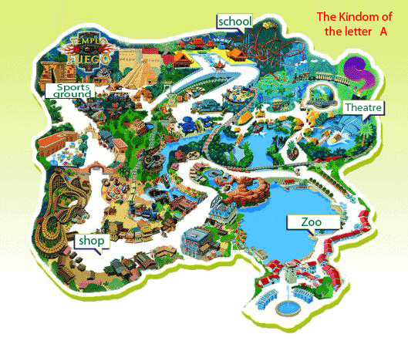

Slide 3
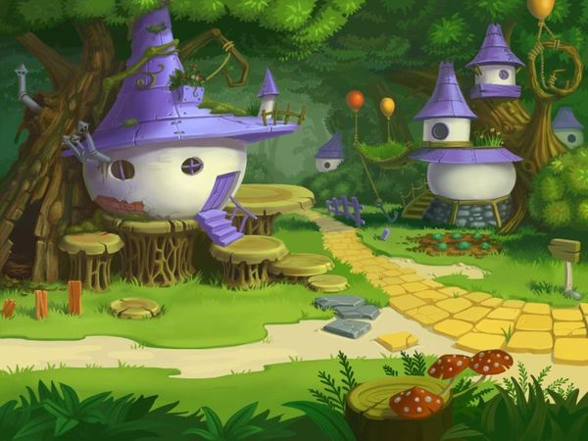
A- STREET

Slide 4

[ei ]
[æ]

Slide 5
A a
[ei]
[æ]
name
cat
brave
bad

Slide 6
Sam, Kate, Dan, Sally, Jane, Larry, Dave, Ann.
[ei ]
[æ]

Slide 7
Kate, Dan, Sally, Jane, Larry, Dave, Ann.
[ei ]
[æ]
Sam

Slide 8
Dan, Sally, Jane, Larry, Dave, Ann.
[ei ]
[æ]
Kate
Sam

Slide 9
Sally, Jane, Larry, Dave, Ann.
[ei ]
[æ]
Kate
Sam
Dan

Slide 10
Jane, Larry, Dave, Ann.
[ei ]
[æ]
Kate
Sam
Dan
Sally

Slide 11
Larry, Dave, Ann.
[ei ]
[æ]
Kate
Sam
Jane
Dan
Sally

Slide 12
Dave, Ann.
[ei ]
[æ]
Kate
Sam
Jane
Dan
Sally
Larry

Slide 13
Ann.
[ei ]
[æ]
Kate
Sam
Jane
Dan
Dave
Sally
Larry

Slide 14
[ei ]
[æ]
Kate
Sam
Jane
Dan
Dave
Sally
Larry
Ann

Slide 16
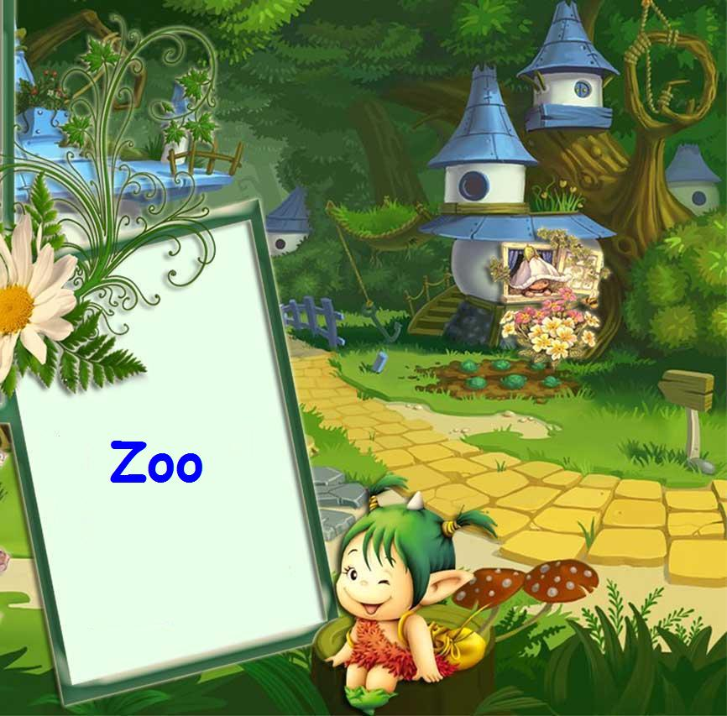

Slide 17
Отгадайте загадки.
It is small. It is not big.
It is grey. It is weak. It can run.
It can’t swim and fly. It likes cheese (сыр).

Slide 18
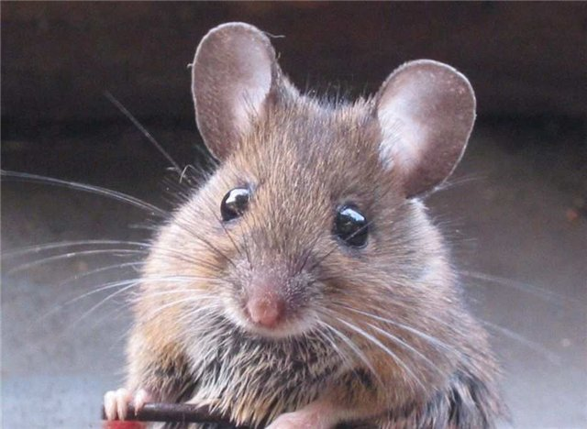
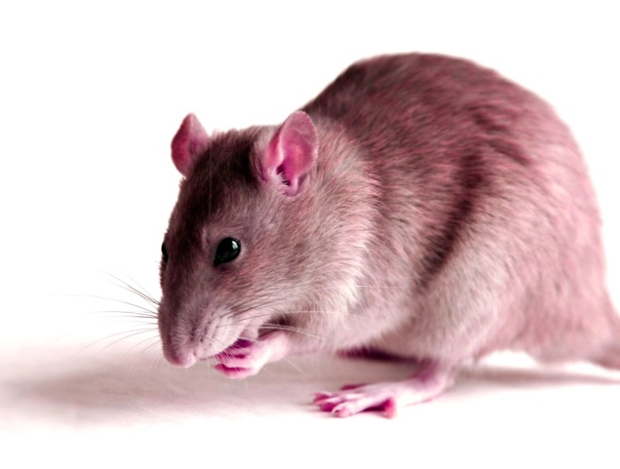
It is small. It is not big. It is grey. It is weak. It can run. It can’t swim and fly. It likes cheese (сыр).
( A mouse.)

Slide 19
It is not big. It is red.
It is cunning. It likes cockerels.
It lives in the forest.

Slide 20
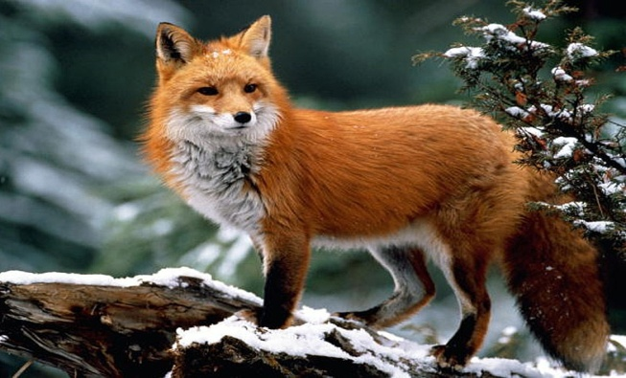
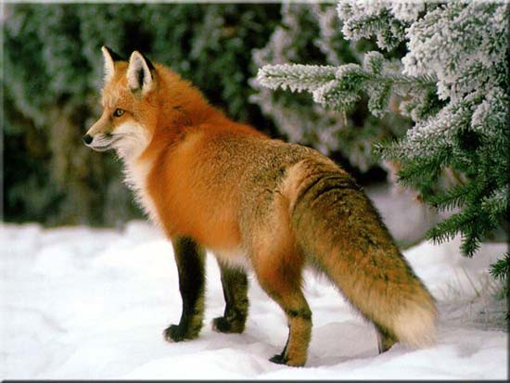
It is not big. It is red.
It is cunning. It likes cockerels.
It lives in the forest.
( A fox.)

Slide 21
It is green. It can jump and swim. But it can’t fly and run.
It is not strong.

Slide 22
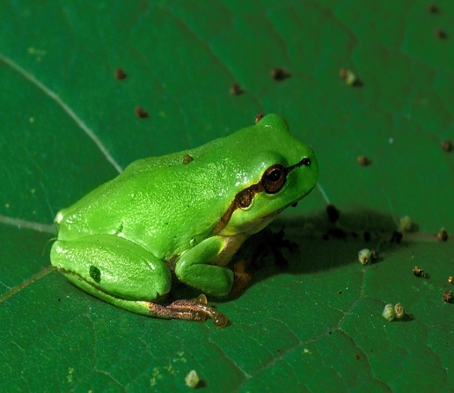
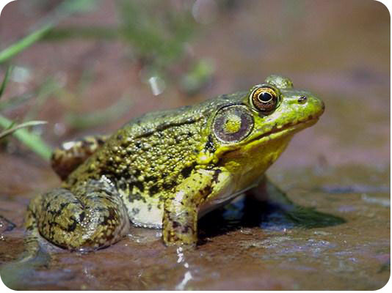
It is green. It can jump and swim. But it can’t fly and run.
It is not strong.
( A frog.)

Slide 23
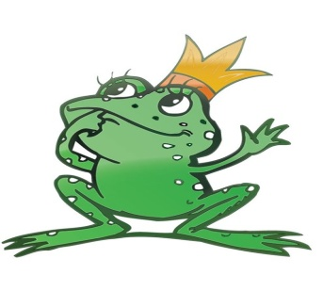
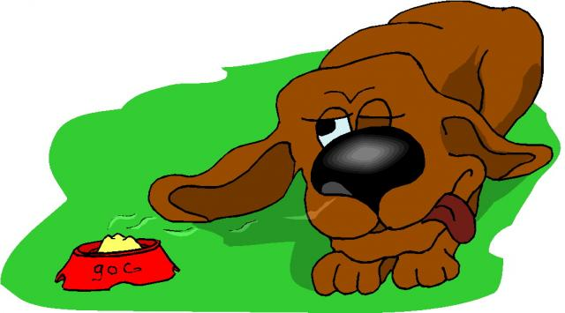


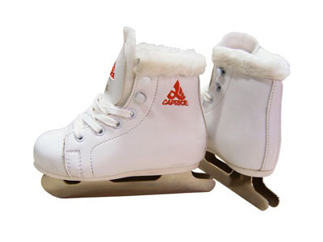
[frog]
[gri:n]
[dog]
[kroko’dail]
[klok]
[r٨n]
[dз۸mp]
[sit]
[breiv]
[neim]
[kæt]
[skeit]

Slide 24
[frog]
[gri:n]
[dog]
[kroko’dail]
[klok]
[r٨n]
[dз۸mp]
[sit]
brave
name
cat
skate

Slide 25
frog
green
dog
crocodile
clock
run
jump
sit
brave
name
can
skate

Slide 26


Slide 27
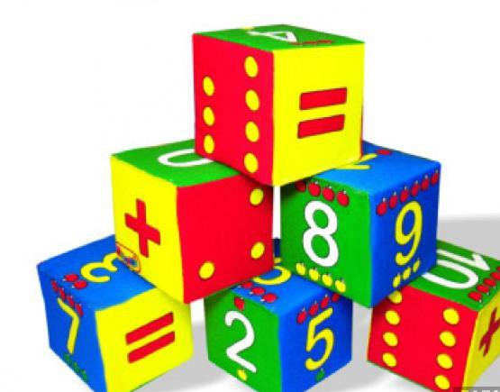

Решите примеры.
2+4=
5+3=
1+6=
7+2=

Slide 28
2+4=6
5+3=
1+6=
7+2=

Slide 29
2+4=6
5+3=8
1+6=
7+2=

Slide 30
2+4=6
5+3=8
1+6=7
7+2=

Slide 31
2+4=6
5+3=8
1+6=7
7+2=9

Slide 32
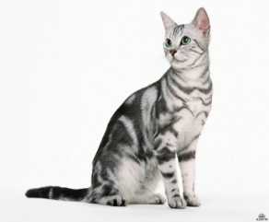
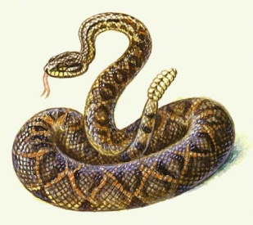
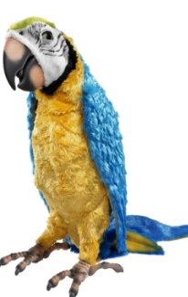
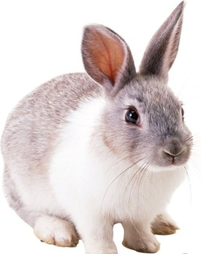
Скажите по-английски.
5
4
7
6

Slide 33
5
4
cats
6
7

Slide 34
5
4
cats
snakes
6
7

Slide 35
5
4
cats
snakes
6
7
rabbits

Slide 36
5
4
cats
snakes
6
7
rabbits
parrots

Slide 37
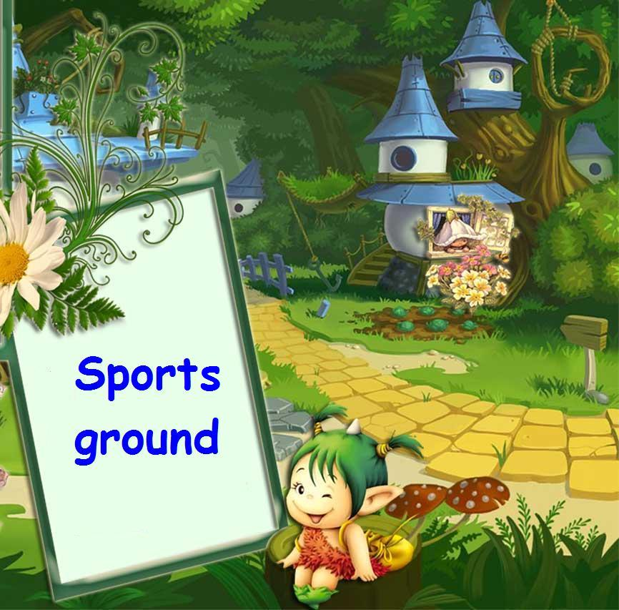

Slide 38
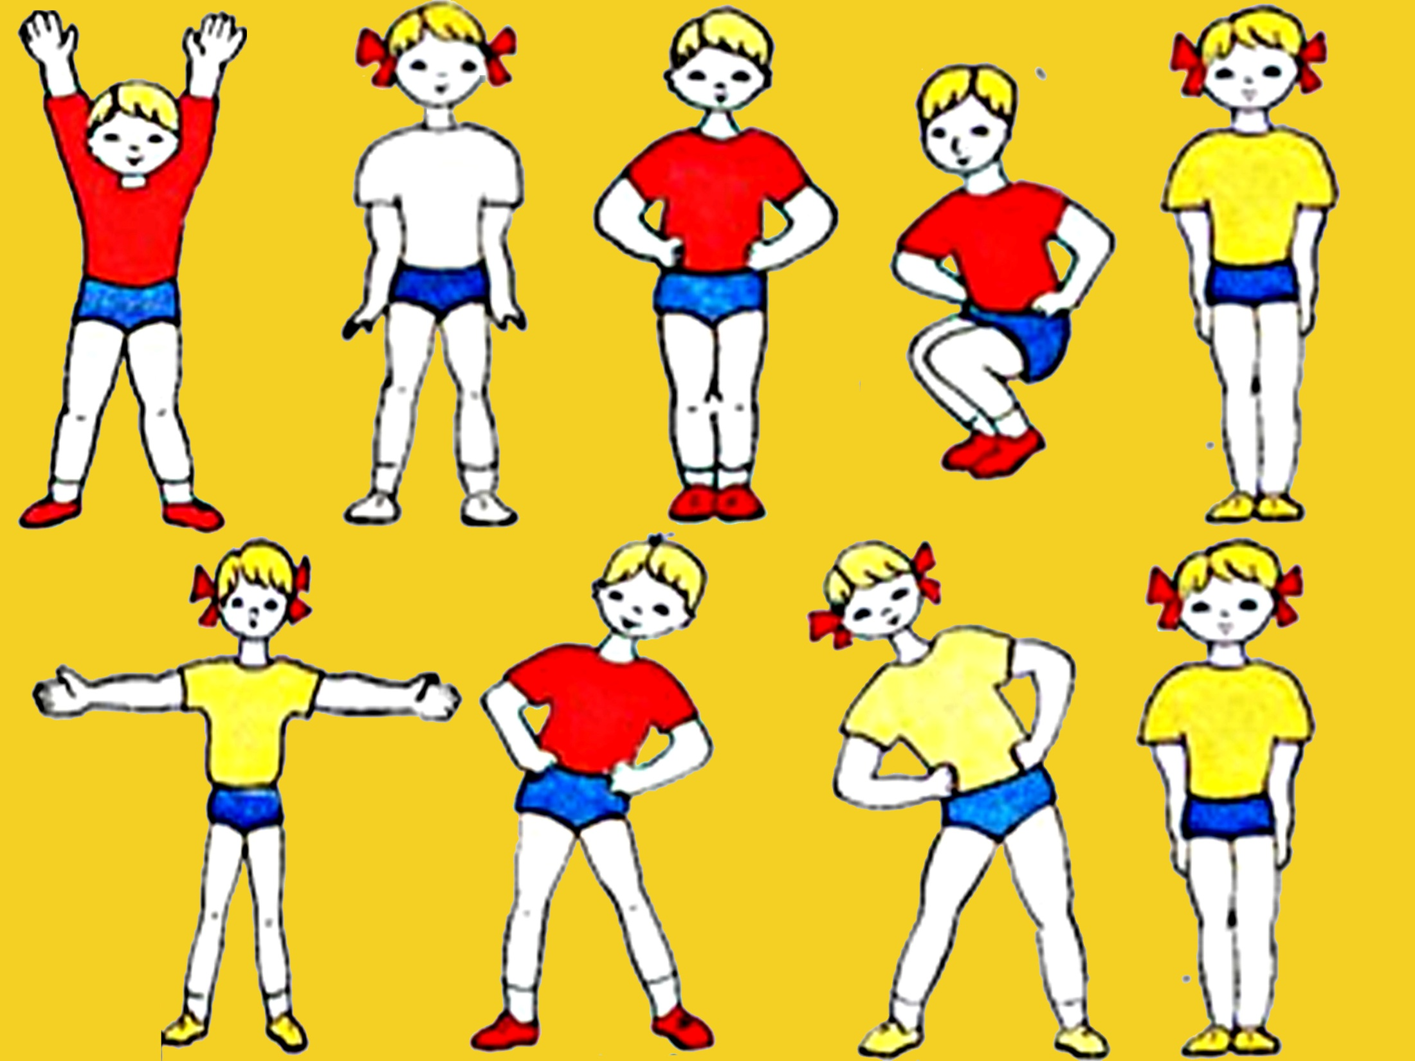

Slide 39


Slide 40
May, 5

Slide 41
Skate, funny, can, frog, must, tennis, plate, clock, rabbit, cockerel, black, make.
[ ei ] [۸] [ i ] [ æ ] [ o ]

Slide 42
Skate, funny, can, frog, must, tennis, plate, clock, rabbit, cockerel, black, make.
[ ei ] [۸] [ i ] [ æ ] [ o ]
skate
plate
make

Slide 43
Skate, funny, can, frog, must, tennis, plate, clock, rabbit, cockerel, black, make.
[ ei ] [۸] [ i ] [ æ ] [ o ]
skate
plate
make
funny
must

Slide 44
Skate, funny, can, frog, must, tennis, plate, clock, rabbit, cockerel, black, make.
[ ei ] [۸] [ i ] [ æ ] [ o ]
skate
plate
make
funny
must
tennis
rabbit
funny

Slide 45
Skate, funny, can, frog, must, tennis, plate, clock, rabbit, cockerel, black, make.
[ ei ] [۸] [ i ] [ æ ] [ o ]
skate
plate
make
funny
must
tennis
rabbit
funny
can
rabbit
black

Slide 46
Skate, funny, can, frog, must, tennis, plate, clock, rabbit, cockerel, black, make.
[ ei ] [۸] [ i ] [ æ ] [ o ]
skate
plate
make
funny
must
tennis
rabbit
funny
can
rabbit
black
frog
clock
cockerel

Slide 47


Slide 48


Slide 49

The End
The End

